Slide 1
Marketing in Today’s Economy

Slide 2
Introduction
Commoditization
A consequence of mature industries, where slowing innovation, extensive product assortment, excess supply, and frugal consumers force margins to the floor.
All organizations—both for-profit and nonprofit—require effective planning and a sound marketing strategy to achieve their goals and objectives. Without these vital efforts, organizations will not be able to satisfy the needs and wants of their customers or other stakeholders.
Organizations use sound marketing strategy to leverage their strengths and capitalize on opportunities that exist in the market. Every organization develops and implements marketing strategies.
This chapter will review some of the major challenges and opportunities that exist in planning marketing strategy in today’s economy. It will also review the nature and scope of major marketing activities and decisions that occur throughout the planning process. Finally, the chapter looks at some of the major challenges involved in developing marketing strategy.

Slide 3
The Challenges and Opportunities of Marketing in Today’s Economy
Fundamental Changes to Marketing and Business Practice:
1-Power shift to customers
2-Massive increase in product selection
3-Audience and media fragmentation
4-Changing value propositions
5-Shifting demand patterns
6-Privacy, security, and ethical concerns
7-Unclear legal jurisdiction

Slide 4
1-Power shift to customers
-The astounding growth of the Internet has shifted power to customers, not marketers.
2-Massive increase in product selection:
-The variety and assortment of goods and services offered for sale on the Internet and traditional stores is staggering. This radical increase in product selection and availability has exposed marketers to inroads by competitors from every corner of the globe.

Slide 5
3-Audience and Media Fragmentation:
-Since the advent of cable television in the late 1970s, mass media audiences have become increasingly fragmented. Media audiences have become fragmented due to:
(1) the sheer number of media choices we have available today.
(2) the limited time we have to devote to any one medium. [Exhibit 1.1]

Slide 6
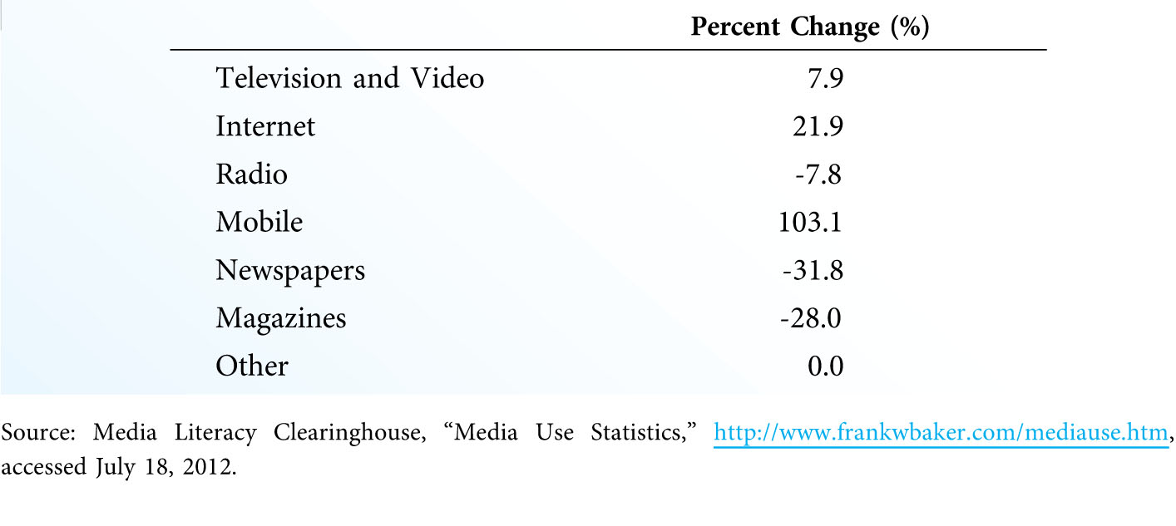
Change in Daily Media Usage by U.S. Adults, 2008-2011 (Exhibit 1.1)

Slide 7
4- Changing Value Propositions:
The speed and efficiency of commerce today has changed the way customers view value. The lesson for marketers is clear: In situations where customers see goods and services as commodities, customers will turn to the most convenient, least expensive alternative.
5- Shifting Demand Patterns:
-In some cases, changes in technology have shifted customer demand for certain product categories. The challenges faced by the movie rental industry bear this out.

Slide 8
6-Privacy, Security, and Ethical Concerns:
-Changes in technology have made our society much more open than in the past. As a result, these changes have forced marketers to address real concerns about security and privacy, both online and offline.
-For example, many well-known and respected companies have been fined for violating the standards of the Children’s Online Privacy Protection Act. [Exhibit 1.2]

Slide 9
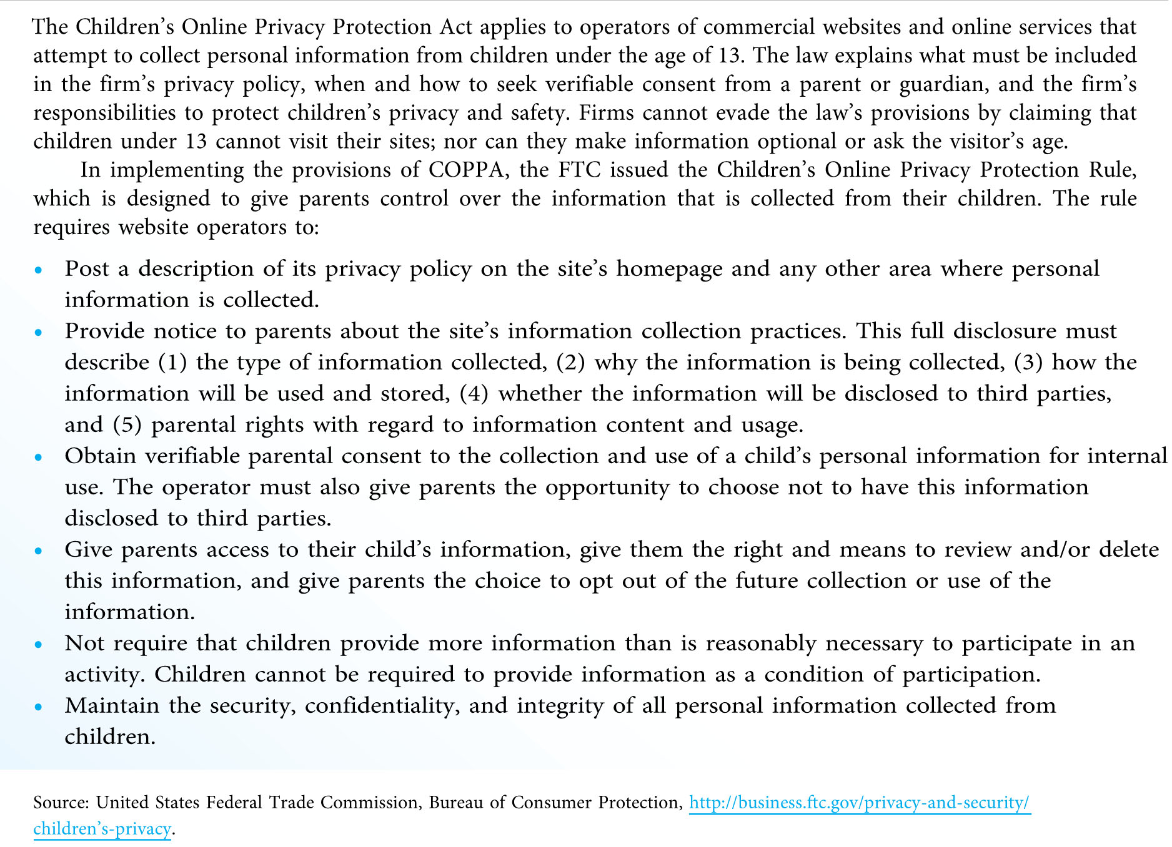
The Children’s Online Privacy Protection Act (Exhibit 1.2)

Slide 10
7-Unclear Legal Jurisdiction:
-A final issue concerns the conflicting perspectives over legal jurisdiction when a company does business in more than one country. Another important issue involves the collection of sales tax for online transactions.
Although the full effect of these changes will not be recognized for some time, circumstances have forced businesses to move ahead by adjusting their marketing activities at both the strategic and tactical levels.

Slide 11
Basic Marketing Concepts: Marketing Defined
Many people, especially those not employed in marketing, see marketing as a function of business. Other individuals, particularly those working in marketing jobs, tend to see marketing as a process of managing the flow of products from the point of conception to the point of consumption.
Marketing (2005 AMA definition)
“… an organizational function and a set of business processes for creating, communicating, and delivering value to customers and for managing customer relationships in ways that benefit the organization and its stakeholders.”

Slide 12
Marketing (2007 AMA definition)
“… the activity, set of institutions, and processes for creating, communicating, delivering, and exchanging offerings that have value for customers, clients, partners, and society at large.”
*A final way to think about marketing relates to meeting human and social needs. This broad view links marketing with our standard of living, not only in terms of enhanced consumption and prosperity, but also in terms of society’s well being.

Slide 13
What is a Market?
At its most basic level, a market is a collection of buyers and sellers. We tend to think of a market as a group of individuals or institutions that have similar needs that can be met by a particular product or product category.
This basic understanding of a market has not changed in a very long time. What has changed, however, is not so much the “what” but the “where” of a market; that is, the location of the buyers and sellers.
Technology mediates some of the fastest growing markets. The term marketspace has been coined to describe these electronic marketplaces unbound by time or space. The shift from marketplaces to marketspaces has significant ramifications for marketers.

Slide 14
Many consumers have been slow to embrace marketspaces because they lack the human element. In these cases, the design and implementation of the online experience is a serious challenge for marketspace operators.
Another shift is the advent of metamarkets (a cluster of closely related goods and services that center around a specific consumption activity) and metamediaries (a single access point where buyers can locate and contact many different sellers in the metamarket). [Exhibit 1.3]

Slide 15
Market
A collection of buyers and sellers; a group of individuals or institutions that have similar needs
Marketspace
Electronic marketplaces unbound by time or space
Metamarket
A cluster of closely related goods and services that center around a specific consumption activity
Metamediary
Provides a single access point where buyers can locate and contact many different sellers in the metamarket

Slide 16
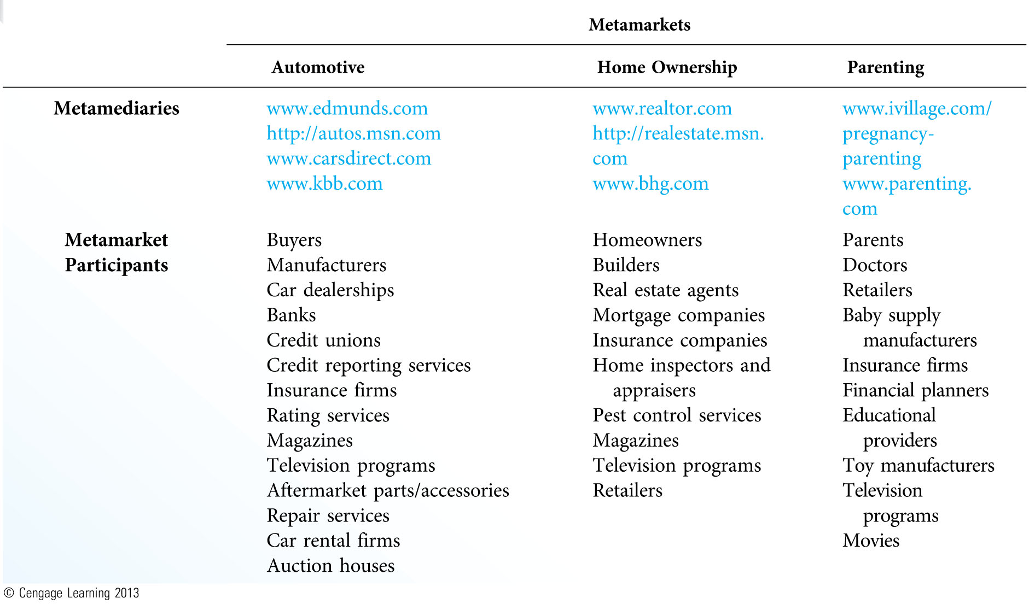
Common Metamarkets and Participants (Exhibit 1.3)

Slide 17
What Is Exchange?
Exchange
The process of obtaining something of value by offering something in return; typically obtaining products for money.
Five Conditions of Exchange :
1-There must be at least two parties to the exchange.
2-Each party has something of value to the other party.
3-Each party must be capable of communication and delivery.
4-Each party must be free to accept or reject the exchange.
5-Each party believes it is desirable to exchange with the other party.

Slide 18
In today’s economy, exchange has become all too easy. Opportunities for exchange bombard us virtually everywhere we go—even in our own homes.
The ease with which exchange can occur today presents a problem in that individuals who do not have the authority to exchange can still complete transactions.

Slide 19
What Is a Product?
The primary focus of marketing is the customer and how the organization can design and deliver products that meet customers’ needs.
A product is something that can be acquired via exchange to satisfy a need or a want. This definition permits us to classify a broad number of “things” as products: goods, services, ideas, information, digital products, people, places, experiences and events, real or financial property, and organizations.

Slide 20
What Is a Product?
Examples of Products
Goods
Services
Ideas
Information
Digital products
People
Places
Experiences and events
Real or financial property
Organizations

Slide 21
Goods: are tangible items ranging from vanned food to fighter jets,from sports memorabilia to used clothing.
Services: are intangible products consisting of acts or deeds directed toward people or their possessions.
Ideas: include platforms or issues aimed at promoting a benefit for the customer.
Information: include websites,magazine and book publishers,schools and universities,research firms,churches,and charitable organizations.

Slide 22
Digital product: such as software,music,and movies are among the most profitable in our economy./
People: the individual promotion of people,such as athletes or celebrities,is a huge business around the world.
Place: when we think of the marketing of place,the marketing of place is quite diverse.
Experiences and Events: marketing can bring together a combination of goods,services,ideas,informations,or people to create one-of-a-kind experiences or single events.

Slide 23
Real or Financial Property: the xchange of stocks,bonds,and real estate, once marketed completely offline via real estate agents and investment companies,now occurs increasingly online.
Organizations: virtually all organizations strive to create favorable images with the public-not noly to increase sales or inguiries,but also to generate customer goodwill.

Slide 24
A customer’s decision to purchase one product or group of products over another is primarily a function of how well that choice will fulfill their needs and satisfy their wants.
Customers usually seek out exchanges with marketers who offer products that are high in one or more of the five types of utility:
a)Form utility: Products high in form utility have attributes or features that set them apart from the competition.
b)Time utility: Products high in time utility are available when customers want them.

Slide 25
b)Place utility: Products high in place utility are available where customers want them, which is typically wherever the customer happens to be or where the product needs to be at that moment.
d)Possession utility: Possession utility deals with the transfer of ownership or title from marketer to customer.
e)Psychological utility: Products high in psychological utility deliver positive experiential or psychological attributes that customers find satisfying.

Slide 26
Major Marketing Activities and Decisions
Organizations must deal with a number of activities and decisions in marketing their products to customers.
Major Marketing Activities and Decisions will be focus in:
Strategic Planning.
Research and Analysis.
Developing Competitive Advantage
Marketing Strategy Decisions
Social Responsibility and Ethics
Implementation and Control
Developing and Maintaining Customer .

Slide 27
1-Strategic Planning
If an organization is to have any chance of reaching its goals and objectives, it must have a game plan or road map for getting there.
A strategy outlines the organization’s game plan for success.
Tactical planning concerns itself with specific markets or market segments and the development of marketing programs that will fulfill the needs of customers in those markets.
The marketing plan provides the outline for how the organization will combine product, pricing, distribution, and promotion decisions to create an offering that customers will find attractive.

Slide 28
2-Research and Analysis
Strategic planning depends on the availability and interpretation of information.
In addition to information about customers, the organization must also have access to three other types of information and analysis:
a)Internal analysis involves the objective review of internal information pertaining to the firm’s current strategy and performance, as well as the current and future availability of resources.
b)Competitive intelligence involves analyzing the capabilities, vulnerabilities, and intentions of competing businesses.
c)Environmental scanning involves the analysis of economic, political, legal, technological, and cultural events and trends that may affect the future of the organization and its marketing efforts.

Slide 29
3-Developing Competitive Advantage
To be successful, a firm must possess one or more competitive advantages that it can leverage in the market in order to meet its objectives.
A competitive advantage is something that the firm does better than its competitors that gives it an edge in serving customers’ needs and/or maintaining mutually satisfying relationships with important stakeholders.

Slide 30
4-Marketing Strategy Decisions
An organization’s marketing strategy describes how the firm will fulfill the needs and wants of its customers.
A marketing strategy can be composed of one or more marketing programs; each program consists of two elements—a target market or markets and a marketing mix (sometimes known as the four Ps of product, price, place, and promotion).

Slide 31
4/1-Market Segmentation and Target Marketing
Marketers engage in market segmentation when they divide the total market into smaller, relatively homogeneous groups or segments that share similar needs, wants, or characteristics.
When a marketer selects one or more target markets, they identify one or more segments of individuals, businesses, or institutions toward which the firm’s marketing efforts will be directed.
(Home work)Discusses how many marketers use online social networking sites—such as Facebook, Twitter, Google+, or LinkedIn—to target specific market segments.

Slide 32
4\2-Marketing Program Decisions
Successful marketing programs depend on a carefully crafted blend of the four major marketing mix elements.
The importance of product decisions hinges on the connection between the product and the customers’ needs.
Price is the only element of the marketing mix that leads to revenue and profit, has a direct connection with customer demand, is the easiest element of the marketing program to change, and is a major quality cue for customers.
Distribution and supply chain issues are among the least apparent decisions made in marketing, particularly with customers.
Modern marketing has replaced the term promotion with the concept of integrated marketing communication (IMC), or the coordination of all promotional activities (media advertising, direct mail, personal selling, sales promotion, public relations, packaging, store displays, website design, personnel) to produce a unified, customer-focused message.

Slide 33
4\3-Marketing Program Decisions
Successful marketing programs depend on a carefully crafted blend of the four major marketing mix elements.
The importance of product decisions hinges on the connection between the product and the customers’ needs.
Price is the only element of the marketing mix that leads to revenue and profit, has a direct connection with customer demand, is the easiest element of the marketing program to change, and is a major quality cue for customers.
Distribution and supply chain issues are among the least apparent decisions made in marketing, particularly with customers.
Modern marketing has replaced the term promotion with the concept of integrated marketing communication (IMC), or the coordination of all promotional activities (media advertising, direct mail, personal selling, sales promotion, public relations, packaging, store displays, website design, personnel) to produce a unified, customer-focused message.

Slide 34
4\4-Branding and Positioning
In order to understand branding, the marketer must have a clear understanding of how the elements of the marketing program work together to create the brand.
While product decisions (such as design, style, and features) play a prominent role in branding, so do other program elements such as price/value, availability/exclusivity, and image/reputation of both the firm and its offerings.

Slide 35
5-Social Responsibility and Ethics
The role of social responsibility and ethics in marketing strategy has come to the forefront of important business issues in today’s economy.
Social responsibility refers to an organization’s obligation to maximize its positive impact on society, while minimizing its negative impact.
A major part of this responsibility is marketing ethics, or the principles and standards that define acceptable conduct in marketing activities.

Slide 36
6-Implementation and Control
Marketing implementation, the process of executing the marketing strategy, is the “how” of marketing planning.
Adequate control of marketing activities is essential to ensure that the strategy stays on course and focused on achieving its goals and objectives.
The implementation phase of marketing strategy calls into play the 5th P of the marketing program: people.

Slide 37
7-Developing and Maintaining Customer Relationships
Developing long-term customer relationships requires that markers shift away from transactional marketing and embrace a relationship marketing approach.
The goal of transactional marketing is to complete a large number of discrete exchanges with individual customers. In relationship marketing, the goal is to develop and maintain long-term, mutually satisfying arrangements where both buyer and seller focus on the value obtained from the relationship. [Exhibit 1.4]
Relationship marketing promotes customer trust and confidence in the marketer, who can then develop a deeper understanding of customers’ needs and wants.

Slide 38
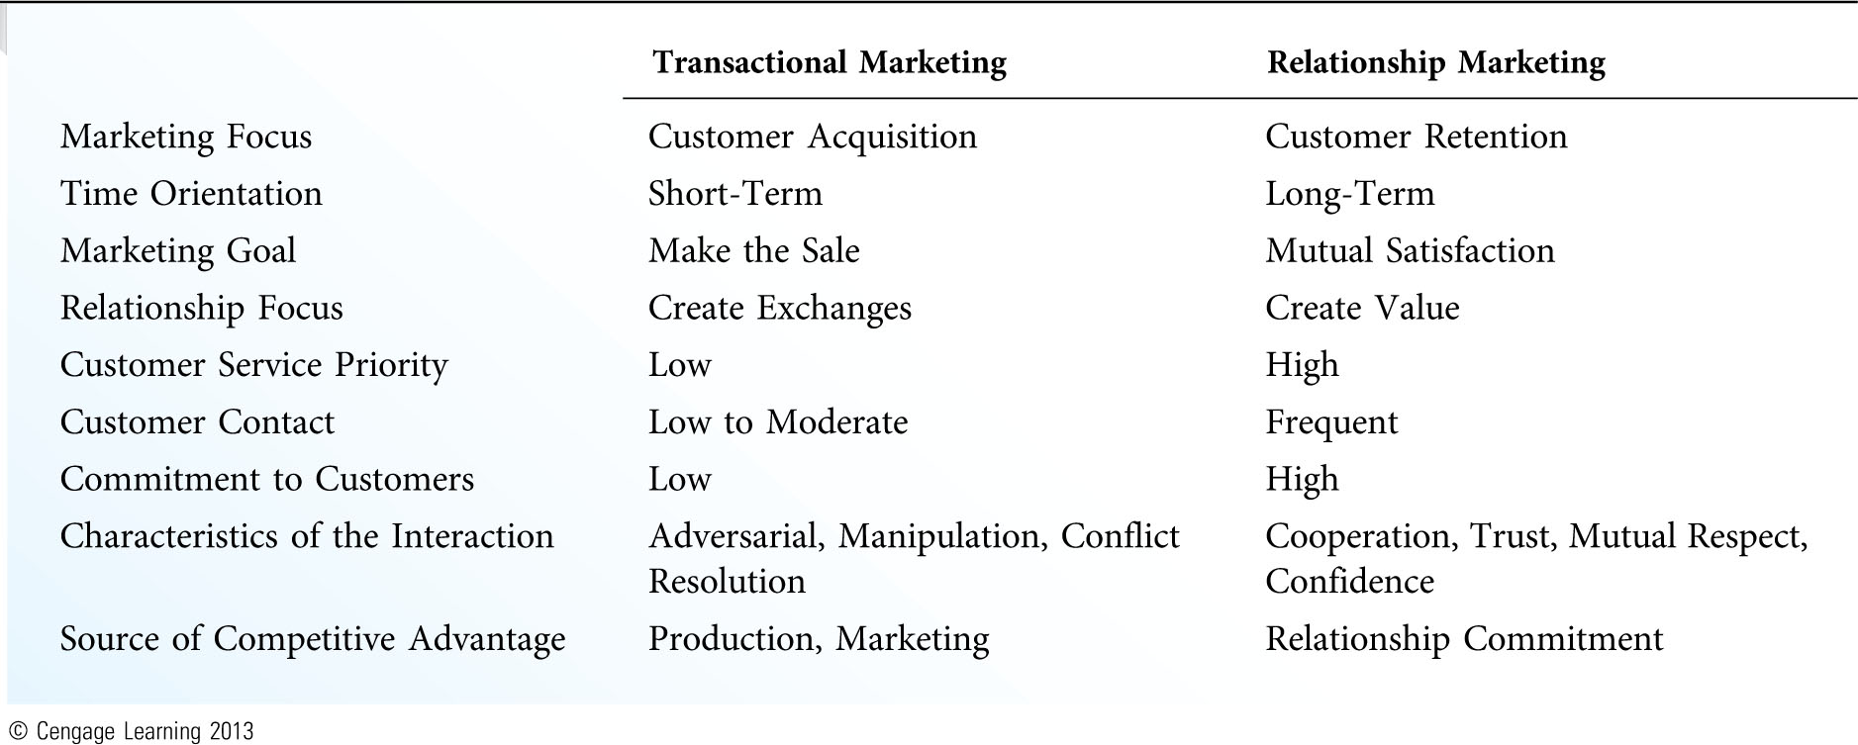
Transactional and Relationship Marketing (Exhibit 1.4)

Slide 39
The Challenges of Marketing Strategy
Challenges and opportunities in planning and developing marketing strategy include:
1.Change—Customers change, competitors change, and even the marketing organization changes. Strategies that are highly successful today will not work tomorrow.
2.People—Marketing strategy is inherently people-driven. It is about people (inside an organization) trying to find ways to deliver exceptional value by fulfilling the needs and wants of other people (customers, shareholders, business partners, society at large). The people-oriented nature of marketing makes marketing strategy a challenging task.
3.Lack of rules—There are very few rules for how to do marketing in specific situations.

Slide 40
4.Increasing customer expectations and declining satisfaction—American customers have a passion for instant gratification that is not being met. The American Customer Satisfaction Index indicates that customer satisfication has only recently recovered since 1994. [Exhibit 1.5]
5.Mature markets (commoditization)—Many firms compete in markets where product offerings have become commoditized by a lack of differentiation (for example, airlines, wireless phone service, department stores, laundry supplies, household appliances).
6.Controlling costs—Businesses have been forced to cut expenses by eliminating products, lowering distribution costs, or downsizing in order to remain competitive.

Slide 41
Even the most admired marketers in the world occasionally have problems meeting the demands of the strategic planning process and developing the “right” marketing strategy.

Slide 42
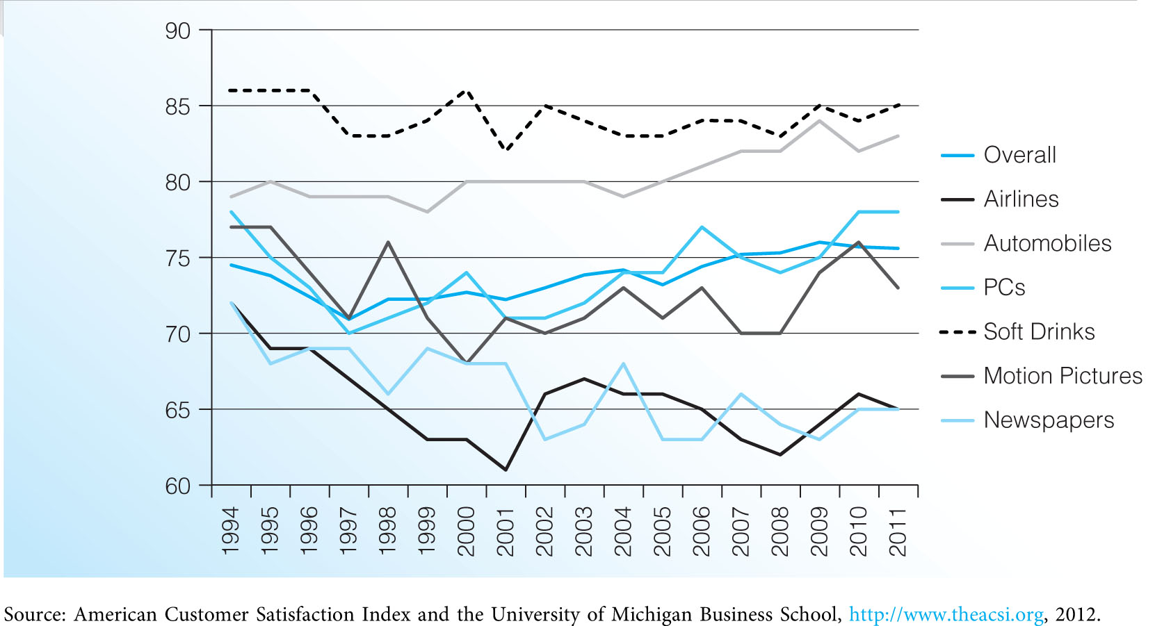
American Customer Satisfaction Index (Exhibit 1.5)

