Slide 1
Chapter 13
Implementing Basic Differences Tests

Slide 2
Learning Objectives
To learn how differences are used for market segmentation decisions
To understand when t tests or z tests are appropriate and why you do not need to worry about this issue when using SPSS
To be able to test the differences between two percentages or means for two independent groups
To know what a paired samples difference test is and when to use it
To comprehend ANOVA and how to interpret ANOVA output
To learn how to perform differences tests for means using SPSS

Slide 3
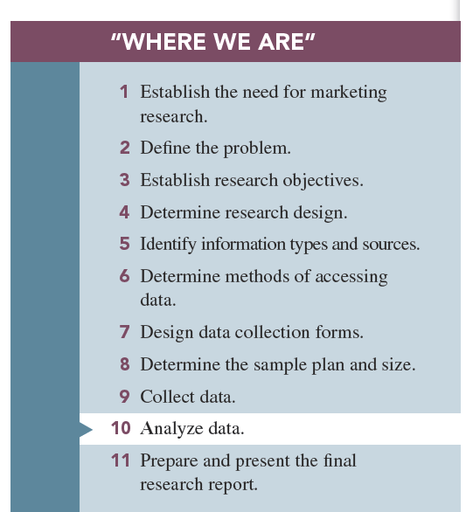

Slide 4
Why Differences are Important
Market segmentation is based on differences between groups of consumers.
One commonly used basis for market segmentation is the discovery of differences that are the following:
1-Statistically significant
2-Meaningful
3-Stable
4-Actionable differences

Slide 5
1-Differences must be statistically significant.
-Statistical significance of differences : means the differences found in the sample(s) truly exist in the population(s) from which the random samples are drawn.
- To be potentially useful to marketing researcher or manager , differences must , at minimum be statistically significant.

Slide 6
2- Differences must be meaningful.
Meaningful difference: one that the marketing manager can potentially use as a basis for marketing decisions.
The differences between the market segments should be of such a magnitude that the market can target them individually.

Slide 7
3-Differences should be stable.
-Stable difference is one that will be in place for the foreseeable future.
-To be potentially useful to marketing researcher or manager , differences must ,if statistically significant and meaningful , be stable.

Slide 8
4- Differences must be actionable.
- Actionable difference means the marketer can focus various marketing strategies and tactics, such as product design or advertising, on the market segments to accentuate the differences between segments.
-To be potentially useful to marketing researcher or manager , differences must ,if statistically significant ,meaningful , stable and actionable.

Slide 9
Small Sample Sizes: The Use of a t Test or z Test and How SPSS Eliminates the worry
t Test: statistical inference test to be used with small sample sizes (n ≤ 30)
z Test: statistical inference test to be used when the sample size is 30 or greater
Note: Most computer statistical programs report only the t value because it is identical to the z value with large samples.

Slide 10
The great advantage to using statistical routines on a computer is that they are programmed to computer the correct statistic.

Slide 11
Testing for Significant Differences Between Two Groups
Statistical tests are used when researcher wants to compare the means or percentages of two different groups or samples.

Slide 12
Differences Between Percentages with Two Groups (Independent Samples)
Independent samples are treated as representing two potentially different populations.
Null hypothesis: the hypothesis that the difference in the population parameters is equal to zero
With a differences test, the null hypothesis states that there is no difference between the percentages (or means) being compared.
alternative to the null hypothesis is that there is a true difference between the population parameters.

Slide 14
Go to p357-358 fro example

Slide 15
-If Z is greater than 1.96 the difference between the two percentages is significant.
With a differences test, you test the null hypothesis that no differences exist between the two group means (or percentages).
-If the null hypothesis is true, we would expect there to be n0 differences between the two percentages.
-Yet we know that, in any given study, differences may be expected due to sampling error.

Slide 16
-If the null hypothesis were true, we would expect 95% of the z scores computed from 100 samples to fall between +1.96 and −1.96 standard errors.
-If the computed z value is greater than +1.96 or −1.96, it is not likely that the null hypothesis of no difference is true. Rather, it is likely that there is a real statistical difference between the two percentages.
Notes:
DELETE SLIDE?

Slide 17
Using SPSS for Differences Between Percentages of Two Groups
SPSS does not perform tests of significance of the difference between the percentages of two groups, but you can use SPSS to generate the relevant information and perform a hand calculation.
Use the SPSS command FREQUENCIES to produce the percentages you need.

Slide 18
Testing the Difference Between Means
We have three testing difference between means;
1-Differences between two means from independent samples
2-Differences between three or more means from independent samples
3-Differences between paired means
Notes:
Add graphs

Slide 19
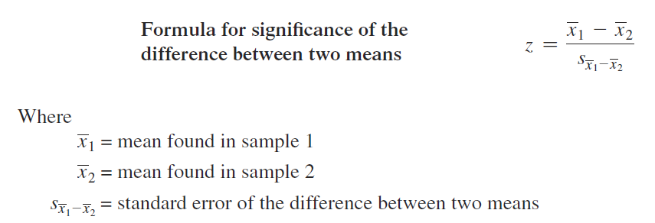
First; Differences Between Means with Two Groups (Independent Samples)
The procedure for testing the significance of difference between two means from two different groups is identical to the procedure for testing two percentages.

Slide 20
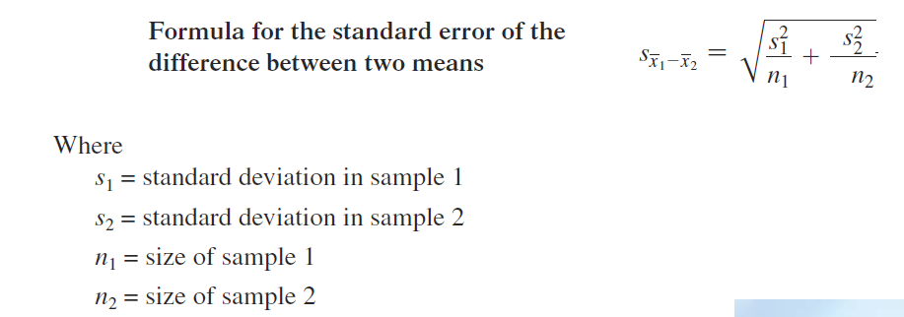

Slide 21
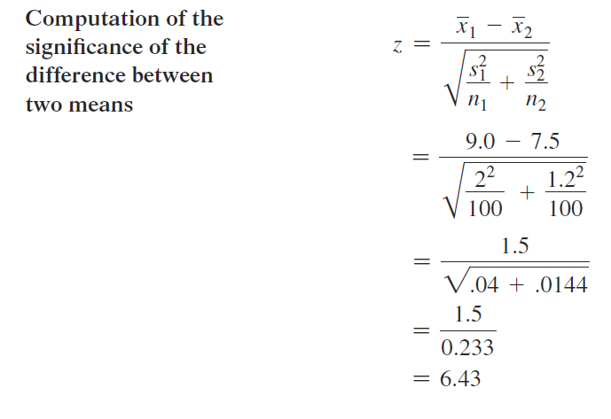
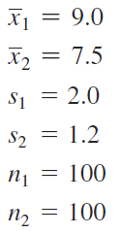
An Example: Testing the Difference Between Two Means
Do male teens and female teens drink different amounts of sports drinks?
The difference between males (9 bottles) and females (7.5 bottles) is significant; z =6.43.

Slide 22
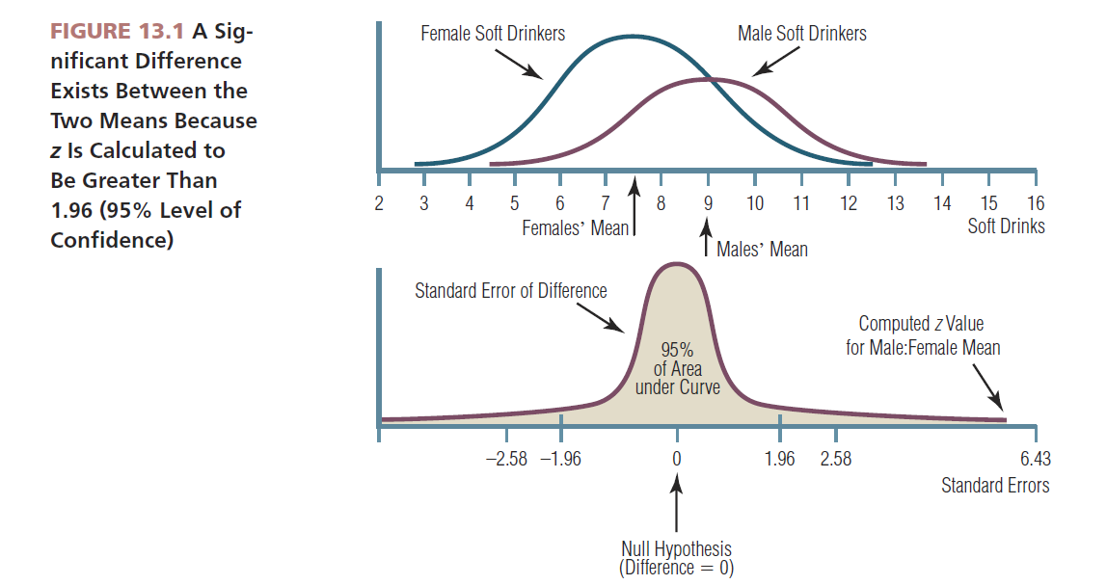

Slide 23
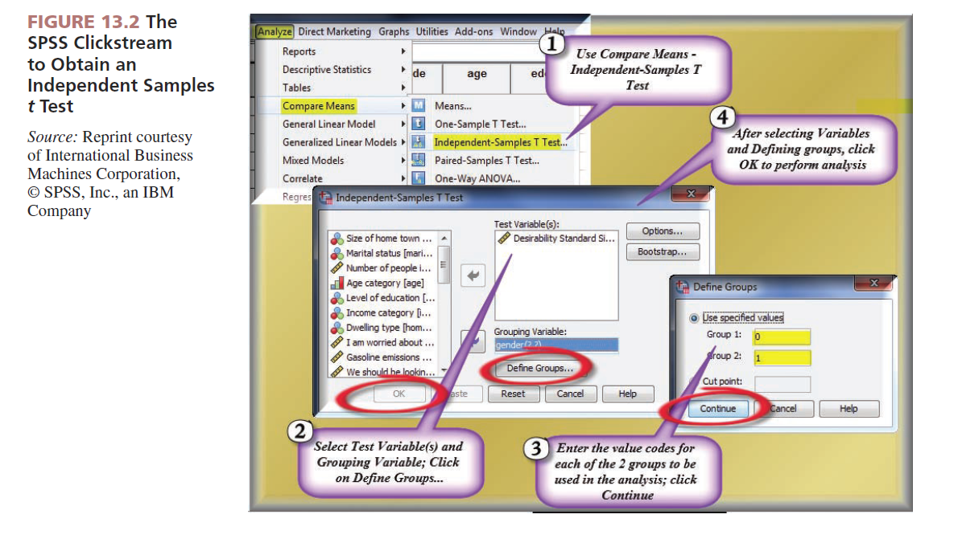

Slide 25
Second; Testing for significant differences in means Among than two Group; Analysis of Variance
Analysis of variance (ANOVA): used when comparing the means of three or more groups
‘ANOVA is an investigation of the differences between the group means to ascertain whether sampling errors or true population differences explain their failure to be equal.

Slide 26
ANOVA will “flag” when at least one pair of means has a statistically significant difference, but it does not tell which pair.

Slide 27
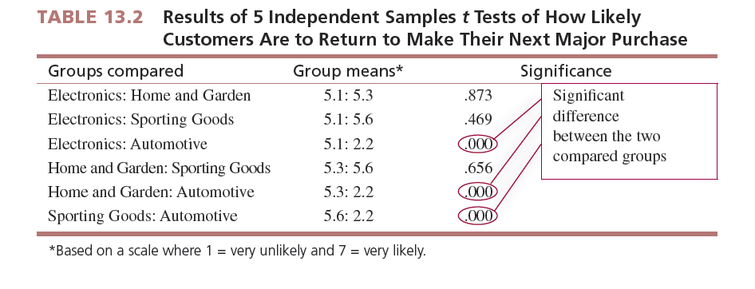

Slide 29
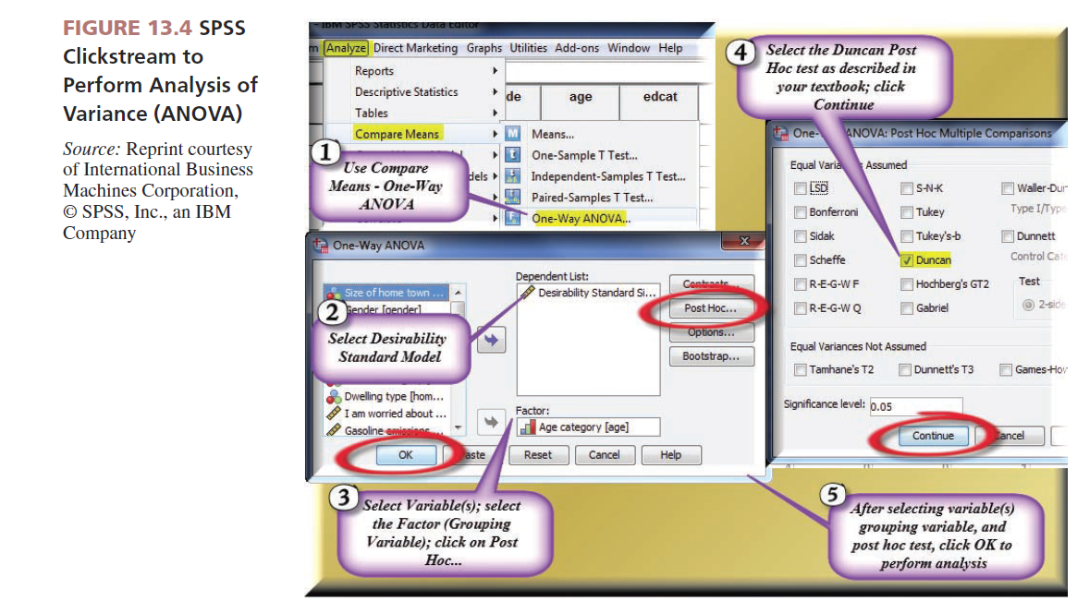

Slide 31
ANOVA Advantages;
ANOVA has two distinct advantages over performing multiple t tests of the significance of the difference between means.
1-Immediately notifies researcher if there is any significant difference
2-Arranges the means so the significant differences can be located and interpreted easily

Slide 32
Post Hoc Tests: Detect Statistically Significant Differences Among Group Means
Post hoc tests: options that are available to determine where the pair(s) of statistically significant differences between the means exist(s)
Duncan’s multiple range test: provides output that is mostly a “picture” of what means are significantly different
The Duncan multiple range test’s output is much less statistical than most other post hoc tests and is easy to interpret.

Slide 33
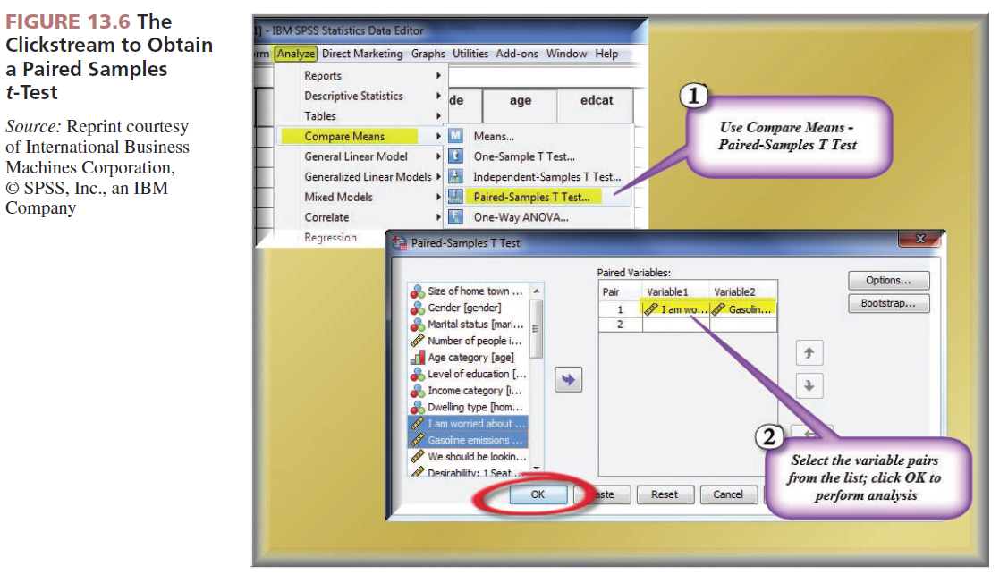

Slide 35
Reporting Group Differences Tests to Clients
Finding significant differences is exciting to marketing researcher because it means they will have something that is potentially useful to report to clients.
The reporting of finding has a significant ethical burden for marketing researcher as they cannot choose to report only “good news” to client .

Slide 36
Third ; Differences Between Two Means Within the Same Sample (Paired Sample)
You can test the significance of the difference between two means for two different questions answered by the same respondents using the same scale.
Paired samples test for the differences between two means: a test to determine if two means of two different questions using the same scale format and answered by the same respondents in the sample are significantly different.

