Slide 1
Systems Analysis and Design 11th Edition
Chapter 12 Managing Systems Support and Security

Slide 2
Introduction
Systems support and security phase begins when a system becomes operational
Continues until the system reaches the end of its life
After delivering the system, the IT team focuses on support and maintenance tasks
Concerns in managing systems support and security
User expectations
System performance
Security requirements

Slide 3
User Support
User Training
IT Department may develop a user training package
Training users about system changes is similar to initial training
Objective - To show users how the system can help them perform their jobs
Help or Service Desks: Provide support and guidance

Slide 4
User Support (Cont. 1)
Objectives
To show people how to use system resources more effectively and provide answers to technical or operational questions
To make users more productive by teaching them how to meet their own information needs
Boost their productivity using remote control software
Remote control software: Allows IT staff to take over a user’s workstation and provide support and troubleshooting
Figure 12-2 A help desk, also called a service desk, provides support to system users.

Slide 5
User Support (Cont. 2)
Outsourcing Issues
Offshore call centers can trim expenses and free up valuable human resources for product development
Customers may shop elsewhere if the quality of tech support decreases
Critical factors
Phone wait times
Performance of support staff
Online support tools

Slide 6
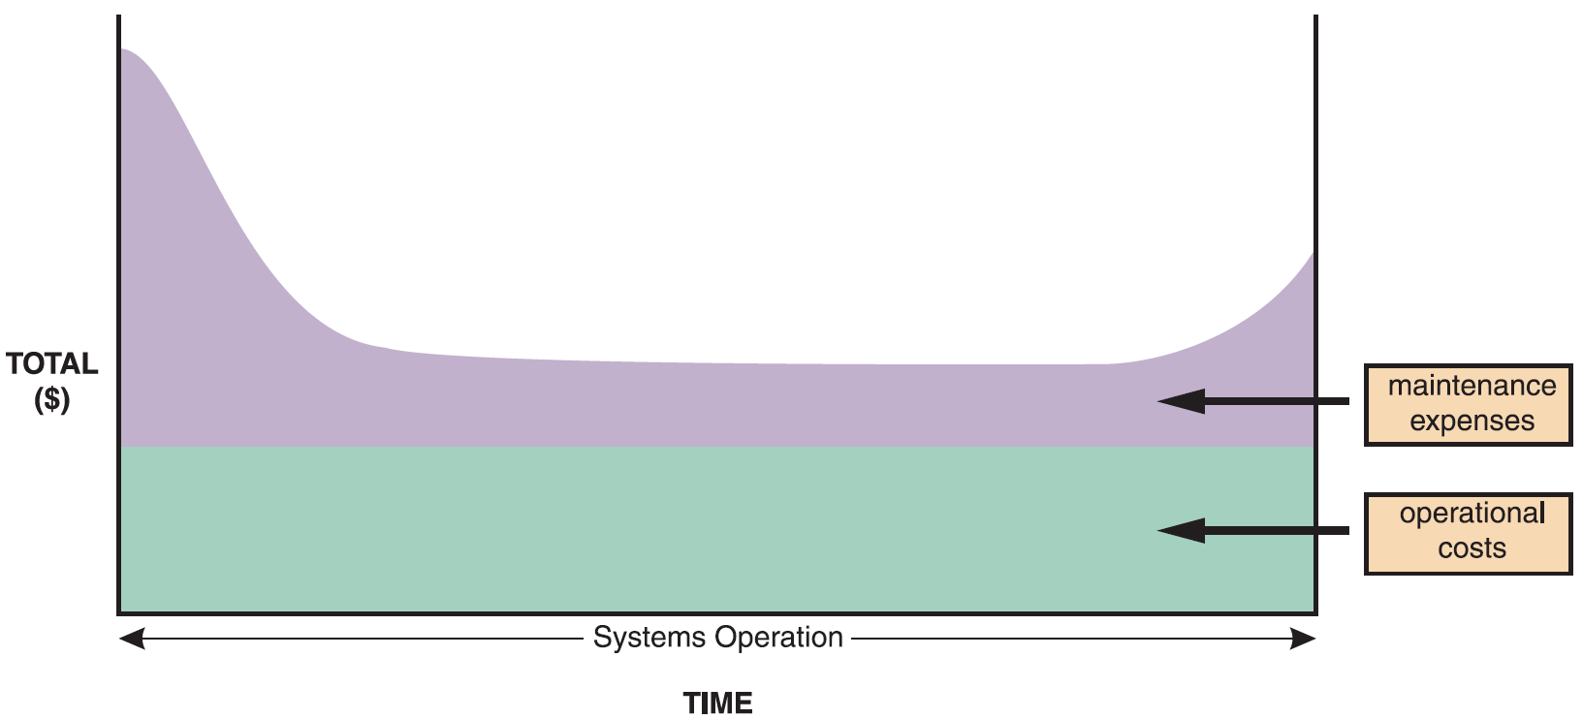
Maintenance Tasks
Figure 12-3 The total cost of operating an information system includes operational and maintenance costs. Operational costs (green) are relatively constant, while maintenance costs (purple) vary over time.

Slide 7
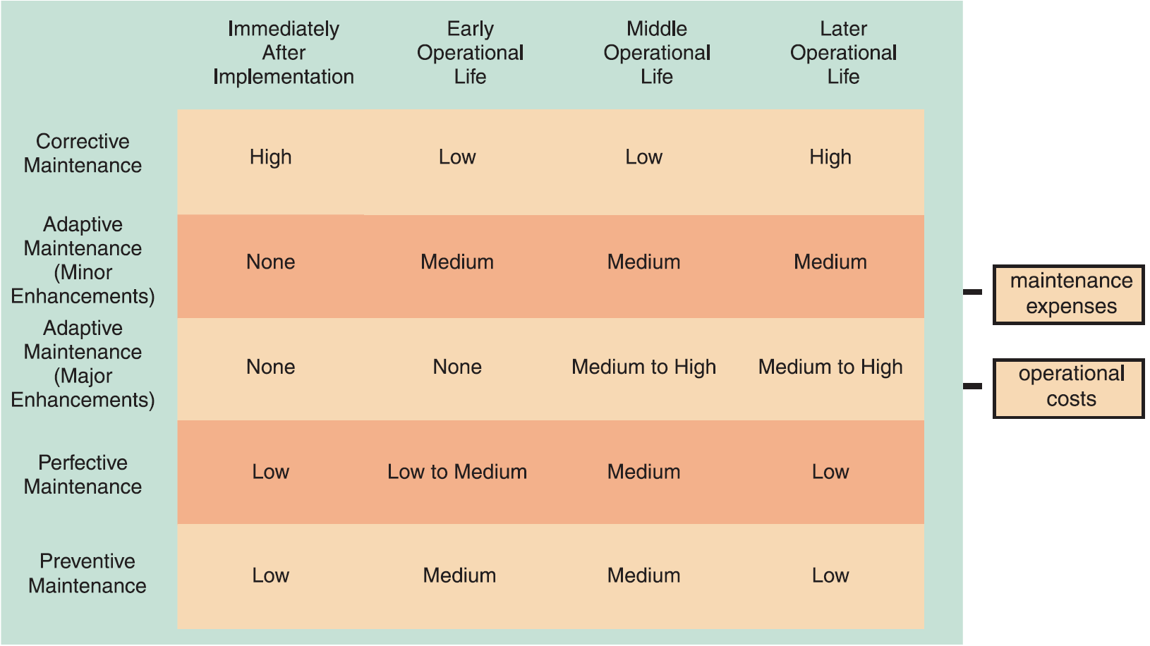
Maintenance Tasks (Cont. 1)
Figure 12-5 Information systems maintenance depends on the type of maintenance and the age of the system.

Slide 8
Maintenance Tasks (Cont. 2)
Corrective Maintenance
Diagnoses and corrects errors in an operational system
Standard procedures are set for minor errors
Worst-case situation is a system failure
Requires a patch
When the system is operational again, the maintenance team determines the cause, analyzes the problem, and designs a permanent solution

Slide 9
Maintenance Tasks (Cont. 3)
Figure 12-6 This three-level ranking framework for IT support considers potential impact and response urgency.

Slide 10
Maintenance Tasks (Cont. 4)
Adaptive Maintenance
Adds enhancements to an operational system and makes the system easier to use
Procedure for minor adaptive maintenance is similar to routine corrective maintenance
Users submit requests that are evaluated and prioritized by the systems committee
Can be more difficult than new systems development
Enhancements must work within the constraints of an existing system

Slide 11
Maintenance Tasks (Cont. 5)
Perfective Maintenance
Changing an operational system to make it more efficient, reliable, and maintainable
Cost-effective during the middle of the system’s operational life
Performed using software reengineering
Software reengineering: Uses analytical techniques to identify potential quality and performance improvements in an information system
The more a program changes, the more likely it is to become inefficient and difficult to maintain

Slide 12
Maintenance Tasks (Cont. 6)
Preventive Maintenance
Requires analysis of areas where trouble is likely to occur
IT department initiates preventive maintenance
Results in:
Increased user satisfaction
Decreased downtime
Reduced TCO
Competes for IT resources along with other projects

Slide 13
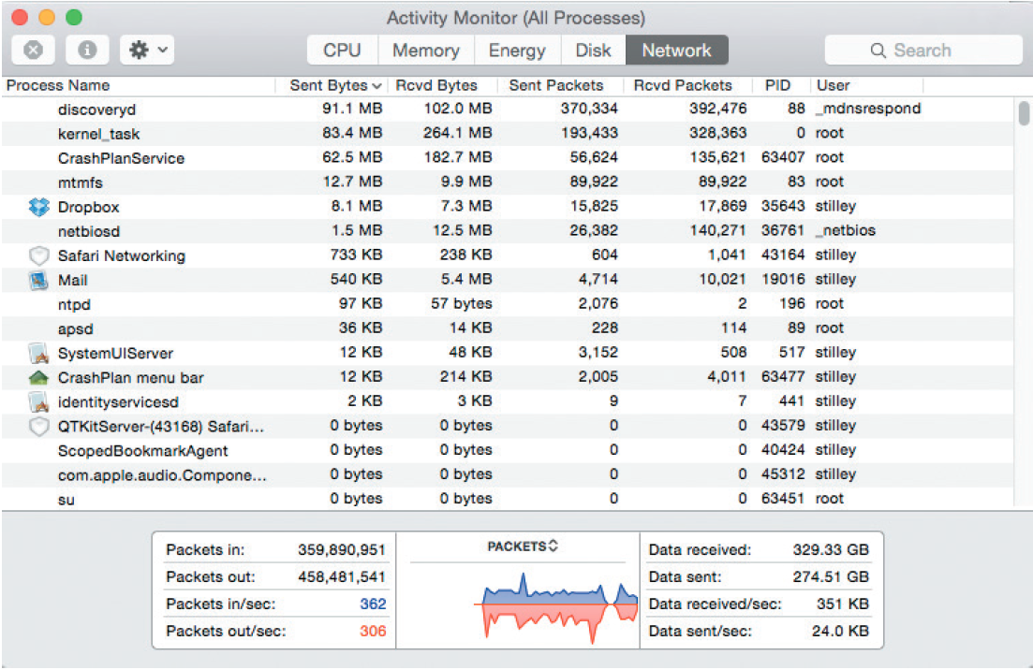
System Performance Management
Fault Management
Includes monitoring the system for signs of trouble, logging all system failures, diagnosing the problem, and applying corrective action
Figure 12-14 The Activity Monitor application on Apple’s Mac OS X displays CPU, memory, energy, disk, and network activity of all running applications in real time.
Source: Apple

Slide 14
System Performance Management (Cont. 1)
Performance and Workload Measurement
System performance is measured using benchmark testing and metrics
Response time: Overall time between a request for system activity and the delivery of the response
Bandwidth and throughput
Can be measured in Kbps (kilobits per second), Mbps (megabits per second), and Gbps (gigabits per second)
Examples of standards of metrics
Arrivals - Number of items that appear on a device during a given observation time
Busy - Time that a given resource is unavailable

Slide 15
System Performance Management (Cont. 2)
Queue length - Number of requests pending for a service
Turnaround time: Applies to centralized batch processing operations
Measures the time between submitting a request for information and the fulfillment of the request
Used to measure the quality of IT services
Management uses current performance and workload data as input for the capacity planning process

Slide 16
System Performance Management (Cont. 3)
Capacity Planning
Monitors current activity and performance levels
Anticipates future activity and forecasts resources required to provide desired levels of service
Uses what-if analysis
What-if analysis: Varies one or more elements to study their effect on other elements
Requires:
Detailed information
An accurate forecast of future business activities
Objective - To develop contingency plans based on input from users and management

Slide 17
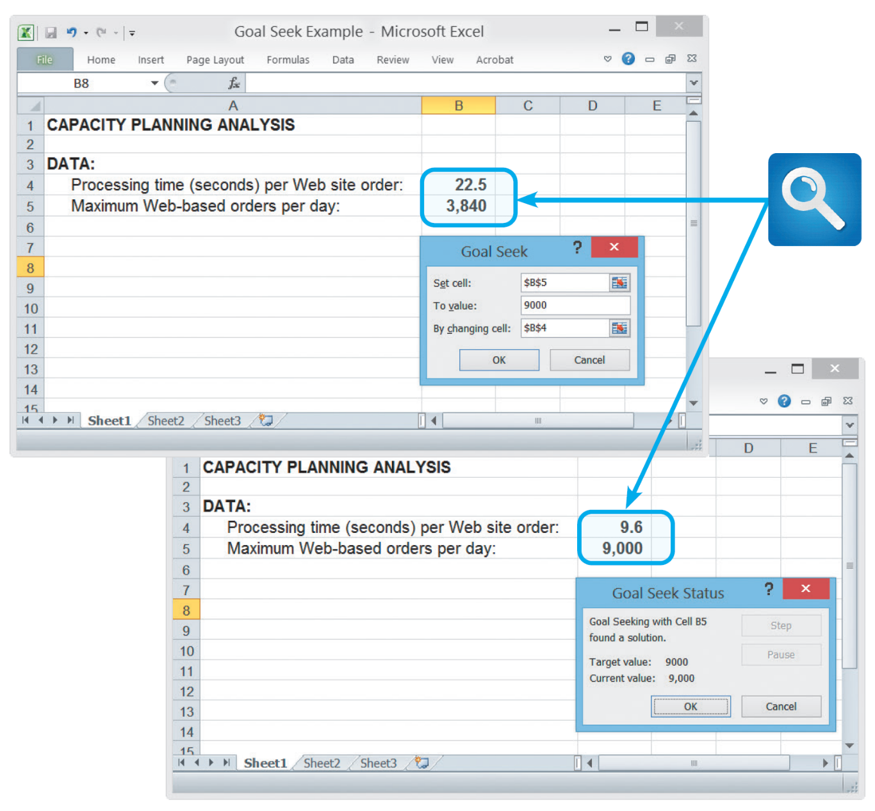
System Performance Management (Cont. 4)
Figure 12-16 In this Goal Seek example, the user wants to know the effect on processing time if the number of daily transactions increases from 3,840 to 9,000.

Slide 18
System Performance Management (Cont. 5)
System Maintenance Tools
Many CASE tools include system evaluation and maintenance features
Spreadsheet and presentation software can be used to calculate trends, perform what-if analyses, and create charts and graphs

Slide 19
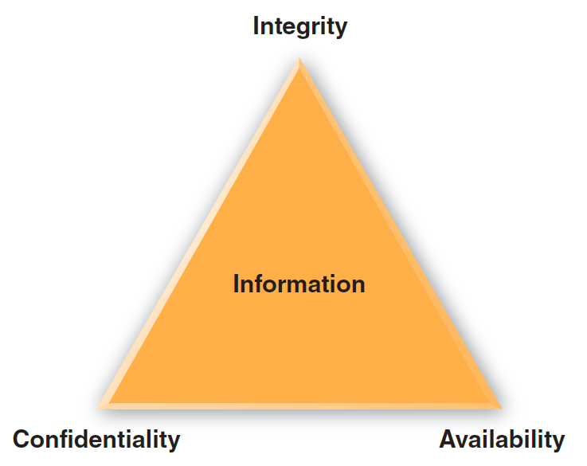
System Security Overview
Security is a vital part of every computer system
System Security Concepts
CIA triangle: Shows the main elements of system security
Elements are used to develop a security policy
Figure 12-18 System security must provide information confidentiality, integrity, and availability (CIA).

Slide 20
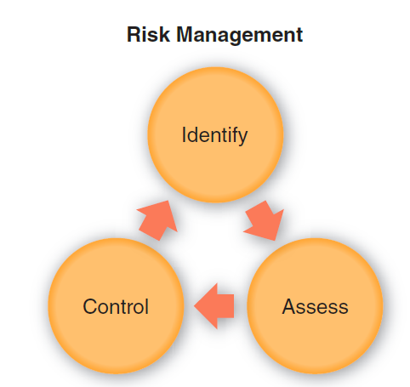
System Security Overview (Cont. 1)
Risk Management: Involves:
Risk identification
List and classify assets and analyze possible threats
Identify vulnerabilities and how they might be exploited
Risk assessment
Risks need to be calculated and prioritized
Risk control
Strategies - Avoidance, mitigation, transference, and acceptance
Figure 12-19 Risk management requires continuous risk identification, assessment, and control.

Slide 21
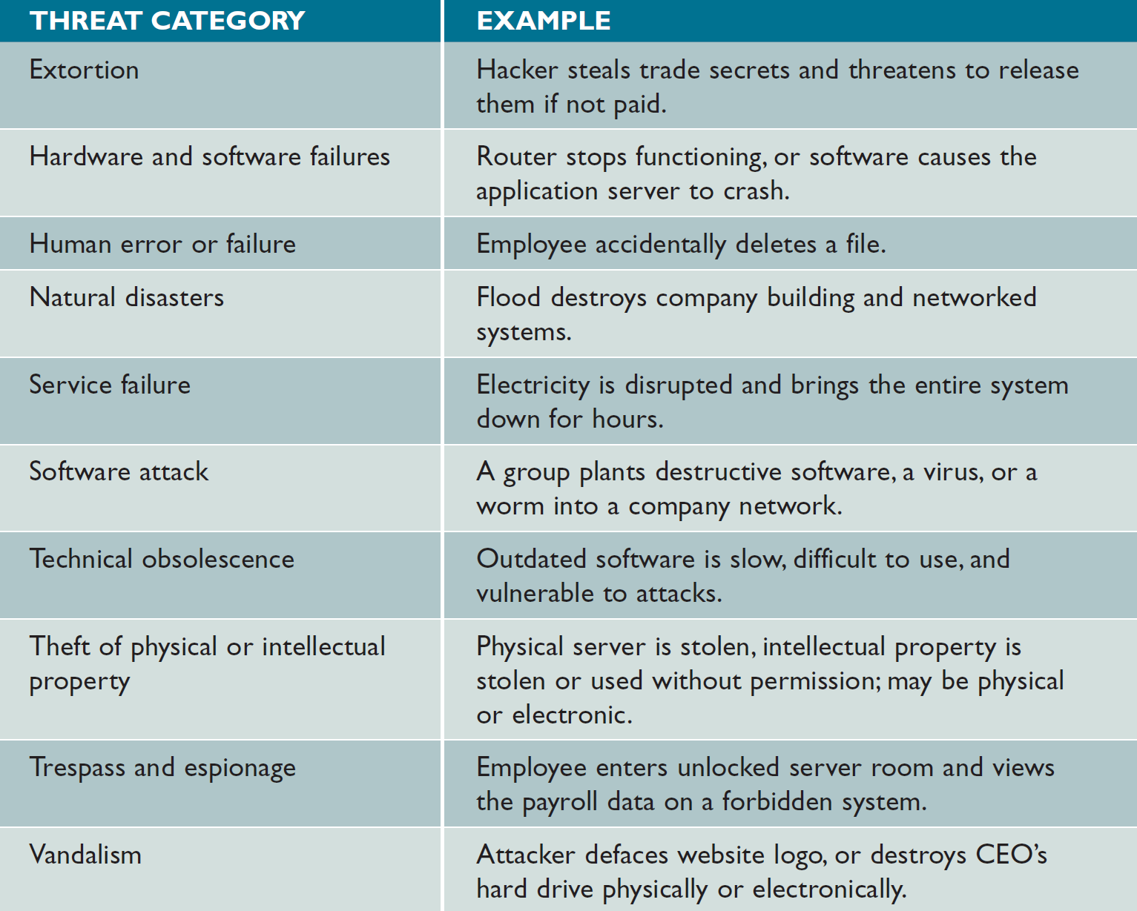
System Security Overview (Cont. 2)
Figure 12-20 System threats can be grouped into several broad categories.

Slide 22
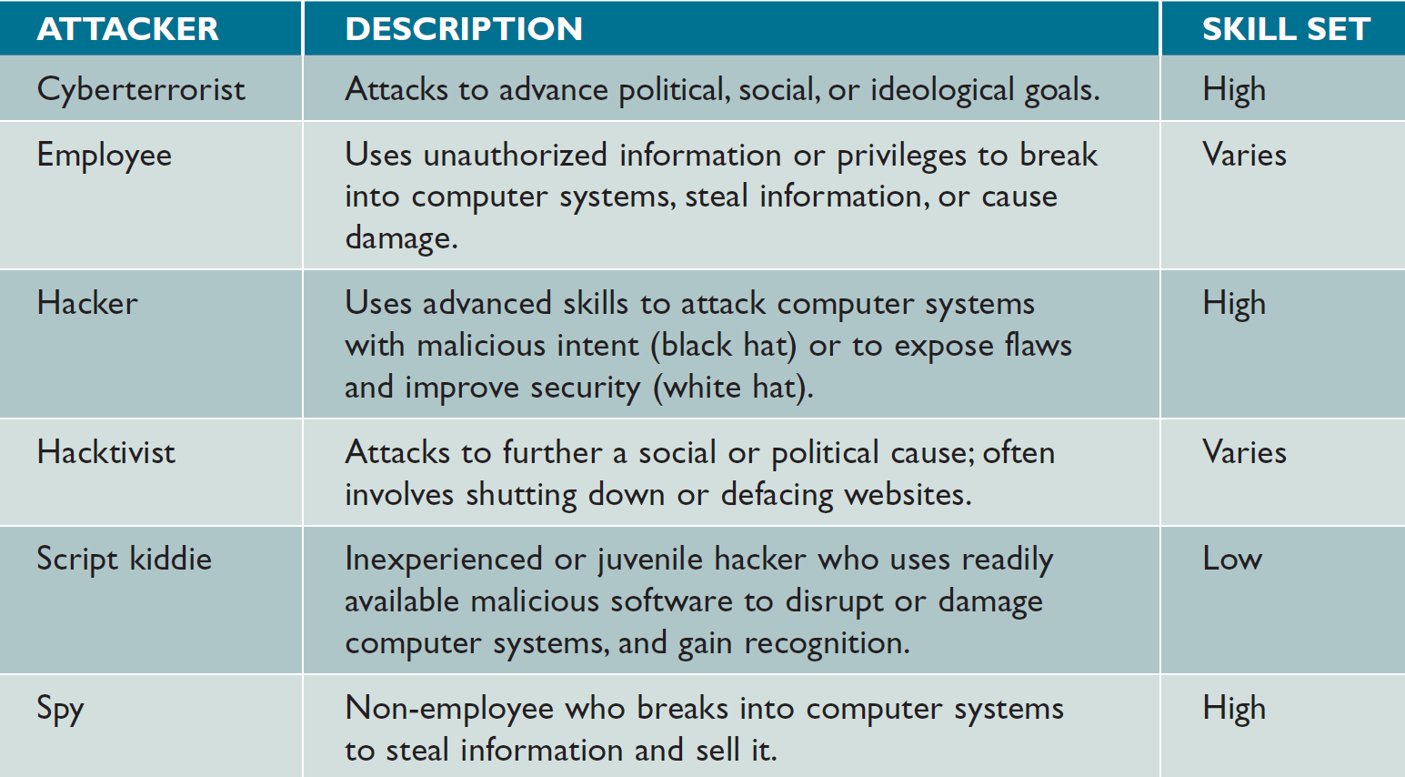
System Security Overview (Cont. 3)
Figure 12-21 IT security professionals have names for various types of attackers.

Slide 23
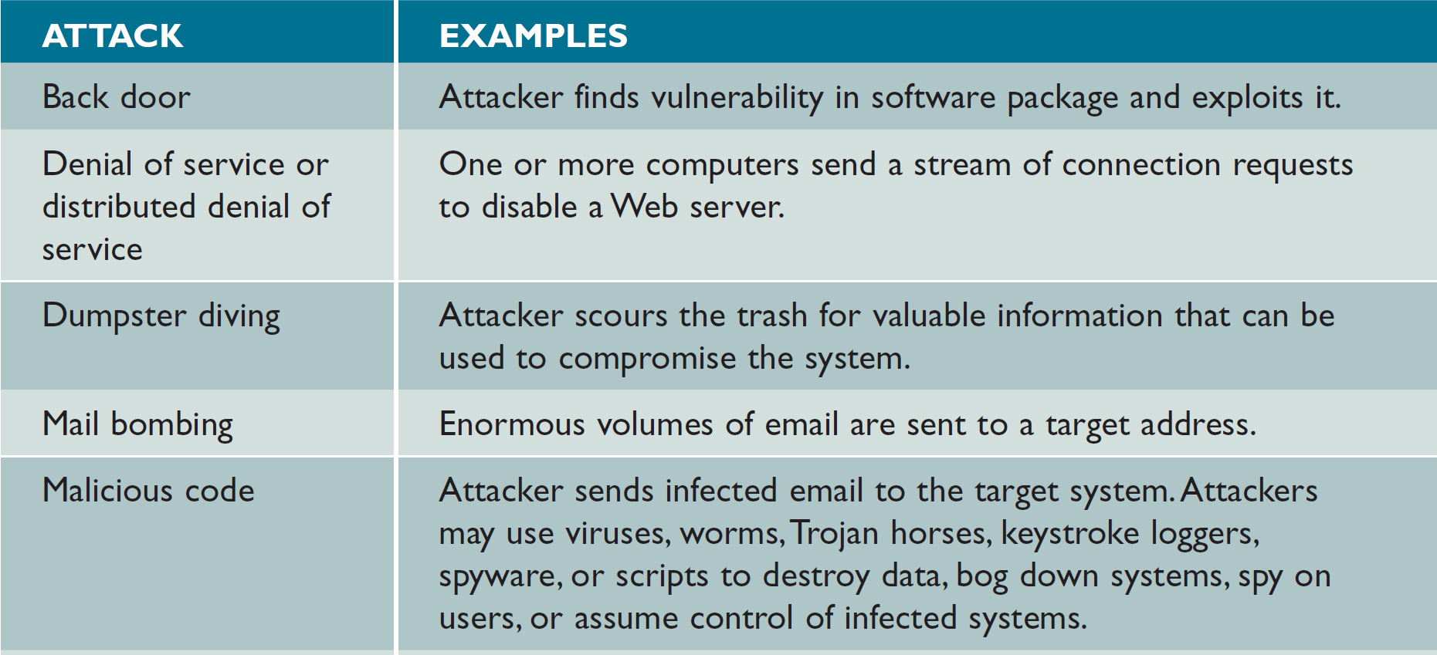
System Security Overview (Cont. 4)
Figure 12-22 Attacks can take many forms, as this table shows. IT security managers must be able to detect these attacks and respond with suitable countermeasures.

Slide 24
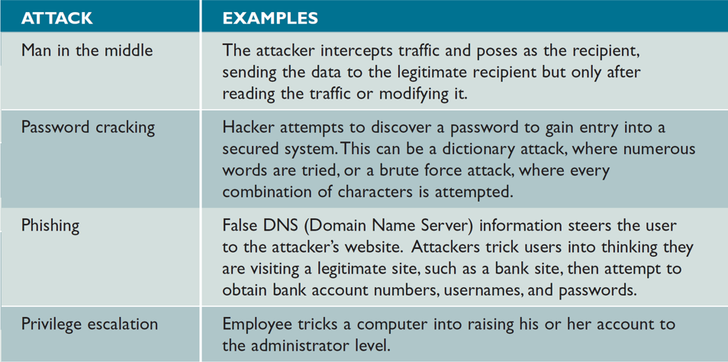
System Security Overview (Cont. 5)
Figure 12-22 Attacks can take many forms, as this table shows. IT security managers must be able to detect these attacks and respond with suitable countermeasures.

Slide 25
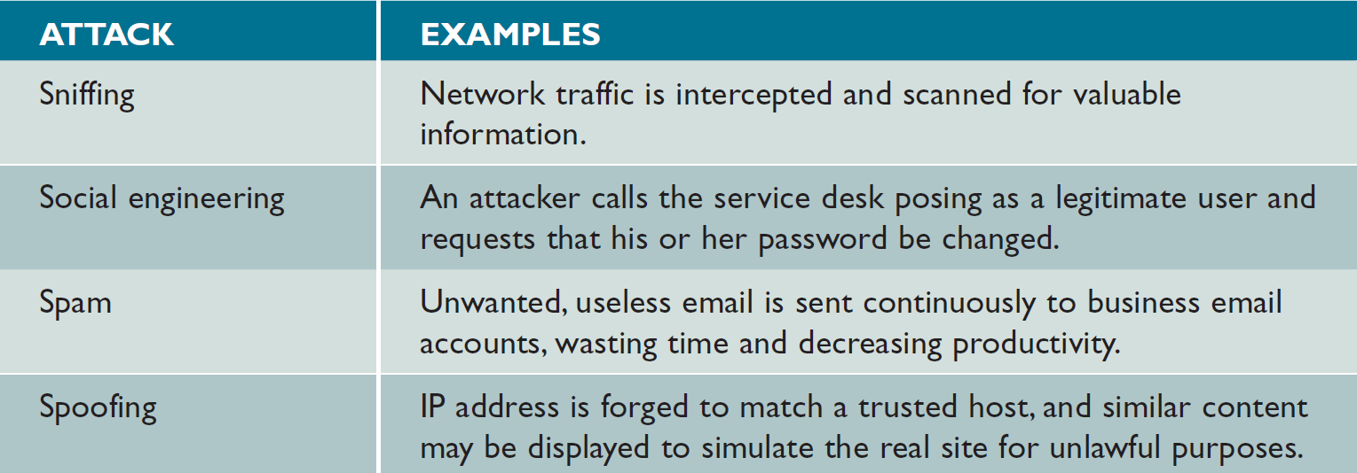
System Security Overview (Cont. 6)
Figure 12-22 Attacks can take many forms, as this table shows. IT security managers must be able to
detect these attacks and respond with suitable countermeasures.

Slide 26
Backup and Recovery
Backup Policies
Backup media: Includes tape, hard drives optical and online storage
Offsiting: Storing backup away from the business location
Cloud-based storage is growing rapidly
Types - Full, differential, incremental, and continuous
Retention periods: Backups are stored for a specific time beyond which they are either destroyed or reused

Slide 27
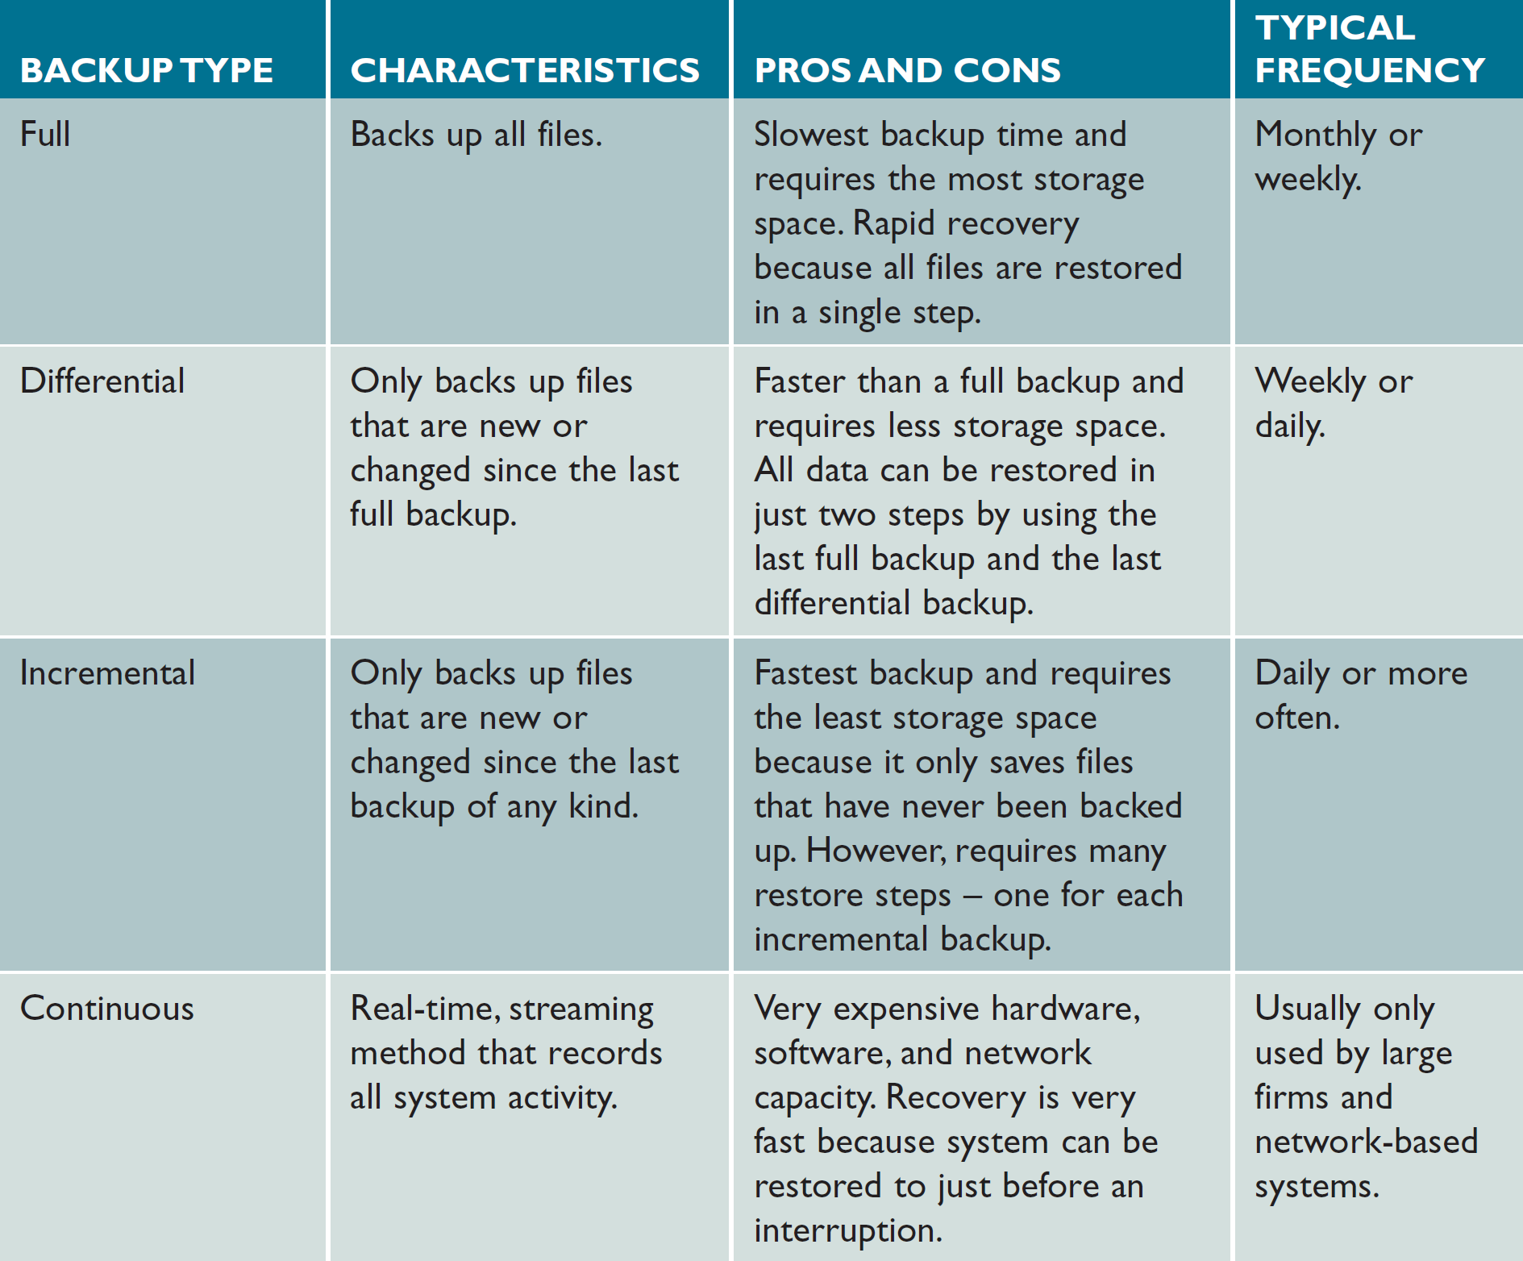
Backup and Recovery (Cont. 1)
Figure 12-34 Comparison of full, differential, incremental, and continuous backup methods.

Slide 28
Backup and Recovery (Cont. 2)
Business Continuity Issues
A disaster recovery plan should be created along with a test plan
Often part of a business continuity plan (BCP)
BCP: Defines how critical business functions can continue during a major disruption
Specifies the use of a hot site, which requires data replication

