Slide 1
Design and Analysis of Engineering Experiments
Ali Ahmad, PhD

Slide 2
Robust Design
Goal is to make products and processes robust or less sensitive to variability transmitted by factors that cannot be easily controlled
Methods for RPD or robust parameter design was developed by Taguchi starting in the 1950s and introduced to western industry in the 1980s
Taguchi methods generated much controversy
Subsequent research produced an improved approach based on RSM

Slide 3
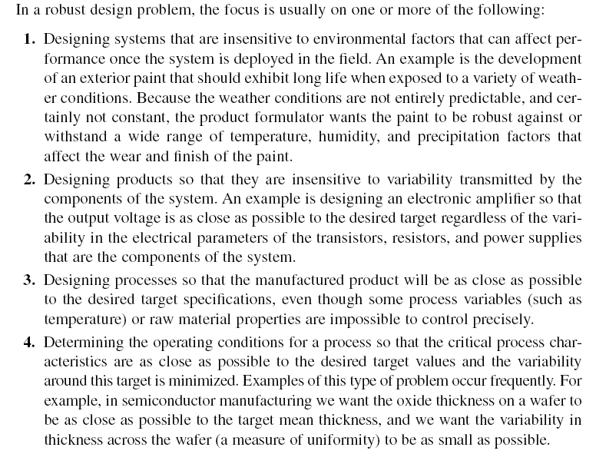

Slide 4
Noise variables transmit variability into the response
Noise variables cannot be controlled in the end application, but can be controlled for purposes of an experiment (assumption)
Objective is to determine the levels of the controllable variables that minimize the variability transmitted from the noise variables
This approach is not always applicable – if the noise factors dominate, other methods must be considered
  changing the design or the process – for example, manufacturing ICs in a clean room to eliminate defects due to microscopic particles or contaminants
  Sometimes technological factors can be employed to reduce noise – for example, substituting electronic components for mechanical ones

Slide 5
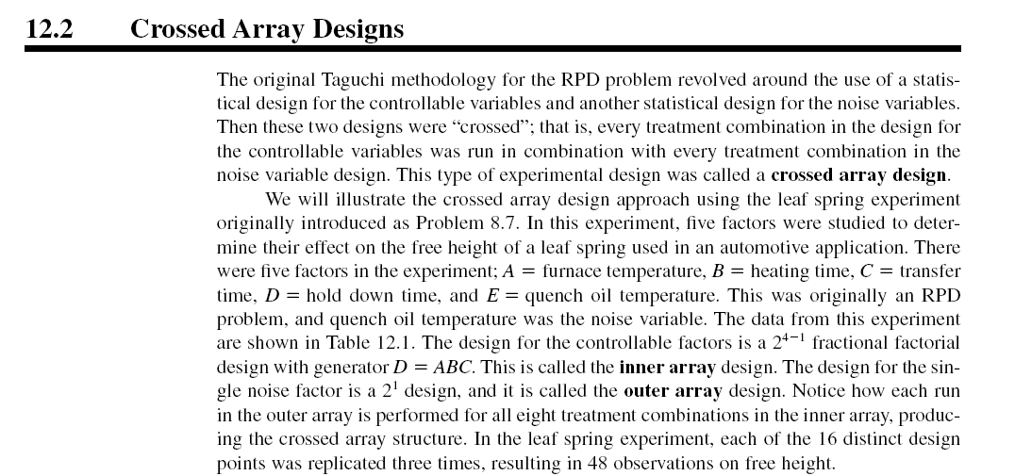

Slide 6
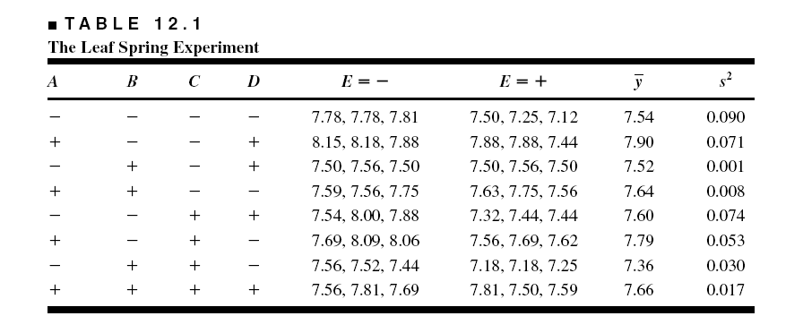

Slide 8
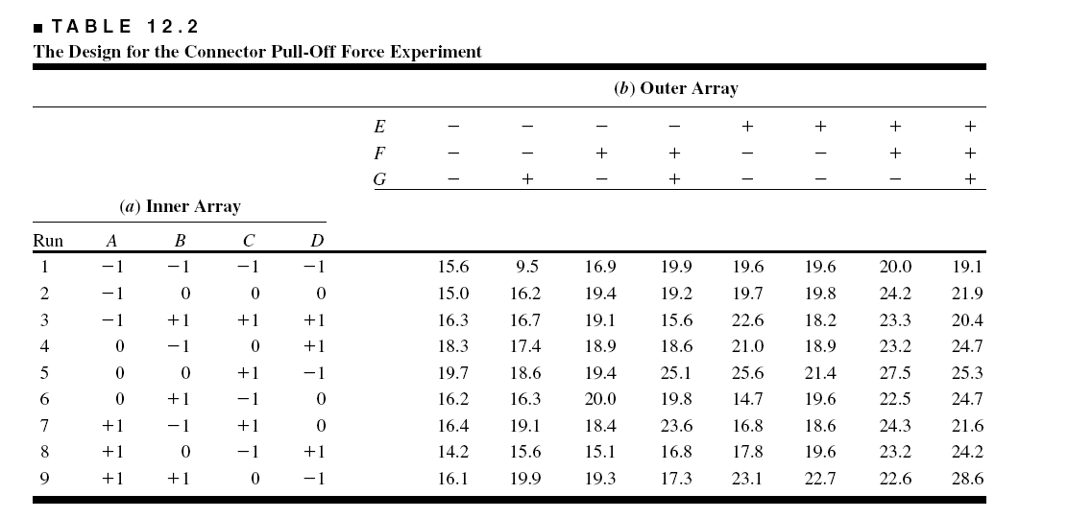

Slide 9
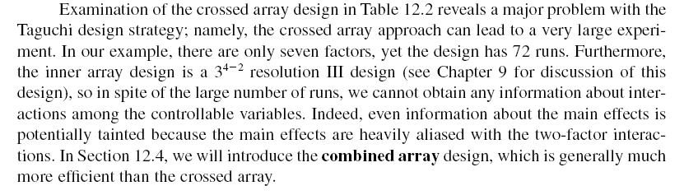

Slide 10
A better approach is to model the mean and variance directly

Slide 11
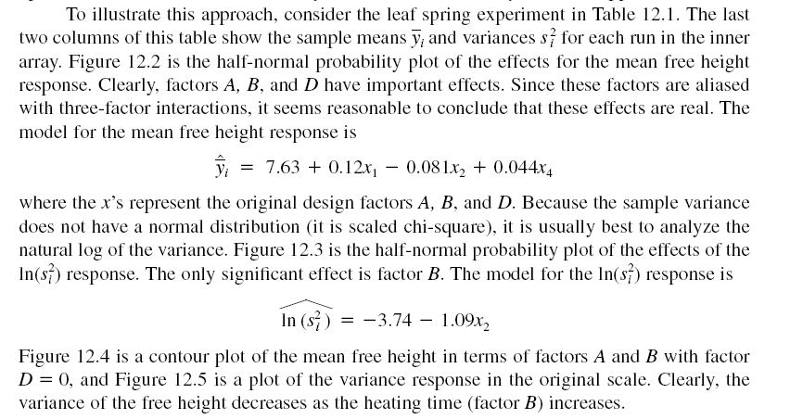

Slide 14
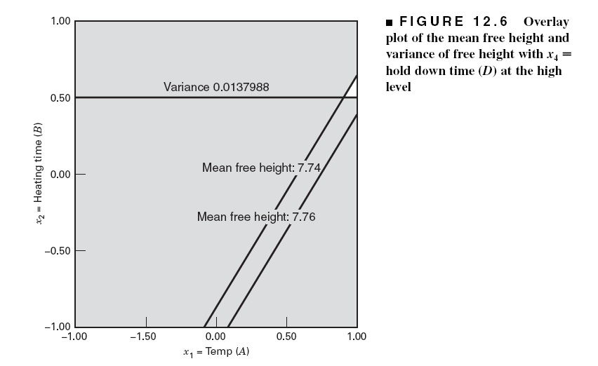

Slide 15
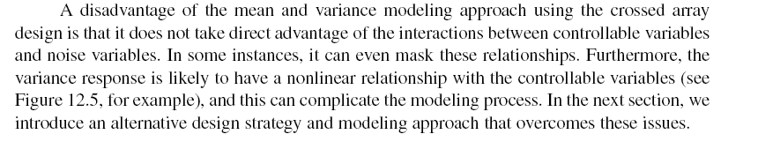

Slide 16
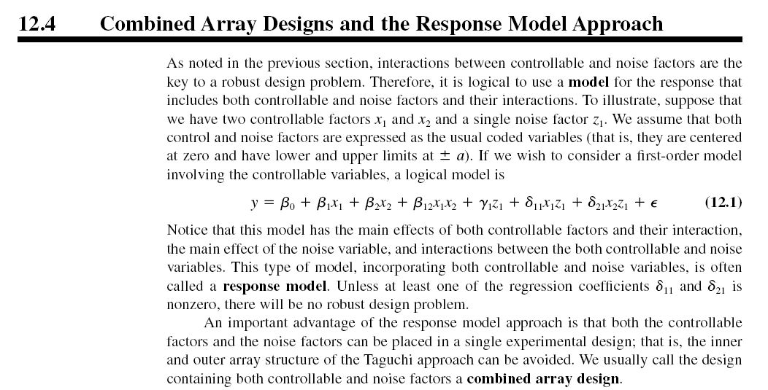

Slide 17
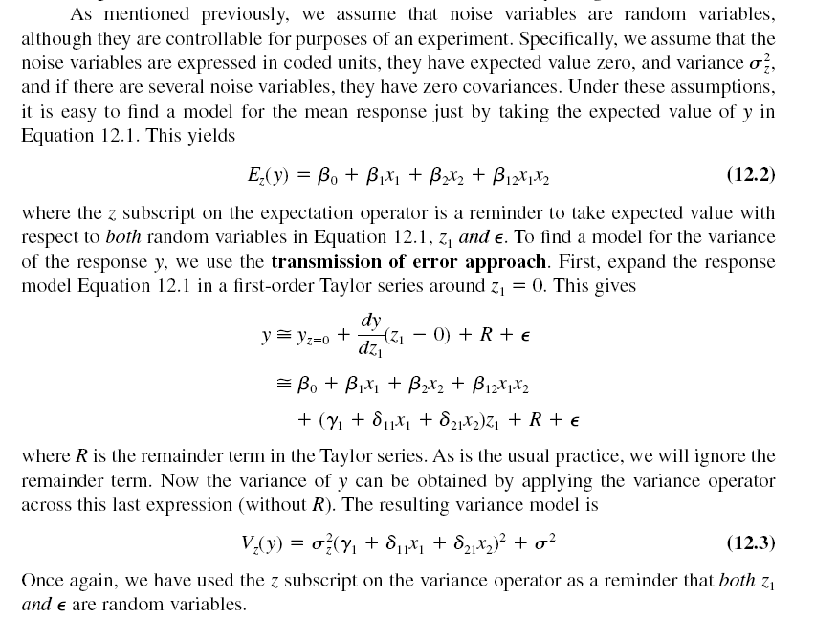

Slide 18
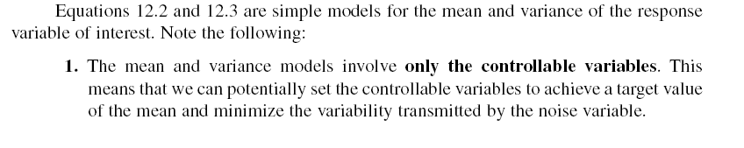

Slide 20
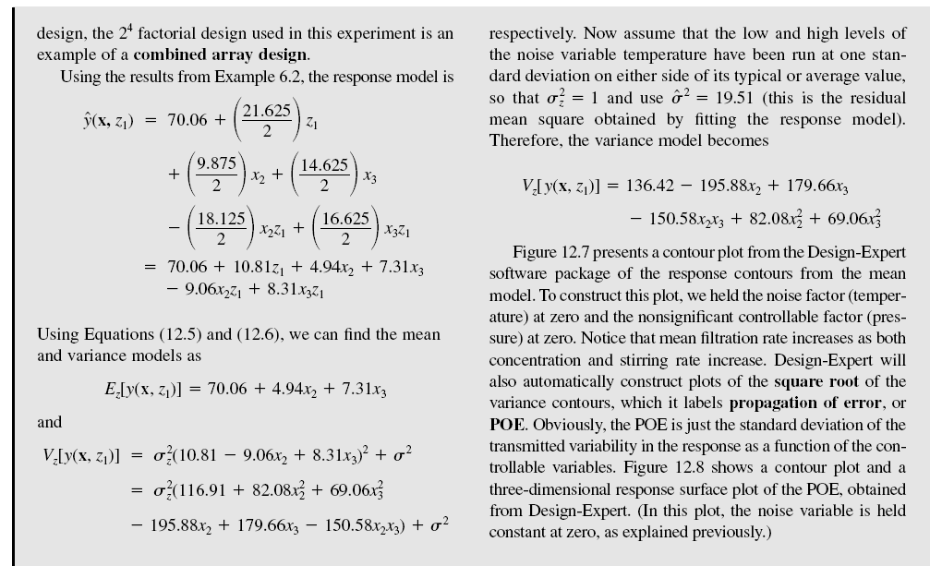

Slide 26
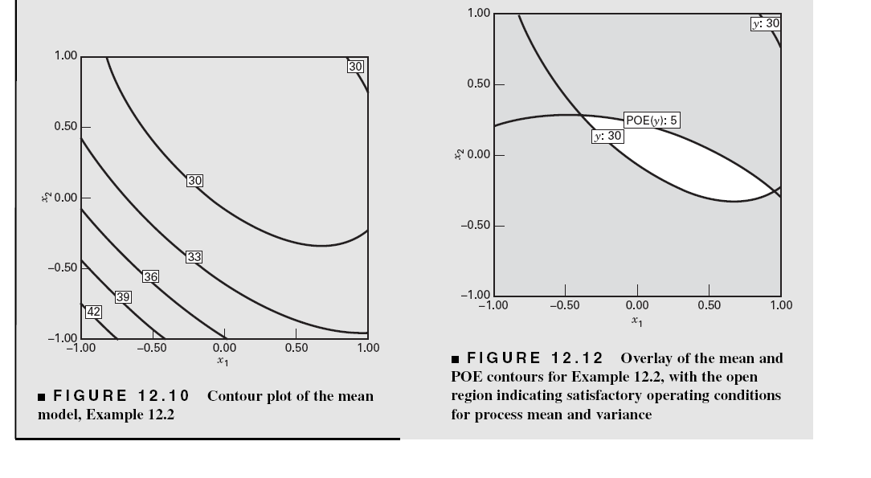

Slide 27
Choice of Designs – First-Order Models
This is a design from Design-Expert
It is a “small” resolution V design

Slide 28
Optimal Designs are Potentially Good Choices in Many Situations

Slide 29
Designs for the Second-Order Case
Modified CCDs
  Delete the axial runs along the noise variable axes
  Use 3-5 center runs
Optimal Designs
  JMP and Design-Expert can construct these designs

