Slide 1
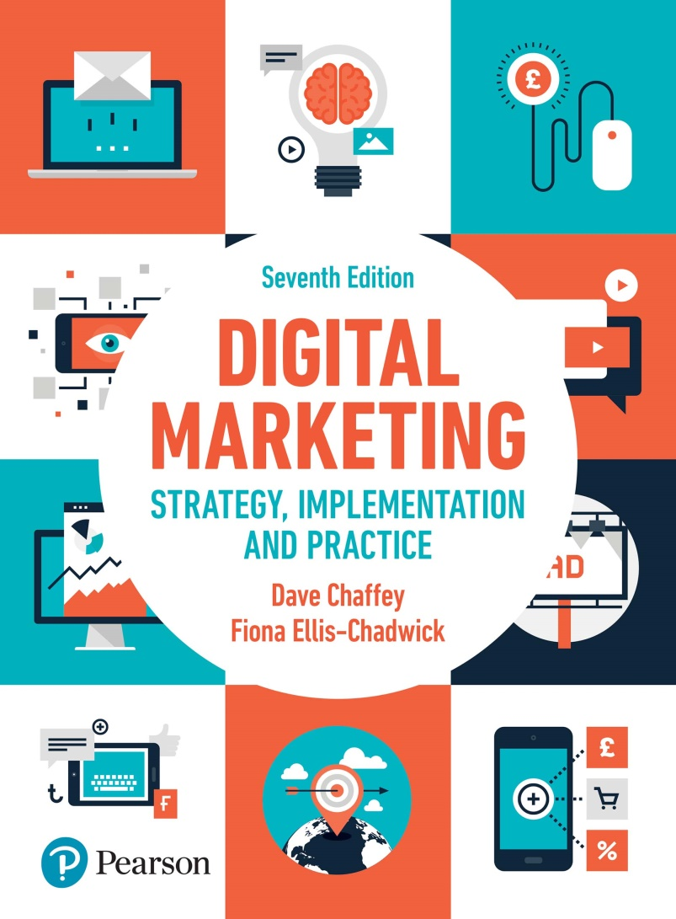
DIGITAL MARKETING STRATEGY, IMPLEMENTATION AND PRACTICE Seventh Edition
Part 3
Digital marketing: implementation and practice
Chapter 10
Evaluation and improvement of digital channel performance

Slide 2
Chapter 10 Evaluation and improvement of digital channel performance
Main topics
Performance management for digital channel
Content management process
Responsibilities for customer experience and site management
Case study 9. Learning for Amazon’s culture of metrics

Slide 3
Performance measurement for digital channels
3 stage process:
Stage 1 Creating a performance measurement system
Stage 2 Defining the performance metrics framework
Stage 3 Tools and techniques for collecting insights, running processes and results

Slide 4
Figure 10.2 A summary of the performance measurement process

Slide 5
Figure 10.3 The five diagnostic categories for digital marketing measurement

Slide 6
Figure 10.4 potential reasons for causing attrition on an e-commerce site

Slide 7
Figure 10.5 Multichannel performance scorecard example for a retailer
Source: Wilson (2008)

Slide 8
Figure 10.6 Thirty categories of martech and insight tools structured across the customer lifecycle
Source: Smart Insights (2017)

Slide 9
Figure 10.7 Examples of different measures of visitor volume to a website

Slide 10
Figure 10.8 A framework for different measures used to evaluate and manage social media marketing
Source: Altimeter (2010) with permission (Creative Commons)

Slide 11
Figure 10.10 Results of multivariate testing for National Express
Source: Oracle Marketing Cloud Customer Success Story, https://www.oracle.com/marketingcloud/customers/success-stories/nationalexpress. html (accessed May 2018)

Slide 12
Figure 10.11 Different types of data within a performance management system for Internet marketing

Slide 13
Content management process
A process of continuous improvement in online marketing, which involves:
Write
Review
Correct
Publish
Test
Publish
Notes:
Figure 10.12 A web document review and update process

Slide 14
Responsibilities for customer experience and site management
Questions to ask are:
Who owns the process?
Who owns the content?
Who owns the format?
Who owns the technology?
Notes:
Figure 10.13 An example of a content update review process

Slide 15
Case study 9: Learning from Amazon’s culture of metrics
Questions:
Evaluate how well Amazon communicates its core proposition and promotional offers
Characterise Amazon’s approach to marketing communications
Explain what distinguishes Amazon in its use of technology for competitive advantage
How does the Amazon ‘culture of metrics’ differ from that in other organisations?

