Slide 1
Regression
Modeling

Slide 2
Design and Analysis of Engineering Experiments
Ali Ahmad, PhD
Notes:
This is a basic course blah, blah, blah…

Slide 3
Regression models are empirical as opposed to mechanistic models
Regression modeling is often performed on undesigned or unplanned data
Regression modeling is also used extensively to build models to data from designed experiments

Slide 4
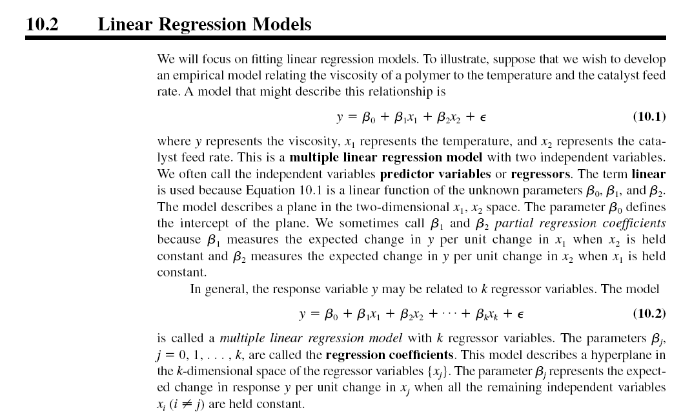

Slide 6
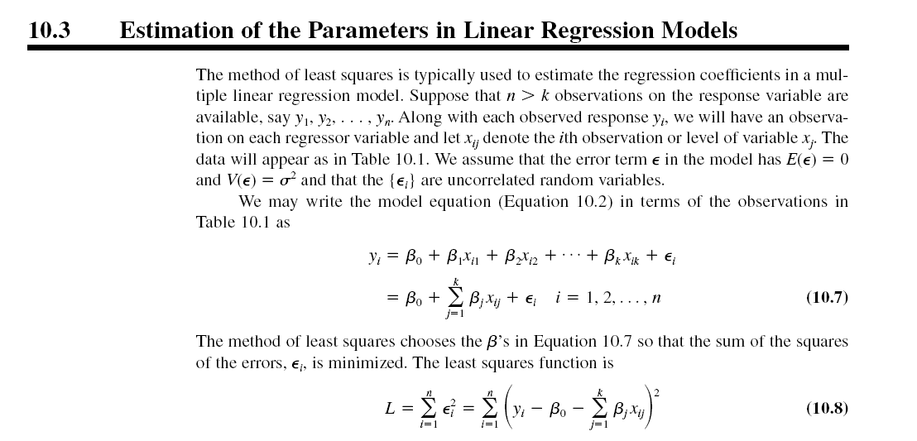
L is minimized by taking derivatives with respect to the model parameters and equating to zero

Slide 7
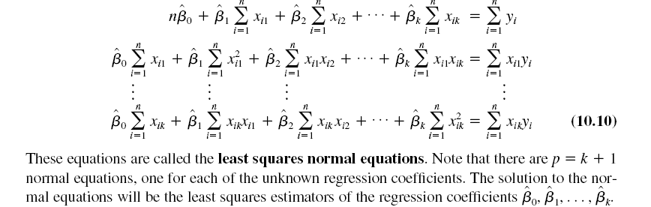
Taking the derivatives and equating to zero results in:

Slide 9
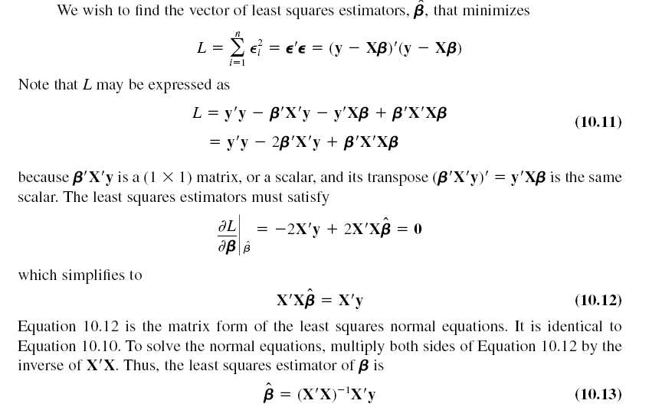

Slide 11
Mean square error

Slide 15
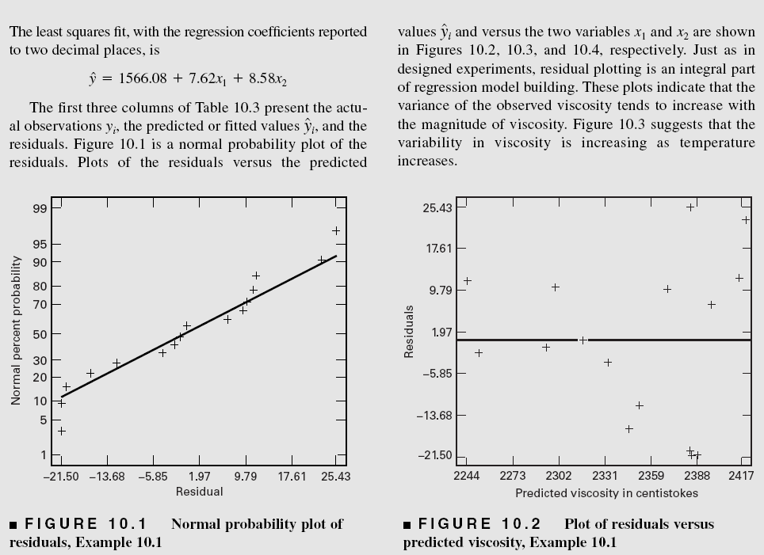

Slide 16
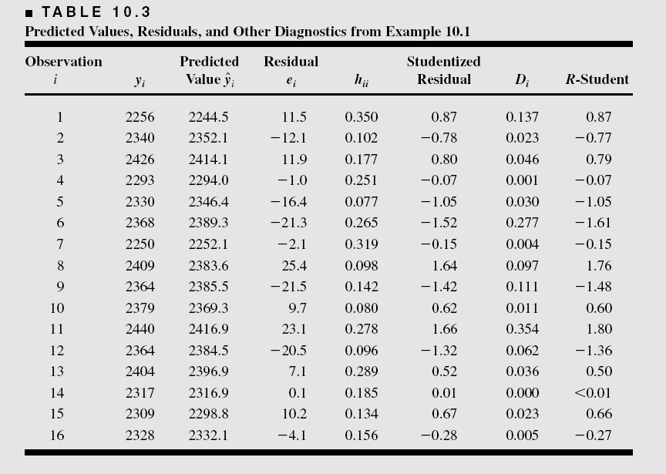

Slide 19
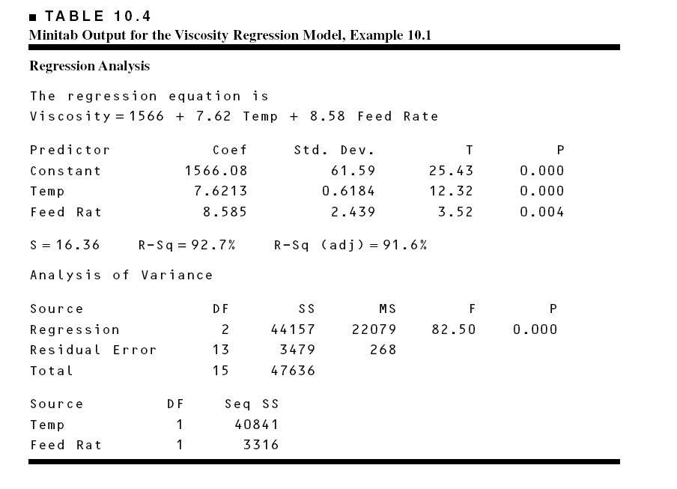

Slide 27
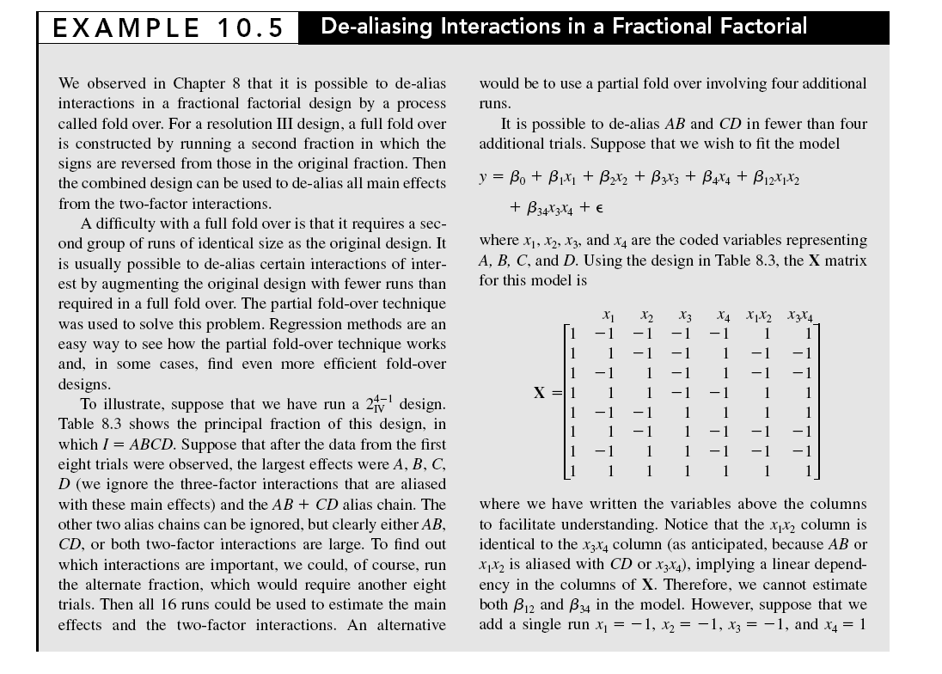

Slide 29
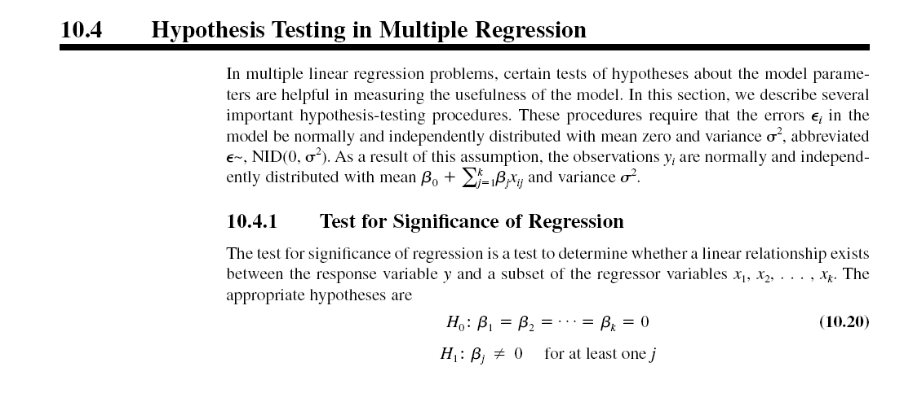

Slide 30
The test uses an ANOVA approach. The regression or model sum of squares is
See Table 10.4 for the viscosity regression model

Slide 33
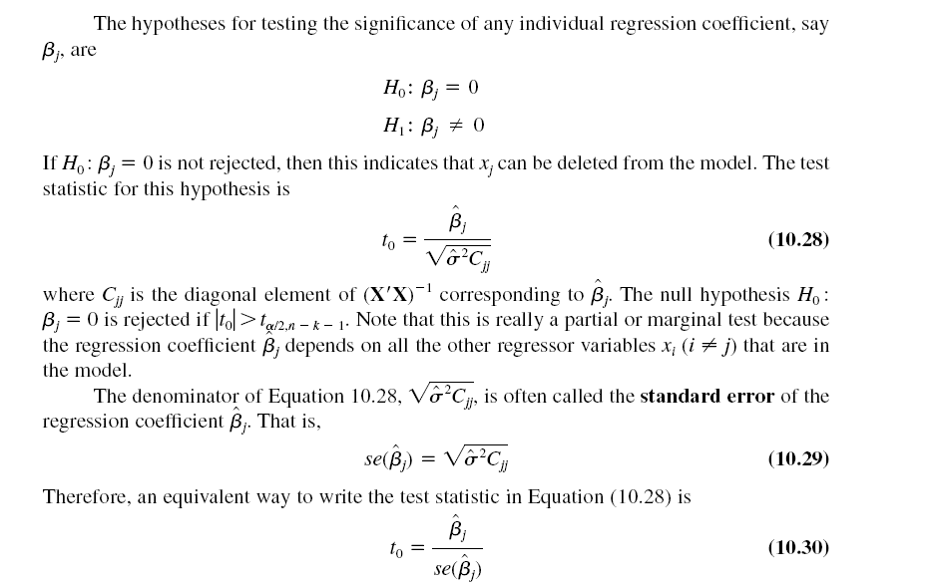
See Table 10.4 for the viscosity regression model

Slide 36
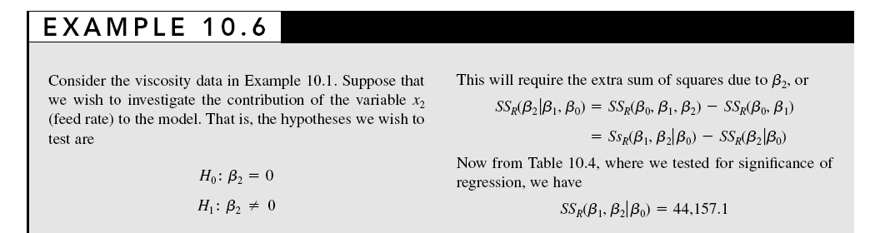

Slide 39
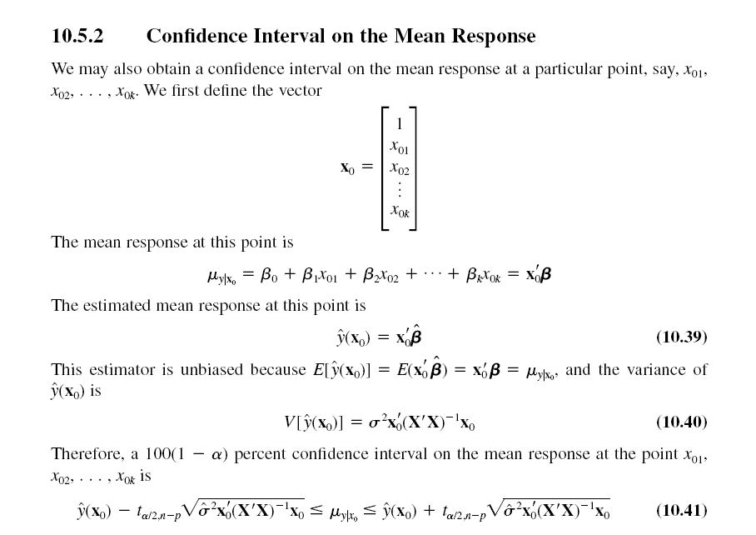

Slide 40
Prediction intervals are useful when running conformation experiments
If the new observation falls within the prediction interval that is some evidence that the model is reliable

Slide 41
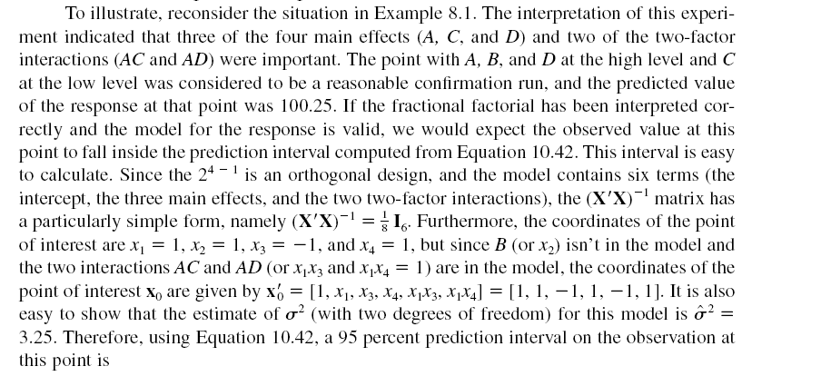

Slide 43


10.7 Regression Model Diagnostics
Scaled residuals and PRESS
Standardized residual
Studentized residual

Slide 46
Influence Diagnostics

Slide 48

10.8 Testing for Lack of Fit
Very important test in both general regression modeling and in analysis of a designed experiment
Does the chosen model adequately fit the data, or should higher-order terms be considered?
A statistical test can be performed provided that the error term can be decomposed into the two components shown below:

Slide 49
