Slide 1
Design and Analysis of Engineering Experiments
Ali Ahmad, PhD

Slide 2
Design of Engineering Experiments
Two-level Fractional Factorial Designs
Motivation for fractional factorials is obvious; as the number of factors becomes large enough to be “interesting”, the size of the designs grows very quickly
Emphasis is on factor screening; efficiently identify the factors with large effects
There may be many variables (often because we don’t know much about the system)
Almost always run as unreplicated factorials, but often with center points

Slide 3
Why do Fractional Factorial
Designs Work?
The sparsity of effects principle
  There may be lots of factors, but few are important
  System is dominated by main effects, low-order interactions
The projection property
  Every fractional factorial contains full factorials in fewer factors
Sequential experimentation
  Can add runs to a fractional factorial to resolve difficulties (or ambiguities) in interpretation

Slide 4
The One-Half Fraction of the 2^{k}
Section 8.2, page 290
Notation: because the design has 2^{k}/2 runs, it’s referred to as a 2^{k-1}
Consider a really simple case, the 2³⁻¹
Note that I =ABC

Slide 5
The One-Half Fraction of the 2³
For the principal fraction, notice that the contrast for estimating the main effect A is exactly the same as the contrast used for estimating the BC interaction.
This phenomena is called aliasing and it occurs in all fractional designs
Aliases can be found directly from the columns in the table of + and - signs

Slide 6
Aliasing in the One-Half Fraction of the 2³
A = BC, B = AC, C = AB (or me = 2fi)
Aliases can be found from the defining relation I = ABC by multiplication:
AI = A(ABC) = A²BC = BC
BI =B(ABC) = AC
CI = C(ABC) = AB
Textbook notation for aliased effects:

Slide 7
The Alternate Fraction of the 2³⁻¹
I = -ABC is the defining relation
Implies slightly different aliases: A = -BC, B= -AC, and C = -AB
Both designs belong to the same family, defined by
Suppose that after running the principal fraction, the alternate fraction was also run
The two groups of runs can be combined to form a full factorial – an example of sequential experimentation

Slide 8
Design Resolution
Resolution III Designs:
  me = 2fi
  example
Resolution IV Designs:
  2fi = 2fi
  example
Resolution V Designs:
  2fi = 3fi
  example

Slide 9
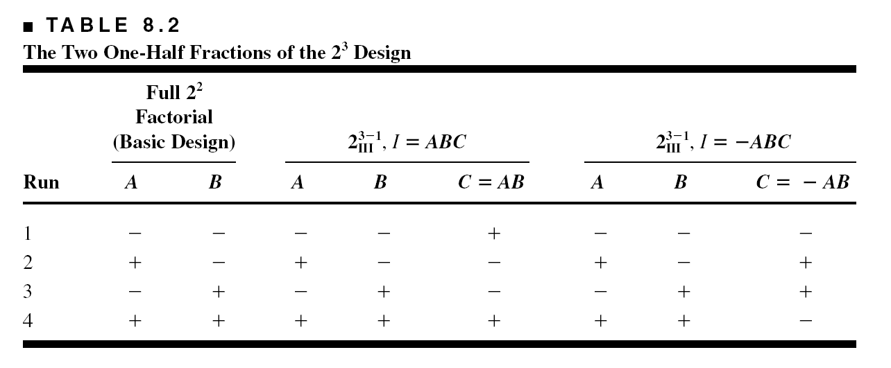
Construction of a One-half Fraction
The basic design; the design generator

Slide 10
Projection of Fractional Factorials
Every fractional factorial contains full factorials in fewer factors
The “flashlight” analogy
A one-half fraction will project into a full factorial in any k – 1 of the original factors

Slide 11
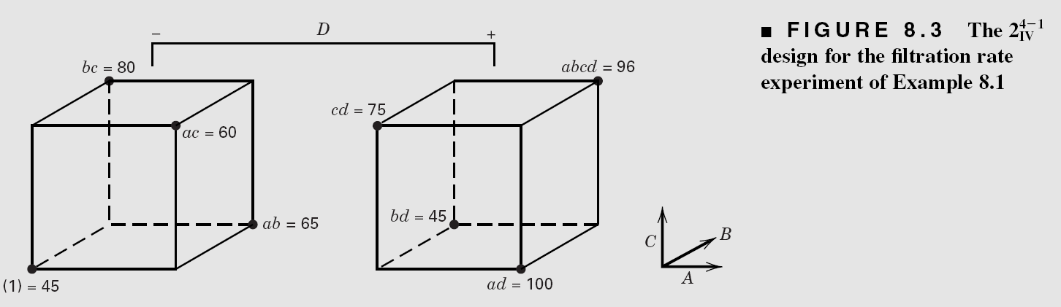
Example 8.1

Slide 12
Example 8.1
Interpretation of results often relies on making some assumptions
Ockham’s razor
Confirmation experiments can be important
Adding the alternate fraction – see page 301

Slide 13
The AC and AD interactions can be verified by inspection of the cube plot

Slide 14
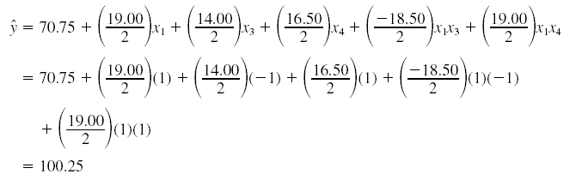
Confirmation experiment for this example: see page 302
Use the model to predict the response at a test combination of interest in the design space – not one of the points in the current design.
Run this test combination – then compare predicted and observed.
For Example 8.1, consider the point +, +, -, +. The predicted response is
Actual response is 104.

Slide 15
Possible Strategies for
Follow-Up Experimentation Following a Fractional Factorial Design

Slide 16
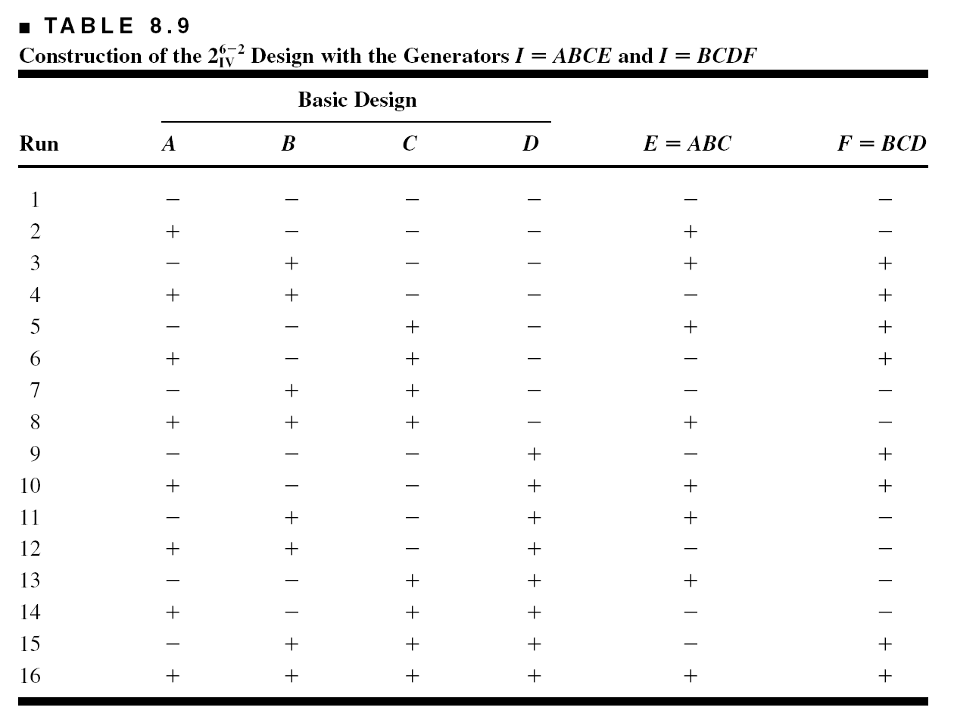
The One-Quarter Fraction of the 2^{k}

Slide 17
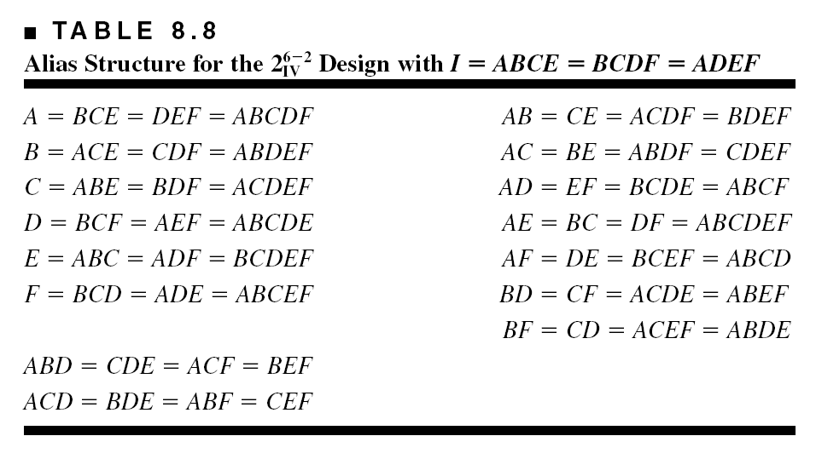
The One-Quarter Fraction of the 2⁶⁻²
Complete defining relation: I = ABCE = BCDF = ADEF

Slide 18
The One-Quarter Fraction of the 2⁶⁻²
Uses of the alternate fractions
Projection of the design into subsets of the original six variables
Any subset of the original six variables that is not a word in the complete defining relation will result in a full factorial design
  Consider ABCD (full factorial)
  Consider ABCE (replicated half fraction)
  Consider ABCF (full factorial)

Slide 19
A One-Quarter Fraction of the 2⁶⁻²:
Example 8.4, Page 305
Injection molding process with six factors
Design matrix, page 305
Calculation of effects, normal probability plot of effects
Two factors (A, B) and the AB interaction are important
Residual analysis indicates there are some dispersion effects (see page 307)

Slide 20
The General 2^{k-p} Fractional
Factorial Design
Section 8.4, page 309
2^{k-1} = one-half fraction, 2^{k-2} = one-quarter fraction, 2^{k-3} = one-eighth fraction, …, 2^{k-p} = 1/ 2^{p} fraction
Add p columns to the basic design; select p independent generators
Important to select generators so as to maximize resolution, see Table 8.14
Projection – a design of resolution R contains full factorials in any R – 1 of the factors
Blocking

Slide 22
The General 2^{k-p} Design: Resolution may not be Sufficient
Minimum abberation designs

Slide 25
Main effects aliased with the 2fis

Slide 26
Resolution III Designs: Section 8.5, page 320
Designs with main effects aliased with two-factor interactions
Used for screening (5 – 7 variables in 8 runs, 9 - 15 variables in 16 runs, for example)
A saturated design has k = N – 1 variables
See Table 8.19, page 320 for a

Slide 27
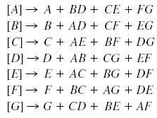
Resolution III Designs

Slide 28
Resolution III Designs
Sequential assembly of fractions to separate aliased effects (page 322)
Switching the signs in one column provides estimates of that factor and all of its two-factor interactions
Switching the signs in all columns dealiases all main effects from their two-factor interaction alias chains – called a full fold-over
Defining relation for a fold-over (page 325)
Be careful – these rules only work for Resolution III designs
There are other rules for Resolution IV designs, and other methods for adding runs to fractions to dealias effects of interest
Example 8.7, eye focus time, page 323

Slide 29
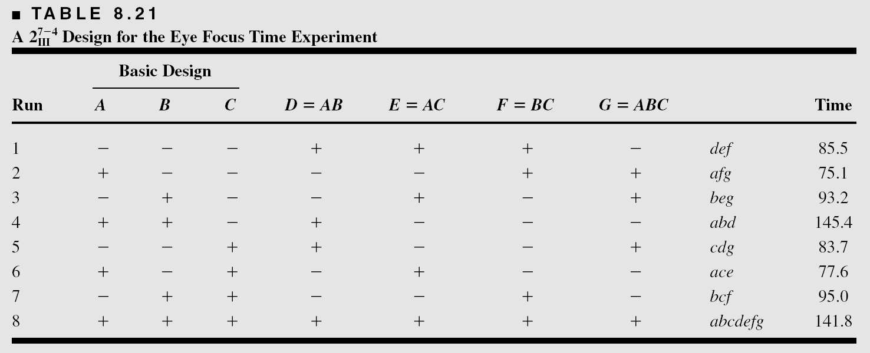
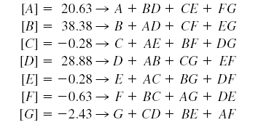

Slide 30
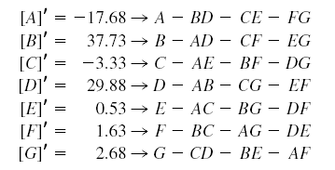
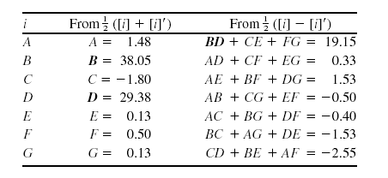

Slide 31
Remember that the full fold-over technique illustrated in this example (running a “mirror image” design with all signs reversed) only works in a Resolution III design.
Defining relation for a fold-over design – see page 325.
Blocking can be an important consideration in a fold-over design – see page 325.

Slide 32
Plackett-Burman Designs
These are a different class of resolution III design
The number of runs, N, need only be a multiple of four
N = 4, 8, 12, 16, 20, 24, 28, 32, 36, 40, …
The designs where N = 12, 20, 24, etc. are called nongeometric PB designs
See text, page 326 for comments on construction of Plackett-Burman designs

Slide 33
Plackett-Burman Designs

Slide 34
This is a non-regular design

Slide 35
Plackett-Burman Designs
Projection of the 12-run design into 3 and 4 factors
All PB designs have projectivity 3 (contrast with other resolution III fractions)

Slide 36
Plackett-Burman Designs
The alias structure is complex in the PB designs
For example, with N = 12 and k = 11, every main effect is aliased with every 2FI not involving itself
Every 2FI alias chain has 45 terms
Partial aliasing can potentially greatly complicate interpretation if there are several large interactions
Use very, very carefully – but there are some excellent opportunities

Slide 43
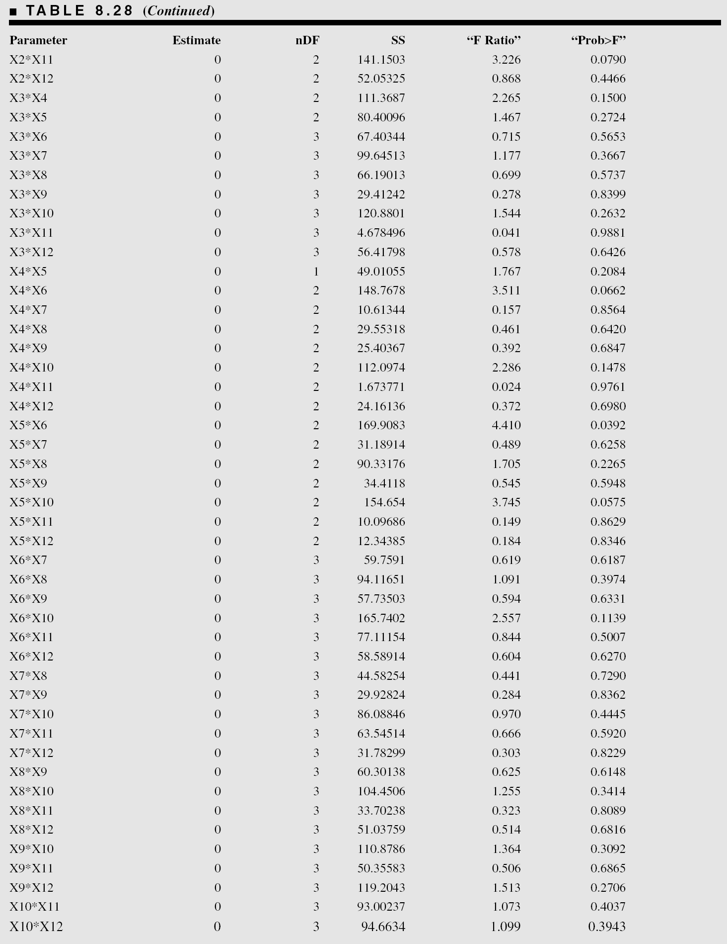

Slide 45
Resolution IV and V Designs (Page 322)
A resolution IV design must have at least 2k runs.
“optimal” designs may often prove useful.

Slide 46
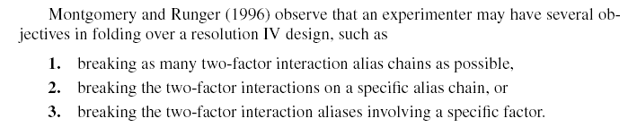
Sequential Experimentation with Resolution IV Designs – Page 339
We can’t use the full fold-over procedure given previously for Resolution III designs – it will result in replicating the runs in the original design.
Switching the signs in a single column allows all of the two-factor interactions involving that column to be separated.

Slide 47
The spin coater experiment – page 340

Slide 48
[AB] = AB + CE
We need to dealias these interactions
The fold-over design switches the signs in column A

Slide 49
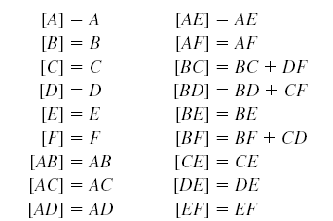
The aliases from the complete design following the fold-over (32 runs) are as follows:
Finding the aliases is somewhat beyond the scope of this course (Chapter 10 provided details) but it can be determined using Design-Expert.

Slide 51
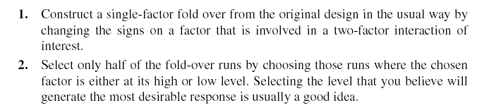
A full fold-over of a Resolution IV design is usually not necessary, and it’s potentially very inefficient.
In the spin coater example, there were seven degrees of freedom available to estimate two-factor interaction alias chains.
After adding the fold-over (16 more runs), there are only 12 degrees of freedom available for estimating two-factor interactions (16 new runs yields only five more degrees of freedom).
A partial fold-over (semifold) may be a better choice of follow-up design. To construct a partial fold-over:

Slide 52
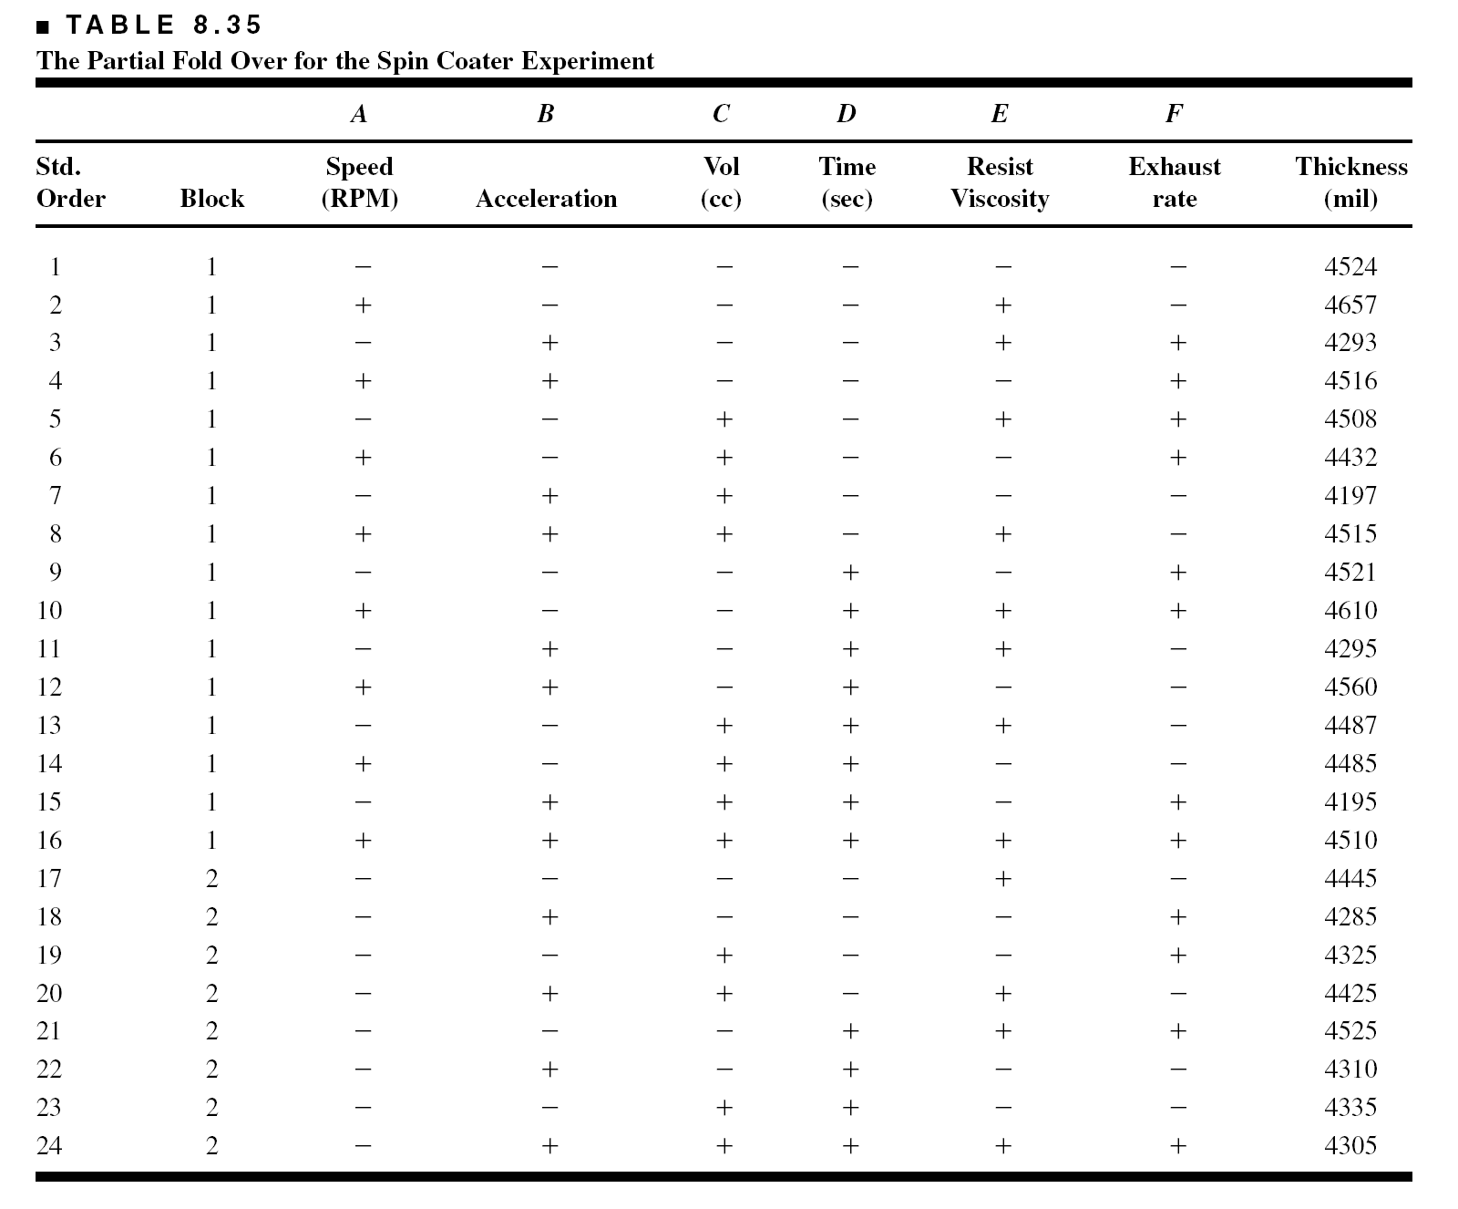
Not an orthogonal design – but that’s not such a big deal
Correlated parameter estimates
Larger standard errors of regression model coefficients or effects

Slide 53
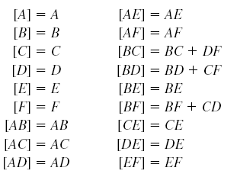
There are still 12 degrees of freedom available to estimate two-factor interactions

Slide 54
Resolution V Designs – Page 331
We used a Resolution V design (a 2⁵⁻²) in Example 8.2
Generally, these are large designs (at least 32 runs) for six or more factors
Irregular designs can be found using optimal design construction methods
JMP has excellent capability
Examples for k = 6 and 8 factors are illustrated in the book

Slide 55
Supersaturated Designs

