Slide 1
Systems Analysis and Design 11th Edition
Chapter 7
Development Strategies

Slide 2
Chapter Objectives
Describe software outsourcing options, including offshore outsourcing and the role of service providers
Explain advantages and disadvantages of in-house software development

Slide 3
Outsourcing
Transfer of information systems development, operation, or maintenance to an outside firm
The Growth of Outsourcing
  Service provider: Offers outsourcing solutions Application service provider (ASP)
    Delivers a software application or access to an application by charging a usage or subscription fee
  Internet business services (IBS)
    Also called managed hosting
    Provide web-based support for transactions

Slide 4
Outsourcing (Cont.1)
Outsourcing Fees
  Fixed fee model: Uses a set fee based on a specified level of service and user support
  Subscription model: Has a variable fee based on the number of users or workstations that have access to the application
  Usage model or transaction model: Charges a variable fee based on the volume of transactions or operations performed by the application

Slide 5
Outsourcing (Cont.2)
Outsourcing Issues and Concerns
  Mission-critical IT systems are outsourced if the result is a cost-attractive and reliable business solution
  Overseas outsourcing can raise issues with control, culture communication, and security
  Reviewing the outsourcing firm’s history and financial condition is vital
  Outsourcing clients can be affected by mergers and acquisitions
  Employee job security is a major concern

Slide 6
Outsourcing (Cont.3)
Offshore Outsourcing
  Called global outsourcing
  Shifting IT development, support, and operations to other countries
  Reason - Lower bottom-line costs
  Risks and concerns
    Impact on the economy
    Project control
    Security issues

Slide 7
In-House Software Development Options
Software development options
  Develop own systems
  Purchase, possibly customize, and implement a software package
Most important consideration is the total cost of ownership (TCO)
Companies can develop user applications based on commercial software packages

Slide 8
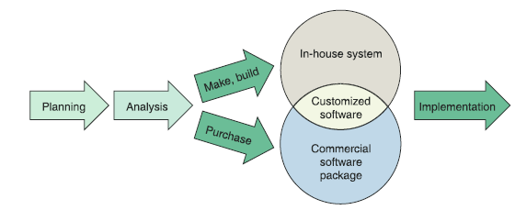
In-House Software Development Options (Cont.1)
Make or Buy Decision
  Refers to the choice between developing and purchasing
  A company’s IT department makes, builds, and develops in-house software
  A software
  package is
  obtained from
  a vendor or
  application
  service provider
FIGURE 7-8 Instead of outsourcing, a company can choose to develop a system in-house, or purchase and possibly customize a commercial package.

Slide 9
In-House Software Development Options (Cont.2)
Make or Buy Decision (cont.)
  Software package: Obtained from a vendor or application service provider
  Software vendors: Develop software for sale
  Value-added reseller (VAR): Enhances a commercial package by adding custom features and configuring it for a particular industry
  Horizontal application: Can be used by many different types of organizations
  Vertical application: Developed to handle information requirements for a specific type of business

Slide 10
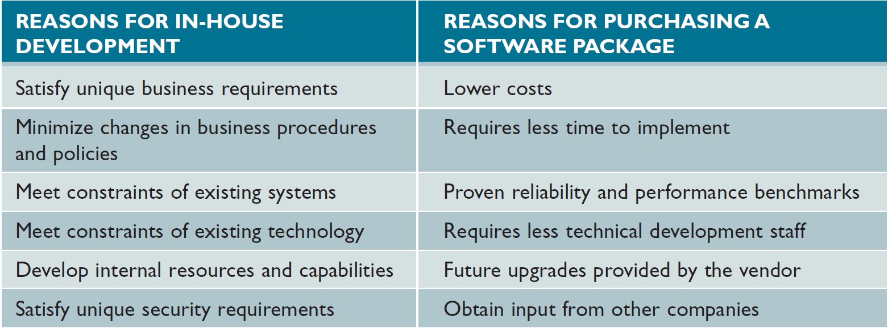
In-House Software Development Options (Cont.3)
FIGURE 7-10 Companies consider various factors when comparing in-house development with the purchase of a software package.

Slide 11
In-House Software Development Options (Cont.4)
Developing Software In-House
  Satisfies unique business requirements
    Not possible with standard commercial software packages
    Minimizes changes in business procedures and policies
    Installing a new software package almost always requires some degree of change in how a company does business
  Meets constraints of existing systems
    Any new software installed must work with existing systems

Slide 12
In-House Software Development Options (Cont.5)
Developing Software In-House (Cont.)
  Meets constraints of existing technology
    The new system must work with existing hardware and legacy systems
  Develops internal resources and capabilities
    Companies can develop and train IT staff who understand the organization’s business functions and information support needs

Slide 13
In-House Software Development Options (Cont.6)
Purchasing a Software Package
  Lower costs
    A software package is less expensive than the one developed in-house
  Requires less time to implement
    Packages have already been designed, programmed, tested, and documented
  Proven reliability and performance benchmarks
    Major problems would have been detected and corrected by the vendor

Slide 14
In-House Software Development Options (Cont.7)
Purchasing a Software Package (Cont.)
  Requires less technical development staff
    Companies can reduce the number of programmers and systems analysts on the IT staff
  Future upgrades provided by the vendor
    Improvements and enhancements are included in regular updates
  Input from other companies
    Users in other companies can be contacted to obtain their input and opinions

Slide 15
In-House Software Development Options (Cont.8)
Customizing a Software Package
  Purchase a basic package that vendors will customize to suit project requirements
  Negotiate directly with the software vendor to make enhancements to meet project needs by paying for the changes
  Purchase the package and make project-specific modifications
    Ensure modifications are permissible under the terms of the software license

Slide 16
In-House Software Development Options (Cont.9)
Creating User Applications
  User application: Utilizes standard business software
  User interface: Enables effective interaction with the application
  Service desk or information center (IC): Provides user support
  Screen generators and report generators: Allow users to design their own data entry forms and reports
  Appropriate controls must be provided to ensure data security and integrity

Slide 17
In-House Software Development Options (Cont.10)
Figure 7-11 Microsoft Access includes Form Wizard and a Report Wizard tools that ask a series of questions and then create the form or report.
Source: Screenshots used with permission from Microsoft

