Slide 1
Design and Analysis of Engineering Experiments
Ali Ahmad, PhD

Slide 2
Factorial Experiments
General principles of factorial experiments
The two-factor factorial with fixed effects
The ANOVA for factorials
Extensions to more than two factors
Quantitative and qualitative factors – response curves and surfaces

Slide 3
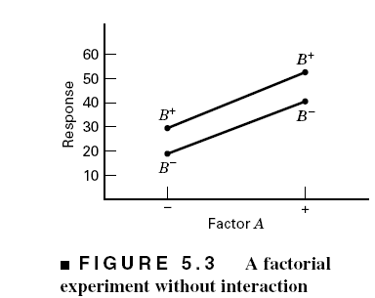
Some Basic Definitions
Definition of a factor effect: The change in the mean response when the factor is changed from low to high

Slide 4
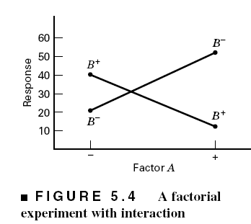
The Case of Interaction:

Slide 5
Regression Model & The Associated Response Surface

Slide 6
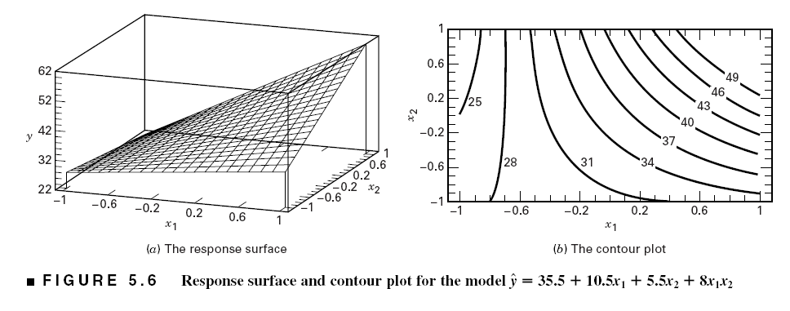
The Effect of Interaction on the Response Surface
Suppose that we add an interaction term to the model:
Interaction is actually a form of curvature

Slide 7
Example 5.1 The Battery Life Experiment
Text reference pg. 167
A = Material type; B = Temperature (A quantitative variable)
What effects do material type & temperature have on life?
2. Is there a choice of material that would give long life regardless of temperature (a robust product)?

Slide 8
The General Two-Factor
Factorial Experiment
a levels of factor A; b levels of factor B; n replicates
This is a completely randomized design

Slide 9
Statistical (effects) model:
Other models (means model, regression models) can be useful

Slide 10
Extension of the ANOVA to Factorials (Fixed Effects Case) – pg. 168

Slide 11
ANOVA Table – Fixed Effects Case
Design-Expert will perform the computations
Text gives details of manual computing (ugh!) – see pp. 171

Slide 13
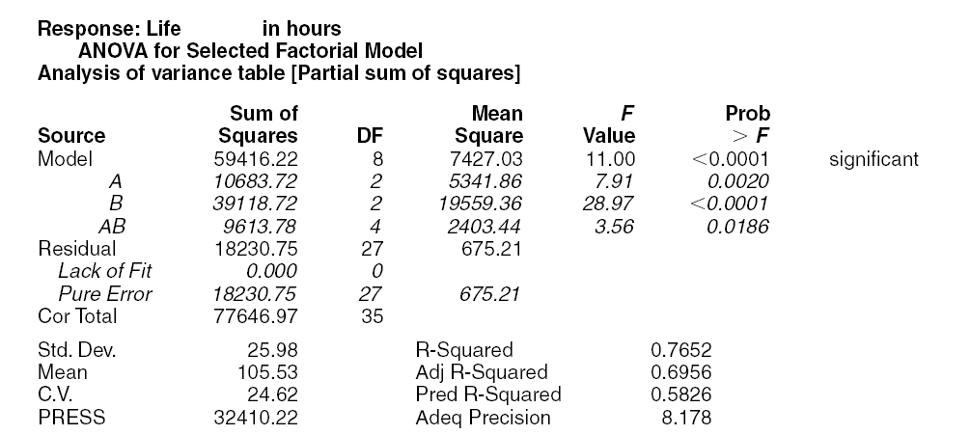
Design-Expert Output – Example 5.1

Slide 14
JMP output – Example 5.1

Slide 15
Residual Analysis – Example 5.1

Slide 16
Residual Analysis – Example 5.1

Slide 17
Interaction Plot

Slide 18
Quantitative and Qualitative Factors
The basic ANOVA procedure treats every factor as if it were qualitative
Sometimes an experiment will involve both quantitative and qualitative factors, such as in Example 5.1
This can be accounted for in the analysis to produce regression models for the quantitative factors at each level (or combination of levels) of the qualitative factors
These response curves and/or response surfaces are often a considerable aid in practical interpretation of the results

Slide 19
Quantitative and Qualitative Factors
A = Material type
B = Linear effect of Temperature
B² = Quadratic effect of Temperature
AB = Material type – Temp_{Linear}
AB² = Material type - Temp_{Quad}
B³ = Cubic effect of Temperature (Aliased)
Candidate model terms from Design- Expert: Intercept
A
B
B²
AB
B³
AB²

Slide 20
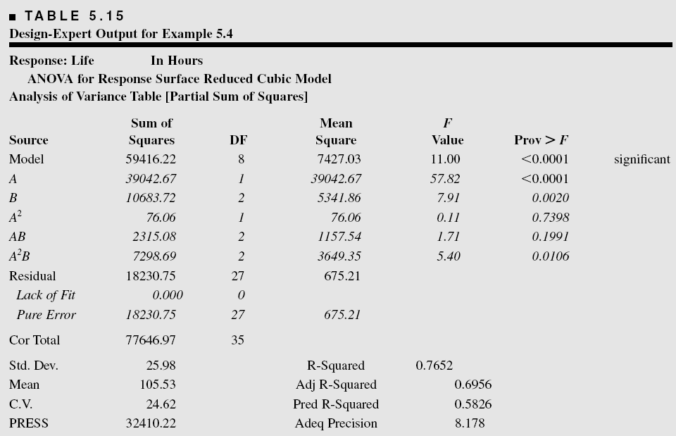
Quantitative and Qualitative Factors

Slide 21
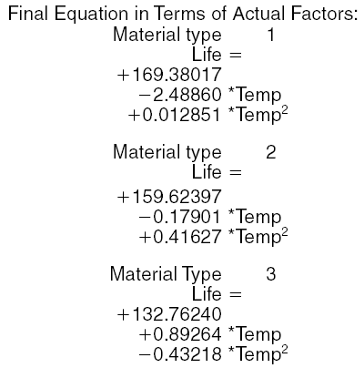
Regression Model Summary of Results

Slide 22
Regression Model Summary of Results

Slide 29
Factorials with More Than
Two Factors
Basic procedure is similar to the two-factor case; all abc…kn treatment combinations are run in random order
ANOVA identity is also similar:
Complete three-factor example in text, Example 5.5

