Slide 1
Systems Analysis and Design 11th Edition
Chapter 2_part2
Managing Systems Projects

Slide 2
Chapter Objectives
Explain project planning, scheduling, monitoring, and reporting
Draw a project triangle that shows the relationship among project cost, scope, and time
Create a work breakdown structure
Describe various scheduling tools, including Gantt charts and PERT/CPM charts

Slide 3
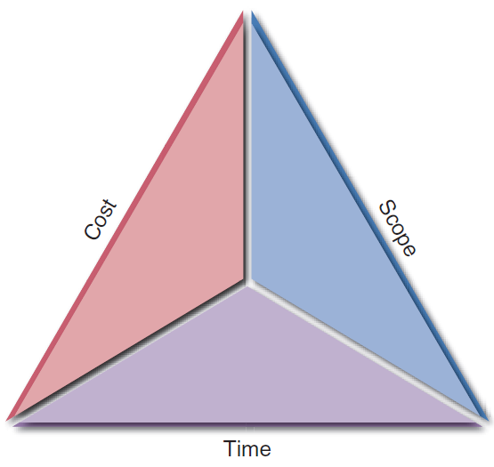
Overview of Project Management
Project Management: Planning, scheduling, monitoring and controlling, and reporting on information system development
What Shapes a Project?
Successful projects must be completed on time, within budget, meet requirements, and satisfy users
What Is a Project Triangle?
Challenge – To find optimal balance among the factors
Any change in one leg of the triangle will affect the other legs
FIGURE 3-2 A typical project triangle includes cost, scope, and time.

Slide 4
Overview of Project Management (Cont.)
What Does a Project Manager Do?
Project planning: Identifying all project tasks and estimating the completion time and cost of each
Project scheduling: Creating a specific timetable showing tasks, task dependencies, and critical tasks that might delay the project
Project monitoring: Guiding, supervising, and coordinating the project team’s workload
Project reporting: Creating regular progress reports for management, users, and the project team itself

Slide 5
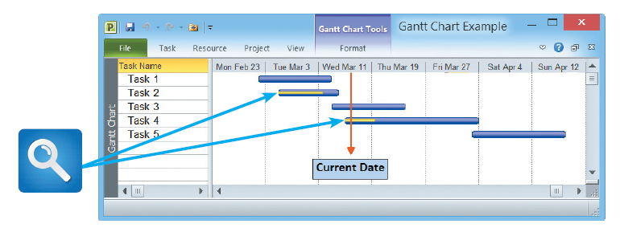
Creating a Work Breakdown Structure
Work breakdown structure (WBS): Breaking down a project into a series of smaller tasks
Gantt Chart
A horizontal bar chart representing a set of tasks
Shows planned and actual progress on a project
Simplifies complex projects using a task group
FIGURE 3-3 In this Gantt chart, notice the yellow bars that show the percentage of task completion.

Slide 6
Creating a Work Breakdown Structure (Cont. 1)
PERT/CPM Charts
Program Evaluation Review Technique (PERT)
Developed by the U.S. Navy to manage complex projects
Critical Path Method (CPM)
Developed by private industry
Utilizes a bottom-up technique
Useful for scheduling, monitoring, and controlling actual work
Displays complex task patterns and relationships

Slide 7
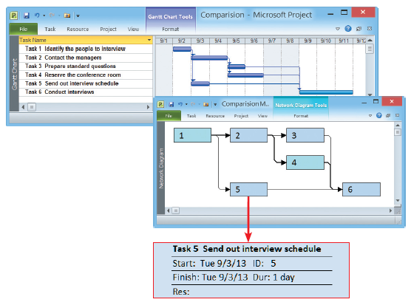
Creating a Work Breakdown Structure (Cont. 2)
FIGURE 3-4 The top screen shows a Gantt chart with six tasks. The PERT chart in the bottom screen displays an easy-to-follow task pattern for the same project. When the user mouses over the summary box for Task 5, the details become visible.

Slide 8
Creating a Work Breakdown Structure (Cont. 3)
Identifying Tasks in a WBS
Task or activity: Any work that has a beginning and an end
Requires the use of company resources such as people, time, or money
Should be small and manageable
Projects have events or milestones
Events or milestones: Recognizable reference points used to monitor progress

Slide 9
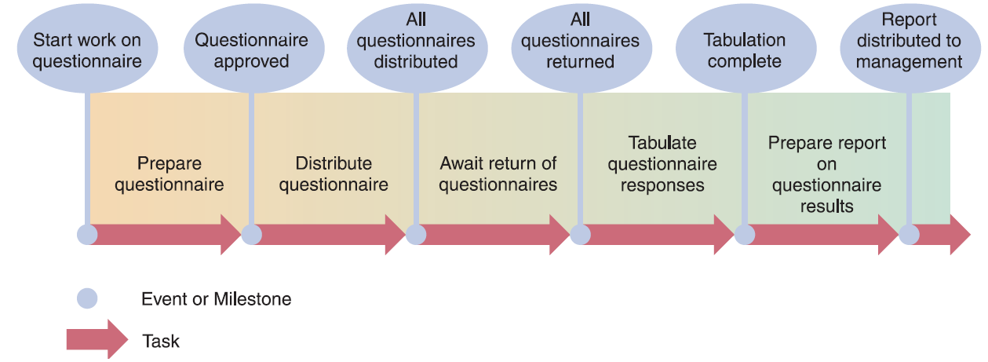
Creating a Work Breakdown Structure (Cont. 4)
FIGURE 3-5 Using a questionnaire requires a series of tasks and events to track the progress. The illustration shows the relationship between the tasks and the events, or milestones, that mark the beginning and end of each task.

Slide 10
Creating a Work Breakdown Structure (Cont. 5)
Identifying Tasks in a Work Breakdown Structure (WBS)
Listing the tasks
Estimating task duration - Can be hours, days, or weeks
Time estimates made by project managers
Best case-estimate (B), probable-case estimate (P), and worst-case estimate (W)
After making estimates, the manager assigns a weight to each estimate and calculates the task duration

Slide 11
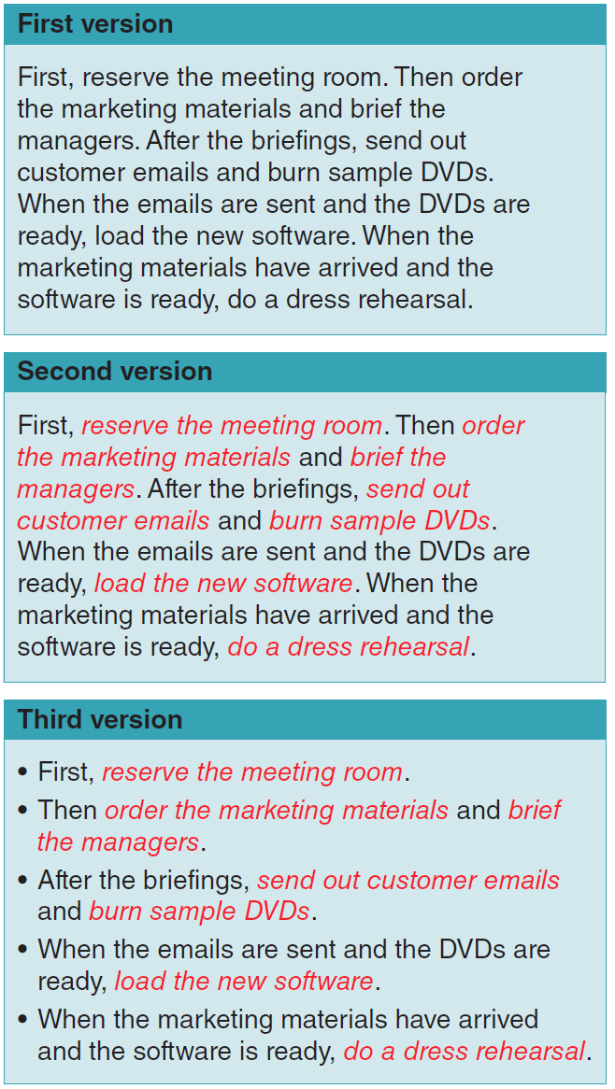
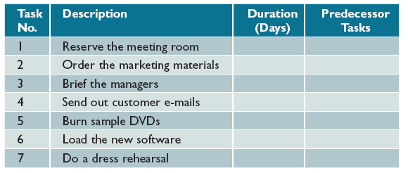
Creating a Work Breakdown Structure (Cont. 6)
FIGURE 3-7 In this table, columns have been added for task number, description, duration, and predecessor tasks, which must be completed before another task can start.
FIGURE 3-6 The three versions show how to transform a task statement into a list of specific tasks for a work breakdown structure.

Slide 12
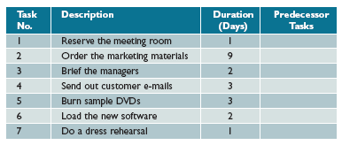
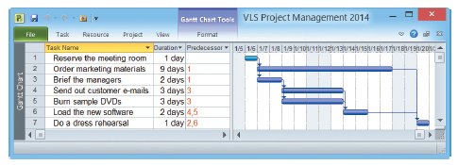
Creating a Work Breakdown Structure (Cont. 9)
FIGURE 3-8 Task durations have been added, and the WBS is complete except for predecessor task information. The predecessor tasks will determine task patterns and sequence of performance.
FIGURE 3-9 This Microsoft Project screen displays the same WBS, including task number, task name, duration, and predecessor tasks.

Slide 13
Chapter Summary
Project management is the process of planning, scheduling, monitoring, and reporting on the development of an information system
A successful project must be completed on time, within its budget, and deliver a quality product that satisfies users and meets requirements
A project triangle shows three legs that require balancing— project cost, scope, and time

Slide 14
Chapter Summary (Cont. 1)
Planning, scheduling, monitoring, and reporting all take place within a larger project development framework, which includes key steps—such as creating a work breakdown structure

Slide 15
Chapter Summary (Cont. 2)
A Gantt chart is a horizontal bar chart that represents the project schedule with time on the horizontal axis and tasks arranged vertically
A PERT/CPM chart shows the project as a network diagram with tasks connected by arrows
Most project managers use powerful software such as Microsoft Project to plan, schedule, and monitor projects

