Slide 1
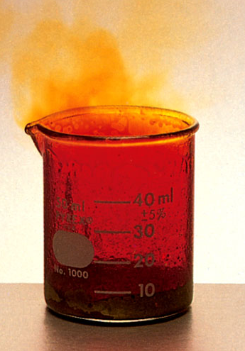
Types of Oxidation-Reduction Reactions
1. Combination Reactions
A combination reaction is a reaction in which two or more substances combine to form a single product.
A + B C
0
0
+3
-1
2Al + 3Br₂ 2AlBr₃

Slide 2
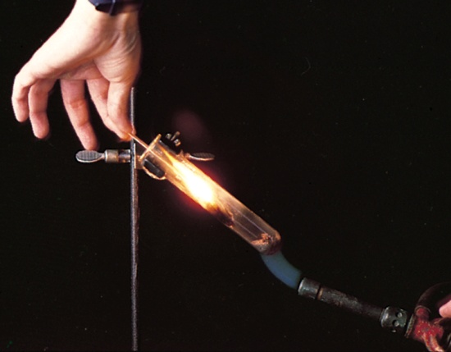
Types of Oxidation-Reduction Reactions
2. Decomposition Reactions
Decomposition reactions are the opposite of combination reactions.
A decomposition reaction is the breakdown of a compound into two or more components.
C A + B
+1
+5
-2
+1
-1
0
2KClO₃ 2KCl + 3O₂

Slide 3
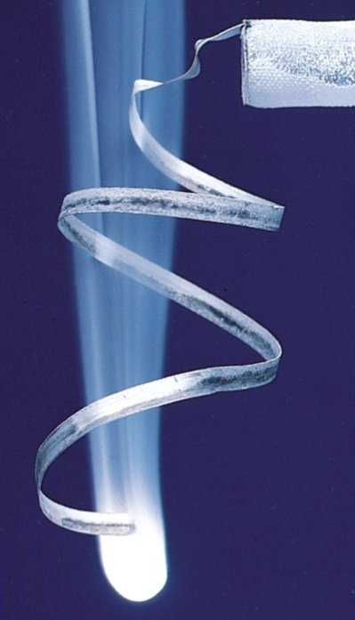
Types of Oxidation-Reduction Reactions
3. Combustion Reactions
A combustion reaction is a reaction in which a substance reacts with oxygen, usually with the release of heat and light to produce a flame
A + O₂ B
0
0
+4
-2
S + O₂ SO₂
0
0
+2
-2
2Mg + O₂ 2MgO

