Slide 1
Chapter 18
Introduction to Network
Layer
Copyright © The McGraw-Hill Companies, Inc. Permission required for reproduction or display.

Slide 2
18.4.3 Classless Addressing
With the growth of the Internet, it was clear that a larger address space was needed as a long-term solution. The larger address space, however, requires that the length of IP addresses also be increased, which means the format of the IP packets needs to be changed. Although the long-range solution has already been devised and is called IPv6, a short-term solution was also devised to use the same address space but to change the distribution of addresses to provide a fair share to each organization. The short-term solution still uses IPv4 addresses, but it is called classless addressing.

Slide 3
18.4.3 Classless Addressing
To overcome address depletion.
no classes, but the address are still granted in blocks.
The size of the block( the number of addresses) varies based on the nature and size of the entity.
Household: 2 addresses
Large organization: thousands of addresses.
ISP: thousands or hundreds of thousands based on the number of customers it may serve.

Slide 4
18.4.3 Classless Addressing
Restriction
The Internet Authorities impose three restrictions:
The address in a block must be contiguous, one after another.
The number of addresses in a block must be a power of 2 ( 1,2,4,8,…)
The first address must be evenly divisible by
the number of addresses..

Slide 5
Example :
The Figure in the next slide shows a block of
addresses, in both binary and dotted-decimal
notation, granted to a small business that needs 16 addresses.

Slide 6
We can see that the restrictions are applied to this block.:
• The addresses are contiguous.
• The number of addresses is a power of 2 (16 = 2⁴)
• the first address is divisible by 16. The first address,
when converted to a decimal number( use base 256), is 3,440,387,360, which when divided by 16 results in 215,024,210.

Slide 7
Classless Addressing Mask
Mask: /n
32- bit
can take any value from 0 to 32, for ex /24
The n leftmost bits are 1s
32-n rightmost bits are 0s
In IPv4 addressing, a block of addresses can be defined as
x.y.z.t /n
in which x.y.z.t defines one of the addresses
and the /n defines the mask.
Example: 172.31.16.42/26

Slide 8
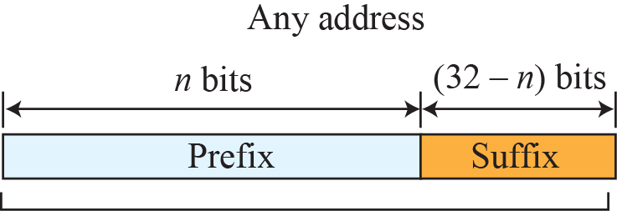
Figure 18.21: Information extraction in classless addressing
Set all suffix bits
to 0s
Set all suffix bits
to 1s

Slide 9
Example 18.1
A classless address is given as 167.199.170.82/27. We can find the above three pieces of information as follows. The number of addresses in the network is 2^{32− n} = 2⁵ = 32 addresses. The first address can be found by keeping the first 27 bits and changing the rest of the bits to 0s.
The last address can be found by keeping the first 27 bits and changing the rest of the bits to 1s.
18.9

Slide 10
Classless Addressing
Each address in the block can be considered as a two-level hierarchical structure:
the leftmost n bits (prefix) define
the network;
the rightmost 32 − n bits define
the host (suffix).

Slide 11
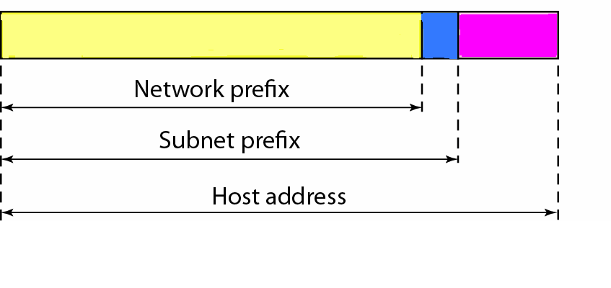
The organization has its own mask : network mask
Each subnet must also have its own mask: subnet mask

Slide 12
Example
An organization is granted a block of addresses
17.12.40.0/26, which contains 64: (2(32-26)=24 =64) addresses.
The organization has three offices and needs to divide the
addresses into three subblocks (subnets) of 32, 16 and 16
Addresses. Design the subblocks and find the new masks.
Solution
Subnet1:
Mask n1: 2 ^{32-n1} = 32; n1=27
Subnet2
Mask n2: 2 ^{32-n2} =16; n2=28
Subnet3
Mask n3: 2 ^{32-n2}= 16; n3= 28

Slide 13
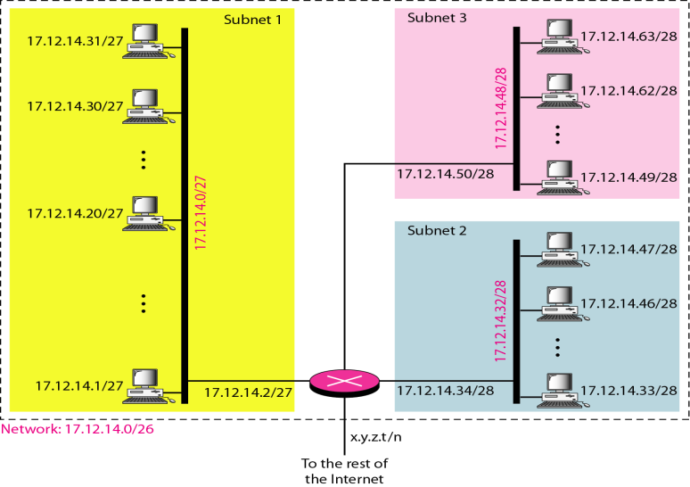
Configuration and addresses in a subnetted network

Slide 14
a. In subnet 1, the address 17.12.14.29/27 can give us the subnet address if we use mask/27:
Host : 17. 12 .14 .00011101
Mask: /27
Subnet: 17.12.14.00000000 17.12.14.0
b. In subnet 2, the address 17.12.14.45/28 can give us the subnet address if we use mask/28:
Host : 17. 12. 14. 00101101
Mask: /28
Subnet: 17.12.14. 00100000 17.12.14.32

Slide 15
c. In subnet 3, the address 17.12.14.50/28 can give us the subnet address if we use mask/28:
Host : 17. 12. 14. 00110010
Mask: /28
Subnet: 17. 12. 14. 00110000 17.12.14.48

