Slide 1
CE 445 Wastewater Reclamation and Reuse
Dr. Mohab Kamal

Slide 2
ENGINEERED NATURAL PROCESSES
Natural processes in water reclamation are usually employed in combination with aboveground engineered processes and consist of managed aquifer recharge systems and natural or constructed wetlands.
Natural systems can be considered as multiobjective treatment processes targeting the removal of pathogens, particulate and suspended matter, DOC, trace organic chemicals, and nutrients, either as the key treatment process or as an add-on polishing step.
All natural treatment processes combine the advantage of a low carbon footprint (i.e., little to no chemical input, low energy needs) with little to no residual generation.
The drawbacks of these processes are the required footprint and a suitable geology, which might not be available where the use of natural treatment systems is desired.

Slide 3
Subsurface Managed Natural Systems
Subsurface managed natural systems can be used to enhance water quality and/or to provide natural storage for reclaimed water.
These systems include surface spreading basins, vadose zone wells, and riverbank filtration wells, which take advantage of attenuation processes that occur in the vadose zone and saturated aquifer.
Other processes, such as aquifer storage and recovery (ASR) and direct injection wells, introduce highly treated reclaimed water directly into a potable aquifer.
In general, subsurface treatment applications offer numerous advantages.
These systems typically require a low degree of maintenance, and the energy requirements are low.
These systems typically require a low degree of maintenance, and the energy requirements are low.
The input of chemicals usually is not required, and the operation is residual free.

Slide 4
Subsurface Managed Natural Systems
Temperature equilibration of water is achieved during subsurface storage and excursions in water quality are buffered due to dispersion in the subsurface and dilution with native groundwater.
However, subsurface applications require that a substantial aquifer be available and that it be characterized by an extensive site assessment. Although the advantages seem to outweigh the disadvantages from an operational standpoint, the lack of clear and standardized guidance for design and operation of these system limits wider establishment of managed subsurface treatment systems.
Lack of process understanding can result in less-than-optimal performance or physical footprints or retention times that are larger than needed for the desired water quality improvements.
Some installations might also exhibit deterioration of water quality in the recovered water due to biogeochemical reactions in the subsurface that were not anticipated.

Slide 5
Surface Spreading or Soil Aquifer Treatment
Surface spreading basins allow reclaimed water to infiltrate slowly through the vadose zone, where sorption, filtration, and biodegradation can enhance the water quality (also called soil aquifer treatment).
Recharge basins for surface spreading operations are often located in, or adjacent to, floodplains, characterized by soils with high permeability. In some instances, excavation is necessary to remove surface soils of low permeability.
For mosquito control and to maintain permeability during operation with reclaimed water, recharge basins are usually operated in alternate wet and dry cycles.
As the recharge basin dries out, dissolved oxygen penetrates into the subsurface, facilitating biochemical transformation processes, and organic material accumulated on the soil surface will desiccate, allowing for the recovery of infiltration rates (Fox et al., 2001).

Slide 6
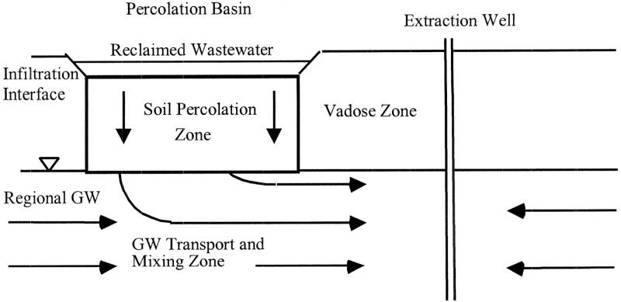
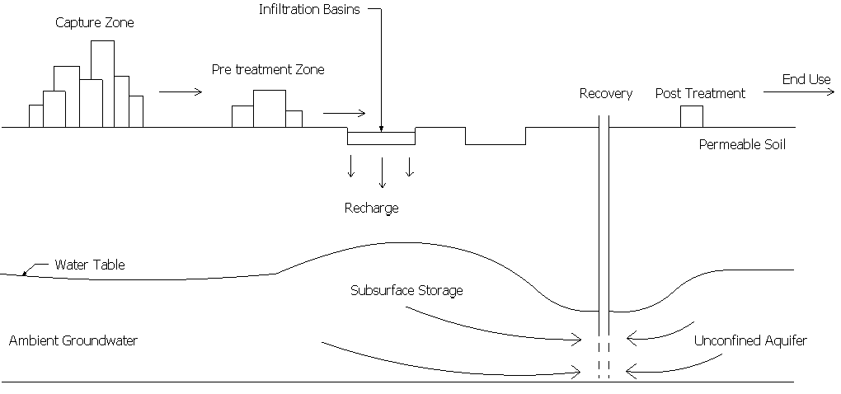
Surface Spreading or Soil Aquifer Treatment

Slide 7
Riverbank Filtration
Riverbank filtration has been practiced in the United States for more than 50 years for domestic drinking water supplies utilizing streams that might have been compromised in their quality due to the discharge of wastewater effluents or other waste streams (Ray et al., 2008).
Recently, water reuse projects have integrated riverbank filtration into their treatment process train to take advantage of the benefits of this natural treatment system.
Aquifers used for riverbank filtration usually consist of alluvial sand and gravel deposits, with thickness ranging from 15-200 feet (5–60 m) and a hydraulic conductivity higher than 10⁻⁴m/s.
In riverbank filtration, constant scour forces due to streamflow prevent the accumulation of particulate and colloidal organic matter in the infiltration layer.

Slide 8
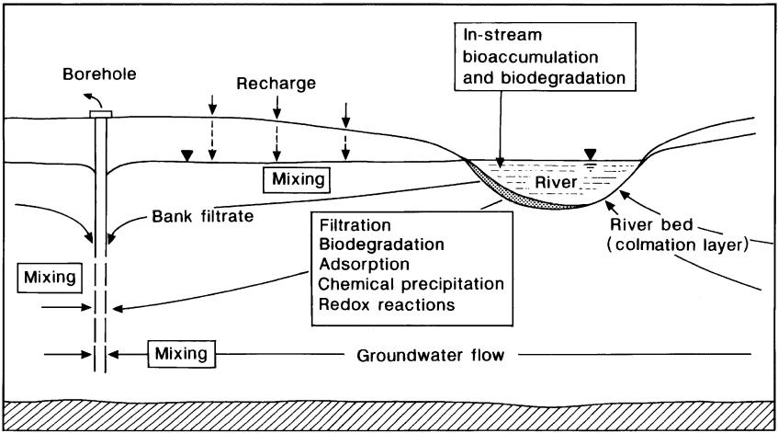
Riverbank Filtration

Slide 9
Direct Injection
Direct injection of reclaimed water may occur in both saturated and unsaturated aquifers using wells that are constructed like regular pumping wells. In the United States, OCWD pioneered direct injection of highly treated reclaimed water in 1976 for seawater intrusion barriers in Southern California.
Direct injection wells may also be used as ASR wells where the same well serves for both injection and recovery (see also NRC, 2008c).
For direct injection projects leading to drinking water augmentation, the reclaimed water is required to meet drinking water standards in addition to project-specific water quality criteria before it is injected into a potable aquifer.
In these systems, the additional treatment provided in the subsurface is usually limited to temperature equilibration and blending with ambient groundwater. Storing reclaimed water after direct injection in the subsurface may also provide additional inactivation of any remaining viruses.
The degree of water quality transformations can vary with the flow path and contact time in the subsurface.
Depending on the geological conditions of the subsurface, water quality degradation is possible; for example, redox change can result in dissolution of certain constituents from the soil matrix, including iron, manganese, or arsenic.
Infiltration rates of direct injection wells are much higher than infiltration rates in spreading basins, although direct injection wells can become clogged at the interface of the gravel envelope of a well and the aquifer.

Slide 10
Surface Managed Natural Systems
In addition to providing aesthetic benefits and providing habitat and recreational opportunities, managed natural surface water systems can provide benefits with respect to water quality.
One of the main differences between surface and subsurface managed natural systems is that managers of surface water systems must frequently satisfy competing demands and multiple objectives.
For example, in addition to providing water quality benefits, engineered treatment wetlands frequently serve as habitat for birds and provide recreational and educational benefits for the community. In addition, they have the potential to serve as breeding grounds for mosquitoes and other vectors.

Slide 11
Surface Managed Natural Systems
Another important difference between surface and subsurface systems is the way in which the water flows.
With the exception of fractured bedrock, the soil and groundwater systems used in managed subsurface treatment processes lead to predictable flow patterns and residence times in the subsurface.
In addition, the high surface area provided by soil and geological materials provides ample surface area for microbial growth, facilitating biological attenuation processes.
In contrast, managed surface systems often exhibit preferential flow and lower biological activity.
As a result, a poorly managed natural system has a higher potential for providing less-effective treatment than expected, with hydraulic short-circuiting and low biological activity leading to little contaminant attenuation.

Slide 12
Treatment Wetlands
Treatment wetlands have been used to treat reclaimed water for nonpotable and potable reuse.
Treatment wetlands are built as either subsurface-flow or surface-flow systems.
Subsurface-flow wetlands consist of plants growing within a gravel bed through which reclaimed water flows whereas surface-flow systems consist of wetland plants growing in anywhere from 0.5 to 2 feet (0.15 to 0.6 m) of flowing surface water with occasional deeper areas to enhance mixing and provide habitat (Kadlec and Knight, 1996).
Subsurface wetlands are more common in colder climates and in locations where there are concerns about contact with contaminants in the reclaimed water (e.g., when wetlands are used for treatment of primary effluent).
With respect to water reclamation, subsurface-flow wetlands may be better suited for decentralized treatment of primary or secondary effluent (e.g., septic tank effluent) than wastewater from full-scale treatment plants.

Slide 13
Treatment Wetlands
Surface-flow wetlands are less expensive to build and maintain and provide better habitat and aesthetic benefits and are therefore more common in warmer climates.
Ammonia is usually removed from reclaimed water through nitrification prior to discharge to surface-flow wetlands because ammonia toxicity affects the growth of plants and can be detrimental to resident fish that control mosquitoes.
Surface-flow wetlands frequently provide good removal of contaminants present in wastewater effluent. In particular, ample data indicate that surface-flow wetlands remove nitrate through denitrification in anoxic zones, and phosphorus through settling of particulate phosphate and uptake by growing plants (Kadlec and Knight, 1996).

Slide 14
Treatment Wetlands
Wetlands also are effective in the removal of particles that settle out at the low flow velocities encountered in the wetland.
As a result, wetlands provide removal of particle-associated pathogens and metals.
Aerobic microorganisms living near the air– water interface and nitrate-reducing microbes below the surface also can transform organic contaminants as they metabolize decaying plants and organic matter present in the reclaimed water.
Concentrations of certain trace organic chemicals, such as trihalomethane disinfection byproducts, also can decrease in treatment wetlands through volatilization (Rostad et al., 2000).
Laboratory microcosm studies demonstrate the ability of microorganisms and organic compounds in wetlands to transform numerous trace organic chemicals (Gross et al., 2004; Matamoros et al., 2005; Matamoros and Bayona, 2006; Waltman et al., 2006).

Slide 15
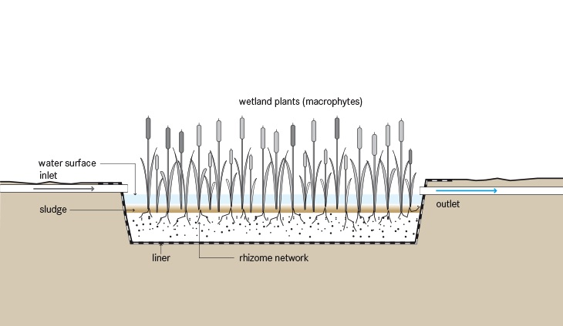
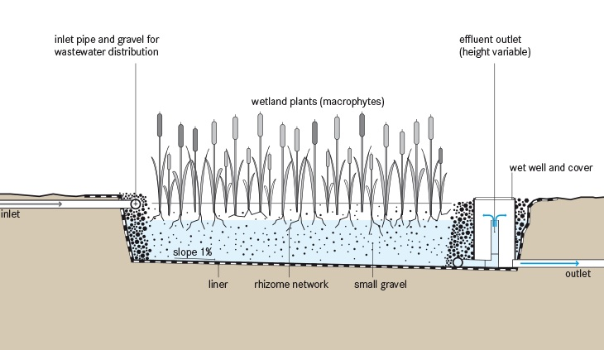
Treatment Wetlands

Slide 16
Design of Constructed Wetlands
See Design of Wetland Attatchment

