Slide 1
CE 445 Wastewater Reclamation and Reuse
Dr. Mohab Kamal

Slide 2
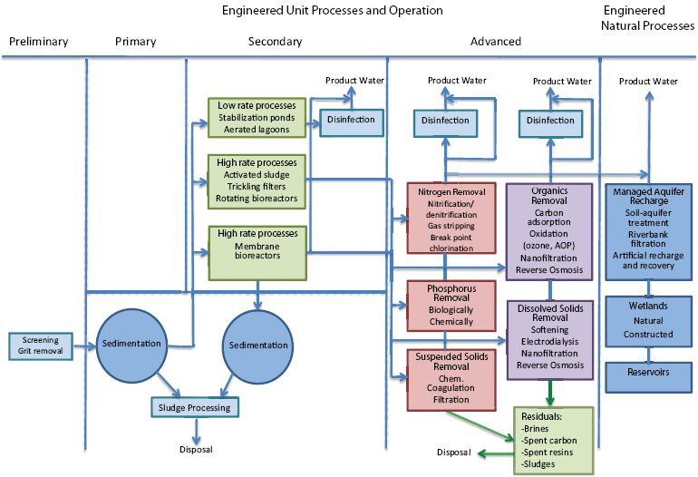
Water Reclamation Technologies
Treatment processes in wastewater reclamation are employed either singly or in combination to achieve reclaimed water quality goals.
Considering the key unit processes and operations commonly used in water reclamation, an almost endless number of treatment process flow diagrams can be developed to meet the water quality requirements of a certain reuse application.

Slide 3
Water Reclamation Technologies
Many factors may affect the choice of water reclamation technology.
Key factors include the type of water reuse application, reclaimed water quality objectives, the wastewater characteristics of the source water, compatibility with existing conditions, process flexibility, operating and maintenance requirements, energy and chemical requirements, personnel and staffing requirements, residual disposal options, and environmental constraints (Asano et al., 2007).
Decisions on treatment design are also influenced by water rights, economics, institutional issues, and public confidence.

Slide 4
Water Reclamation Technologies
The relative importance of some of these factors is likely going to change in the future.
With the current desire to limit greenhouse gas emissions and introduction of carbon taxes, energy-intense processes likely will be viewed much less favorable than today.
This chapter focuses on treatment processes—characterized as preliminary, primary, secondary, and advanced and including both NATURAL and ENGINEERED processes—that can be used to meet water quality objectives of a reuse project and their treatment effectiveness.

Slide 5
PRELIMINARY, PRIMARY, AND SECONDARY TREATMENT
Wastewater treatment typically includes preliminary treatment steps in addition to primary and secondary treatment.
Preliminary steps include measuring the flow coming into the plant, screening out large solid materials, and grit removal to protect equipment against unnecessary wear.
Primary treatment targets settle-able matter and scum that floats to the surface.
Secondary treatment processes are employed to remove total suspended solids, dissolved organic matter (measured as biochemical oxygen demand), and, with increasing frequency, nutrients.
Secondary treatment processes usually consist of aerated activated sludge basins with return activated sludge or fixed-media filters with recycle flow (e.g., trickling filters; rotating bio-contactors), followed by final solids separation via settling or membrane filtration and disinfection.

Slide 6
DISINFECTION
Disinfection processes are those that are deliberately designed for the reduction of pathogens.
Pathogens generally targeted for reduction are bacteria (e.g., Salmonella, Shigella), viruses (e.g., norovirus, adenovirus), and protozoa (e.g., Giardia, Cryptosporidium).
Common agents used for disinfection in wastewater reclamation are chlorine (applied as gaseous chlorine or liquid hypochlorite) and ultraviolet (UV) irradiation.
Only chlorine is purchased as a chemical in commerce.

Slide 7
DISINFECTION
Chlorine dioxide, ozone, and UV are generated on-site.
In drinking water applications, chlorine and hypochlorite remain the most common disinfectants, although they are decreasing in prevalence.
Chloramines are formed from either chlorine or hypochlorite if appropriate amounts of ammonia are present (as in wastewater) or if ammonia is deliberately added.
Although chlorine or hypochlorites are still the most prevalent disinfection processes used in wastewater applications, UV is much more common and chlorine dioxide and ozone are less common than in drinking water applications.

Slide 8
ADVANCED ENGINEERED TREATMENT
Advanced engineered unit processes and operations can be grouped into engineering systems targeting the removal of nutrients and organic constituents, reduction of total dissolved solids (TDS) or salinity, and provision of additional treatment barriers to pathogens.
Nutrients can be reduced by biological nitrification / denitrification processes, gas stripping, breakpoint chlorination, and chemical precipitation.
Organic constituents can be further removed by various advanced processes, including activated carbon, chemical oxidation (ozone, advanced oxidation processes [AOPs]), nano-filtration (NF), and reverse osmosis (RO).
Dissolved solids are retained during softening, electro dialysis, NF, and RO.
Various processes can be combined to produce the desired effluent water quality depending on the reuse requirements, source water quality, waste disposal considerations, treatment cost, and energy needs.

Slide 9
ADVANCED ENGINEERED TREATMENT Nutrient Removal
Nutrient removal is often required in reuse applications where streamflow augmentation or groundwater recharge is practiced to prevent eutrophication or nitrate contamination of shallow groundwater.
Nutrient removal can be either an integral part of the secondary biological treatment system or an add-on process to an existing conventional treatment scheme.
All of the biological processes for nitrogen removal include an aerobic zone in which biological nitrification occurs.
An anoxic zone and proper retention time is then provided to allow biological denitrification (conversion to nitrogen gas) to reduce the concentrations of nitrate to less than 8 mg N/L.
Gas stripping for removal of ammonia or breakpoint chlorination as the primary means for nitrogen removal is not commonly employed in wastewater reclamation applications.

Slide 10
ADVANCED ENGINEERED TREATMENT Nutrient Removal
To accomplish biological phosphorus removal via phosphorus-storing bacteria, a sequence of an anaerobic zone followed by an aerobic zone is required.
Phosphorus removal can also be achieved by chemical precipitation by adding metal salts (e.g., Ca(II), Al(III), Fe(III)) with a subsequent filtration following the activated sludge system. Although chemical precipitation for phosphorus removal is practiced in many water reclamation facilities, biological phosphorus removal requires no chemical input.
Biological phosphorus removal, however, requires a dedicated anaerobic zone and modifications to the activated sludge process, which usually is more costly during a plant retrofit than an upgrade to chemical precipitation.
A biological phosphorus removal process is also more challenging to control and maintain because it depends upon a more consistent feedwater quality and steady operational conditions. Biological and chemical phosphorus removal can result in effluent concentrations of less than 0.5 mg P/L.

Slide 11
ADVANCED ENGINEERED TREATMENT Suspended Solids Removal
Filtration is a key unit operation in water reclamation, providing a separation of suspended and colloidal particles, including microorganisms, from water.
The three main purposes of filtration are to (1) allow a more effective disinfection; (2) provide pretreatment for subsequent advanced treatment steps, such as carbon adsorption, membrane filtration, or chemical oxidation; and (3) remove chemically precipitated phosphorus.
Filtration operations most commonly used in water reclamation are depth, surface, and membrane filtration.

Slide 12
ADVANCED ENGINEERED TREATMENT Suspended Solids Removal
Depth filtration is the most common method used for the filtration of wastewater effluents in water reclamation.
In addition to providing supplemental removal of suspended solids including any sorbed contaminants, depth filtration is especially important as a conditioning step for effective disinfection.
At larger reuse facilities (>1,000 m³/d or >4 MGD), mono- and dual-media filters are most commonly used for wastewater filtration with gravity or pressure as the driving force.
Both mono- and dual-media filters using sand and anthracite have typical filtration rates between 2,900 and 8,600 gal/ft² per day (4,900–14,600 L/m² per hour) while achieving effluent turbidities between 0.3 and 4 nephelometric turbidity units (NTU).
Because large plants with many filters usually do not practice wasting of the initial filtrate after backwash (filter-to-waste), effluent qualities with elevated initial turbidity are commonly observed, and as a consequence, the overall effluent quality can be less consistent in granular media filtration plants compared with reclaimed water provided by a membrane filtration plant.

Slide 13
Removal of Organic Matter and Trace Organic Chemicals
The following sections describe processes that are designed to remove organic matter and trace organic chemicals from reclaimed water.
These processes include membrane filtration (MF, UF, NF, and RO), adsorption onto activated carbon, biological filtration, and chemical oxidation (chlorine, chloramines, ozone, and UV irradiation).

Slide 14
Removal of Organic Matter and Trace Organic Chemicals Microfiltration and Ultrafiltration
MF and UF membrane processes can be configured using pressurized or submerged membrane modules.
In the pressurized configuration, a pump is used to pressurize the feedwater and circulate it through the membrane.
Pressurized MF and UF units can be operated in two hydraulic flow regimes, either in cross-flow or dead-in filtration mode. In a submerged system, membrane elements are immersed in the feedwater tank and permeate is withdrawn through the membrane by applying a vacuum.
The key operational parameter that determines the efficiency of MF and UF membranes and operating costs is flux, which is the rate of water flow volume per membrane area.
Factors affecting the flux rate include the applied pressure, fouling potential, and reclaimed water characteristics (Zhang et al., 2006).
Flux can be maintained by appropriate cross-flow velocities, backflushing, air scouring, and chemical cleaning of membranes. Typically, MF and UF processes operate at flux rates ranging from 28 to 110 gal/ft² per day (48 to 190 L/m² per hour) (Asano et al., 2007).

Slide 15
Removal of Organic Matter and Trace Organic Chemicals Microfiltration and Ultrafiltration
MF and UF membranes are effective in removing microorganisms.
It is generally believed that MF can remove 90 to 99.999 percent (1 to 5 logs) of bacteria and protozoa, and 0 to 99 percent (0 to 2 logs) of viruses (EPA, 2001; Crittenden et al., 2005).
However, filtration efficiencies vary with the type of membrane and the physical and chemical characteristics of the wastewater, resulting in a wide range of removal efficiencies for pathogens (NRC, 1998).
MF and certain UF membranes should not be relied upon for complete removal of viruses for several reasons (Asano et al., 2007).
First, whereas the terms micro-and ultrafiltration nominally refer to pore sizes that have cutoff characteristics, the actual pore sizes in today’s commercial membranes often vary over a wide range.
Second, experience has shown that today’s membrane systems sometimes experience problems with integrity during use for a variety of reasons. Although membrane integrity tests have been developed and these tests are widely used, they are not suitable for detecting imperfections small enough to allow viruses to pass.

Slide 16
Removal of Organic Matter and Trace Organic Chemicals Nanofiltration or Reverse Osmosis
For reuse projects that require removal of dissolved solids and trace organic chemicals and where a consistent water quality is desired, the use of integrated membrane systems incorporating MF or UF followed by NF or RO may be required.
RO and NF are pressure-driven membrane processes that separate dissolved constituents from a feedstream into a concentrate and permeate stream (Figure 4-4).
Treating reclaimed water with RO and NF membranes usually results in product water recoveries of 70 to 85 percent.
Thus, the use of NF or RO results in a net loss of water resources through disposal of the brine concentrate.
RO applications in water reuse have been favored in coastal settings where the RO concentrate can be conveniently discharged to the ocean, but inland applications using RO are restricted because of limited options for brine disposal.
Thus, existing inland water reuse installations employing RO membranes are limited in capacity and commonly discharge brine to the sewer or a receiving stream provided that there is enough dilution capacity.

Slide 17
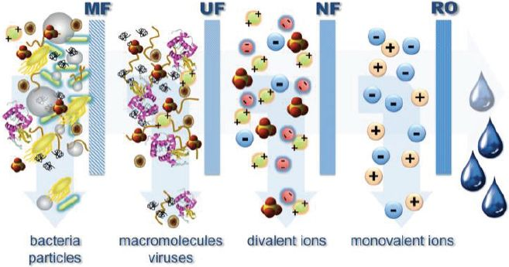
Substances and contaminants nominally removed by pressure-driven membrane processes.

Slide 18
Multistage wastewater Reclamation Processes

Slide 21
To be continued …………

