Slide 1
CE 445
Wastewater Reclamation and Reuse
Dr. Mohab Kamal

Slide 2
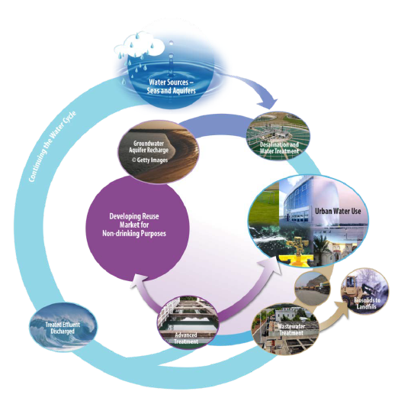
Introduction (Section 13 – 1)
Water reclamation and reuse has become an important worldwide total water management topic over the last 30 years as the limitations of freshwater resources have come into sharp focus.
In the Kingdom of Saudi Arabia (KSA), potable water is produced from either non-renewable or very slowly renewable water resources such as groundwater or capital- and energy-intensive seawater desalinations.
Much of the potable water produced from these costly and nonrenewable sources is used for non-potable purposes, and these existing sources and treatment methods will not sustainably meet the future potable and non-potable water demands in most regions of KSA.

Slide 3
Introduction
Reserving the use of expensive potable water for truly potable needs will extend the life of these valuable resources.
Fortunately, non-potable demands can be met by using a sustainable resource that is available in KSA – RECLAIMED WATER.
Considering strategies that include water reuse as an essential component of integrated water resources management to ensure that present water needs and future demands are met cost-effectively and in a sustainable manner is a rapidly growing trend especially in water-scarce regions.
Depict the urban water cycle that is currently in place in many of the largest cities in KSA; water is reclaimed by advanced treatment and then used in urban settings primarily for landscaping and irrigation.
The use of reclaimed water in industrial settings is increasing, and additional markets are developing.

Slide 4
Why Water Reuse?
Reclaimed water is produced by treating wastewater so that it can be safely reused for non-potable needs such as industrial processes and cooling, agricultural irrigation, landscaping, groundwater recharge, and ecosystem creation or restoration.
The primary drivers for reuse are:
  Increasing populations create water demands that cannot sustainably be met using only the existing water sources and treatment technologies.
  Meeting new demands will require very significant capital and operation and maintenance (O&M) investment in new desalination plants and groundwater wells.
  The use of alternative water resources such as reclaimed water can reduce the infrastructure needed for new potable water supplies.
  The need to prevent seawater intrusion and replenish groundwater sources.
  Increasingly stringent wastewater quality discharge requirements will necessitate significant capital and O&M investments to meet new discharge standards.
  By discharging highly treated wastewater to the sea or other surface waters, the return on the investments made in purifying the water for drinking and then treating it to stringent levels to discharge is lost because the water is not reused.
  Reduces energy used for treatment and conveyance.
  Using the reclaimed water, rather than discharging it to surface waters, minimizes the discharge of pollutants to surface waters.

Slide 5
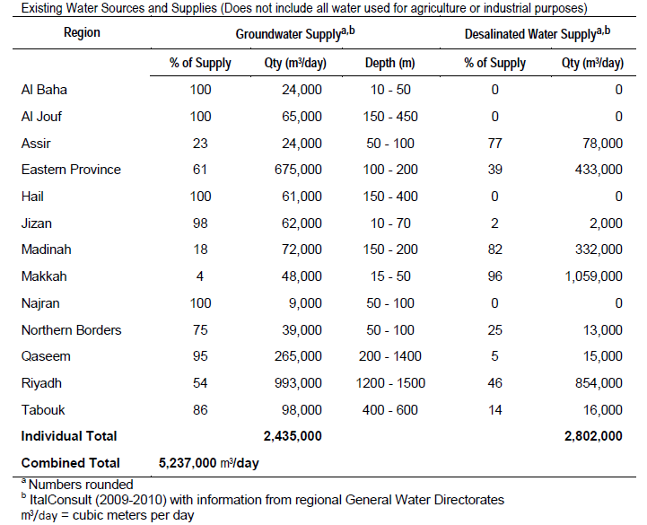
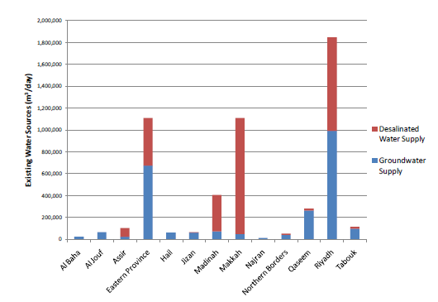
Water Supplies in KSA
Water supplies in KSA consist primarily of groundwater and desalinated water and vary by region

Slide 6
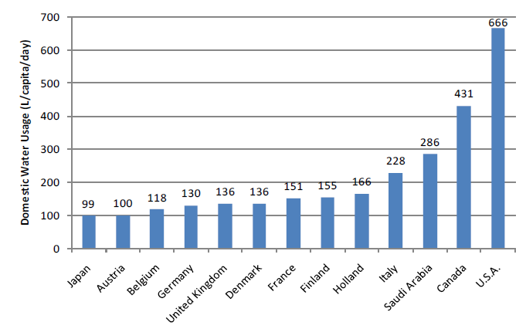
Domestic Water Demands in KSA
The domestic water demand per capita per day has been established by MOWE, based upon city size as follows:
  250 liters (L)/capita/day for cities with populations > 85,000 (large cities)
  200 L/capita/day for cities with populations < 85,000 (medium and small cities)

Slide 7
Domestic Water Demands in KSA
Riyadh
Desalinated water is supplied to the city of Riyadh from the Al Jubail Desalination Plant located on the Arabian Gulf in the Eastern Province. Approximately, 52 percent of the city’s water supply.
Groundwater comprises 48 percent of the city of Riyadh water supply and is supplied from nine wellfields.
However, the groundwater table in Riyadh has declined significantly due to an increase in withdrawals, causing the piezometric level to fall from 45 m in 1956 to 170 m below ground in 1980, and to more than 250 m in 2008.

Slide 8
Domestic Water Demands in KSA
Jeddah
The city of Jeddah’s water supply is almost all desalinated water produced by two plants on the Red Sea: the Jeddah Plant, which provides about 400,000 m3/day, and the Shoaibah Plant, which provides approximately 230,000 m3/day.
The combined total was 630,000 m3/day in 2009.
A small additional amount of water (3,000 m3/day) was provided by groundwater.
There are plans to increase the capacity of both the Jeddah Plant and the Shoaibah Plant to meet future water demands. The water supply and distribution systems are the responsibility of the NWC.

Slide 9
Domestic Water Demands in KSA
Makkah and Taif
The city of Makkah’s water supply consists entirely of desalinated water produced by the Shoaibah Plant located near Jeddah; approximately 280,000 m3/day was provided to Makkah in 2009.
In Makkah, the water supply and distribution systems are the responsibility of the NWC.
The desalinated water supply for the city of Al Taif is transferred from the city of Makkah. It is supplied by the Shoaibah Plant located near Jeddah and comprises 83 percent of the water supply of Al Taif.
The remaining 17 percent of the city’s supply is groundwater from wellfields located several hundred km from the city. The water supply and distribution systems are the responsibility of the NWC.

Slide 10
Wastewater Flows
WWTPs are located in nearly every region and primarily serve the large and medium cities.
Many more plants throughout the Kingdom are under construction or planned.
It should be noted that currently many cities have only a small percentage of their service area provided with sewage collection.
The larger cities tend to have a higher percentage of sewage system coverage.
According to MOWE plans, the percent coverage for sewage collection systems will be nearly 100 percent in cities greater than 5,000 people by the Year 2025

Slide 11
Wastewater Flows

Slide 12
Definition of terms in Water Reuse Applications
Beneficial Uses: The many ways water can be used, either directly by people or for their overall benefit. Examples include municipal water supply, agricultural and industrial applications, navigation, fish and wildlife, and water contact recreation.
Direct Potable Reuse: A form of reuse by the incorporation of reclaimed water directly into a potable water supply system, often implying the blending of reclaimed water with potable water.
Direct Reuse: The use of reclaimed water which has been transported from the wastewater reclamation plant to the water reuse site without intervening discharge to a natural body of water, including such uses as agricultural and landscape irrigation.
Dual Distribution System: Two sets of pipelines for water delivery, one for potable water and another for reclaimed water.
Indirect Potable Reuse: Potable reuse by incorporation of reclaimed water into a raw water supply, allowing mixing and assimilation by discharge into an impoundment or natural body of water.

Slide 13
Definition of terms in Water Reuse Applications
Indirect Reuse: Use of reclaimed indirectly by passing through a natural body of water or use of groundwater that has been recharged with reclaimed water.
Non-Potable Water Reuse: All reuse applications that do not involve either indirect or direct potable use.
Planned Reuse: Deliberate direct or indirect use of reclaimed water, without give up control over the water during its delivery.
Potable Water Reuse: An augmentation of drinking water supplies directly or indirectly by reclaimed water that is highly treated to protect public health.
Water reuse: The planned use of recycled water for a specific beneficial purpose.

Slide 14
Definition of terms in Water Reuse Applications
Recycled Water or Reclaimed Water: (terms are interchangeable) Water that originated as municipal wastewater and has undergone a high level of treatment at a reclamation facility so that it can be beneficially reused for a variety of purposes. The degree of treatment for recycled water depends on the water quality needed for the specific use and for public health protection.
Water Reuse: The use of treated wastewater for a beneficial use, such as agricultural irrigation and industrial cooling.
Unplanned Reuse: Wastewater entering the natural water system (creeks, rivers, lakes, aquifers), which is eventually extracted from the natural system for drinking water; with generally no awareness that the natural system contains treated wastewater.

Slide 15
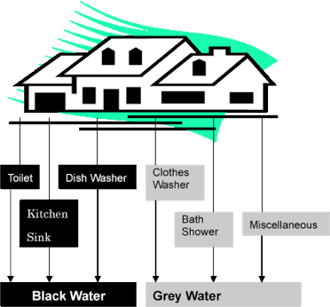
Types Of Wastewater That Leave Your House

Slide 16
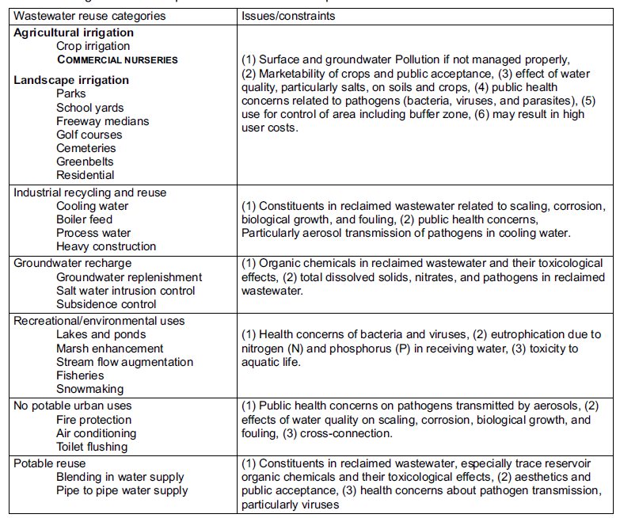
Categories Of Municipal Wastewater Reuse And Potential Issues/Constraints (Table 13-4)

Slide 17
Current and Projected Water Reuse in KSA

Slide 18
Proposed Water Reuse Amounts by Region by Type in Year 2025 Shown as Percent of Total

Slide 19
Suggested Water Recycling Treatment and Uses
Effluent from secondary treatment
Agricultural and Landscape Irrigation
Disinfection
Urban Application (Toilet flushing, car washing)
Treatment
Flocculation (Alum, lime, etc.)
Dissolved air floatation clarifier
Sand filtration
Activated carbon treatment
Membrane filtration
Disinfection
Environmental Water Enhancement
Reviving Stream
Creation of Amenities
Industrial Reuse (Cooling System, etc.)
Reverse Osmosis
Groundwater Recharge
Disinfection
Groundwater Recharge

Slide 20
Reuse Applications by Primary and Sub-Category

Slide 21
Reuse Options
Football oval irrigation.
Re-vegetation of community and the area around the house.
Fruit and nut trees, community gardens.
Community uses:
  Aquaculture
  Flushing toilets.
Firefighting, dust suppression.

Slide 22
Wastewater Reuse
Wastewater – used water.
Each type of use – need special quality.
  Laboratory purposes.
  Drinking
  Boiler
  Domestic
  Institutional
  Commercial
  Industrial

Slide 23
Industrial Uses
Boiler
Cooling water
Cleaning and washing
Roadwork
Firefighting
Irrigation
Building construction

Slide 24
Commercial Uses
Irrigation: Parks and sports grounds
Plantation: trees
Agriculture
Aquaculture
Groundwater recharge
Recreation

Slide 25
Wastewater and Reuse in the City of Riyadh
Currently, there are five major wastewater systems that collect and treat municipal wastewater in the city and one system that collects and treats industrial wastewater.
However, there are many other small private WWTPs serving other entities such as airports, military camps, and hospitals.
According to the General Water Directorate’s statistics for Riyadh, there are about 62 operating WWTPs in the city.

Slide 26
Wastewater and Reuse in the City of Riyadh
The city of Riyadh has been very successful in reusing nearly 50% of its wastewater, primarily in these four categories:
  Discharged into wadis or pumped to farms for agricultural uses; an example is treated wastewater reuse from the Manfouha plants (East, North, and South) for the Wadi Hanifa project.
  Used for landscaping activities; an example is the treated wastewater reuse from the Al Jazira plant, which is used by Riyadh Municipality.
  Used by industries; examples include reuse from the Manfouha East Plant and the 2nd Industrial City Plant.
  Used for natural recharge; an example is the treated wastewater from the Al Heet Treatment Plant, which is discharged through a canal 40 km to the south in the Al Kharj area, where it is stored in a pond and then infiltrates through the sandy soil to groundwater.

Slide 27
Summary of Major Existing WWTPs and Reuse Status in Riyadh

Slide 28
Future Reuse Amounts in City of Riyadh

Slide 29
Wastewater and Reuse in the City of Jeddah
Wastewater is treated in 12 major WWTPs with a total capacity of approximately 681,000 m3/day. The estimated 2010 wastewater flows were 370,400 m3/day.
Most treated wastewater is discharged to the Red Sea, but approximately 15 to 20 percent was reused for landscaping in the 2008-2009.
The approximately 50 percent of the city that does not have sanitary sewer uses septic tanks, which are emptied by tanker trucks.
The trucks have disposed of the septage at the Al Misk Lake (now referred to as the Jeddah Sewage Lake) located approximately 18 km east of the city.
In early 2010, emptying of trucks directly to the lake was halted and all trucks emptied directly to the tertiary WWTP located at the lake.
This WWTP has a capacity of 60,000 m3/day.
Approximately 20,000 m3/day of the treated wastewater is used for irrigation of planted forests in the vicinity of the lake and an additional approximately 5,000 m3/day is hauled by tanker for use for irrigation around the municipality and region.
The remaining treated wastewater is discharged to a pipeline that leads to a drainage canal that goes to the sea.

Slide 30
Summary of Existing WWTPs and Reuse Status in Jeddah

