Slide 1
CE417: Construction Methods and Management
Tutorial #8
CH5: Compaction and Finishing

Slide 2
Q1\ Estimate the production in CCM per hour of a self propelled tamping foot roller under the following conditions: Average speed =5 Km/h, compacted lift thickness=15cm, effective roller width=1.5m, job efficiency 0.75 and number of passes=8.
Compactor production(CCM/h)=$\frac{10×width\left(m\right)×speed\left(\frac{km}{h}\right)×thickness\left(cm\right)×job eff.}{No. of passes}$
Compactor production(CCM/h)=$\frac{10×1.5×5×15×0.75}{8}=105.46 CCM/h$

Slide 3
Q2\twelve mile of gravel road require reshaping and leveling. You estimate that a motor grader will require two passes at 3 mph, two passes at 4 mph and one pass at 5 mph to accomplish the work. How many grader hours will be required for this work if the job efficiency factor is 0.86?
Time(h)=$[ ∑\frac{No. of passes×section length}{Avg. speed for the section }]×\frac{1}{efficiency}$
Time(h)=[ $\frac{2×12}{3}+\frac{2×12}{4}+\frac{1×12}{5} ] × \frac{1}{0.83}=19.76 hour=19 h and 45min$

Slide 4
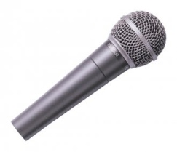
Thank You
Questions Please

