Slide 1
CBL
Elbow Pain
Dr.Hisham Alsanawi
Assistant Professor
King Saud University

Slide 2
Instructions to the students
Please read the case carefully, individually or in the group before you come to the “Case Based Learning” (CBL) session. Look at the objectives and try to fulfill these objectives. Prepare for the case well by referring to some suggested reading list. The tutor in CBL session will ask you to go through case and answer some of his stimulating questions to ensure that you have achieved the objectives.

Slide 3
Tutor’s role
The tutor should try to keep the discussion focused on how to approach the case and make sure that the learning objectives given to the students are achieved.
He/she should also try to observe punctually and should facilitate the process of learning by putting up some facilitating questions.
During the sessions all the students including the day-dreamers should be encouraged to participate in the discussion too.

Slide 4
Suggested reading
Turek's Orthopaedics: Principles and Their Application, 2005 edition, Chapter 6
lecture review

Slide 5
History
62 year-old man
Regular follow up in clinic for elbow fusion
Elbow pain, swelling, and discharge for 5 days
It is getting worse with time
No hx of trauma

Slide 6
Objectives
Students should be able to:
Demonstrate an essential knowledge in ability to obtain a complete and relevant history in order to identify:
  Any risk factors associated with such clinical presentations
  Any key factors in history to help out in reaching the most likely differential diagnosis.
  An initial Potential list of a differential diagnosis
  Any Red flags

Slide 7
Further Hx
PMH:
  DM type II on OHA
  Psychiatry – mild schizophrenia on medication but not compliant → one genuine suicide attempt
PSH:
  Elbow fusion done 3/12 @ kkuh for unstable comminuted non-united distal humerus fracture

Slide 8
Further Hx
Social Hx:
  Married with 2 sons and 1 daughter
  Jobless
  Lives in a rented house
  Frequent travels to Bahrain
  Heavy smoker
  ?alcohol consumption – patient was not clear on this
Systemic review → not significant

Slide 9
Objectives
After obtaining a complete patient History, students should be able to:
  Formulate their DD.
  Demonstrate a clinical reasoning skills by providing the rationales to justify their DD.
  Demonstrated knowledge in how to perform a focused and relevant physical examination based on such clinical presentation and DD.

Slide 10
Suggested facilitation questions for the tutor
Discuss patient’s presenting complaints in detail.
Discuss a differential diagnosis based on his/her presenting history.
What else do you want to know about this patient? What further questions would you ask to further refine your hypothesis?
Can you explain the above symptoms/feature using basic sciences, basic pathology?
What is the correlation of symptoms improving after sometime?
Discuss the mechanism of action of treatment (if given to patient).
What is the relevance of family history/risk factors in the case presentation?
What will be your next step? What other information do you want to know about this patient?

Slide 11
DDx

Slide 12
Physical exam
Pt looks in pain
temp 37
BP 110/70
pulse 95
RR 18

Slide 13
Physical exam
Elbow is
  tender
  swollen
  red
  wound dehiscence
  yellowish thick discharge
  it is in 90 deg flexion
  no ROM
Systemic exam is unremarkable

Slide 14
Objectives
By end of performing a focused and relevant PE, students should be able to:
  Reformulate & listed top DDxs.
  Demonstrate a clinical reasoning skills by providing the rationales to justify their DDx.
  Problem solving skills by initiating an appropriate investigations and provide a rationales for that.
  Link the expected abnormalities and investigations to the possible DDx.

Slide 15
Suggested facilitation questions for the tutor
Discuss the clinical examination findings.
Discuss the method of conducting the examination.
Discuss the significance of the tests discussed in the case.
Considering the history and physical examination findings, what would be the likely diagnosis.
How would you further proceed?

Slide 16
DDx

Slide 17
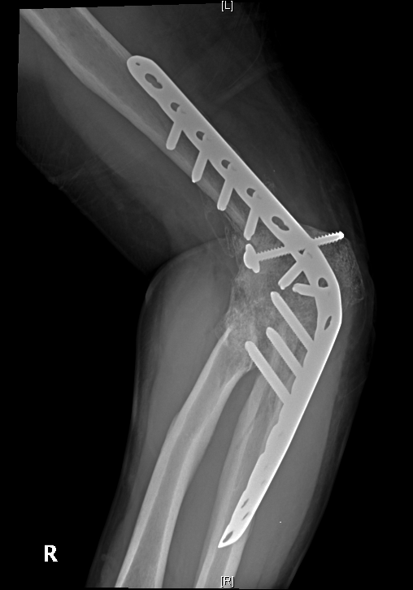
X-ray

Slide 18
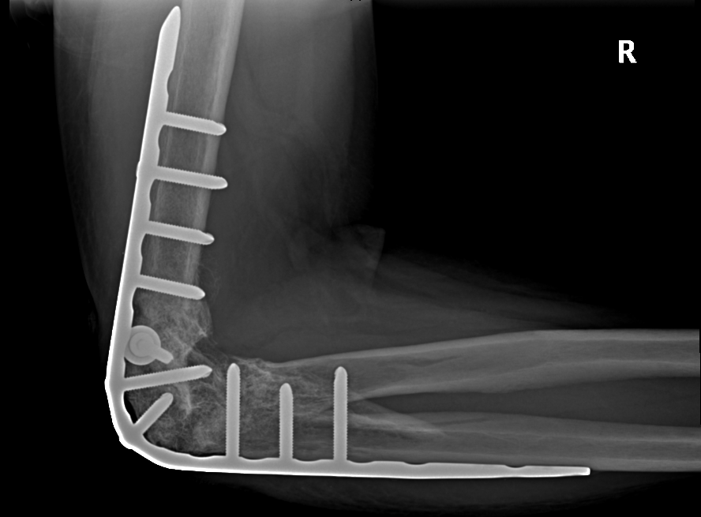
X-ray

Slide 19
Read the X-ray
Pre ABC
A
B
C
Soft tissue

Slide 20
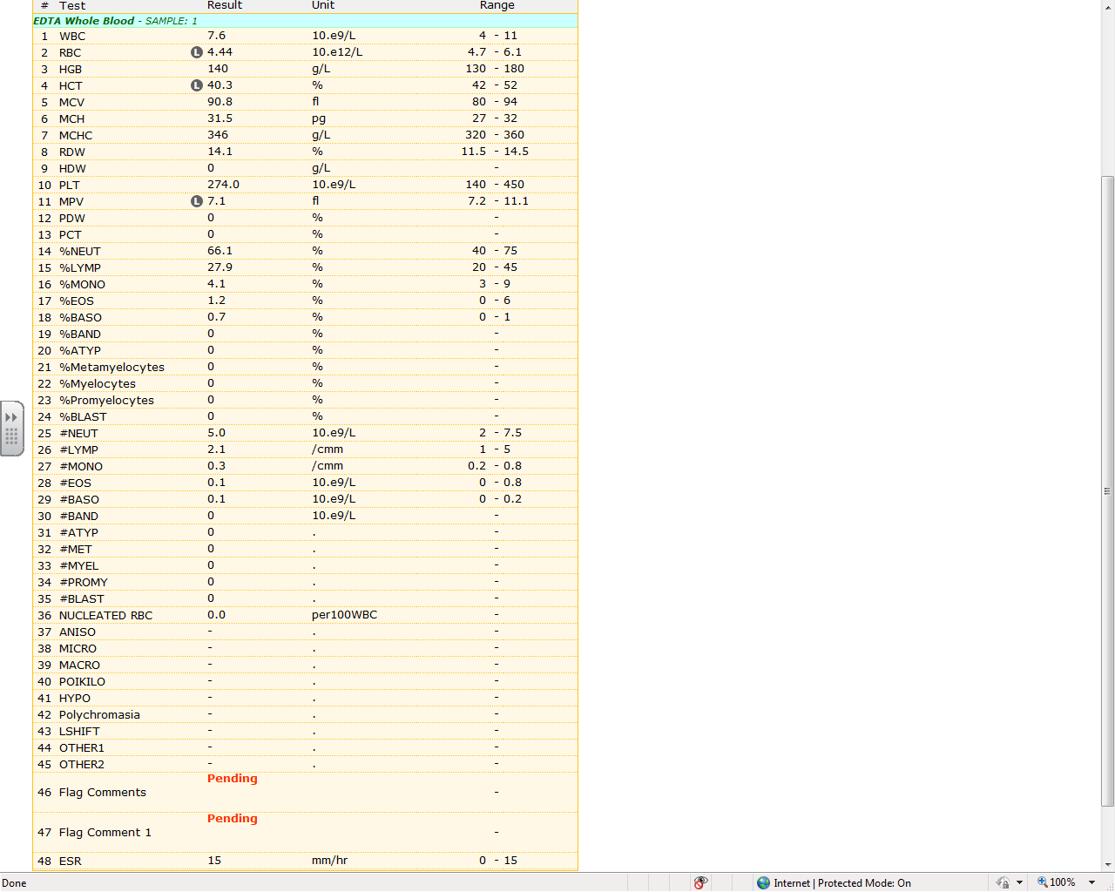
Blood tests
admission
CBC

Slide 21
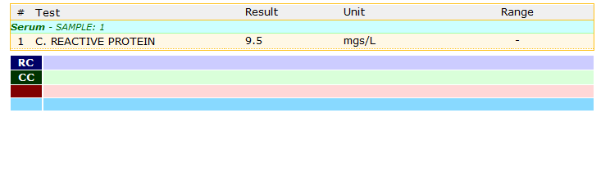
Blood Tests

Slide 22
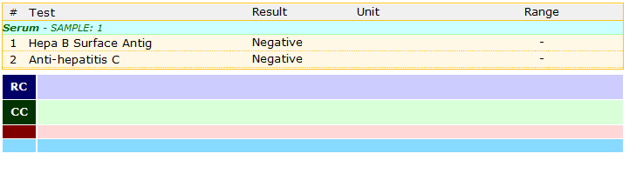
Blood Tests

Slide 23
What next?
Objectives:
Identify most likely diagnoses
Demonstrate a critical thinking skills during analyzing this case.
Demonstrate essential knowledge of principles of treatment for such problem

Slide 24
Suggested facilitation questions for the tutor
Discuss the significance of each test
Can you interpret each test result?
How to interpret the X-ray findings?
How would you proceed?

Slide 25
Treatment - initial
Surgery:
  C/S
  Removal of hardware
  Bone and joint do not look infected
Antibiotics
  IV - cefazolin

Slide 26
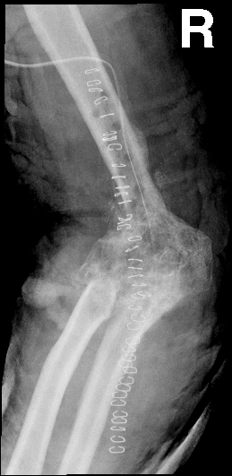
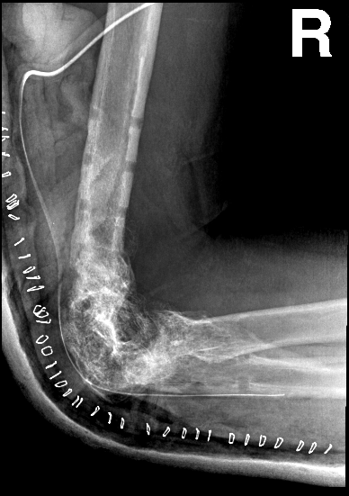
day 1 post op

Slide 27
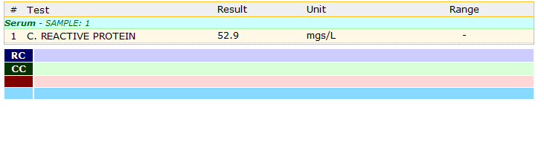
day 1 post op
Less pain
no discharge
less swelling
less redness

Slide 28
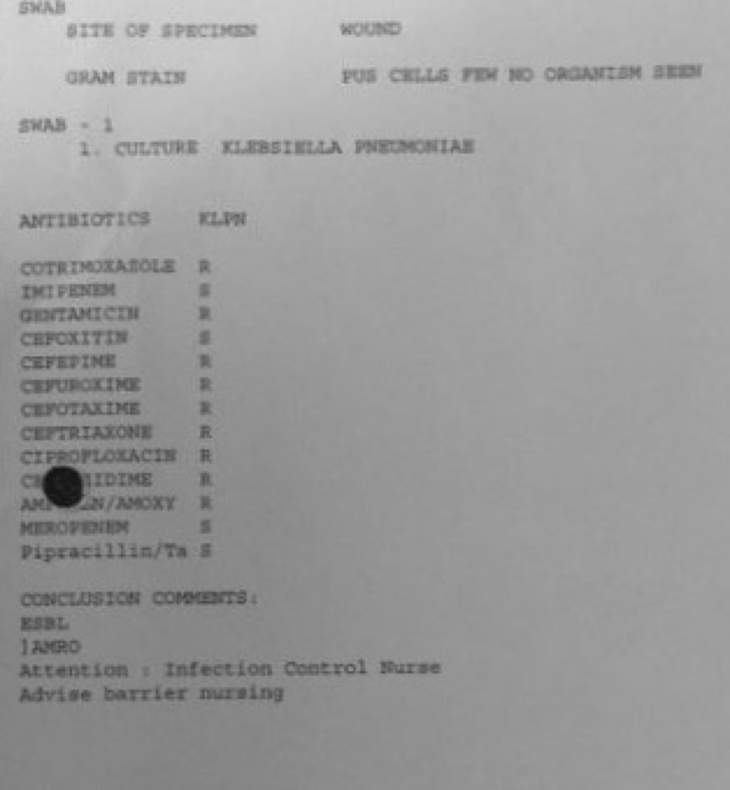
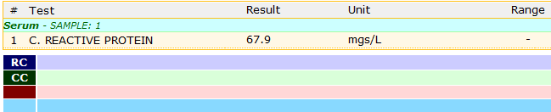
3 days post op
no pain
no discharge
less swelling
patient is happier
Organism: Klebsiella
Pneumoniae -- MRO

Slide 29
what to do now!
Abx changed to IV Meropenem

Slide 30
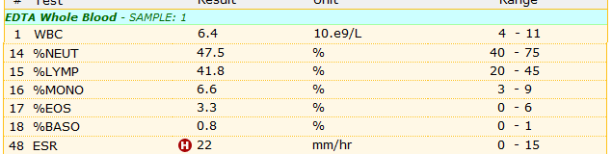
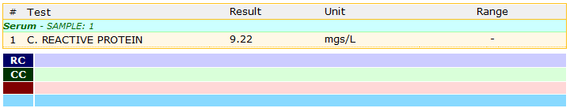
day 7 post op
pt is happy
no pain
no discharge
swelling is much less

Slide 31
Objectives
Students should be able to:
Interpret the X-ray findings.
Demonstrate knowledge of this disabling and serious complications of missing such condition.
Provide explanations why does it matter to treat such condition urgently?

Slide 32
Suggested facilitation questions for the tutor
How would you treat this patient?
What advice/health education that you would give this patient?
Discuss the mechanism of action of treatment.
Discuss the potential complications.
Discuss why such case can be missed and implication of that on patient outcome.

Slide 33
Take home message!
Bone and Joint infections should be treated aggressively
Hardware + infection = hardware removal if possible
Post op monitoring is very important -
  clinical vs lab
  CRP vs ESR
Patient info can dictate type of treatment
  total elbow replacement (very compliant and cooperative pt) vs elbow fusion (unreliable pt)

Slide 34
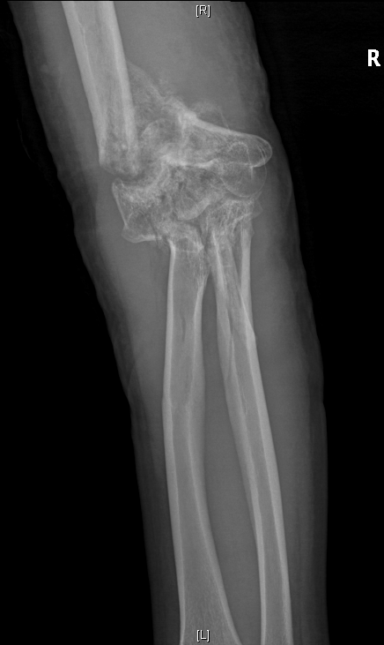
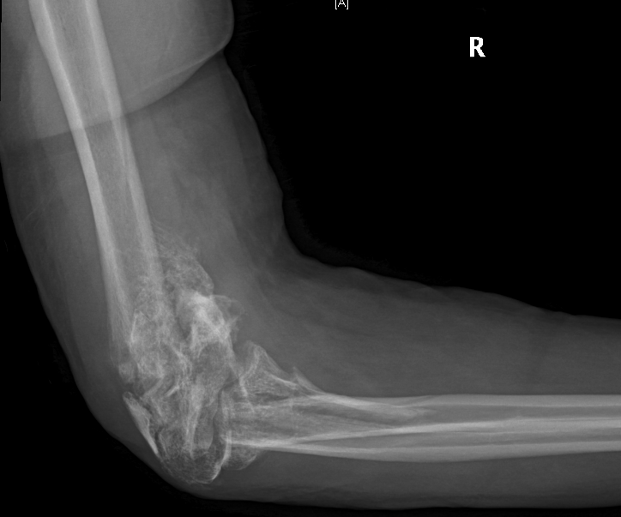
The story started with this ???!

Slide 35
I hope you enjoyed!
Thank you!

