Slide 1
BCH 471
Experiment (12)
Complete Blood Count (CBC)

Slide 2
Objectives
To estimate the number of RBC in blood sample
To estimate the number of total WBC in blood sample
To perform a differential count for a blood sample

Slide 3
Introduction
Complete blood count (CBC) is a test that gives information about the cells in a patient's blood.
A CBC test usually includes:
WBC count.
WBC differential count.
RBC count.
HCT
Hb
Red blood cell indices: There are three red blood cell indices: mean corpuscular volume (MCV), mean corpuscular hemoglobin (MCH), and mean corpuscular hemoglobin concentration (MCHC).
Platelet count
Mean platelet volume (MPV)

Slide 4
CBC can applied by two way:
Automated blood count
Manual blood count
Automated blood count:
CBC is performed by an automated analyzer that counts the numbers and types of different cells within the blood.
It aspirates a very small amount of the sample through the narrow tubing. Within this tubing, there are sensors that count the number of cells going through it, and can identify the type of cell; this is called flow-cytometry.

Slide 5
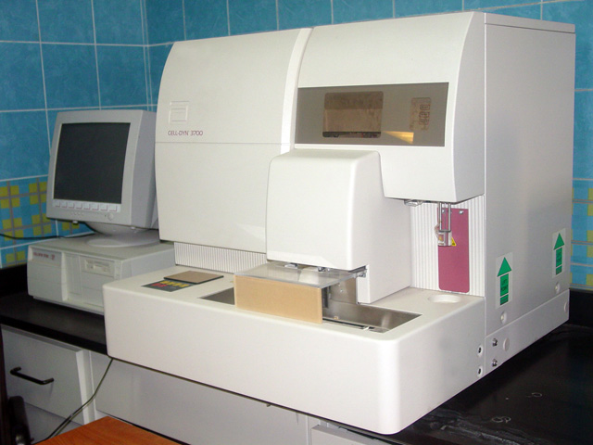
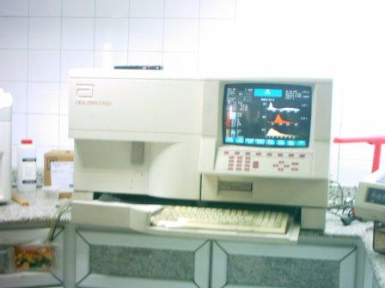

Slide 6
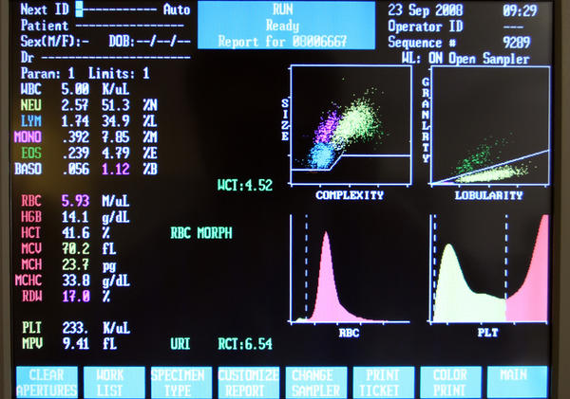

Slide 7
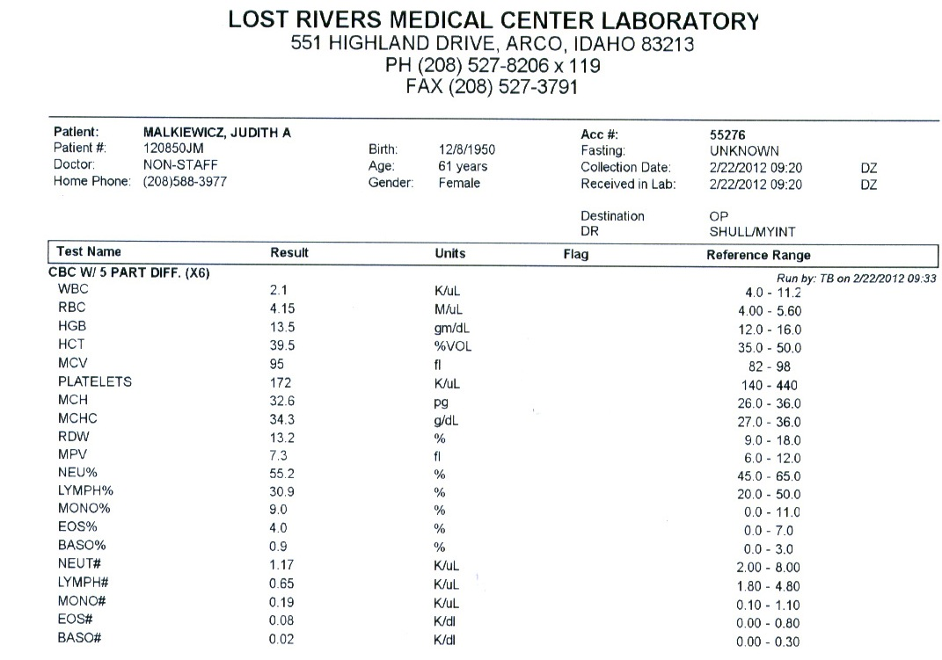

Slide 8
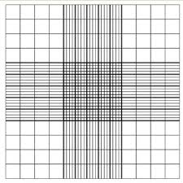
Manual blood count
This measurement is made with a microscope and a specially ruled chamber (hemocytometer) using diluted blood.

Slide 9
Red blood count:
It is test done to determination the number of RBC in a sample of blood , also it evaluate the size and shape of RBC
It is range from 4.2 – 5.5 million RBC per cubic millimeter (mm³)
It is considered a very important indicator of a patent’s health
Low RBC count
Anemia
Acute or chronic blood loss
Malnutrition
Chronic inflammation
High RBC count
Polycythemia
Congenital heart disease
Renal problem

Slide 10
Normally high (RBC count)
People who live at high altitudes
Smokers
Principle :
The process involves by counting cells in several squares of the grid and obtain an average number, this number is multiply by a factor that compensates the amount of dilution. The final results expresses the number of RBC /mm³ of original blood sample.
Oxygen is low→ RBC synthesis increases

Slide 11
WBC count :
Total leukocytes count shows the number of WBC in a sample of blood .
A normal WBC count is between 4,500 and 11,000 cells per cubic millimeter .
The number of WBC is sometimes used to identify an infection or to monitor the body’s response to treatment.
Low WBC count → Leukopenia
A Condition in which the number of leukocytes is abnormally low and which is most commonly due to sever infections (such as HIV) and radiation poisoning.
High WBC count → Leukocytosis
A condition characterized by an elevated the number of WBC occur as a result of an infection, or cancer (Leukemia).
It can occur normally after eating fat-rich meals .

Slide 12
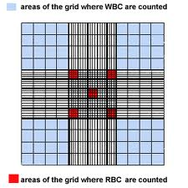
Principle:
It is necessary to obtain RBC free preparation of WBC from blood .
Suspension of the red blood cell in a very hypotonic solution will lead to the destruction of RBC .

Slide 13
How to count blood cells

Slide 14
Calculations: RBC blood cell count ( 5 squares) Find the sum of RBCs in 5 large squares, and divide it with 80 (5 X 16) small squares to find the average in one square, multiply it by 200 to allow for the dilution and then multiply by 4000 to obtain the number per cubic milliliter. The sum of RBCs in 5 large squares = 84+71+63+93+83= 394 cells. The average of RBCs in one square= 394/80 = 4.9 cells. RBC count= 4.9 x 200 x 4000 = 4 million/mm³. Normal range= 4.2-5 million/mm³

Slide 15
WBC blood cell count ( 4 squares) Find the sum of WBCs in 4 large squares, and divide it with 64 (4 X 16) small squares to find the average in one square, multiply it by 20 to allow for the dilution and then multiply by 160 to obtain the number per cubic milliliter. The sum of WBCs in 4 large squares = 16+21+17+15= 69 cells. The average of WBCs in one square= 69/64 = 1.07 cells. WBC count= 1 x 20 x 160 = 3200 Cells/mm³. Normal range= 4500-11000 cells /mm³

Slide 16
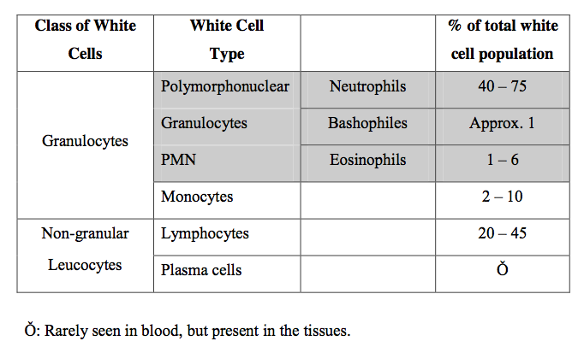
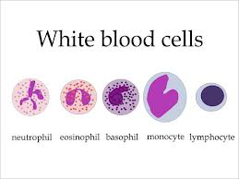
(C) Differential Count
It determines the number of each type of WBC present in the blood

Slide 17
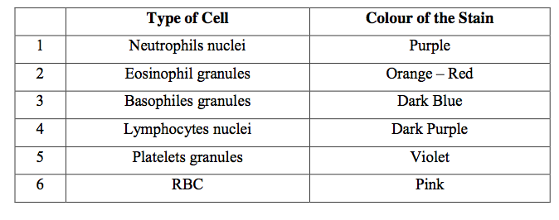
Principle:
Classification of polymorphonuclear granulocytes (PMN) is based on the size , shape , number and staining characteristics of their granules .
Leishman’s stain
It is based on a mixture of methylene blue and eosin.
It differentiates between WBC as indicated in the following table:

