Slide 1
C H A P T E R 8
Linear Transformations

Slide 2
8.1
GENERAL LINEAR TRANSFORMATIONS
Definitions and Terminology

Slide 3
EXAMPLE 2 The Zero Transformation

Slide 4
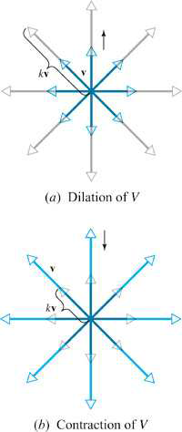
EXAMPLE 4 Dilation and Contraction Operators

Slide 5
EXAMPLE 10 A Linear Transformation Using an Inner Product

Slide 6
EXAMPLE 13 A Transformation That Is Not Linear

Slide 7
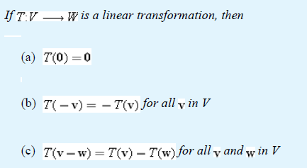
Properties of Linear Transformations
THEOREM 8.1.1

Slide 8
EXAMPLE 14 Computing with Images of Basis Vectors

Slide 9
8.2
KERNEL AND RANGE
DEFINITION

Slide 10
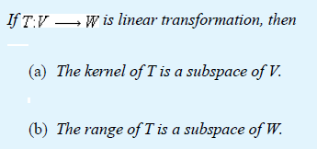
Properties of Kernel and Range

Slide 11
Remarks
1. The range of a linear transformation is a subspace of its
codomain.
2. The range of a matrix transformation is the column space
of the matrix.

Slide 12
DEFINITION
THEOREM 8.2.2

Slide 13
EXAMPLE 7 Finding Rank and Nullity

Slide 14
THEOREM 8.2.3
Dimension Theorem for Linear Transformations

