Slide 1
Chapter 12
Using Descriptive Analysis, Performing
Population Estimates and Testing Hypotheses

Slide 2
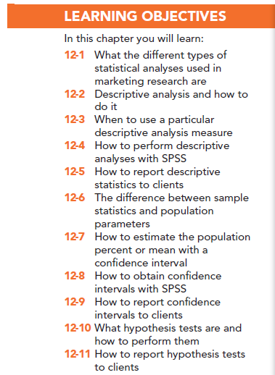

Slide 3
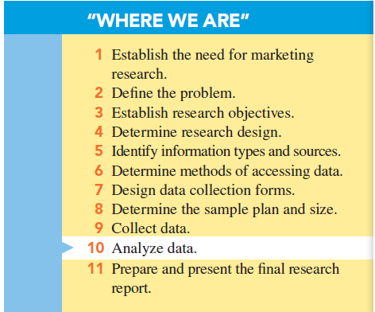

Slide 4
Types of Statistical Analyses Used in Marketing Research
Descriptive analysis
Inferential analysis
Differences analysis
Associative analysis
Predictive analysis

Slide 5
Descriptive Analysis
Used by marketing researchers to describe the sample dataset in such a way as to portray the “typical” respondent and to reveal the general pattern of responses.

Slide 6
Inference Analysis
Used when marketing researchers use statistical procedures to generalize the results of the sample to the target population it represents.

Slide 7
Difference Analysis
Used to determine the degree to which real and generalizable differences exist in the population to help the manager make an enlightened decision on which advertising theme to use.

Slide 8
Association Analysis
Investigates if and how two variables are related

Slide 9
Relationship Analysis
Statistical procedures and models to help allow insight into multiple relationships among variables

Slide 10
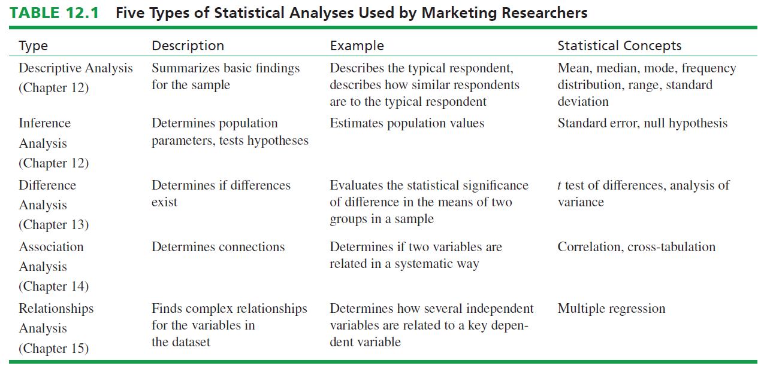

Slide 11
Understanding Data Via Descriptive Analysis
Two sets of measures are used extensively to describe the information obtained in a sample.
Measures of central tendency or measures that describe the “typical” respondent or response
Measures of variability or measures that describe how similar (dissimilar) respondents or responses are to (from) “typical” respondents or responses

Slide 12
Summarizing the “Typical” Respondent
Measures of central tendency:
Mode: a descriptive analysis measure defined as that value in a string of numbers that occurs most often.
Median: expresses that value whose occurrence lies in the middle of an ordered set of values.
Mean (or average):

Slide 13
Measures of Variability: Visualizing the Diversity of Respondents
All measures of variability are concerned with depicting the “typical” difference between the values in a set of values.
There are three measures of variability:
Frequency distribution
Range
Standard deviation

Slide 14
Measures of Variability: Visualizing the Diversity of Respondents
A frequency distribution is a tabulation of the number of times that each different value appears in a particular set of values.
The frequency for each value divided by the total number of observations for all values, resulting in a percent, called a percentage distribution.

Slide 15
Measures of Variability: Visualizing the Diversity of Respondents
Range: identifies the distance between lowest value (minimum) and the highest value (maximum) in an ordered set of values.
Standard deviation: indicates the degree of variation or diversity in the values in such a way as to be translatable into a normal or bell-shaped curve distribution.

Slide 16
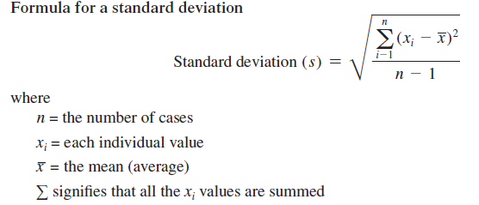

Slide 17
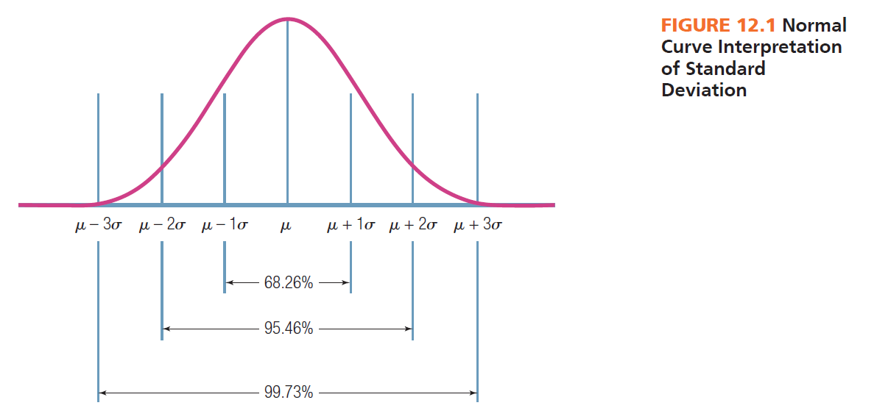

Slide 19
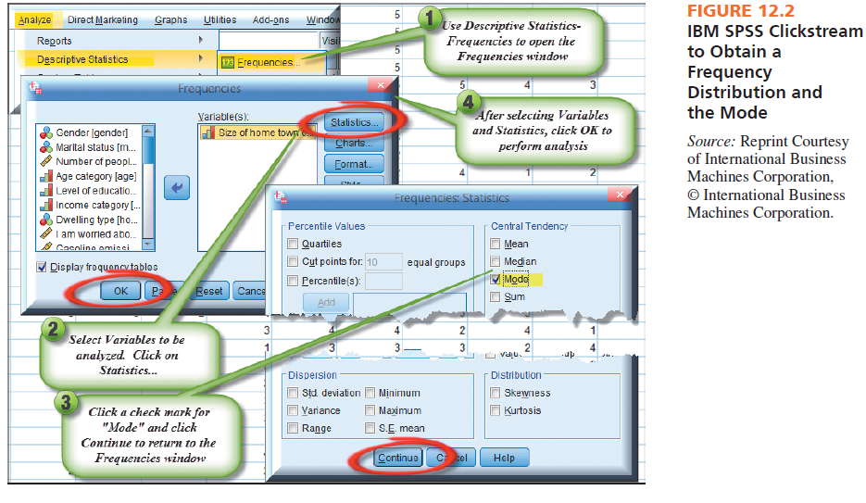

Slide 20
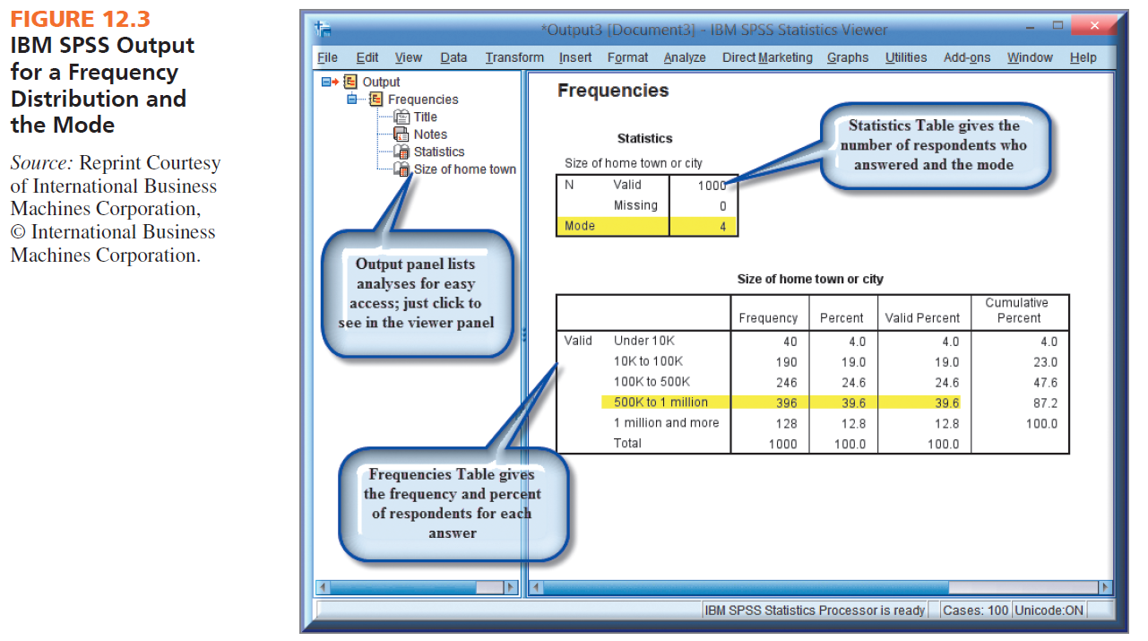

Slide 21
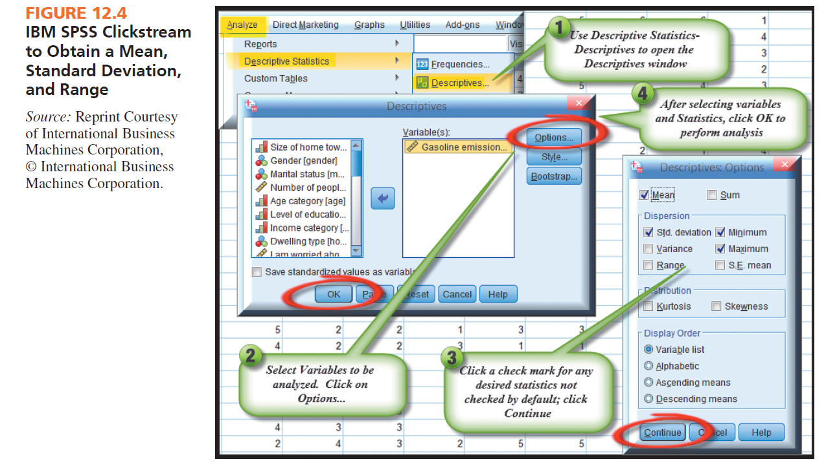

Slide 23
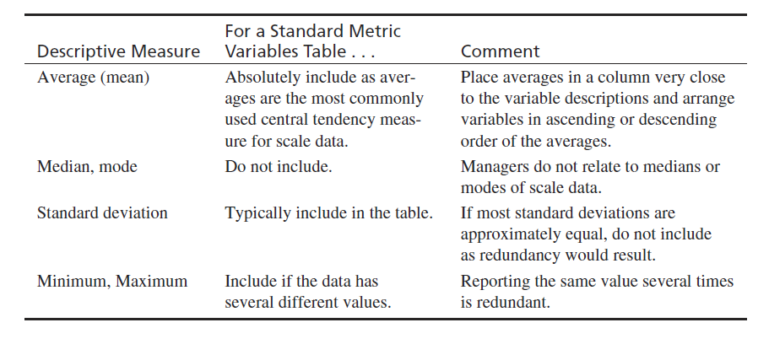
Reporting Scale Data

Slide 24
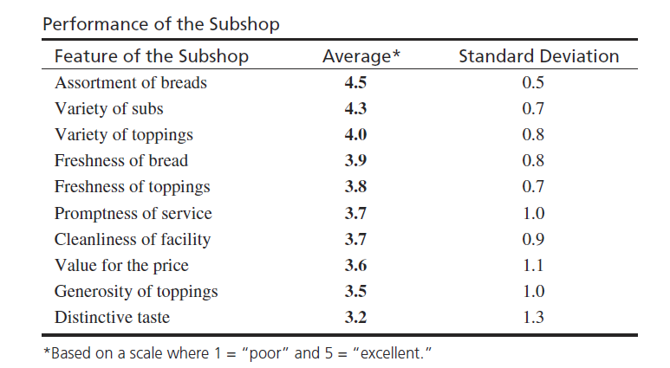
Example Scale Variables Table

Slide 25
Reporting Nominal or Categorical data

Slide 26
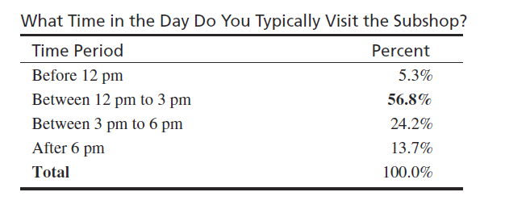
Sample Nominal or Categorical Variable Table

Slide 27
Statistical Inference
Statistics are sample values
Parameters are corresponding population values
Statistical inference is the set of procedures used in which sample statistics are used to estimate population parameters

Slide 28
Two Types of Statistical Inference
A parameter estimate is used to approximate a parameter using confidence intervals
Hypothesis testing is used to compare sample statistics to hypothesized parameter values.

Slide 29
Parameter Estimation: Estimating the Population Percent or Mean
Parameter estimation is the process of using sample information to compute an interval that describes the range of a parameter such as the population mean or the population percentage.
It involves the use of three values:
The sample statistic
The standard error of the statistic
The desired level of confidence

Slide 30
Statistical Inference: Sample Statistics and Population Parameters
A sample statistic is usually a mean or percentage.
Standard error is the measure of variability in the sampling distribution.
A confidence interval is the degree of accuracy desired by the researcher stated in the form of a range with an upper and lower boundary.

Slide 32
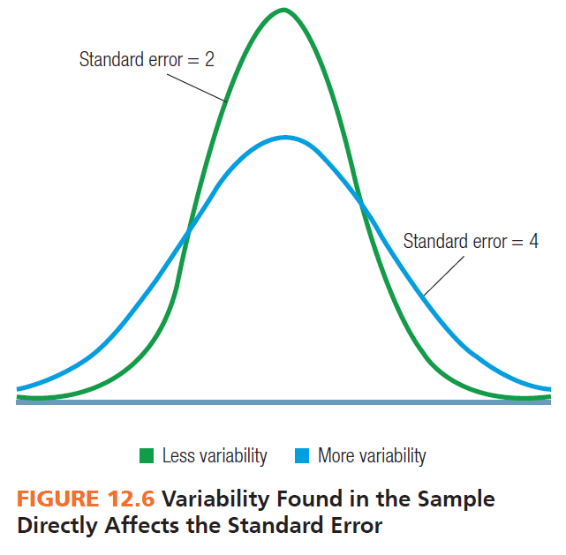

Slide 33
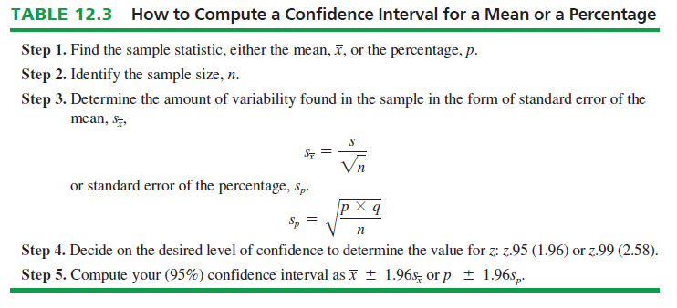

Slide 34
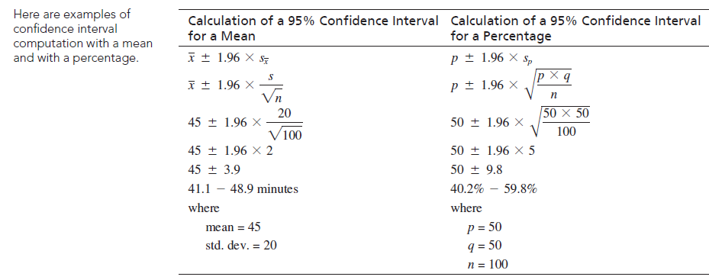

Slide 35
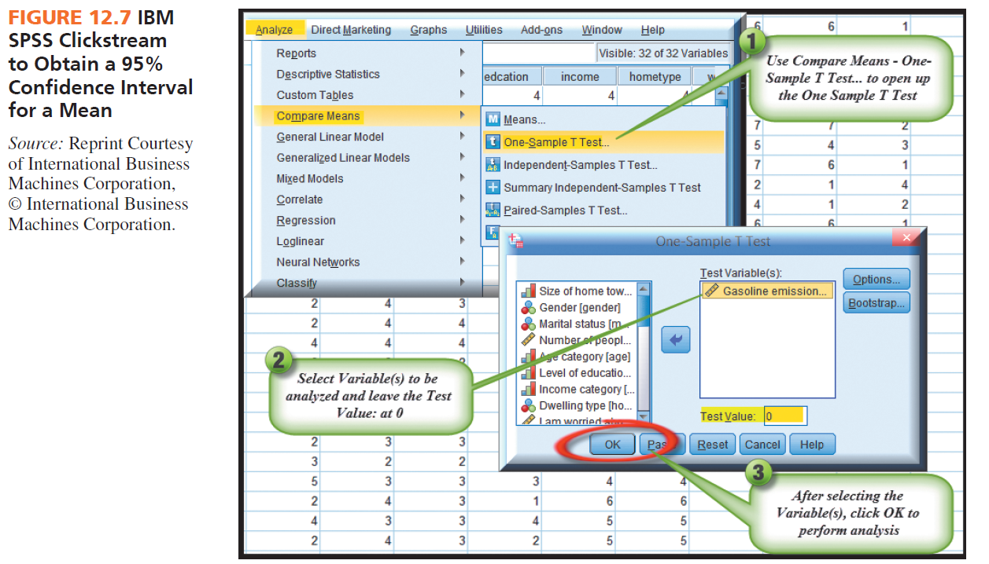

Slide 36
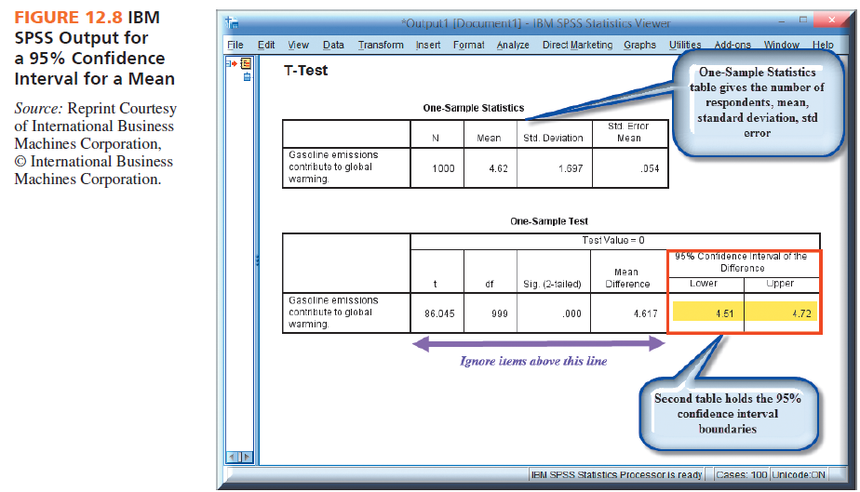

Slide 37
Hypothesis Tests
Tests of an hypothesized population parameter value:
Test of an hypothesis about a percent
Test of an hypothesis about a mean
The crux of statistical hypothesis testing is the sampling distribution concept.

Slide 38
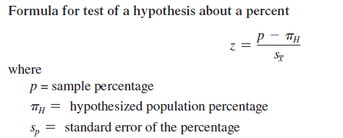

Slide 39
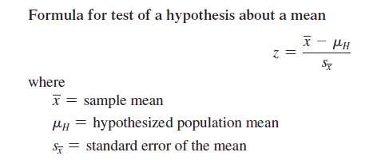

Slide 40
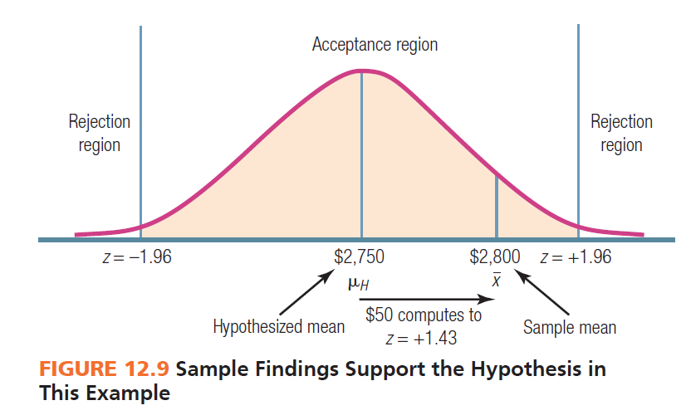

Slide 42
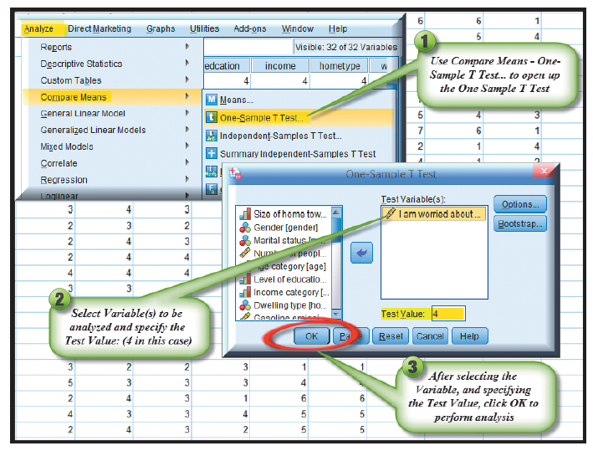
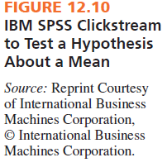

Slide 43
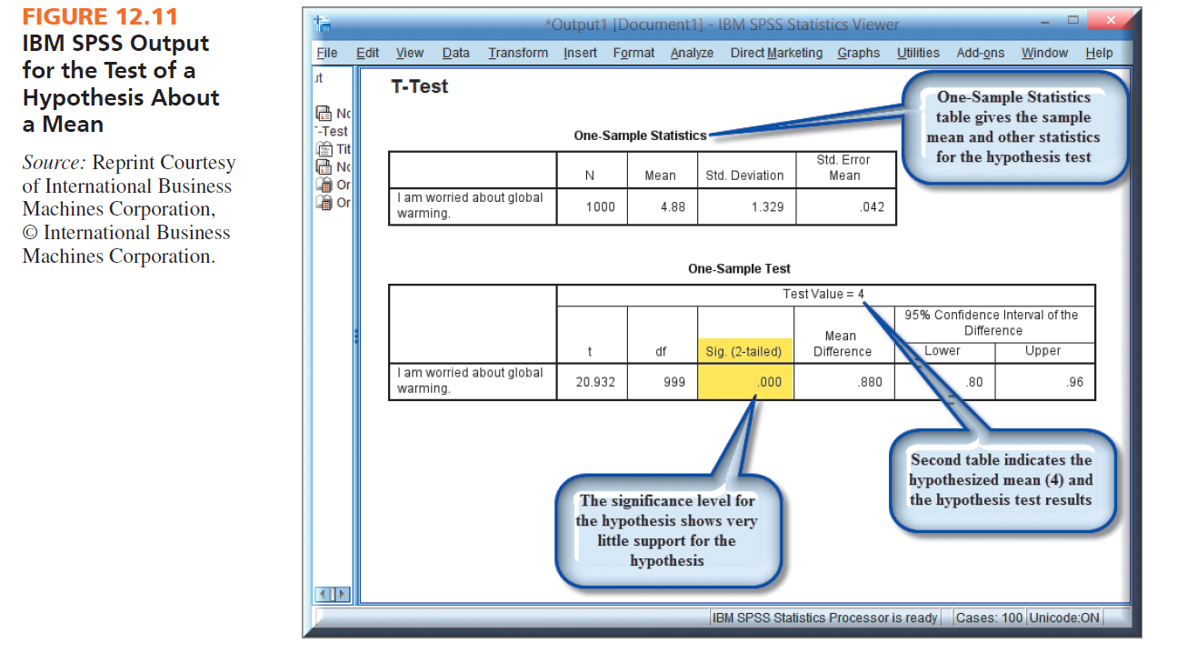

Slide 45
All rights reserved. No part of this publication may be reproduced, stored in a retrieval system, or transmitted, in any form or by any means, electronic, mechanical, photocopying, recording, or otherwise, without the prior written permission of the publisher. Printed in the United States of America.

