Slide 1
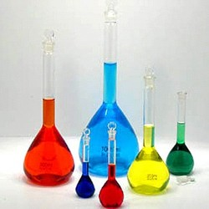
Buffer Capacity
BCH 312
Experiment (7)

Slide 2
Objectives
To understand the concept of buffer capacity.
To determine the maximum buffer capacity of a number of buffer solutions.
To establish the relationship between buffer capacity and buffer concentration.

Slide 3
Introduction
Common buffer mixtures contain two substances, a conjugate acid and a conjugate base .
Together the two species (conjugate acid and conjugate base) resist large changes in pH by absorbing the H+ ions or OH- ions added to the system.
When H+ ions are added to the system they will react with the conjugate base in the buffer .
When OH- ions are added they will react with the conjugate acid in the buffer
→ Thus the buffer is effective as long as it does not run out of one of its components.

Slide 4
Buffer Capacity
Quantitative measure of this resistance to pH changes is called buffer capacity.
Buffer capacity can be defined as the number of moles of H+/OH- ions that must be added to one liter of the buffer in order to decrease /increase the pH by one unit respectively.
Where [H⁺] = the hydrogen ion concentration of the buffer ,β is the buffer capacity , [C] is Bffer capacity.
From the equation that the buffer capacity is directly proportional to the buffer concentration.

Slide 5
Method
You are provided with 2 acetate buffers, pH=5. Each with different concentrations ; 0.1 M and 0.2 M .
Transfer 8 ml of each buffer into a 50 ml beaker.
Add 0.5 ml of ( 0.1 M) HCl from the burette and determine the pH of the solution after each addition
Continue adding acid in until pH falls to about 2 pH units from your starting pH .
Plot a Curve of pH versus ml of HCl added and calculate the Buffer capacity
Then compare between two buffer which one has higher buffer capacity and why?

