Slide 1
PHL 313 (lab. 5) Hypertension (HTN)
Effect of some adrenergic drugs and its blockers on the blood pressure

Slide 2
HTN is the most common cardiovascular disease.
HTN was found in 29% of American adults.
60- 80 % of men and women will develop HTN by age 80
Uncontrolled BP damages blood vessels in kidney, heart , and brain.

Slide 3
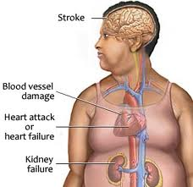

Slide 4
BP= CO × PR
Cardiac Output (Q) = SV × HR
HR is Heart Rate, expressed as BPM (Beats Per Minute)
Total Peripheral Resistance = (Mean Arterial Pressure - Mean Venous Pressure) / Cardiac Output

Slide 5
Etiology of HTN
85 – 90 % essential HTN (no specific cause)
10 – 15 % secondary HTN ( specific cause)

Slide 6
Anatomic sites of BP control
Resistance ( Arterioles )
Capacitance (Venules)
Pump output (Heart)
Volume (Kidney)

Slide 7
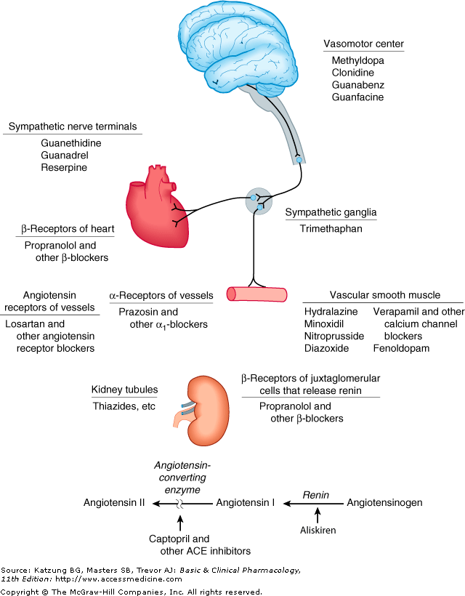

Slide 8
Antihypertensive drugs
Diuretics
Adrenergic receptor antagonists
Calcium channel blockers
Renin Inhibitors
ACE inhibitors
Angiotensin II receptor antagonists
Aldosterone antagonists
Vasodilators
Alpha-2 agonists
Positive Inotropes.

Slide 9
Diuretics
Loop diuretics: eg. Furosemide
Thiazide diuretics: eg. hydrochlorothiazide
Thiazide-like diuretics: eg. indapamide
Potassium-sparing diuretics: eg. triamterene

Slide 10
Aldosterone antagonists
Spironolactone

Slide 11
Adrenergic receptor antagonists
Beta blockers:
Non selective beta1 (Propranolol)
Selective beta1 (Atenolol)
2. Alpha blockers: (Prazosin)
3. Mixed alpha and beta blockers: (carvedilol)

Slide 12
Calcium channel blockers
Dihydropyridines:
Amlodipine
Nifedipine
2. Non- dihydropyridines (cardio selective):
Verapamil
Diltiazem

Slide 13
Renin Inhibitors
Aliskiren

Slide 14
ACE inhibitors
Captopril
Enalapril
fosinopril

Slide 15
Angiotensin II receptor antagonists
Candesartan
Valsartan

Slide 16
Vasodilators
act directly on the smooth muscle of arteries to relax their walls
Sodium nitroprusside ( arteries, veins)
Hydralazine (arteries)

Slide 17
Alpha-2 agonists
by stimulating alpha-receptors in the brain
Clonidine
Methyldopa

Slide 18
Positive Inotropes
Digoxin
$ vagal nerve leading to bradycardia and AV block in high dose
Used to treat atrial fib. WHY?
And to treat C.H.F. because inhibits Na/K pump.

Slide 19
Thanks

