Slide 1
Bile

Slide 2
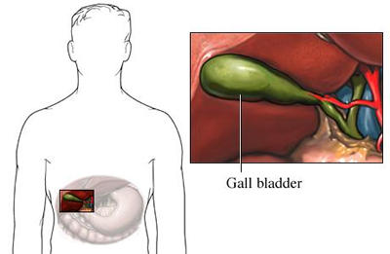
Physical Properties
Bile is a dark green to yellowish brown fluid produced by the hepatocytes in the liver, draining through many bile ducts that penetrate the liver.
It is stored in the gallbladder and upon eating is discharged into the duodenum.

Slide 3
The human liver can produce close to 1 L of bile per day (depending on body size).
The electrolytes composition of human bile collected from the hepatic ducts is similar to that of blood plasma, except that the HCO₃⁻ concentration may be higher, resulting in an alkaline PH. Why ?
Biliary secretion is an important route for the excretion of billirubin from the body.

Slide 4
Bile Composition:
The liver produces and secretes 600 - 1000 ml of bile per day.
The major constituents of bile are:
bile pigment (bilirubin), bile salts , phospholipids
(mainly lecithin), cholesterol and inorganic ions

Slide 5
Function of bile:
1- It is important in the digestion and absorption of lipids.
(The digestive function of bile is accomplished by bile salts, which emulsify fats in the small intestine).
2- Bile serves as the route of excretion for bilirubin, cholesterol.
3-The alkaline bile has the function of neutralizing acid from stomach.

Slide 7
Bile secretion:
Bile is secreted in two stages ;
Stage 1: Hepatocytes secrete an initial secretion that is rich in bile salts , cholesterol, and other organic components, the initial secretion will drain through the bile canaliculi that penetrate the liver.
Stage 2: The initial secretion will flow towards the bile ducts , during its flow through the ducts, a secondary secretion is added to the initial bile which is a watery solution of sodium bicarbonate ions.

Slide 8
Storing and Concentrating Bile in the
Gallbladder:
Bile is secreted continually by the liver cells, but most of it is normally stored in the gallbladder until needed in the duodenum.
Bile is stored in the gallbladder and are concentrated.

Slide 9
In the concentrating process in the gallbladder,
Water and large portions of the electrolytes are reabsorbed by the gallbladder mucosa; essentially all other constituents, especially the bile salts and the lipid substances, cholesterol and lecithin, are not reabsorbed and, therefore, become highly concentrated in the gallbladder bile.

Slide 10
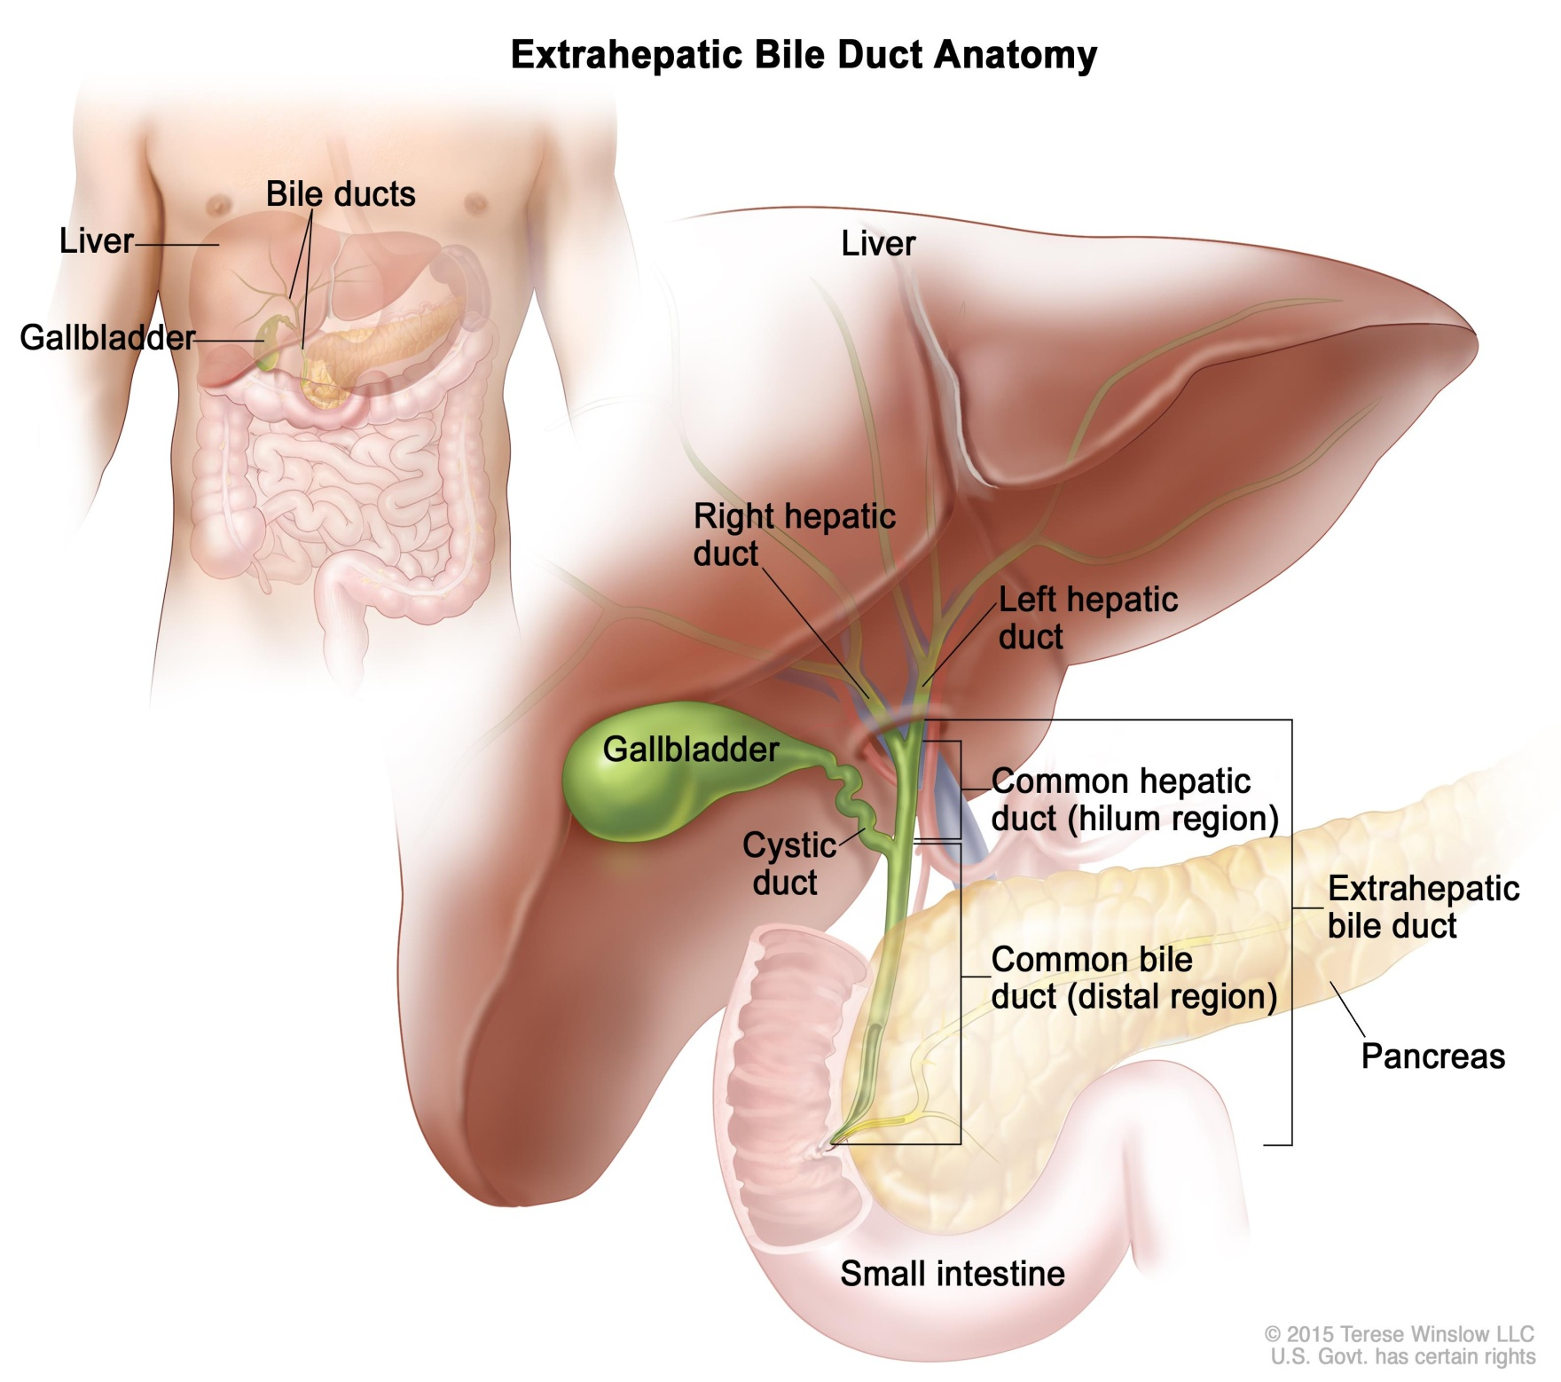

Slide 11
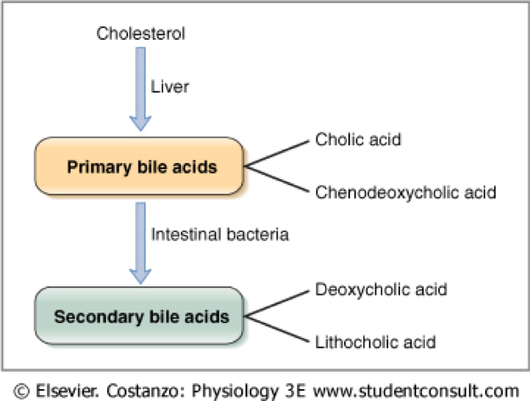
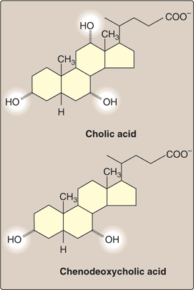
Bile acids are derivatives of cholesterol. Cholesterol, ingested as part of the diet or derived from hepatic synthesis is converted into the bile acids, cholic and chenodeoxycholic acids, which are then conjugated to an amino acid (glycine or taurine) to yield the conjugated form that is actively secreted into cannaliculi.

Slide 12
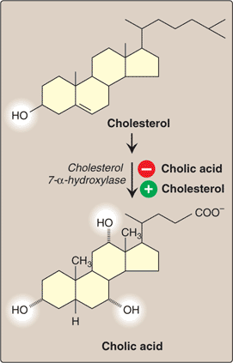
Bile acids:
The precursor of the bile salts is cholesterol
-The cholesterol is first converted to cholic acid or chenodeoxycholic acid.
These acids in turn combine with glycine and taurine to form glyco- and tauro-conjugated bile acids.
Bile salts have emulsifying function.
help in absorption of lipids.

Slide 14
The entero hepatic circulation

Slide 15
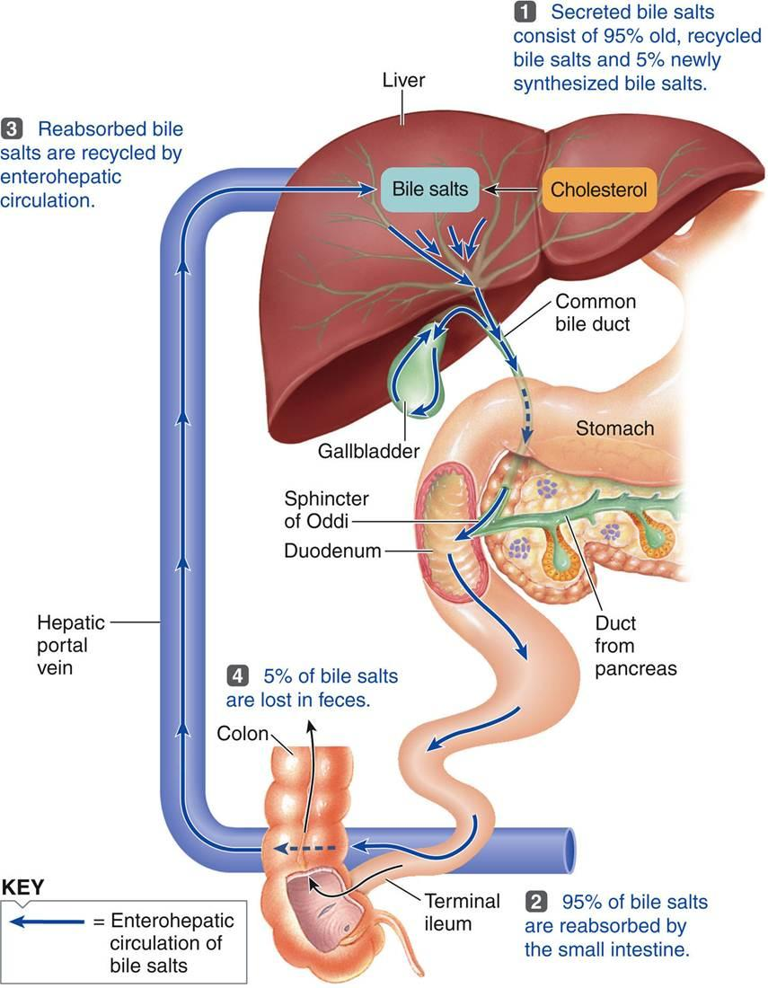

Slide 16
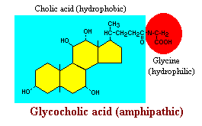
Role of Bile Acids in Fat Digestion and Absorption
Bile acids are amphipathic, that is, they contain both hydrophobic (lipid soluble) and polar (hydrophilic) faces.
The cholesterol-derived portion of a bile acid has one side that is hydrophobic (that with methyl groups) and one that is hydrophilic (that with the hydroxyl groups); the amino acid conjugate is polar and hydrophilic.

Slide 17
Their amphipathic nature enables bile acids to carry out two important functions:
Emulsification of lipid aggregates
Solubilization and transport of lipids in an aqueous environment

Slide 18
Stimulation of Bile secretion
1-Under neural control mediated by e.g acetyl choline.
2- Under hormonal control ;
When food is released by the stomach into the duodenum in the form of chyme, the duodenum releases cholecystokinin (CCK).
-The release of CCK into the blood causes the gallbladder to contract and release the concentrated bile into the duodenum to complete the digestion of fat.
- Gastrin and secretin also stimulate bile secretion.
Lack of bile salts in the enterohepatic circulation stimulates bile synthesis and secretion.

Slide 19
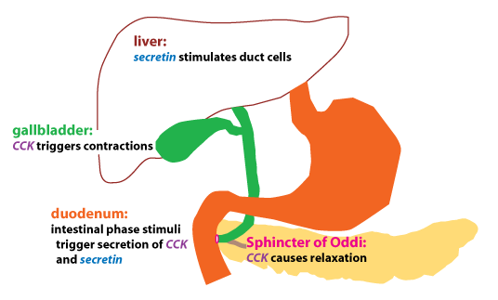

Slide 20
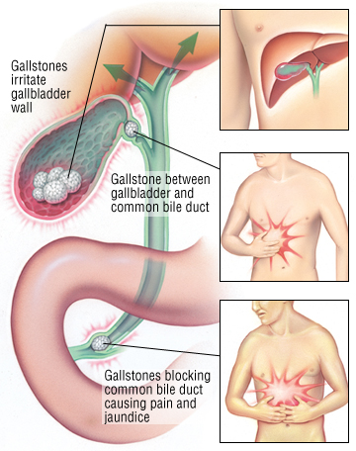
Abnormalities associated with bile:
●Gallstones:
Gallstone is the crystalline concretion produced inside the gallbladder by accumulation of the bile.
These stones can be formed due to the hardening of particles in the cholesterol and pigments in the bile. Gallstones can be formed by one or more causes which include body weight, poor diet, and genetic reasons as well. Cholesterol drugs, high estrogen in the body and diabetes also result in an increased risk of getting gallstones.

Slide 21
●Steatorrhea:
-In the absence of bile, fats become indigestable and are instead excreted in feces, a condition called steatorrhea.

Slide 22
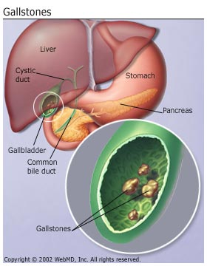
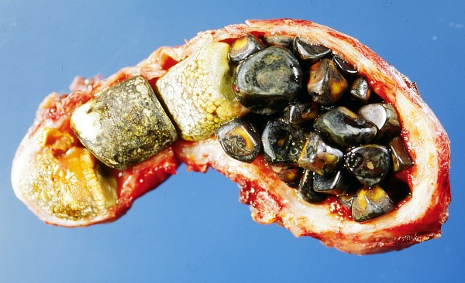

Slide 23
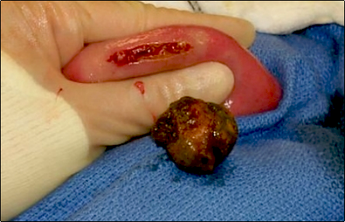
Removal by surgery

Slide 24
What happens when you don’t have a gallbladder?
Your liver continues to synthesize bile, but there is no longer a place to store it or concentrate it. Therefore bile continually slowly secreted into the intestines.
If you eat a fatty meal, you will not be able to secrete a large enough amount of bile into your intestines, therefore the fat will be poorly digested. This means many people experience diarrhea,
bloating, nausea or indigestion.
Not digesting fat well means you
will not be able to digest essential fatty acids, including omega 3 and omega 6 fats.
It also means you’ll have a hard time absorbing fat soluble vitamins such as vitamins D, E, A and K.
A lot of the antioxidants in vegetables are fat soluble: lycopene, lutein and carotenoids are all fat soluble.
If you don’t produce adequate bile, you will not be adequately absorbing these life saving compounds from foods.

Slide 25
Pancreatic secretions

Slide 26
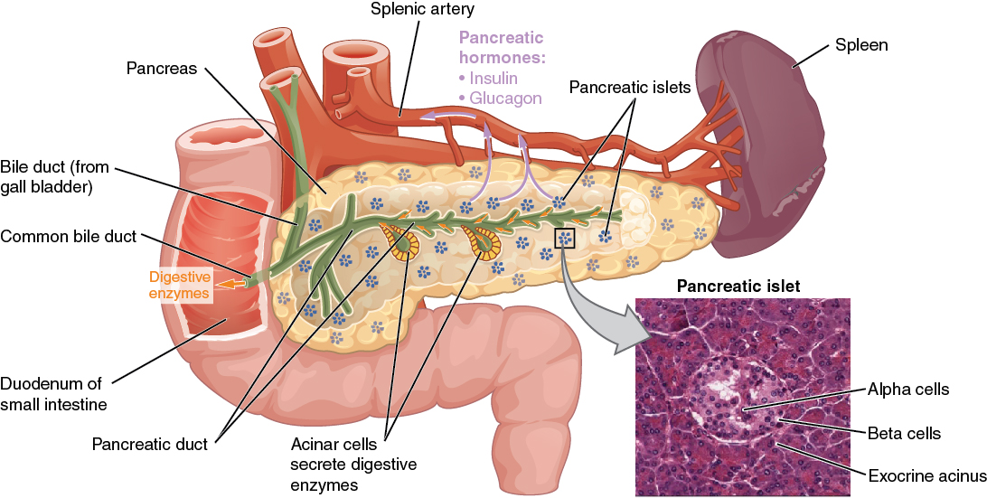
Anatomy of the pancreas

Slide 27
Pancreatic juice:
A clear alkaline secretion of the pancreas containing enzymes that aid in the digestion of proteins, carbohydrates, and fats.
The pancreas is located adjacent to the duodenum and functions as both an endocrine and exocrine gland.
The endocrine function produces several important hormones including insulin, glucagon, and somatostatin.
The exocrine gland secretes pancreatic juice which contain digestive enzymes that pass to the small intestine via duct and break down carbohydrates, protein, and fat in chyme

Slide 28
Composition
Pancreatic juice is composed of two secretory products critical to proper digestion:
water
Digestive enzymes: The enzymes are synthesized and secreted from the exocrine acinar cells
Bicarbonate: is secreted from the epithelial cells lining small pancreatic ducts.
Bicarbonate is a base and critical to neutralizing the acid coming into the small intestine from the stomach

Slide 29
Digestive Enzymes:
Proteases:
The two major pancreatic proteases are trypsin and chymotrypsin, which are synthesized and packaged into secretory vesicles as an the inactive proenzymes trypsinogen and chymotrypsinogen.
Trypsinogen is activated by the enzyme enterokinase, which is embedded in the intestinal mucosa.
2. Pancreatic Lipase
3. Alpha - amylase
Most pancreatic enzymes are produced as zymogens

Slide 30
Secretion of Pancreatic Juice:
Secretion of pancreatic juice is stimulated by:
Secretin:
- Occurs in response to duodenal pH < 4.5.
- Stimulates production of HC0₃⁻ by pancreas.
CCK:
- Occurs in response to fat and protein content of chyme
in duodenum.
- Stimulates the production of pancreatic enzymes.

Slide 31
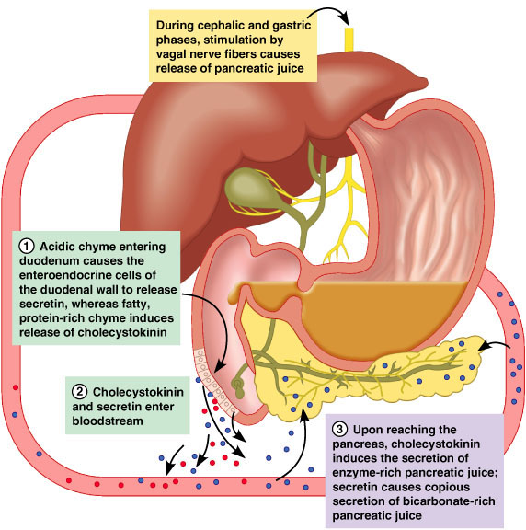
regulation of pancreatic secretion

Slide 32
regulation of pancreatic secretion.
The majority of pancreatic secretion arises from intestinal phase stimuli (when chyme reaches the duodenum).
The hormones secretin and cholecystokinin (CCK) are released by endocrine cells that are located in the duodenal epithelium.
Secretin release is triggered by H⁺ ions (low pH). Secretin then travels via the circulation to stimulate bicarbonate secretion by duct cells.
CCK release is triggered by digestive products (fats and peptides). CCK then travels via the circulation to stimulate digestive enzyme secretion by acinar cells.

Slide 34
Intestinal secretions

Slide 35
In the small intestines
In the small intestine, the macromolecular aggregates are exposed to pancreatic enzymes and bile.
The final stages of digestion occur on the surface of the small intestinal epithelium.

Slide 36
The net effect of passage through the small intestine is absorption of most of the water and electrolytes (sodium, chloride, potassium) and essentially all dietary organic molecules (including glucose, amino acids and fatty acids).
Through these activities, the small intestine does not only provide nutrients to the body, but plays a critical role in water and acid-base balance

Slide 37
In the large intestines
1.Recovery of water and electrolytes from ingesta:
By the time ingesta reaches the terminal ileum, roughly 90% of its water has been absorbed.
but considerable water and electrolytes like sodium and chloride remain and must be recovered by absorption in the large gut.

Slide 38
2. Formation and storage of feces:
As ingesta is moved through the large intestine, it is dehydrated, mixed with bacteria, mucus, and formed into feces.

Slide 39
3. Microbial fermentation:
The large intestine of all species teems with microbial life. Those microbes produce enzymes capable of digesting many of molecules that are indigestible,
EX: cellulose

Slide 40
Faeces
After chyme has remained in the large intestine, it normally become solid or semi-solid and is then called feces.

Slide 41
Composed of
Water
Undigested and unabsorbed food residues.
Intestinal secretions.
Inorganic matter (10-20%).
Bacteria and their metabolic wastes and other cellular elements.
80 - 170 g/day
Gases ( N , O , CO2)

Slide 42
Characteristics
Odor: due to Skatole and indole formed during putrefecation in the intestines
Consistency: Can be loose or firm depending on diet
Pigments: Stercobilin (a bile pigment) gives the brown color.

Slide 43
Fecal analysis
Stool sample is collected in a clean container and then sent to the laboratory.
Laboratory analysis includes microscopic examination, chemical tests, and microbiological tests.

Slide 44
The stool will be checked for color, consistency, weight (volume), shape, odor, and the presence of mucus.
The stool may be examined for hidden (occult) blood, fat, bile, white blood cells.
The pH of the stool also may be measured.
A stool culture is done to find out if bacteria may be causing an infection

Slide 45
Why It is Done
1.Help identify diseases of the digestive tract, liver, and pancreas.
2.Screen for colon cancer by checking for hidden (occult) blood.
3.Look for parasites, such as pinworms.
4.Look for the cause of an infection, such as bacteria, a fungus, or a virus.
5. Check for poor absorption of nutrients by the digestive tract (malabsorption syndrom)

Slide 46
Abnormal values
High levels of some components in the stool may be caused by diseases such as pancreatitis, sprue (celiac disease), cystic fibrosis, or other disorders that affect the absorption of nutrients.
Blood in the stool may be caused by bleeding in the digestive tract.

Slide 47
White blood cells in the stool may be caused by inflammation of the intestines or bacterial infection.
Rotaviruses are a common cause of diarrhea in young children. If diarrhea is present, testing may be done to look for rotaviruses in the stool.
carbohydrate in feces detected by the Copper reduction test , to detect reducing sugars , if positive, infant may be tested by other more specific serum tests.
If carbohydrate is present the pH of feces drops from below 5.5

Slide 48
High levels of fat in the stool may be caused by diseases such as pancreatitis, cystic fibrosis, pancreatic carcinoma or other disorders that affect the absorption of fats.

