Slide 1
Estimation of Glutathione in Plasma

Slide 2
- Objectives:
To draw the standard Curve of Glutathione by given known amount of glutathione assay procedure using spectrophotometric technique.
To estimate the amount of glutathione in plasma sample.

Slide 3
- Glutathione (gamma-glutamylcysteinylglycine or GSH) is a naturally occurring tripeptide. - It has nucleophilic and reducing properties. - Glutathione function: 1- Play a central role in metabolic pathways. 2- Play as antioxidant system of most aerobic cells. 3 - GSH plays a critical role as a coenzyme with a variety of enzymes including, glutathione peroxidase, glutathione S-transferase and thiol transferase.
-Introduction:

Slide 4
4- GSH also plays major roles in drug metabolism, calcium metabolism, the g-glutamyl cycle, blood platelet and membrane functions.
- In addition, GSH is crucial to a variety of life processes, including 1. The detoxification of xenobiotics.
2. Maintenance of the SH level of proteins.
3. Thiol-disulfide exchange.
4. Removal of hydroperoxides and free radicals.
5. Amino acid transport across membranes.

Slide 5
Physiological values of intracellular GSH generally range from 1 to 10 mM.
Glutathione's three major roles in the body are:
1- Anti-oxidant
2- Blood Booster
3- Cell Detoxifier
Glutathione deficiencies have been linked to many forms of cancer.

Slide 6
The principle of the assay is based on the oxidation of the reduced form of glutathione by the aromatic disulphide compound and 5,5-dithiobis-2-nitrobenzoic acid (DTNB) to form GSSG and the aromatic thiol,5thio-2nitrobenzoic acid (TNB). The yellow color formed is measured at 412nm and is proportional to the amount of glutathione present in the sample.
Assay Principle

Slide 7
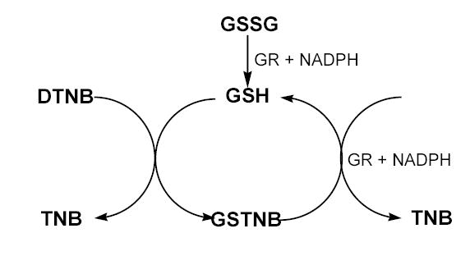
- The enzymatic recycling method for quantitation of GSH and/or GSSG. GSSG, oxidized glutathione;; GSH, reduced glutathione; GR, glutathione reductase; DTNB, 5,5′-dithiobis(2-nitrobenzoic acid); TNB, 5-thio-2-nitrobenzoic acid; GSTNB, the disulfide product of reaction of GSH with DTNB.

Slide 8
- Method:
Preparation of serial GSH concentration
Tube No. | GSH stock Solution (ml) | Phosphate Solution (ml) | DTNB (ml) | Total Volume (ml) | GSH Concentration (mg/dl) | GSH Concentration (μg/ml)
1 | 0.6 | 2.15 | 0.25 | 3 | 2 | 20
2 | 1.2 | 1.55 | 0.25 | 3 | 4 | 40
3 | 1.8 | 0.95 | 0.25 | 3 | 6 | 60
4 | 2.4 | 0.35 | 0.25 | 3 | 8 | 80
5 | 3 | 0 | 0.25 | 3 | 10 | 100
Blank | 0 | 0.6 | 0.25 | 3 | 0 | 0
Sample 1 | 0.3 | 2 | 0.25 | 3
- Tubes from 1 to 5- Take 0.5 ml of solution+ 2ml of Ph Solution+ + 0.25 DTNB+ 0.25 H2O.
- For sample: Make up the volume to 3ml by adding 0.45 ml H2O.
- For Blank: Make up the volume to 3ml by adding 2.15 ml H2O.
Water bath at 37 ⁰C for 10 min Read absorbance at 412 nm

Slide 9
- Glutathione standard curve data:
Tube No. | GSH concentration (μg/ml) | Absorbance At 412 nm
1 | 20
2 | 40
3 | 60
4 | 80
5 | 100
Blank | 0
Sample 1
How to convert concentration unit from mg/dl to μg/ml ?
2 mg/dl to μg/ml 2 x 1000/100= 20 μg/ml

Slide 10
Preparation of Blood Sample for GSH determination.
Best results are obtained with fresh blood samples
1- Collect the blood in heparin test tubes.
Immediately shake the tubes and keep the blood at 4⁰C .
Centrifuge at least 5 ml of whole blood at 600g at 4°C for 10 minutes.
3. The pellet contains the red blood cells and the supernatant is the plasma fraction.
4. Keep the supernatant (plasma ) for glutathione assay. Discard the precipitate (erythrocytes).

Slide 11
5. Take 0.2 ml of plasma supernatant +1.8ml of deionized distilled water + 0.3ml of precipitating reagent .
6. Centrifuge at 1200Xg for 10 min.
7. Take 0.3ml of above supernatant+ 2ml of Na2PO4(0.3M) +0.25ml of DTNB-Reagent .
- Make up the volume to 3ml with distilled water 0.45 ml H2O.
8- Incubate the above mixture for 10min in water bath 37⁰C.
9- Read the absorbance at 412nm using spectrophotometer.

Slide 12
Calculation of glutathione Concentration:
The glutathione concentration in the sample was calculated by plotting its absorbance on the standard curve and expressed as μg/ml of the plasma.
Total volume of extracted plasma is 3 ml, so calculate the concentration in 3 ml of plasma.
Calculate sample concentration of the sum GSH and GSSG in mg by converting μg to mg.
Normal range:
GSH and GSSG concentration = 3.8-5.5 μmol/L = 3.344-4.84 mg
1 μmol/L = 0.88 mg

