Slide 1
Bayes’ Rule

Slide 2
Total Probability Theorem of the total probability (rule of elimination)

Slide 3
Example:
Suppose that our sample space S is the
population of adults in a small town who have
completed the requirements for a college
degree. We shall categorize them according to
gender and employment status. The data are
given in Table below

Slide 4
Suppose that we are now given the additional information that 36 of those employed and 12 of those unemployed are members of the Rotary Club. We wish to find the probability of the event A that the individual selected is a member of the Rotary Club.

Slide 5
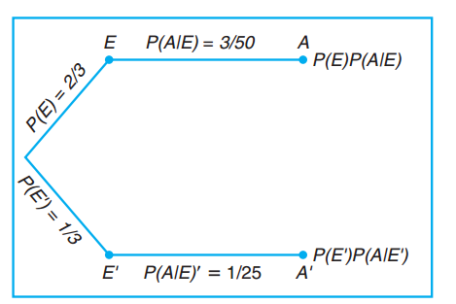

Slide 6
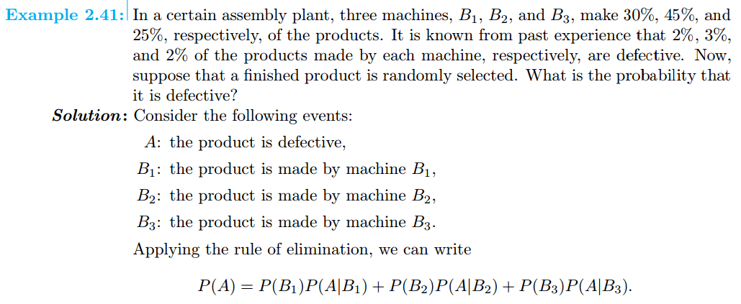

Slide 8
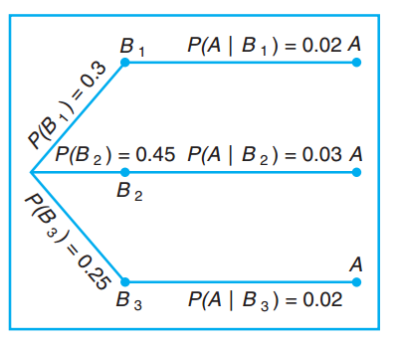

Slide 9
Bayes’ Rule
Instead of asking for P(A) in the above example, by the rule of elimination, suppose that we now consider the problem of finding the conditional probability P(Bi|A). In other words, suppose that a product was randomly selected and it is defective. What is the probability that this product was made by machine Bi? Questions of this type can be answered by using the following theorem, called Bayes’ rule

Slide 10
Theorem:

Slide 12
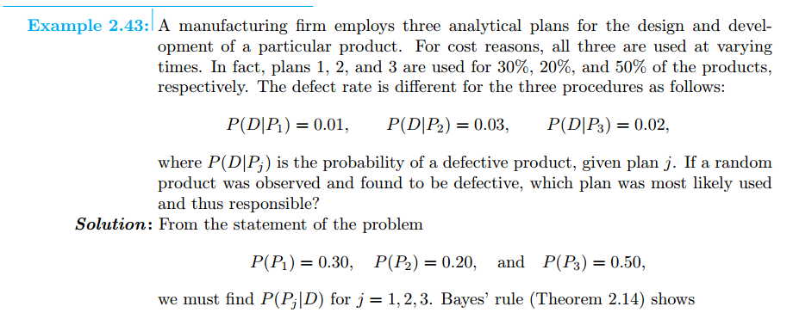

Slide 13
