Slide 1
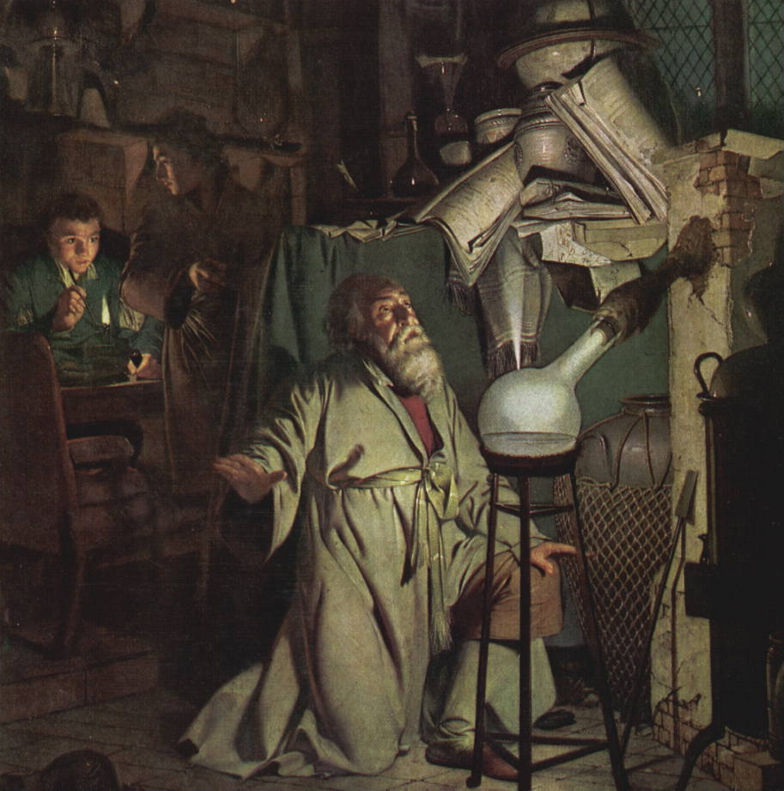
Chemistry of Life

Slide 2
All living organisms are composed of matter.
Matter is anything that takes up space and has mass
An element is the simplest form of matter.
Cannot be broken down to other substances by chemical reactions.

Slide 3
Elements of Life
The human body is primarily made of 6 elements:
Element | % of Body Weight | Significance
Oxygen, O | 65 | Part of water; Needed for cellular respiration.
Carbon, C | 18.6 | Backbone of all organic molecules.
Hydrogen, H | 9.7 | Found in nearly every compound in the body.
Nitrogen, N | 3.2 | Part of proteins and nucleic acids.
Calcium, Ca | 1.8 | Bones, teeth, used in nerve impulses and to signal muscle contraction.
Phosphorus, P | 1.0 | Bones, teeth, nucleic acids, and ATP (energy molecule).

Slide 4
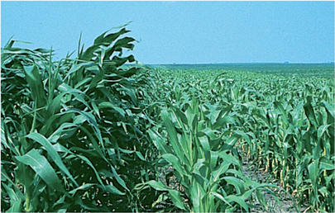
The lack of even one element of life in an organism can cause its health to deteriorate.
A goiter, or enlarged thyroid, caused by iodine deficiency.
Nitrogen deficient corn (right side).

Slide 5
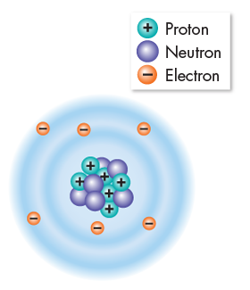
The building blocks of matter are atoms, basic units of matter made of protons, electrons, and neutrons.
Atoms are extremely small; 100 million atoms laid side-by-side would only make a row one centimeter long.
About the width of your little finger!

Slide 6
Atoms are made of three particles, two in the nucleus:
Protons are positively charged particles (+) that determine the atom’s identity.
Neutrons are particles that carry no charge and determine the atom’s mass.
Protons and neutrons are similar size and mass.

Slide 7
Electrons are negatively charged particles (–) with only 1/1840 the mass of a proton.
Electrons are in constant motion in the space surrounding the nucleus.
Electrons determine how reactive an atom will be with other atoms.

Slide 8
Neutral atoms have equal numbers of protons and electrons.
The positive and negative charges cancel each other out, leaving no net charge across the atom.
The carbon atom shown to the right is a neutral atom with 6 protons and 6 electrons.

Slide 9
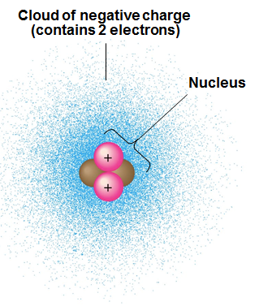
Atoms are typically drawn in two ways.
The more accurate representation involves drawing an electron cloud.
This is considered more accurate because electrons move too quickly to pinpoint them at any specific location in the atom.

Slide 10
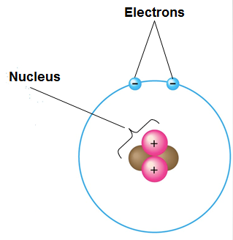
The most commonly used way to draw atoms is the planetary, or electron-shell model.
This method makes it easier to see the electrons and how they interact with other atoms during chemical reactions.
Electron shell models are inaccurate in two ways:
They are not drawn to scale, as the atom is mostly empty space.
The electrons are not stationary.

Slide 11
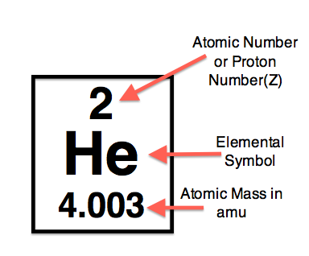
Atomic Number and Atomic Mass
The particles that a specific atom is made of can be determined by looking at the periodic table.
An element’s atomic number represents the number of protons in the nucleus.
An element’s mass number or atomic mass represents the average atomic mass of protons plus neutrons in the nucleus.
Electrons are too light to affect the mass in a significant way.

Slide 12
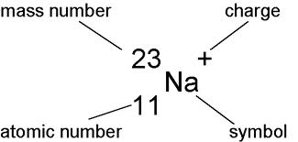
Ions
Atoms that have gained or lost an electron are no longer neutral, they have a charge.
They are now called ions.
Ions in the human body are sometimes called electrolytes, and include:
Na+ (sodium), found in tears, sweat, blood
K+ (potassium), found in nerve cells, blood
Ca+ (calcium), found in blood, nerve cells, muscle cells, bone
Cl- (chloride), found in blood and stomach acid
Isotope notation.

Slide 13
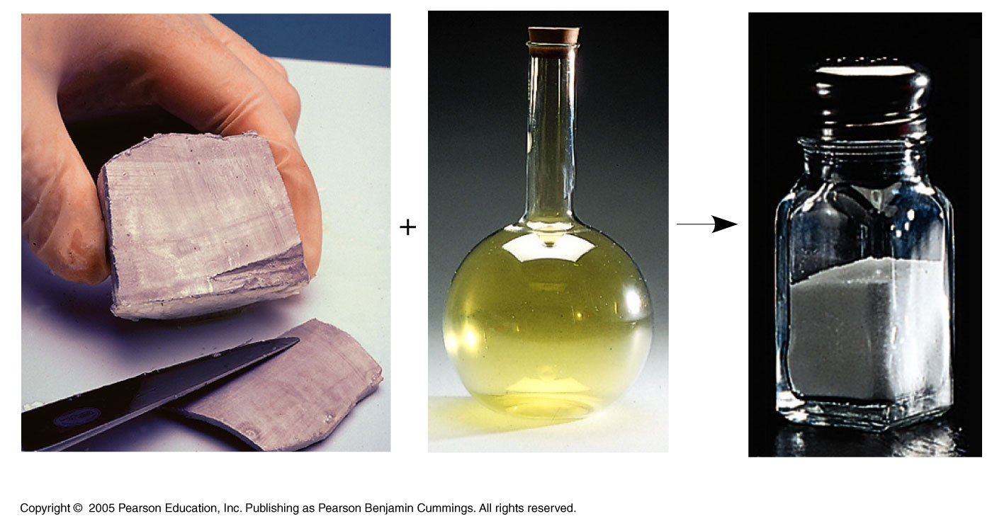
Chemical Bonds
Two or more elements can combine to form molecules. They are held together by chemical bonds.
2Na_{(s)} + Cl_{2(g)} → 2NaCl_{(s)}

Slide 14
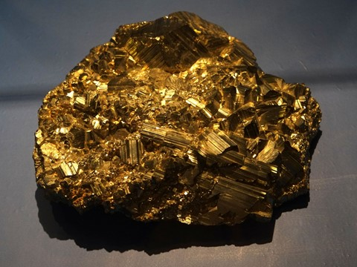
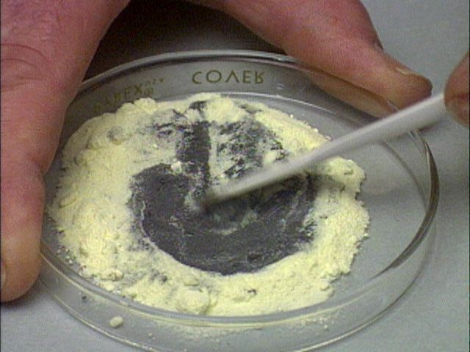
A compound is a molecule consisting of two or more elements that have chemically combined.
Compounds may have entirely different properties than the elements they are made of.
These are different than mixtures, which are made of compounds or elements that are not chemically combined.
Iron Sulfide, FeS
Iron and Sulfur mixture

Slide 15
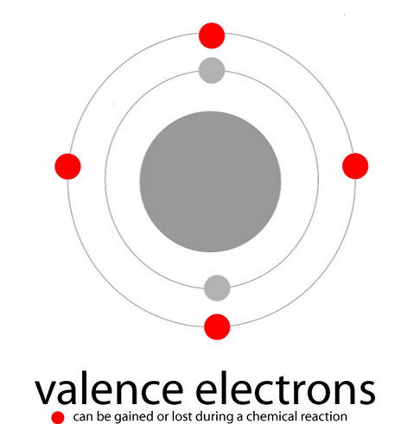
Valence Electrons
Valence electrons are those in the outermost level of an atom.
Atoms tend to interact with other atoms in such a way that they have eight valence electrons.
This is called the ”octet rule.”

Slide 16
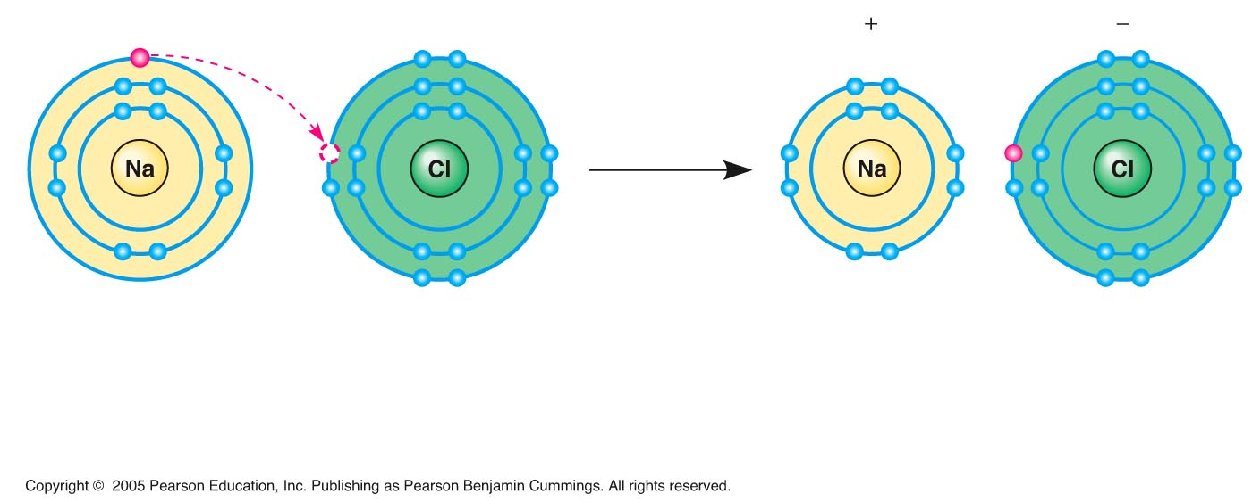
Atoms are in their most stable form when their outer “shell” of valence electrons is full.
To do this, some atoms will take electrons from others.
For example, an electron transfers from sodium to chlorine.
After the transfer, both atoms are charged ions.
The two ions attract each other, forming an ionic bond.
Sodium atom
(an uncharged
atom)
Chlorine atom
(an uncharged
atom)
Sodium chloride (NaCl)
Na⁺
Cl–
Sodium ion
Chlorine ion

Slide 17
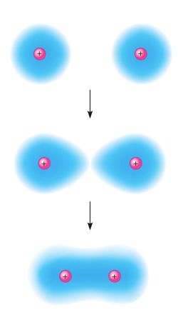
Atoms can also fill their outer electron shell by sharing electrons with another element.
The resulting molecule is held together with a covalent bond.
Hydrogen atoms (2 H)
Hydrogen
molecule (H₂)

Slide 18
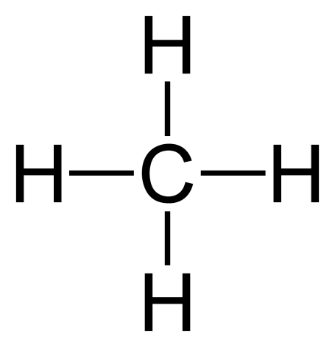
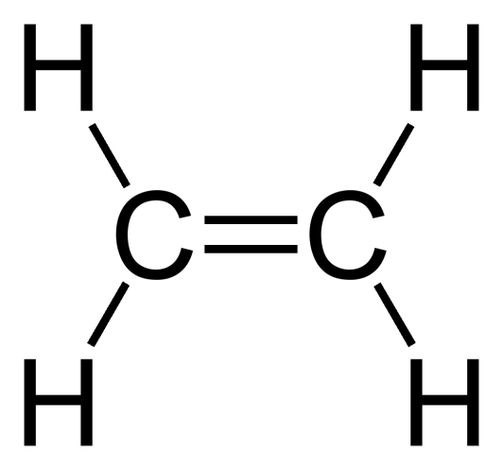
If atoms share one pair of electrons, they form a single covalent bond.
A double covalent bond, is the sharing of two pairs of valence electrons.
A triple covalent bond, is the sharing of three pairs of valence electrons.

Slide 20
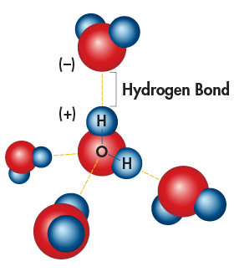
Some covalent molecules have, as a result of the positioning of their electrons, a negative and positively-charged end.
These are called polar covalent molecules.
A hydrogen bond occurs when opposite charges of two polar compounds attract each other.
A common example is the interactions between water molecules.

Slide 21
Properties of Water
Water is an essential compound for all life, and has many unusual properties as a result of its hydrogen-bonding.
Cohesion is the attraction between molecules of water.
Causes water to form beads or droplets.

Slide 22
Cohesion also creates the effect of surface tension.

Slide 23
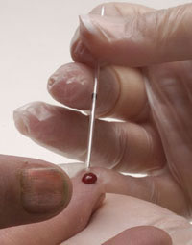
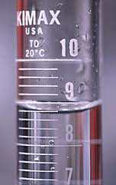
Adhesion is the attraction of water to the molecules of the container or tube it is in.

Slide 24
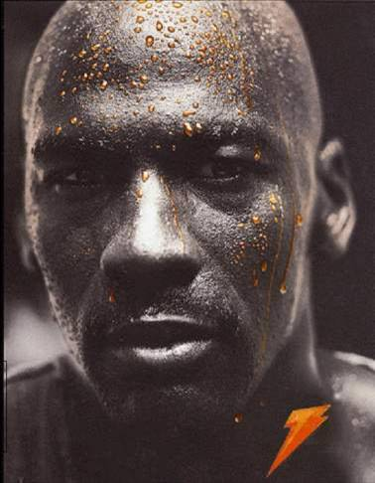
Water has a very high heat capacity, meaning a large amount of heat energy is required to raise the temperature of water.
The evaporation of sweat from skin removes a lot of excess heat.

Slide 25
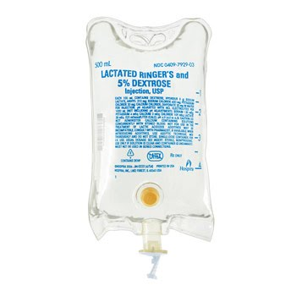
Water also known as the universal solvent.
Because water is polar, it can dissolve many different solutes, such as salts and sugars.
When something is dissolved completely in water, it is called a solution.
Ringer’s solution: Sodium ion, chloride ion, lactate, potassium ion, calcium ion, water.

Slide 26
Acids and Bases
A few (1 in 550 million) water molecules spontaneously split into ions.
Pure water has equal amounts of H+ and OH- ions. This is considered neutral.
Acids have higher amounts of H+ ions.
Bases have higher amounts of OH- ions.
pH measures the concentration of hydrogen ions in a solution.
Lower pH means a higher concentration of H+

Slide 27
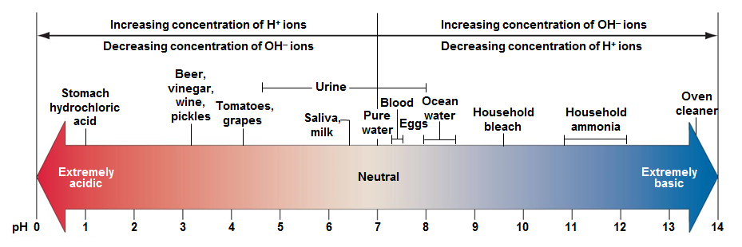
The pH scale is used to measure the relative acidity or alkalinity of solutions.
7 is considered neutral.
Anything approaching zero is more acidic.
Anything approaching 14 is more basic or alkaline.

Slide 28
pH is a logarithmic scale, meaning that an change of 1 pH is actually a tenfold increase or decrease in the H+ concentration of the solution.
Beer is 10 times (10¹) more acidic than tomatoes.
Stomach acid is 1000 (10³) more acidic than tomatoes.

Slide 29
pH and Homeostasis
Blood requires a pH of 7.35-7.45.
Sweat has a pH between 4.0-6.8.
Saliva pH is normally around 6.0.
Blood and other body fluids contain buffers, which can “absorb” increases on H+ (acid) or OH- (base) ions.
This keeps blood pH within a narrow range, no matter how acidic or alkaline your diet is.

