Slide 1
Java Applets

Slide 2
Lecture Objectives
Learn about Java applets.
Know the differences between Java applets and applications.
Designing and using Java applets
Running Java applets.
Security issues with Java applets.

Slide 3
Introduction
Java programs are divided into two main categories, applets and applications.
An application is an ordinary Java program.
An applet is a kind of Java program that can be run across the Internet.

Slide 4
Programming Applets
The word applet is meant to suggest a small application.
Applets were intended to be small programs run over the Internet:
However, there are no size constraints on applets.
Applets can be viewed over the Internet, or without any connection to the internet.
An applet is similar to a Swing GUI:
In fact, almost all of the Swing techniques can be used in applets.

Slide 5
Defining an Applet
An applet class is normally defined as a derived class of the class Japplet.
The class JApplet is in the package javax.swing.
There is also an older class, Applet, which has been superseded by the JApplet class.

Slide 6
Designing an Applet
An applet class can be designed as a derived class of JApplet in much the same way that regular Swing GUIs are defined as derived classes of Jframe.
However, an applet normally defines no constructors.
The method init performs the initializations that would be performed in a constructor for a regular Swing GUI

Slide 7
Designing an Applet (Cont’d)
Components can be added to an applet in the same way that a component is added to a JFrame
The method add is used to add components to an applet in the same way that components are added to a JFrame

Slide 8
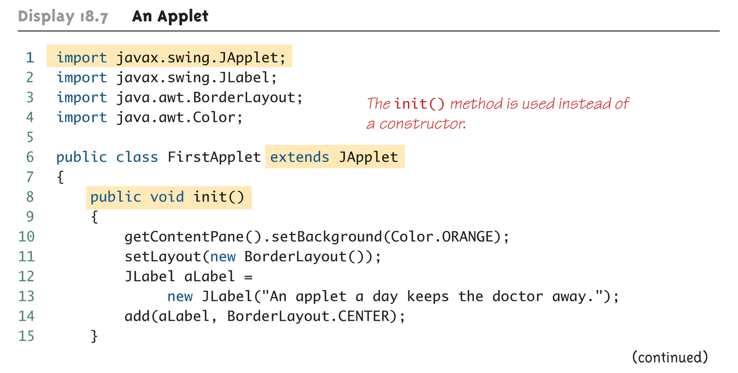
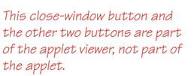
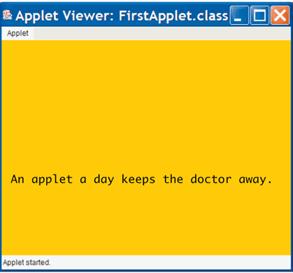
Java Applets: An Example
Output using an applet viewer

Slide 9
How Applets Differ from Swing GUIs?
Some of the items included in a Swing GUI are not included in an applet
Applets do not contain a main or setVisible method
Applets are displayed automatically by a Web page or an applet viewer
Applets do not have titles
Therefore, they do not use the setTitle method
They are normally embedded in an HTML document, and the HTML document can add any desired title

Slide 10
How Applets Differ from Swing GUIs? (Cont’d)
Applets do not use the setSize method
The HTML document takes care of sizing the applet
Applets do not have a close-window button
Therefore, they do not have a setDefaultCloseOperation method
When the HTML document containing the applet is closed, then the applet is automatically closed

Slide 11
Running an Applet
An applet class is compiled in the same way as any other Java class
However, an applet is run differently from other Java programs
The normal way to run an applet is to embed it in an HTML document
The applet is then run and viewed through a Web browser

Slide 12
Running an Applet (Cont’d)
An applet can also be viewed using an applet viewer
An applet viewer is a program designed to run an applet as a stand-alone program
The Java appletviewer can be used to run an applet:
appletviewer FirstApplet.html
It may be necessary, however, to create the HTML document, and place the applet in it

Slide 13
Menus in a JApplet
Menus are constructed and added to a JApplet as they are for a Jframe
JApplet has a method named setJMenuBar that behaves the same as the setJMenuBar method of a JFrame
JApplet can also have menu bars added to a JApplet or to a panel that is part of the JApplet using the add method

Slide 14
Tip: Converting a Swing Application to an Applet
The fastest and easiest way to explain how to define an applet, is to explain how to modify a Swing GUI to transform it into an applet
Derive the class from the class JApplet instead of from the class Jframe
Remove the main method
Replace the constructor with a no-parameter method named init
The body of the init method can be the same as the body of the deleted constructor, but with some items removed

Slide 15
Tip: Converting a Swing Application to an Applet (2)
Delete any invocation of super
Delete any method invocations that program the close-window button of a windowing GUI
Delete any invocation of setTitle
Delete any invocation of setSize
The following applet was generated in this way.

Slide 16
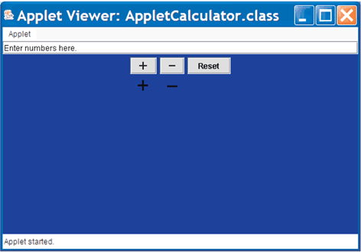
The Applet Calculator

Slide 17
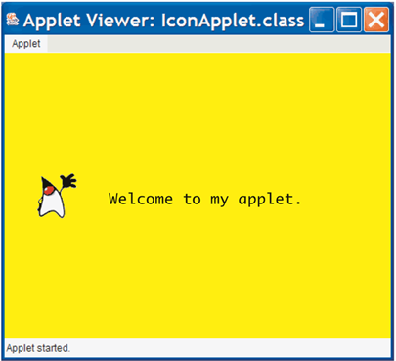
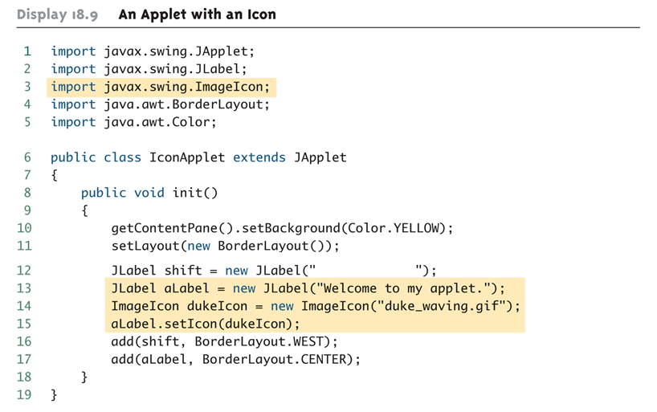
An Applet with an Icon
Output using an applet viewer

Slide 18
Inserting an Applet in an HTML Document
An applet can be placed in an HTML document with an applet tag:
<applet code="PathToApplet"
width=Number1 height=Number2>
</applet>
If given a .class file name only, then the HTML file and the applet file must be in the same directory
The PathToApplet can be a full or relative path name

Slide 19
Inserting an Applet in an HTML Document (Cont’d)
Note that the name of the .class file, not the .java file, is given
Note also that the width and height of the applet is given in this command, and not within the applet class definition
The width and height are in pixels
The following code, when placed in an HTML document, will display the calculator applet in a browser as shown
<applet code="AppletCalculator.class"
width=400 height=300>
</applet>

Slide 20
An Applet in an HTML Document
<html>
<head>
<title>
Vampire Control
</title>
</head>
. . .
<applet code="AppletCalculator.class" width=400 height=300>
</applet>
. . .
</html>

Slide 21
Pitfall: Using an Old Web Browser
An old browser may not be able to run applets from an HTML document:
Even if a java application runs correctly on the same system.
Web browsers do not use the same Java Virtual Machine used to run regular Java applications.
An old browser will have an old Java Virtual Machine, or perhaps, no Java Virtual Machine.
However, an applet viewer will work, as long as a recent version of Java is installed.

Slide 22
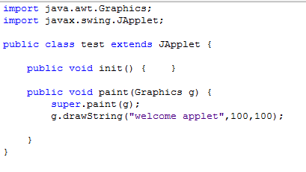
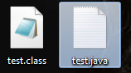
Getting started…
Create a new java class file
After that build the file … the you will get tow files

Slide 23
Getting started…
<HTML> <HEAD> <TITLE> Welcome Applets </TITLE> </HEAD> <BODY> <OBJECT code="test.class" width="400" height="400" > </OBJECT> </BODY> </HTML>
Now use the previous code in to a regular HTML document

Slide 24
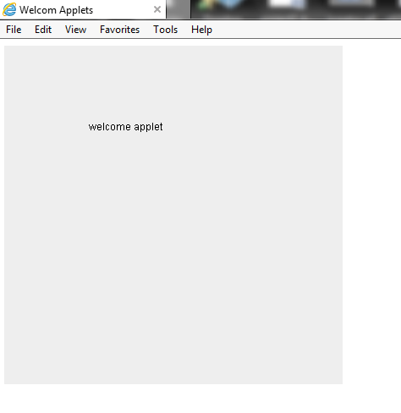

Slide 25
Developing Applets
Java applets do not need a ‘main’ method. they can run in a web browser environment
The applet have
Init()
Start()
Stop()
Paint( Graphics g)

Slide 26
init()
called by the browser or applet viewer to inform this applet that it has been reloaded to the system
We use init() to:
Initialize variables
Get data from user
Place various GUI component.

Slide 27
start() & stop()
Start() //called by the browser or applet viewer to inform this applet that it should start its execution
Stop() //called by the browser or applet viewer to inform this applet that it should stop its execution

Slide 28
paint( Graphics g)
is used to create the output .
whenever you override this method the first java statement is
super.paint(g);
To draw a string we use drawString method
Public abstract void drawstring(String str, int x, int y)

Slide 29
paint( Graphics g)
To change the text font
setFont(new Font(“font name”, ”font style”, font_size)
To chang the text color setColor(Color.red)
The available constant colors
White, Black , blue, cyan, darkGray ,gray ,lightGray ,red, yellow,pink, orange, magenta ,green
Using JDK guarantees the following fonts: | Font style
Serif | Font.PLAIN
Sanserif | Font.BOLD
Monospaced | Font.ITALIC
Dialog
DialogInput

Slide 30
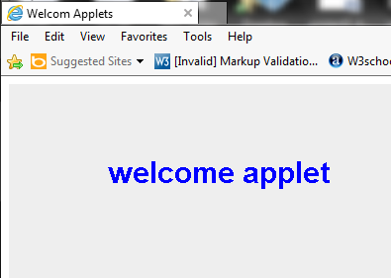
Example

Slide 31
JAVA application VS. applets
Java applications and Applets share some common programming features although they differ in some aspects
GUI | Applets
Is derived from class Jframe | Is derived from class JApplet
Have “MAIN” method | Do not have main method instead It have init(), start(), stop(), paint(..)
Uses the class constructor to initialize the GUI component and data members | Uses the init() method to initialize the GUI component and data members
Uses setSize(),setTitle(), setVisible() methode | don not use the because the HTML document do the job.

Slide 32
converting JAVA application to applets
Change the extends from JFrame to JApplets.
Change the constructor to method init().
Remove method calls like setSize(),setTitle(), setVisible() .
Remove the method main

Slide 33
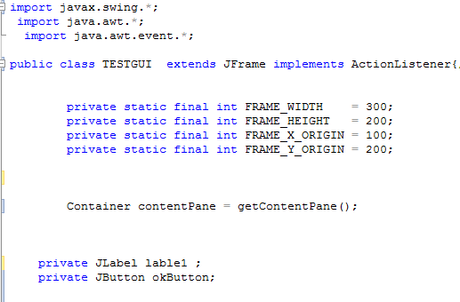
Simple application Example

Slide 34
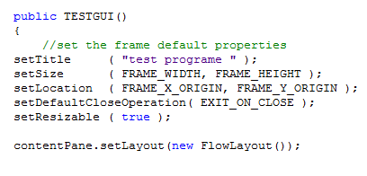
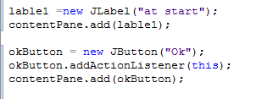
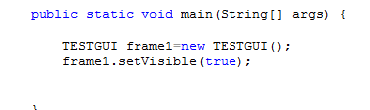

Slide 35
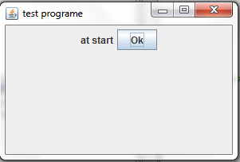
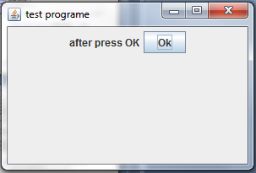

Slide 36
Convert to applet

Slide 38
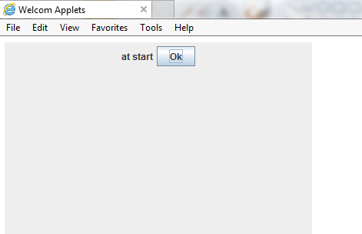
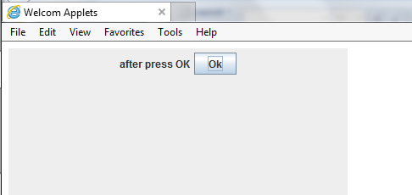

Slide 39
The java.awt package
“awt” stands for “Abstract Window Toolkit”
The java.awt package includes classes for:
Drawing lines and shapes
Drawing letters
Setting colors
Choosing fonts
If it’s drawn on the screen, then java.awt is probably involved!

Slide 40
Importing the java.awt package
Since you may want to use many classes from the java.awt package, simply import them all:
import java.awt.*;
The asterisk, or star (*), means “all classes”
The import directives can go in any order, but must be the first lines in your program

Slide 41
The applet so far
import java.applet.Applet; import java.awt.*;

Slide 42
Your applet class
public class Drawing extends Applet { … }
Drawing is the name of your class
Class names should always be capitalized
extends Applet says that our Drawing is a kind of Applet, but with added capabilities
Java’s Applet just makes an empty window
We are going to draw in that window
The only way to make an applet is to extend Applet

Slide 43
The applet so far
import java.applet.Applet; import java.awt.*;
public class Drawing extends Applet {
…we still need to put some code in here...
}

Slide 44
The paint method
Our applet is going to have a method to paint some colored rectangles on the screen
This method must be named paint
paint needs to be told where on the screen it can draw
This will be the only parameter it needs
paint doesn’t return any result

Slide 45
The paint method, part 2
public void paint(Graphics g) { … }
public says that anyone can use this method
void says that it does not return a result
A Graphics (short for “Graphics context”) is an object that holds information about a painting
It remembers what color you are using
It remembers what font you are using
You can “paint” on it (but it doesn’t remember what you have painted)

Slide 46
The applet so far
import java.applet.Applet; import java.awt.*;
public class Drawing extends Applet {
public void paint(Graphics g) { …we still need to put some code in here… } }

Slide 47
Colors
The java.awt package defines a class named Color
There are 13 predefined colors—here are their fully-qualified names:
Color.BLACK Color.PINK Color.GREEN Color.DARK_GRAY Color.RED Color.CYAN Color.GRAY Color.ORANGE Color.BLUE Color.LIGHT_GRAY Color.YELLOW Color.WHITE Color.MAGENTA
For compatibility with older programs (before the naming conventions were established), Java also allows color names in lowercase: Color.black, Color.darkGray, etc.

Slide 48
Setting a color
To use a color, we tell our Graphics g what color we want:
g.setColor(Color.RED);
g will remember this color and use it for everything until we tell it some different color

Slide 49
The paint method so far
public void paint(Graphics g) { g.setColor(Color.BLUE); …draw a rectangle… g.setColor(Color.RED); …draw another rectangle… } }

Slide 50
Pixels
A pixel is a picture (pix) element
one pixel is one dot on your screen
there are typically 72 to 90 pixels per inch
java.awt measures everything in pixels

Slide 51
Java’s coordinate system
(0, 0)
(50, 0)
(0, 20)
(50, 20)
(w-1, h-1)
Java uses an (x, y) coordinate system
(0, 0) is the top left corner
(50, 0) is 50 pixels to the right of (0, 0)
(0, 20) is 20 pixels down from (0, 0)
(w - 1, h - 1) is just inside the bottom right corner, where w is the width of the window and h is its height

Slide 52
Drawing rectangles
There are two ways to draw rectangles:
g.drawRect( left , top , width , height );
g.fillRect(left , top , width , height );

Slide 53
The complete applet
import java.applet.Applet; import java.awt.*;
public class Drawing extends Applet {
public void paint(Graphics g) {
g.setColor(Color.BLUE); g.fillRect(20, 20, 50, 30); g.setColor(Color.RED); g.fillRect(50, 30, 50, 30); } }

Slide 54
Some more java.awt methods
g.drawLine( x1 , y1 , x2 , y2 );
g.drawOval( left , top , width , height );
g.fillOval( left , top , width , height );
g.drawRoundRect( left , top , width , height );
g.fillRoundRect( left , top , width , height );
g.drawArc( left , top , width , height , startAngle , arcAngle );
g.drawString( string , x , y );

Slide 55
The HTML page
You can only run an applet in an HTML page
The HTML looks something like this:
<html> <body> <h1>DrawingApplet Applet</h1> <applet code="DrawingApplet.class" width="250" height="200"> </applet> </body> </html>

