Slide 1
Antibiotic
By:Afnan Bakhsh

Slide 2
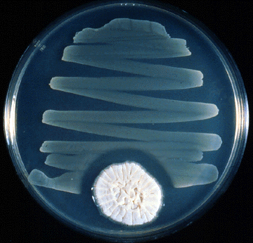
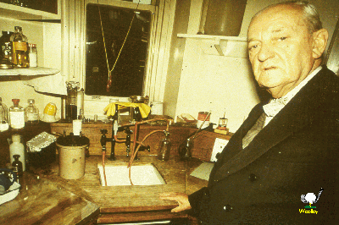
Sir Alexander Fleming (1881 –1955)
“One sometimes finds what one is not
looking for“ Penicillin
He observed inhibition of staphylococci on an agar
plate contaminated
by a Penicillium mold

Slide 3
Antibiotic: It’s a compound produced by living organism which inhibit or kills other organism.
It can be:
Bactericidal: antibiotic that kills the bacteria.
Bacteriostatic: antibiotic that inhibits the growth of bacteria.

Slide 4
Types of antibiotics:
1- broad-spectrum: If it is effective against both gram +ve and gram −ve organisms.
2- narrow-spectrum: If it is effective against gram +ve only or gram −ve organisms only.

Slide 5
Antibiotics mechanisms of action against bacteria:
Inhibition of DNA synthesis.
Inhibition of protein synthesis
Inhibition of cell wall synthesis
Inhibition of cell membrane function

Slide 7
Why do we do sensitivity testing??
1-To know which drug we use to the patient.
2-To Know the dose of antibiotic.
It is important to use the lowest effective concentration of the antibiotic to avoid toxicity in patient.

Slide 8
Antibiotic susceptibility test:
We have to test the susceptibility of bacteria to several antibiotics to check if the bacteria is sensitive or resistant to the used antibiotic.
Methods of Antibiotic susceptibility test:
1) Broth dilution
2) Agar diffusion (solid) :
1) Kirby-Bauer method:
2) Stoke's method
:

Slide 9
Termenology
Sensitive (=Susceptible):
Organism is inhibited by this antibiotic.
Resistant:
Organism is not inhibited by this antibiotic.
Intermediate:
Organism response to antibiotic may be lower than for the sensitive isolates. And usually the drug should be used in higher than normal dosage.

Slide 10
1) Kirby-Bauer method:
We use:
Muller Hinton agar (MH)
Test bacteria (from the patient)
Antibiotics discs
Result:
If the bacteria are sensitive to the antibiotic we will see inhibition zone.
If the bacteria are resistance to the antibiotic we will NOT see the inhibition zone.

Slide 11
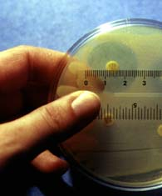

Slide 13
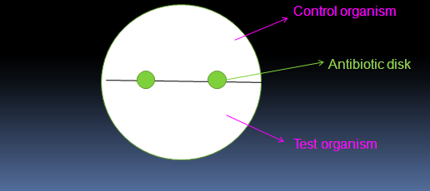
2) Stoke's method:
We use:
1-Muller Hinton agar (MH)
2-Test bacteria (from the patient) and
Control bacteria (from the reference lab)
3-Antibiotics discs

Slide 15
Results of Stockes Method:
Result:
If the inhibition zone of the test organism is bigger or equal to the inhibition zone of the control organism that means that the bacteria is sensitive to the antibiotic.
If the inhibition zone of the test organism is smaller to the inhibition zone of the control organism that means that the bacteria is resistance to the antibiotic.
T > C or T = C ➔ Sensitive
T< C ➔ Resistance

Slide 17
:Broth Dilution Method
MIC (minimum inhibitory concentration):
This test to know the minimum concentration of antibiotic that can inhibit or kill the bacteria growth.
MIC of the test is the last tube that shows No growth.

Slide 18
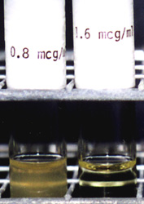

Slide 21
Thank You

