Slide 1
Analysis of marriage

Slide 2
Marriage
Legal union of persons of opposite sex
The legality of the union may be established by civil, religious, or other means as recognized by the laws of each

Slide 3
Types of marriage:
1- Monogamy:
is a form of marriage in which an individual has only one spouse during their life time.
2- Polygamy:
Is a form of marriage where a man is married to more than one wife at a time.

Slide 4
The measurement of marriage:
1- Crude marriage rate (CMR):
marriage in year
CMR =
X 1000
Mid-year population

Slide 5
Example:
In a certain community, the number of marriages in 1412H was 1404.
The number of people at the mid-year was 194,650.

Slide 6
1404
X 1000
= 7.2/1000
CMR =
194650
Note that:
1- Numerator is the number of marriages, rather the number of persons getting married.
For this reason the rate tend to be low, since there will be only one event in the numerator per two people in the denominator.

Slide 7
2- It has the deficiency that the denominator is the total population, including children and others not currently at risk of marrying (currently married) or divorcing.
3- Age structure of the population also affects CMR.

Slide 8
General marriage rate (GMR):
Marriages
GMR =
X 1000
Mid-year age 15+
General Marriage Rate is the number of marriages per 1,000 population age 15 and older

Slide 9
Example:
In the previous example, if the number of those who were below 15 was 68512 calculate CMR:
To get the number who were 15+, we deduct the number of those who were less than 15 from mid- year population, that is:

Slide 10
194650 –68512 = 126138
1404
CMR =
X 1000
= 11.13/1000
126138

Slide 11
General Marriage Rate can also be obtained separately for Women and Men
General marriage rate for women (GMRf)
Marriages
GMRf =
X 1000
Mid-year female15+

Slide 12
General marriage rate for men(GMRm)
Marriages
X 1000
GMRm =
Mid-year male15+

Slide 13
Exercise
General Marriage Rate
Calculate the general marriage rate for women and compare it to the general marriage rate for Brazil (1988) based on the following data

Slide 14
Brazil, 1988
Number of marriages : 951 236
Total population 15+ : 92 852 000
Total female population 15+: 46,706 000
Answers:
1- GMR = 10.24
2- GMRf = 20.37

Slide 15
Age specific marriage rate:
The Timing of marriage is a basic consideration in explaining fertility trends:
Early marriage is associated with higher fertility, together with high proportions remaining unmarried is associated with lower fertility.

Slide 16
age specific rates are valuable for showing whether marriage is occurring early or late.
The rates are often calculated separately for each sex, because of each differences between spouses.

Slide 17
Age specific marriage rate ASMR (females):
ASMR =
Marriages for females aged x to x + n
X 1000
Mid-year female population aged x to x + n

Slide 18
age specific marriage rate for Australia 2000
Marriage rate/1000 | Women marrying | Mid-year population females | age intervals
4.9 | 322 | 65805 | 15 - 19
41.5 | 2733 | 66587 | 20 – 24
51.5 | 3772 | 73273 | 25 – 29
27.3 | 1943 | 71211 | 30 – 34
13.3 | 995 | 74916 | 35 – 39
8.2 | 590 | 72366 | 40 – 44
4.3 | 280 | 65210 | 45 - 49

Slide 19
For example, age specific marriage in the interval (25 – 29) can be obtained as:
ASMR (F, 25 – 29)=
3772
X 1000 =
73273
51.5/1000

Slide 20
Total marriage rate (TMR):
The ASMR can be summed to form
Total marriage rate in analogous way to the total fertility rate.
For our example, this can be calculated as:
(4.9 + 41.5 + 51.5 + 27.3 + 13.3 + 8.2 + 4.3) x 5
1000

Slide 21
0.755
This could be interpreted as the proportion of women who could eventually marry if the age specific rates are prevailed.

Slide 22
Indicators of Divorce

Slide 23
Divorce
Separation of the husband and wife by a judicial decree which confers on the parties the right to remarriage

Slide 24
1- Crude divorce rate (CDR)
Number of divorces per 1,000 population
Number of divorces
CDR =
X 1000
Mid-year population

Slide 25
General Divorce Rate (GDR):
Is the umber of divorces per 1,000 persons age 15 and more
Number of divorces
X 1000
GDR =
Mid-year pop 15+

Slide 26
Calculate the crude divorce rate and the general divorce rate for Brazil (1988) based on the data:
Number of divorces : 33,437
Total population 15+: 92,852,000
Total population : 144,428,000

Slide 27
Crude Divorce Rate =
6.45 divorces per 1,000 population
General Divorce Rate =
10.03 divorces per 1,000 persons age 15+

Slide 28
Divorce Rate Among Married Couples
Is the Number of divorces per 1,000 married persons (DRM)
Number of divorces
X 1000
DRM=
Mid-year pop among married

Slide 29
Age-Specific Divorce Rate (ASDR)
Is the number of divorces per 1,000 women (or men) of age “a”
ASDR=
Divorces by women age “a”
X 1000
Mid-year pop women age “a”

Slide 30
Exercise
Calculate the age-specific divorce rates for women 30–34 and 40–44 for Brazil (1988) based on the following data:
Age groups | divorces | population
30 - 34 | 6689 | 5,443,000
40 - 44 | 4825 | 3,590,000

Slide 31
Age-specific divorce rate:
1.23 divorces per 1,000 women 30–34
1.34 divorces per 1,000 women 40–44

Slide 32
Upon the completion of this module, the student will be able to :
Define migration and its different forms
Define pull and push factors for migration.
Describe the consequences of migration\
Define urbanization

Slide 33
Migration

Slide 34
What is Migration?
Migration:
The act of moving to a new place outside the community of origin; with the purpose of establishing a new permanent or semi-permanent residence.

Slide 35
2. International Migration:
Moves between countries
Immigration :
move into a new country
Immigrant:
An international migrant who enters the area from a place outside the country.

Slide 36
Emigration:
move out of home country.
Emigrant:
An international migrant departing to another country by crossing the international boundary.

Slide 37
3. Internal migration:
Moves within a country
In-Migration:
movement into a new geographically/ administratively defined area within the same country.
In-Migrant :
A person who moves into a new area within the same country􀂊

Slide 38
Types of Migration
Voluntary migration
The migrant makes the decision to move.
Involuntary
Forced migration in which the mover has no role in the decision-making process.

Slide 39
Refugees.
Military conscription.
Children of migrants.
Situations of divorce or separation.

Slide 40
Meanings
Lina decides to leave her home town for good and move to a new area.
Ahmed moves from Emirates to Saudi Arabia.
Rana and her family have to leave Iraq because of the war.

Slide 41
Huda is happy in Riyadh but decides to move to Jeddah for a new job and better standard of living.
Ali travels from Kharg to Riyad each day to go to work.
Nadia moves to Jeddah every summer to work in the tourist area.

Slide 42
1. International migration
Ahmed moves from Emirates to Saudi Arabia.
2. Forced migration
Rana and her family have to leave Iraq because of the war
3. Seasonal regional migration
Nadia moves to Jeddah every summer to work in the tourist area.

Slide 43
4- Voluntary migration
Huda is happy in Riyadh but decides to move to Jeddah for a new job and better standard of living.
5. Permanent migration
Lina decides to leave her home town for good and move to a new area.
6. Daily migration
Ali travels from Kharg to Riyad each day to go to work.

Slide 44
Sources of migration data
Population censuses
Population registers
Sample surveys
International migration statistics records
Other sources

Slide 45
Why do people move?
All migration is a combination of push and pull factors.

Slide 46
Characteristics of Migrants
Historically, males were more likely than females to migrant internationally
Because men worked more than women and left to find job opportunities
Since the 1990s, female migrants are on the rise
Most long distance migrants are young adults seeking work –not children or elderly

Slide 48
Push Factors:
Things that force/“push” people out of a place.
War/crime and violence
Lack of basic infrastructure (light, roads, ….)
Limited number of jobs
Overpopulation

Slide 49
Few health facilities
poor educational opportunities
Political persecution
Environmental problems
Lack of technologies

Slide 50
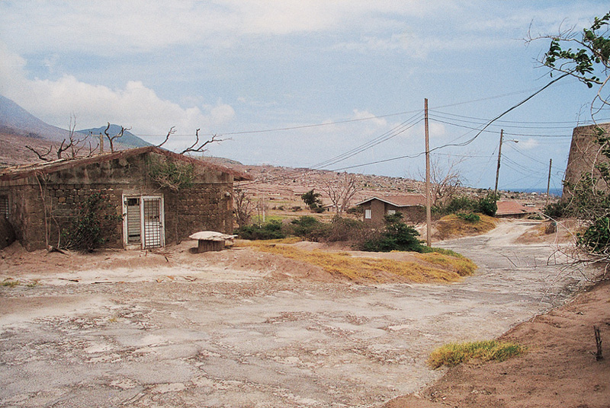

Slide 51
Pull Factors
Better standards of living
Job opportunities
Religious Freedom
Availability medical care
factors that encourage a person to come to a new place

Slide 52
Weather Conditions
Education Opportunity
Better climate
Political stability

Slide 53
Effects of international migration
For the ‘gaining’ country
It gains a bigger often cheaper labour force.
It needs to provide more services for extra people.
Immigrants sometimes set up shanty towns in the cities
It receives new ideas and cultures.

Slide 54
Effects of international migration
For the ‘losing’ country
It loses many 20-35 year olds and their children, so the population rises less quickly.
It can cause family break-ups as it is often just the male who migrates.
People who move away send money back to their families.

Slide 55
Indicators for Studying Migration
Crude In-Migration Rate:
Number of in-migrants per 1,000 population
= (I/P) * 1000
Crude Out-Migration Rate
Number of out-migrants per 1,000 population
= (O/P) * 1000

Slide 56
Crude Net Migration Rate
Difference between the number of in-migrants and the number of out-migrants per 1,000 population
= (I – 0)/P * 1000

Slide 57
Calculate the crude net migration rate for Zimbabwe in 1987, based on the following data
Zimbabwe, 1987
Long-term immigrants: 3 925
Long-term emigrants : 5 330
Total population : 8 640 000

Slide 58
What is urbanization
It is the growth of cities, brought about by a population shift from rural areas and small communities to large ones.
Urbanization is the process by which there is an increase in the proportion of people living in urban area.

Slide 59
Why move to cities
Escape constraints of village
Education Opportunity
Job opportunities
Better social services:
Availability medical care
Government offices
Variety of entertainment

Slide 60
Drawbacks of urbanization
Huge demand on land, water, transport, housing and employment.
Problem of waste and sanitation.
Crime and violence.
Homelessness.
Unemployment

Slide 61
Urban population:
Persons living in cities or towns of 2,500 or more residents.
Urbanized area:
One or more places and the adjacent densely populated surrounding area that together have a minimum population of 50,000.
Mega-cities:
Cities with 10 million residents or more.

Slide 62
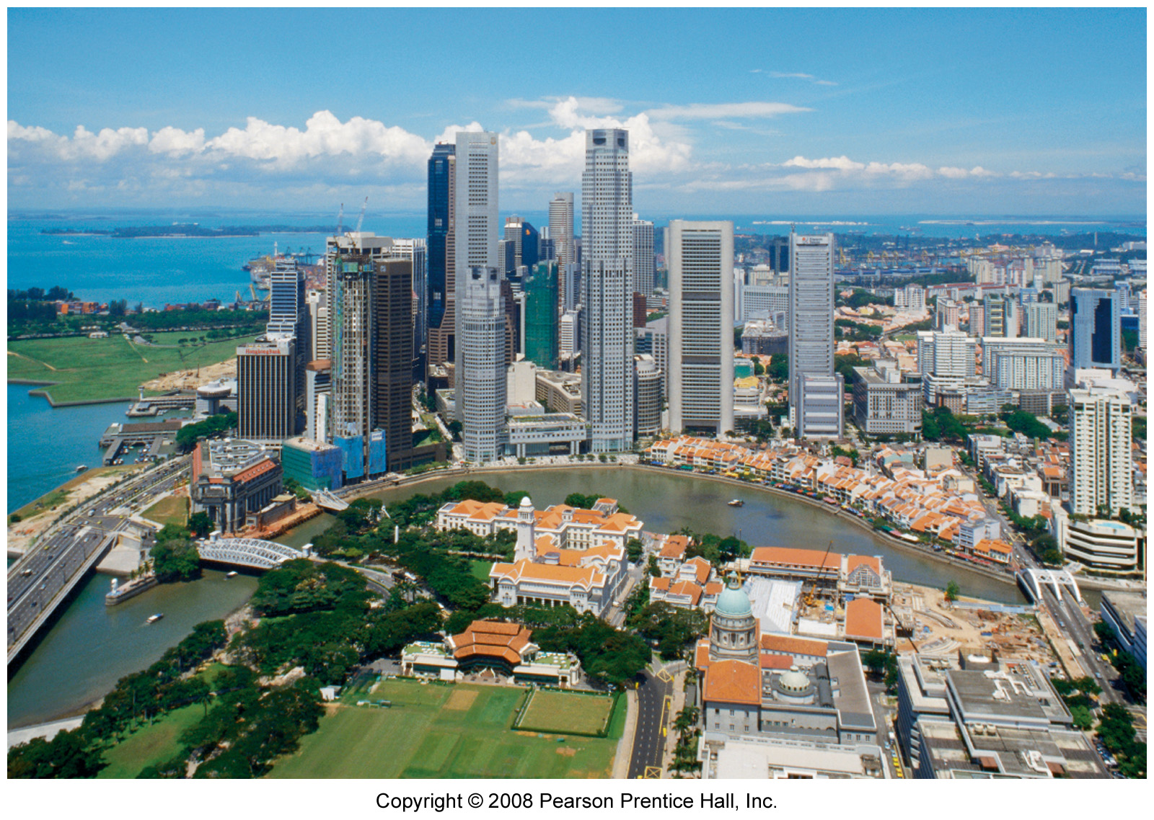

Slide 63
Strategies for Reducing Urban Growth
Promoting agricultural development in rural areas.
Providing incentives to industries and businesses to relocate from urban to rural areas.

Slide 64
Providing incentives to encourage new businesses in rural areas.
Developing the infrastructure of rural areas, including transportation systems, clean water supplies, sanitary waste disposal systems, and social services.

Slide 65
Environment of Cities
Transportation problems (commute to work)
Air
Smoke & dust (particulates)
Hydrocarbons, nitrous oxides, ozone
Water
Usually must be piped in from distance.
Pollution from industrial waste,
Human waste (sewage).

Slide 66
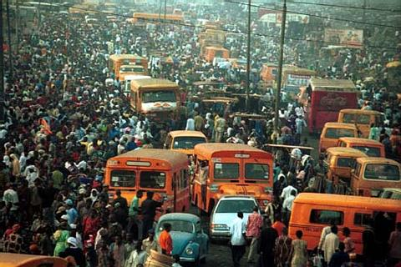
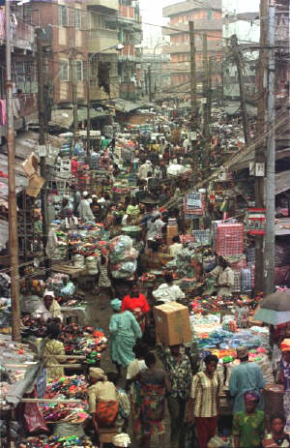

Slide 67
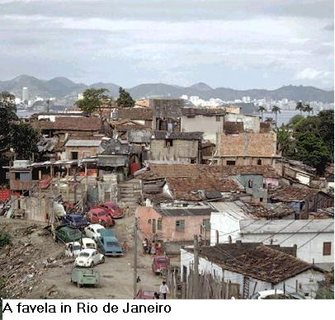

Slide 68
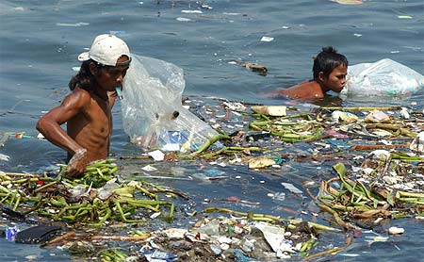
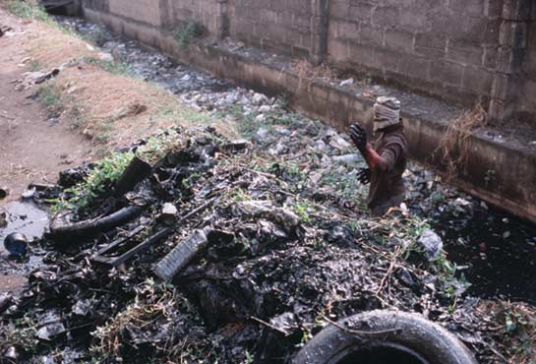

Slide 69
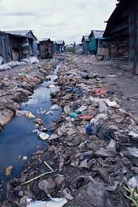
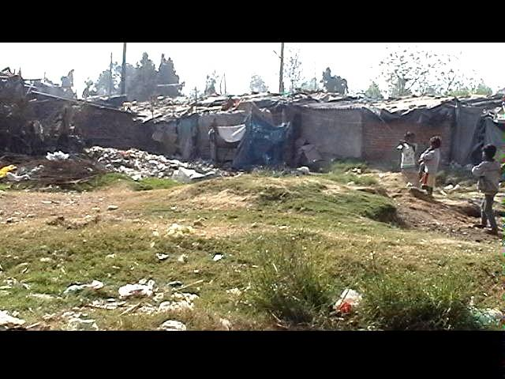

Slide 70
Solid waste, garbage, litter.
Spread of infectious diseases
Common cold, influenza, measles
Cholera, typhoid fever, plague
Malaria, yellow fever, dengue, West Nile virus

Slide 71
Migration-consequences
Overcrowding
Mushrooming of slums
Unemployment
Poverty
Physical & mental stress
Change of Family structure-Nuclear families

Slide 72
Overcrowding and related health issues
Rapid growth of urban centers has led to substandard housing on marginal land and overcrowding
Outbreaks of diseases transmitted through respiratory and faeco-oral route due to increased population density

Slide 73
It exacerbates health risks related to insufficient and poor water supply and poor sanitation systems.
Lack of privacy leading to depression, anxiety, stress etc

Slide 74
Air pollution and its consequences
Due to increase in the numbers of motorized vehicles and industries in the cities of the developing world
Air pollution can affect our health in many ways with both short-term and long-term effects

Slide 75
Short-term air pollution can aggravate medical conditions like asthma and emphysema.
Long-term health effects can include chronic respiratory disease, lung cancer, heart disease, and even damage to other vital organs

Slide 76
Water and sanitation problems
Nearly 1.1 billion people worldwide do not have access to clean drinking water and over 400 million people, lack simple improved latrine.
This can lead to increased episodes of diarrhea and other communicable diseases.

Slide 77
The rising trends of non-communicable diseases are a consequence of the demographic and dietary transition.
Decreases in activity combined with access to processed food high in calories and low in nutrition have played a key role

