Slide 1
Amino acids
Amino acids:
are organic molecules that are the building block of
proteins.
-There is 20 α-amino acids commonly found in proteins
( they have a carboxyl group and an amino group
bonded to the same carbon atom [the α-carbon]).
-The 20 α-amino acids of proteins are often referred as
the standard amino acids.

Slide 2
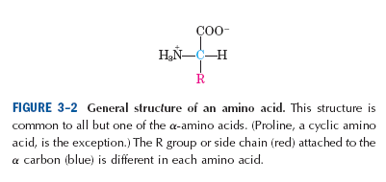
- Amino acids differ from each other in their side chains
(R-group) which vary in structure, size, and electric charge
and which influence the solubility of the amino acids in water.

Slide 3
-All amino acids have free α-carboxyl group.
All amino acids except proline have free unsubstituted
α-amino group.
- The common amino acids of proteins have been assigned
three-letter abbreviations and one letter symbols.
example:
Alanine: Ala
Serine : Ser

Slide 4
Classification of amino acids
A) on the basis of their R-group
(depend on the polarity of
their R-group).
B)Nutritional classification
C) Metabolic classification

Slide 5
A) Classification on the basis of their R-group:
[depend on the polarity of their R-groups [tendency to interact with water at biological PH (near PH 7.0)]
The polarity of the R-groups varies widely from non-polar and hydrophobic (water-insoluble) to highly polar and hydrophilic (water-soluble).
1) Amino acids with non-polar (hydrophobic) R-groups.
2) Amino acids with aromatic R-groups .
3) Amino acids with polar, uncharged R-group
4) Amino acids with positively charged (basic) R-group.
5) Amino acids with negatively charged (acidic) R-group.

Slide 6
1) Amino acids with non-polar (hydrophobic)R-group:
The R-group in this class of amino acids are non-polar and hydrophobic.
● Glycine has the simplest structure.
● Glycine
Alanine
Proline
Valine have non-polar, aliphatic R-group
Leucine
Isoleucine
Methionine
● Methionine is sulfur-containing amino acid
● Proline has an aliphatic side chain with a distinctive cyclic structure.

Slide 7
2) Amino acids with aromatic R-groups :
- They are:
phenylalanine
tryptophan
tyrosine
- The hydroxyl group of tyrosine can form hydrogen bonds.

Slide 8
3) Amino acids with polar, uncharged R-group:
- The R-groups of these amino acids are more soluble in water, or more hydrophilic, than those of the non-polar amino acids, because they contain functional groups that form hydrogen bonds with water.
This class of amino acids includes:
serine
threonine
cysteine
aspargine
glutamine

Slide 9
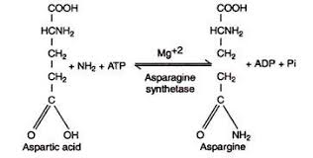
●The polarity of serine and threonine is contributed by their hydroxyl groups.
● The polarity of cysteine is contributed by its sulfhydryl group (thiol group).
● The polarity of aspargine and glutamine is contributed by their amide groups.
- Aspargine is amide of aspartic acid (aspartate).
Glutamine is amide of glutamic acid (glutamate).
- Cysteine is readily oxidized to form covalently linked dimeric amino acid called cystine, in which two cysteine molecules or residues are joined by a disulfide bond.

Slide 11
4) Amino acids with positively charged (basic) R-group:
- The most hydrophilic R-groups are those that are either positively or negatively charged.
- The amino acids in which the R-groups have significant positive charge at PH 7.0 are:
lysine
arginine
histidine
- Lysine has amino group on ε-position of its R-group.
Arginine has positively charged guanidinium group in its
R-group.
- Histidine has an aromatic imidazole group in its R-group.

Slide 12
5) Amino acids with negatively charged (acidic) R-group:
- The two amino acids having R-groups with a net negative charge at PH 7.0 are:
Aspartic acid (aspartate)
Glutamic acid (glutamate)
-These amino acids have carboxyl group in their side
chains (R-groups).

Slide 13
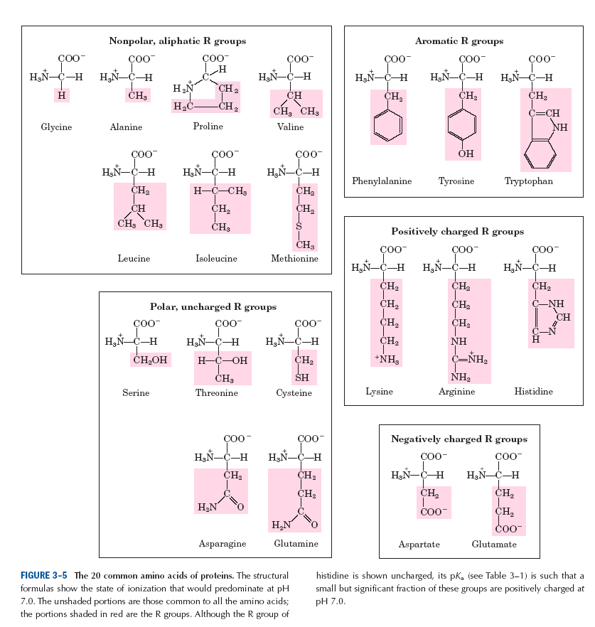

Slide 14
Uncommon amino acids
i) Rare amino acids of proteins:
- uncommon amino acids also have important functions.
-In addition to the 20 common amino acids, proteins may contains uncommon amino acids which are derived from common (standard) amino acids.
Example:
4-hydroxyproline found in collagen.
5-hydroxylysine
γ-carboxyglutamate found in the blood clotting
protein prothrombin.

Slide 15
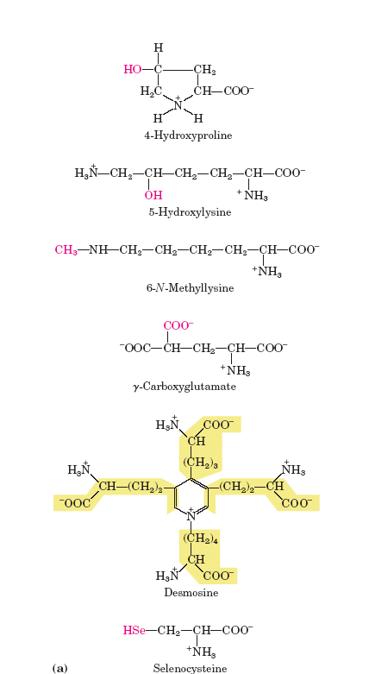

Slide 16
ii) Non-protein amino acids:
- These non-protein amino acids are found in cells and occur biologically in free or combined form but not in proteins.
Example:
ornithine and citrulline they are intermediates in the
biosynthesis of arginine and in
the urea cycle.

Slide 17
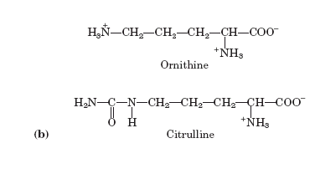

Slide 18
B) Nutritional classification:
i) Essential amino acids:
(can not be synthesized in the body,
must be provided in diet).
Valine
Leucine ii) Non-essential amino
Isoleucine acids:
Methionine (they synthesized in
Phenylalanine the body).
Tryptophan
Threonine
Lysine
Arginine
Histidine

Slide 19
C) Metabolic classification:
i) Glucogenic amino acids:
- which give glucose
e.g., glycine, serine, arginine,
glutamic acid.
ii) Ketogenic amino acids:
- That gives ketone bodies.
e.g., leucine
iii) Glucogenic and
ketogenic amino
acids:
- give both glucose and
ketone bodies.
e.g., phenylalanine, tyrosine,
tryptophan, isoleucine

Slide 20
Properties of amino acids

Slide 21
1) Optical activity of amino acids:
All standard amino acids except glycine have an asymmetric carbon atom [α-carbon atom bound to four different substituent groups (i.e., a carboxyl group, amino group,
R-group, and a hydrogen atom).
-The asymmetric α-carbon atom is thus a chiral center.
-Because amino acids that obtained from the hydrolysis of proteins have one or more asymmetric carbon atoms
so all amino acids except glycine are optically active.
The α-carbon atom of all amino acids except glycine is asymmetric, and thus amino acids exist in two stereoisomeric forms: L-isomer, D-isomer.

Slide 22
L- and D-isomer of amino acid depend on the configuration of the four different substituents around the asymmetric carbon atom.
Example:
Alanine

Slide 23
-Nearly all biologically occurring compounds containing asymmetric carbon atom are found in nature in only one stereoisomers form either D or L.
-Except for glycine, the amino acids present in protein molecules are L-stereoisomers.
-When a compound has two or more asymmetric carbon atom, it has 2^{n} possible stereoisomers (n = number of asymmetric carbon atoms).

Slide 24
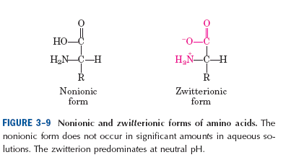
2) All amino acids contain α-carboxyl group and
α-amino group.(and functional groups in the side chain of
some amino acids)
All these groups determine the physical and chemical properties of amino acids.
3) Amino acids are ionized in water solution and form dipolar ion or zwitterion.

Slide 25
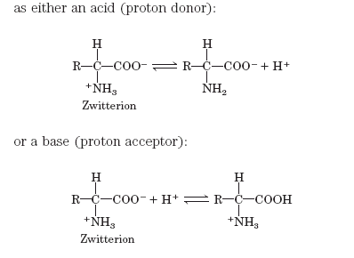
4) Amino acids are soluble in polar solvent (e.g., water).
5) Amino acids can act as acids and bases:
- Amino acids in aqueous solution are ionized and can act as acid or base.

Slide 26
- Substances having two-way property are amphoteric.
In an electric field:
The amino acid in acidic media will move towards cathode
- The amino acid in basic media will move towards anode

Slide 27
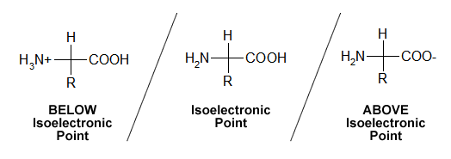
6) Isoelectric point or isoelectric PH (PI):
is the PH at which the net electric charge on amino
acid is equal to zero.
an amino acid will not move in an electric field.
-Each amino acid has its specific PI.
e.g., glycine has PI = 5.97

Slide 28
7) Titration curve of amino acids:
Titration curve:
is a plot of the PH versus the equivalents of base added during titration of an acid.
Titration curve of glycine:
- Glycine is non-polar amino acid.
- It has one carboxyl group (α-carboxyl group) and one amino group (α-amino group).
- Its titration curve consist of two stages.

Slide 34
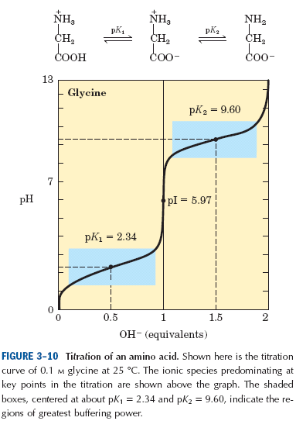

Slide 35
Titration curve of aspartic acid:
- Aspartic acid is a negatively charged amino acid (acidic amino acid)
- Aspartic acid contains two carboxyl groups and one amino group.
- Its titration curve consist of three stages.

Slide 36
At the first pKa, the alpha-carboxyl dissociates. At the second pKa, the R-group carboxyl dissociates, At the third pKa, the alpha-amino dissociates.

Slide 37
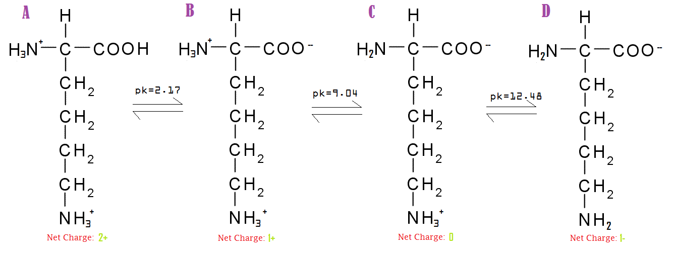
Titration curve of lysine:
- Lysine is a positively charged amino acid (basic amino acid).
- Lysine contains one carboxyl group and two amino groups.
- Its titration curve consist of three stages.

Slide 39
8) Absorption spectra:
-Three amino acids (tyrosine, tryptophan, and phenylalanine), absorb light significantly in the ultraviolet.
- Since most proteins contain tyrosine residues, measurement of light absorption at 280 nm in a spectrophotometer is an extremely rapid and convenient means of estimating the protein content of a solution.

Slide 40
The chemical reactions of amino acids
As for all organic compounds, the chemical reactions of amino acids are those characteristic of their functional group. i.e.,
1- the α-carboxyl group
2 - the α-amino group
3 - and the functional groups
present in the different side
chains.

Slide 41
1) Reaction of carboxyl group:
a) Formation of ester:
b) Formation of amide:

Slide 42
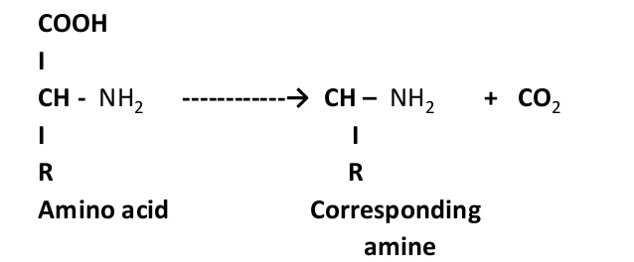
c) Reduction of the α-COOH of amino acid with reducing agent lithium borohydride (LiBH₄) to yield the corresponding primary alcohol.
COOH CH₂OH
H₂N - C – H LiBH₄ H₂N - C – H
R R
d) Decarboxylation

Slide 43
2) Reactions of amino group:
a) Acylated amino acid:
This is by treatment with acid halids.
e.g., formation of the benzyloxy carbomyl (carbobenzoxy)
derivative of amino acids.

Slide 45
b) Ninhydrine reaction:
- can be utilized to estimate amino acids quantitatively in very small amounts.
- On heating, an α-amino acid reacts with two molecules of ninhydrine to yield an intensly coloured product.
- A purple color is given in the ninhydrin reaction by all amino acids and peptides having a free α-amino group, whereas proline and hydroxyproline, in which the α-amino group is substituted, yield derivatives with a characteristic
yellow colour.

Slide 46
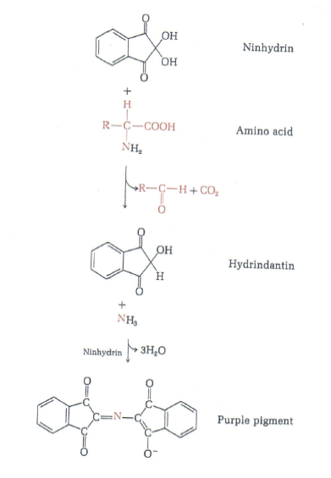

Slide 47
c) Formation of a Schiff′s base:
- The α-amino groups of amino acids react reversibly with aldehydes to form compounds called Schiff′s base.
- Schiff′s bases appear to be intermediates in a number of enzymatic reaction.

Slide 48
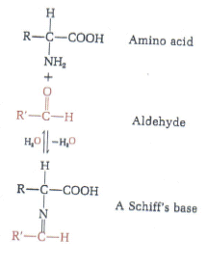

Slide 49
d) Reaction with cyanate:

Slide 50
e) Reaction of α-amino acid with reagent 1-fluoro
2,4 dinitrobenzen (FDNB):
- In mild alkaline solution FDNB reacts with α-amino acids
to yield 2,4 dinitrophenyl derivatives, useful in identification of individual amino acids.

Slide 51
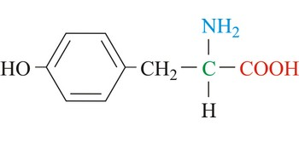
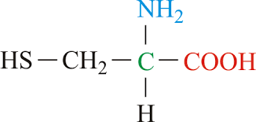
3) Reaction of the R-groups:
- Amino acids show qualitative colour reaction typical of certain functions present in their R-groups.
e.g., - The thiol group of cysteine
- The phenolic hydroxyl group of tyrosine
- The guanidinium group of arginine

Slide 52
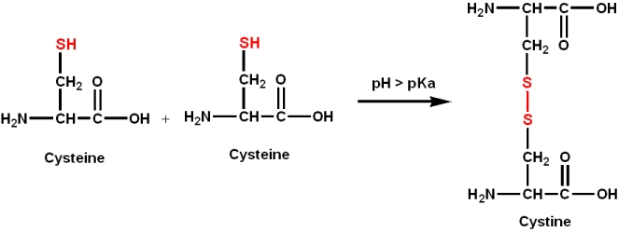
Reaction of thiol group:
i) Oxidation of cysteine to cystine:
- Oxidation by atmospheric oxygen in the presence of iron salts or by other mild oxidizing agents.
- The oxidation product is cystine, in which the disulfide bond constitute a covalent bridge between two residues of cysteine.

Slide 54
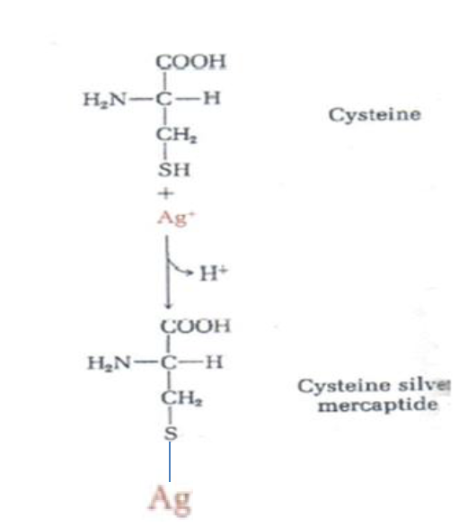
ii) Reaction of cysteine with Ag⁺:
-This is another reaction of thiol group of cysteine with heavy metals such as Hg⁺² and Ag+ which form mercaptides.

Slide 55
iii) Reaction of cysteine with Elman′s reagent:
- The thiol groups of cysteine and cysteine residues in peptides and proteins can be measured by a quantitative reaction with Elman′s reagent, yielding a product that can be measured colorimetrically.

Slide 57
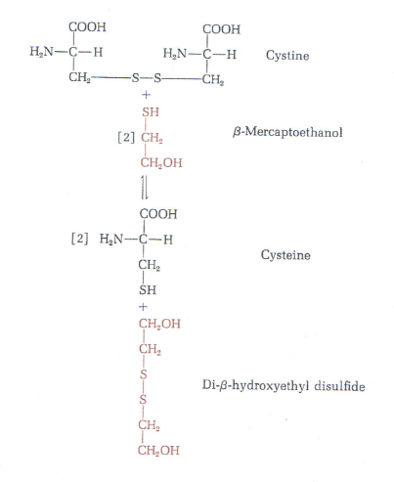
iv) Reduction of cystine to cysteine:

Slide 58
B) Reaction of phenolic hydroxyl group of tyrosine:
i) Millon reaction:
When tyrosine is heated with millon solution (HgSO₄ in H₂SO₄), a red colour is produced.
C) Reaction of guanidinium group of arginine:
i) Sakaguchie test:
The guanidinium group of arginine, react with α-naphthol
and sodium hypochlorite to a red colour.

Slide 59
Separation of amino acids:
Complex mixtures of amino acids can be separated, identified and estimated by:
● Electrophoresis
● Ion exchange chromatography

Slide 60
Paper electrophoresis:
- The simplest method for separating amino acids is paper electrophoresis.
● A drop of an aqueous solution of the amino acid mixture is placed on a filter-paper strip moistened with a buffer at
a given PH.
● A high-voltage electric field is applied to the strip.
● Because of their different PK values, the amino acids migrate in different directions and at different rates along the strip, depending on the • PH of the buffer system
• and the voltage applied.

Slide 61
Example:
●At PH 1.0 , histidine, arginine, and lysine have a charge
of +2 and move more rapidly to the negatively charged
cathode than the other amino acids, which have a charge
of +1 .
●At PH 6.0 , the positively charged amino acids (lysine, arginine, histidine) move to the cathode and the negatively charged amino acids (aspartic acid and glutamic acid) to
the anode.
●All the other amino acids will remain at or near the origin, since they have no ionizing groups other than their α-amino and α-carboxyl group and thus have about the same isoelectric point.

Slide 62
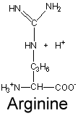
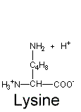

Slide 63
https://www.youtube.com/watch?v=GyO1FQFM_OE
●To locate the amino acids on the paper, it is dried, sprayed with ninhydrin and heated.
●Blue or purple spots, each indicating the presence of an amino acid, will appear on the paper.

Slide 64
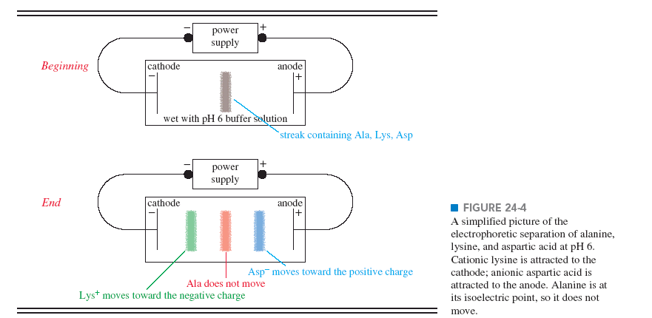

Slide 65
Ion exchange chromatography:
It is the most widely used method for separating, identifying, and quantitating the amounts of each amino acid in
a mixture.
- The chromatographic column consists of a long tube filled with the granules of a synthetic resin containing fixed charged groups.
- Resins with fixed anionic groups are called cation exchange resins.
- Resins with fixed cationic groups are anion exchange resins.

Slide 66
In the simplest form of ion-exchange chromatography,
amino acids can be separated on columns of cation-exchange resins, in which the fixed anionic groups, e.g sulfonic acid groups (-SO₃⁻), are first charged with Na⁺.
●an acid solution (PH 3) of the amino acid mixture to be analyzed is then poured on the column and allowed to percolate through slowly.
-At PH 3 , the amino acids are largely cations with net positive charges.

Slide 67
●As the mixture passes down the column, the positively charged amino acids will displace the bound Na⁺ ions from the fixed (-SO₃⁻) groups of the resin particles.
Example:
• At PH 3.0 , the amino acids with the largest positive charge
(lysine, arginine, and histidine) will displace Na+ from the resin first and will be bound to the resin most tightly.
• The amino acids with the least amount of positive charge at
PH 3 (glutamic acid and aspartic acid) will be bound
least.
• All the other amino acids will have intermediate amounts of positive charge.

Slide 68
- The different amino acids will therefore move down the resin
column at different rates, which depend largely on their PK values.
• glutamic acid and aspartic acid will move down the
column at the highest rates, since they bound least at
PH 3.0
• whereas lysine, arginine, and histidine will move
most slowly.
● small fractions of a few milliliters each collected from the bottom of the column and analyzed quantitatively.

Slide 69
