Slide 1
3rd Class Study Foundations: The Research Topic, Problem, Purpose
NUR500
Latifah Almater RN, PhD
1.10.2018

Slide 2
Outline
In this class we will cover the following:
Research topic
Research problem
Research question
Research purpose

Slide 3
Development of Research Problem
1. Select Research Topic
Broad topic vs. Narrow topic
General vs. Specific
Tips to select your research topic
Ideas (Brainstorm)
Background (Read)
Define your topic (Focus)
Useful keywords (List)
Define your research question (Write)

Slide 4
Development of Research Problem
2. Narrowing your topic:
What is going on with…?
What is the process by which…?
What is the meaning of …?
What is the extent of …?
What is the influence or causes for …?
What differences exist between …?
What are the consequences of …?

Slide 5
Development of Research Problem
3. Evaluate the research problem:
Significance of the problem
Researchability of the problem
Feasibility
Time
Researcher experience
Availability of the participants
Cooperation of others
Ethical consideration
Facilities and Equipment / Money
Researcher interest

Slide 6
Research Problem
Research problem identified within a topic of interest.
Solving the research question or contributing the solution should be clarified by the research purpose.
Problem statement is to articulate the problem (precise and clear)
Class Assignment: Read and Explain- Research Problem and Paradigm ( P.69)

Slide 7
Source of Research Problem
Clinical experience
Quality improvement
Nursing literature
Social issues
Theories
Ideas from external sources

Slide 8
Research Question
It is the specific question that the researcher want to answer by the end of his study.
RQ must address the research problem
RQ must fit the research method.
RQ determines the methodology.
RQ guides the data collection.
RQ guides all stages of inquiry, analysis, and reporting.
In quantitative research method where there are predication answers, they use hypotheses that can be tasted.

Slide 9
Examples of useful phrases of RQ
To what extent / degree...
How effective is...
How have the decisions of... affected...
What is the role and significance of...
What is the best / cheapest / quickest method for....
In light of... how can one understand...
What has been the influence of... on...

Slide 10
Research Purpose
Research purpose = research goal
Purpose: “what you want to achieve when you do something; the reason you do or plan something”
Aim: “something you hope to achieve by doing something”
Objective: “the specific thing that you are trying to achieve”
(english.stackexchange.com)
In quantitative research the research purpose identifies the variables, their interrelationship and the population (PICO elements)
In qualitative research the research purpose identifies the concept or phenomena, the group, and the setting under the study.

Slide 11
Research Purpose and Types of Research Questions
Identification (qualitative)
Description (quantitative and qualitative)
Exploration (quantitative and qualitative)
Explanation (quantitative and qualitative)
Predication (quantitative)
Control (quantitative)
Check table 1.3 ( p.15)

Slide 12
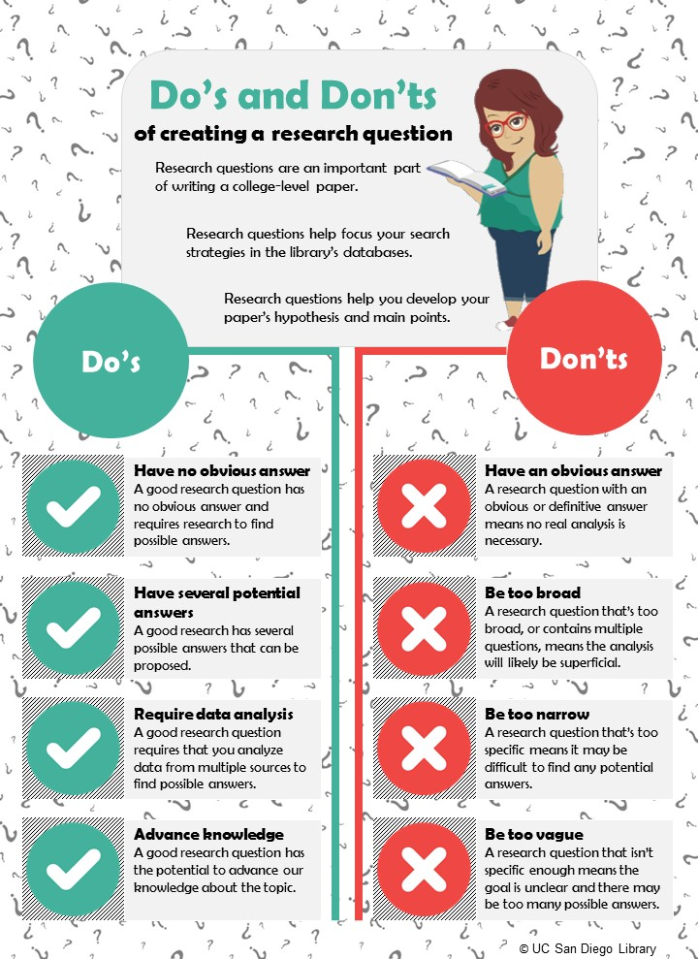
Do’s and Don’ts

Slide 13
QUESTIONS?

