Slide 1
KINGDOOM OF SAUDI ARABIA
King Saud University
College of Sciences - Department Botany & Microbiology
Plant Physiology
BOT- 272
Dr. Abdulrahman Al-hashimi

Slide 2
Lecture 8
Respiration and Lipid Metabolism
1- Glycolysis
2- Pentose Phosphate Pathway
2- Citric acid cycle (Krebs cycle)
3- Oxidative phosphorylation
4- Lipid metabolism

Slide 3
Overview of Respiration
The photosynthesis provides the organic building blocks (Sugars) that plants (and nearly all other life) depend on.
All living organisms break down sugars to get energy by a process called Cellular Respiration.
There are two types of the cellular respiration ;
Aerobic Respiration: the breaking down of sugar to produce energy in the presence of oxygen.
Anaerobic Respiration (Fermentation): the breaking down of sugar to produce energy in the absence of oxygen.

Slide 4
Overview of Respiration
The Aerobic respiration (oxygen-requiring respiration) is common to nearly all the eukaryotic organisms.
The respiratory process in plants is similar to that found in animals. However, some specific aspects of the plant respiration distinguish it from the animal respiration.
Aerobic respiration is the biological process by which reduced organic compounds (Sugars) are mobilized and subsequently oxidized in a controlled manner to release energy required for the maintenance and development of the plant.

Slide 5
Overview of Respiration
Glucose is most commonly cited as the substrate for respiration.
However, in a functioning plant cell the reduced carbon is derived from sources such as hexose phosphates and triose phosphates from starch degradation and photosynthesis, fructose-containing polymers (fructans), and other sugars, as well as lipids, organic acids, and some times proteins.

Slide 6
Overview of Respiration
Substrates for respiration are generated by other cellular processes and enter the respiratory pathways.
Pathways or Steps of Respiration include :
Glycolysis
Pentose phosphate pathway
Citric acid cycle (Krebs cycle)
Oxidative phosphorylation

Slide 7
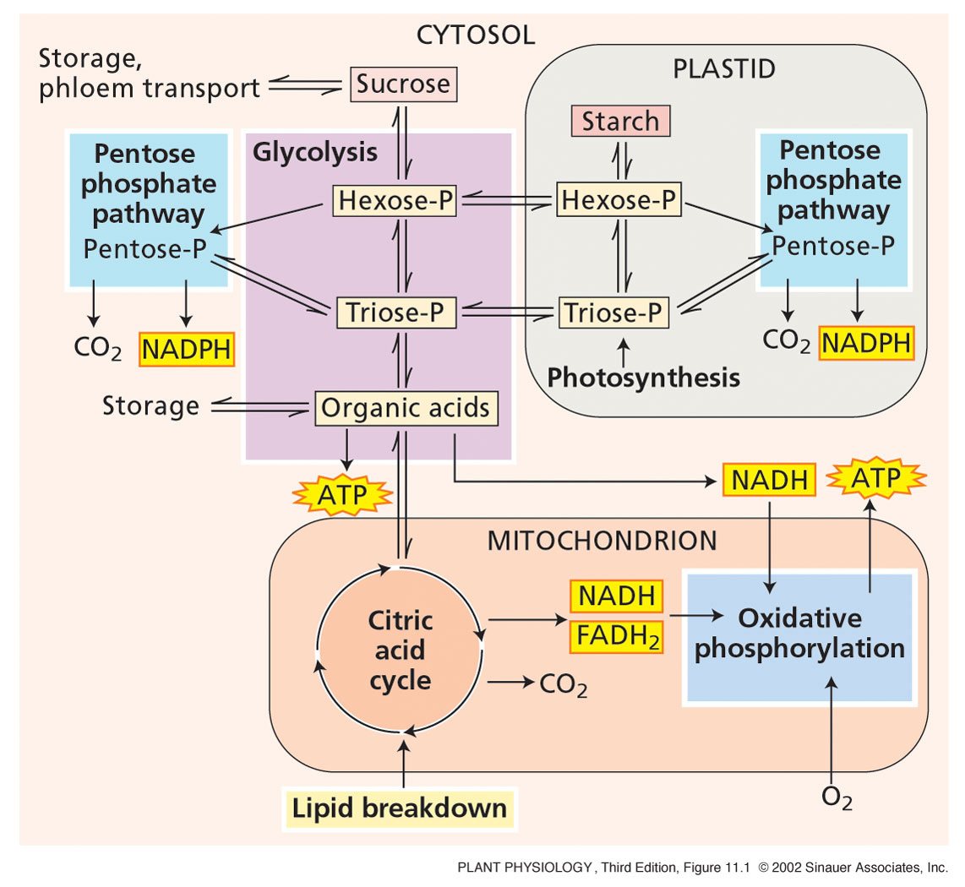
Overview of Respiration

Slide 8
Overview of Respiration
Glycolysis and pentose phosphate pathways in the cytosol and plastid convert sugars to organic acids, via hexose phosphates and triose phosphates, generating nicotinamide adenine dinucleotides, NADH or NADPH (electron carrying cofactors), and ATP (adenosine triphosphate, energy-storing molecules).
The organic acids are oxidized in mitochondrial citric acid cycle, and the produced NADH and FADH₂ (flavin adenine dinucleotide, electron carrying cofactor) provide energy for ATP synthesis in the oxidative phosphorylation.

Slide 9
Overview of Respiration
NAD⁺/NADH are organic cofactors (coenzymes) for many enzymes required for redox reactions (reduction/oxidation).
NAD⁺ is the oxidized form, while NADH is the reduced form.
A related compound, nicotinamide adenine dinucleotide phosphate (NADP⁺/NADPH), also play an important role in redox reactions of the photosynthesis.
The oxidation of NADH to NAD⁺ by oxygen via the electron transport chain releases free energy for the synthesis of ATP.

Slide 10
Overview of Respiration
The cellular respiration can be expressed as;
Complete oxidation of 12-carbon molecule (sucrose) to CO₂
Reduction of 12 molecules of O₂ to water.
Production of 60 ATP molecules.
The reaction is the reversal of the photosynthetic process, and represents a coupled redox reactions.

Slide 11
Glycolysis
Glycolysis involves a series of reactions by enzymes located in the cytosol and the plastid.
The sucrose is partly oxidized, producing a small amount of energy storage molecules (ATP), and a reduced pyridine nucleotide (NADH) in the cytoplasm and plastids.
The main processes of Glycolysis are ;
Glucose is converted to hexose phosphates (6-carbons), which are then split into two triose phosphates (3-carbons).
Triose phosphates are oxidized to produce two molecules of the 3-carbons organic acid, Pyruvate (Pyruvic acid).

Slide 12
Glycolysis
See next steps

Slide 13
Glycolysis

Slide 14
Glycolysis
The Glycolysis occurs in all living organisms (prokaryotes and eukaryotes). However, plant glycolysis has unique regulatory features, as well as a partial glycolytic pathway in plastids and alternative enzymatic pathways for several cytosolic steps.
Because sucrose is the major translocated sugar in most plants, it is the true sugar substrate for plant respiration.
In early steps, sucrose is broken down into glucose and fructose, which can readily enter the glycolytic pathway.

Slide 15
Glycolysis
Plastids such as chloroplasts or amyloplasts can also supply substrates for glycolysis. Photosynthetic products can directly enter the glycolytic pathway as triose phosphate.
Starch is synthesized only in the plastids, and carbon components obtained from starch degradation enters the glycolytic pathway in the cytosol primarily as;
hexose phosphate (translocated out of amyloplasts).
triose phosphate (translocated out of chloroplasts).

Slide 16
Fermentation
If Oxygen is present (aerobic condition), the pyruvate produced from Glycolysis is converted to acetyl CoA, which enters the citric acid cycle.
In Oxygen is absent (anaerobic), the citric acid cycle (krebs cycle) and oxidative phosphorylation cannot work, and thus the NAD⁺ required for glycolysis is limited.
Once all the NAD⁺ becomes in the reduced form (NADH),
the plants and other organisms can overcome this problem by further metabolism of pyruvate, known as Fermentation.

Slide 17
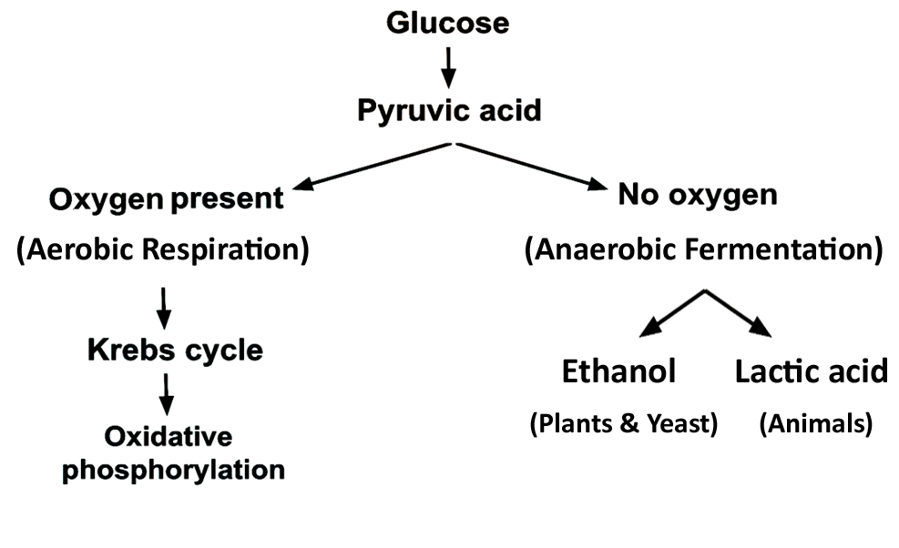
Fermentation

Slide 18
Fermentation
In alcoholic fermentation (common in plants and yeast), two enzymes, pyruvate decarboxylase and alcohol dehydrogenase converts pyruvate (pyruvic acid) into ethanol and CO₂ and oxidizing NADH to NAD⁺ , which is required for glycolysis.
In lactic acid fermentation (common to mammalian muscle but also found in plants), the enzyme lactate dehydrogenase uses NADH to reduce the pyruvate to lactate (lactic acid), and regenerating NAD⁺ required for glycolysis.

Slide 19
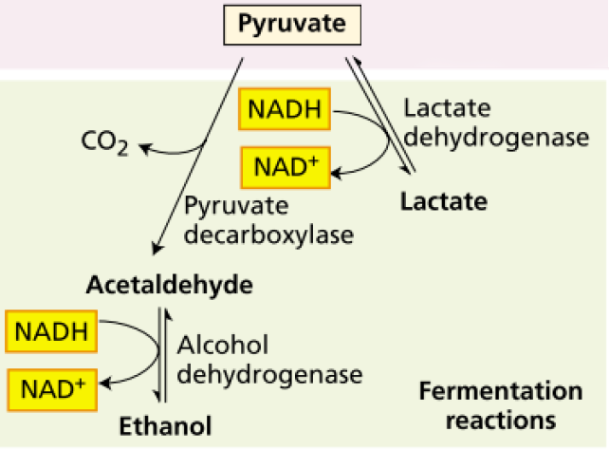
Fermentation

Slide 20
Fermentation
In corn, the initial response to low oxygen is lactic acid fermentation, but the subsequent response is alcoholic fermentation.
Ethanol is less toxic end product of fermentation because it can diffuse out of the cell.
Lactate accumulation promotes acidification of the cytosol.
In other cases, plants function under near-anaerobic conditions by carrying out some form of fermentation.

Slide 21
Gluconeogenesis
The sequence of reactions that lead to formation of pyruvate from glucose occurs in all organisms that carry out Glycolysis.
In addition, organisms can operate an opposite pathway (Gluconeogenesis) to synthesize sugar from organic acids.
Gluconeogenesis is not common in plants, but in seeds of some plants, such as castor bean and sunflower, that store a significant quantity of their carbon in form of oils (triacylglycerols), after seed germination, much of the oil is converted by gluconeogenesis to sucrose for growing seedling.

Slide 22
Pentose Phosphate Pathway
The glycolysis is not the only pathway for the oxidation of sugars in plant cells. Other metabolic pathway, the oxidative pentose phosphate pathway can also perform this task.
The reactions are carried out by soluble enzymes present in the cytosol and in plastids.
The first two reactions of this pathway involve oxidative events that convert 6-carbon sugar (glucose-6-phosphate) to a 5-carbon sugar (ribulose-5-phosphate), with loss of a CO₂ molecule and generating two NADPH molecules (not NADH).

Slide 23
Pentose Phosphate Pathway
The remaining reactions of the pathway convert ribulose-5-phosphate to the glycolytic intermediates, glyceraldehyde-3-phosphate (triose phosphate) and fructose-6-phosphate.
The triose phosphate enters the last stages of glycolysis.
The end result of the pathway is the complete oxidation of one glucose-6-phosphate molecule to CO₂ with the synthesis of 12 NADPH molecules (nicotinamide adenine dinucleotide phosphate, energy-carrying molecule).

Slide 24
Pentose Phosphate Pathway
The oxidative pentose phosphate pathway plays several roles in plant metabolism:
The produced NADPH drives reductive steps associated with various biosynthetic reactions in the cytosol.
In nongreen plastids, such as amyloplasts, and in chloroplasts functioning in the dark, the NADPH is used in biosynthetic reactions such as lipid biosynthesis and nitrogen assimilation.
Some of the reducing agent (NADPH) generated by this pathway may contribute to cellular energy metabolism for reducing O₂ and generating ATP.

Slide 25
Pentose Phosphate Pathway
The pathway produces ribose-5-phosphate, which is a precursor of the ribose and deoxyribose needed in the synthesis of RNA and DNA, respectively.
Another intermediate in this pathway, the 4-carbon erythrose-4-phosphate, combines with the phosphoenylpyruvate (PEP) in the initial reaction that produces plant phenolic compounds.
During early stages of greening, before leaf tissues become fully photoautotrophic, the oxidative pentose phosphate pathway is thought to be involved in generating Calvin cycle intermediates.

Slide 26
Citric Acid Cycle (Krebs Cycle)
In 1937, the biochemist Hans Krebs reported the citric acid cycle (also called tricarboxylic acid (TCA) cycle, or Krebs cycle.
The krebs cycle takes place in the mitochondrial matrix.
In a preparatory reaction; the pyruvate (3-carbons) produced from glycolysis is oxidized to acetyl coenzyme A (2-carbns, acetyl-CoA) by the enzyme pyruvate dehydrogenase,
The products of this reaction are NADH (from NAD⁺) and CO₂ .
Pyruvate is produced by glycolysis in the cytoplasm, but pyruvate oxidation takes place in mitochondrial matrix.

Slide 27
Citric Acid Cycle (Krebs Cycle)
The preparatory reaction occurs twice because glycolysis produces two molecules of pyruvate.
In the next reaction, the enzyme citrate synthase combines the acetyl group of acetyl-CoA with a 4-carbon dicarboxylic acid (oxaloacetate, OAA) to give a 6-carbon tricarboxylic acid (citrate).
The citrate is then converted to isocitrate by the enzyme aconitase.

Slide 28
Citric Acid Cycle (Krebs Cycle)
The following two reactions are oxidative decarboxylations, each of which produces one NADH and releases one molecule of CO₂, producing a 4-carbon succinyl-CoA.
At this point, three molecules of CO₂ have been produced from each pyruvate (6 CO₂ from each Glucose).
Succinyl-CoA is converted to succinate and ATP is produced.
The resulting succinate is then oxidized to fumarate by succinate dehydrogenase, and FADH₂ produced from FAD.

Slide 29
Citric Acid Cycle (Krebs Cycle)
In the final two reactions, the fumarate is hydrated to produce malate, which is subsequently oxidized by malate dehydrogenase to regenerate OAA, and producing NADH.
The OAA produced is now able to react with another acetyl-CoA and continue the cycling.
Krebs cycle of plants has unique features ;
the presence of an enzyme called NAD⁺ malic enables plant mitochondria to operate alternative pathways.
Malate is oxidize to pyruvate by the enzyme NAD⁺ malic.

Slide 30
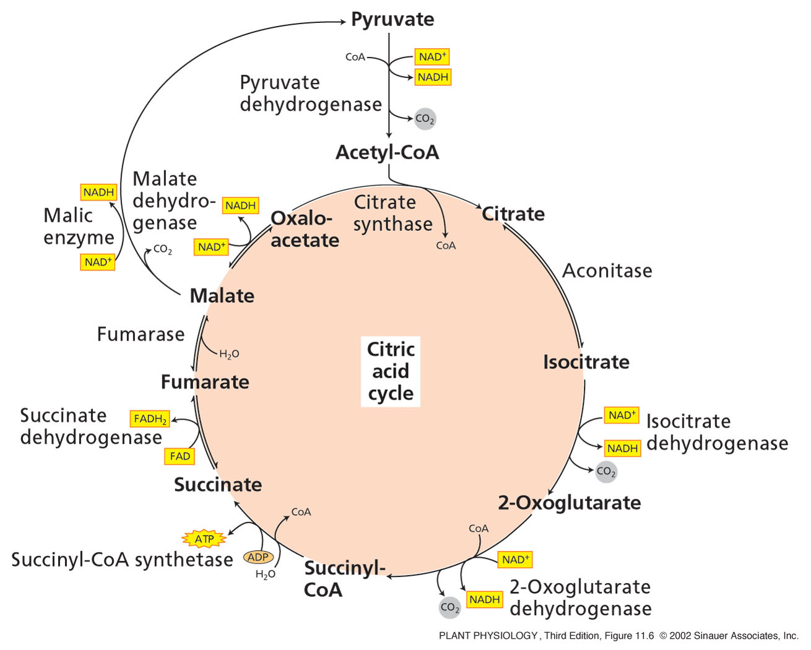
Citric Acid Cycle (Krebs Cycle)
In aerobic condition, pyruvate from glycolysis is converted to acetyl CoA
which enters the citric acid cycle

Slide 31
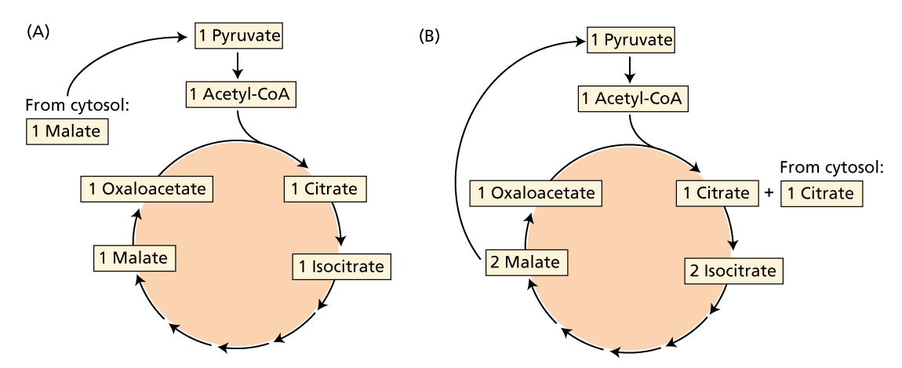
Citric Acid Cycle (Krebs Cycle)
The Citric Acid Cycle of Plants Has Unique Features
Malic enzyme allows the plant mitochondria to oxidize both malate (A) and citrate (B) to CO₂ without involving pyruvate delivered by glycolysis

Slide 32
Citric Acid Cycle (Krebs Cycle)
The Krebs cycle turns twice because two acetyl CoA are produced from each glucose molecule.
The end products of each Krebs cycle are;
three CO₂ molecules, four NADH , one FADH₂ and one ATP.
ATP is the energy carrier used by cells to drive living processes, therefore, chemical energy conserved during the citric acid cycle in the form of NADH and FADH₂ must be converted to ATP to perform useful work in the cell.

Slide 33
Oxidative phosphorylation
The oxidative phosphorylation is the last stage of respiration, occurs in the inner mitochondrial membrane.
In the oxidative phosphorylation ;
The electrons are transferred along an electron transport chain, by electron transport proteins bound to the inner mitochondrial membranes.
This system transfers electrons from NADH and FADH₂ produced during glycolysis, pentose phosphate pathway, and citric acid cycle, to oxygen.

Slide 34
Oxidative phosphorylation
The electron transfer releases a large amount of free energy, much of which is conserved, as ATP, through the synthesis of ATP from ADP and Pi (inorganic phosphate) by ATP synthase.
The redox reactions of the electron transport chain and the synthesis of ATP are called oxidative phosphorylation.
This final stage completes the oxidation of sucrose to CO₂.

Slide 35
Oxidative phosphorylation
For each molecule of sucrose oxidized through glycolysis and citric acid cycle pathways, 4 NADH molecules are generated in the cytosol, 16 NADH and 4 FADH₂ molecules are generated in the mitochondrial matrix.
NADH and FADH₂ pass through the electron transport chain in the inner mitochondrial membrane to reduce oxygen.

Slide 36
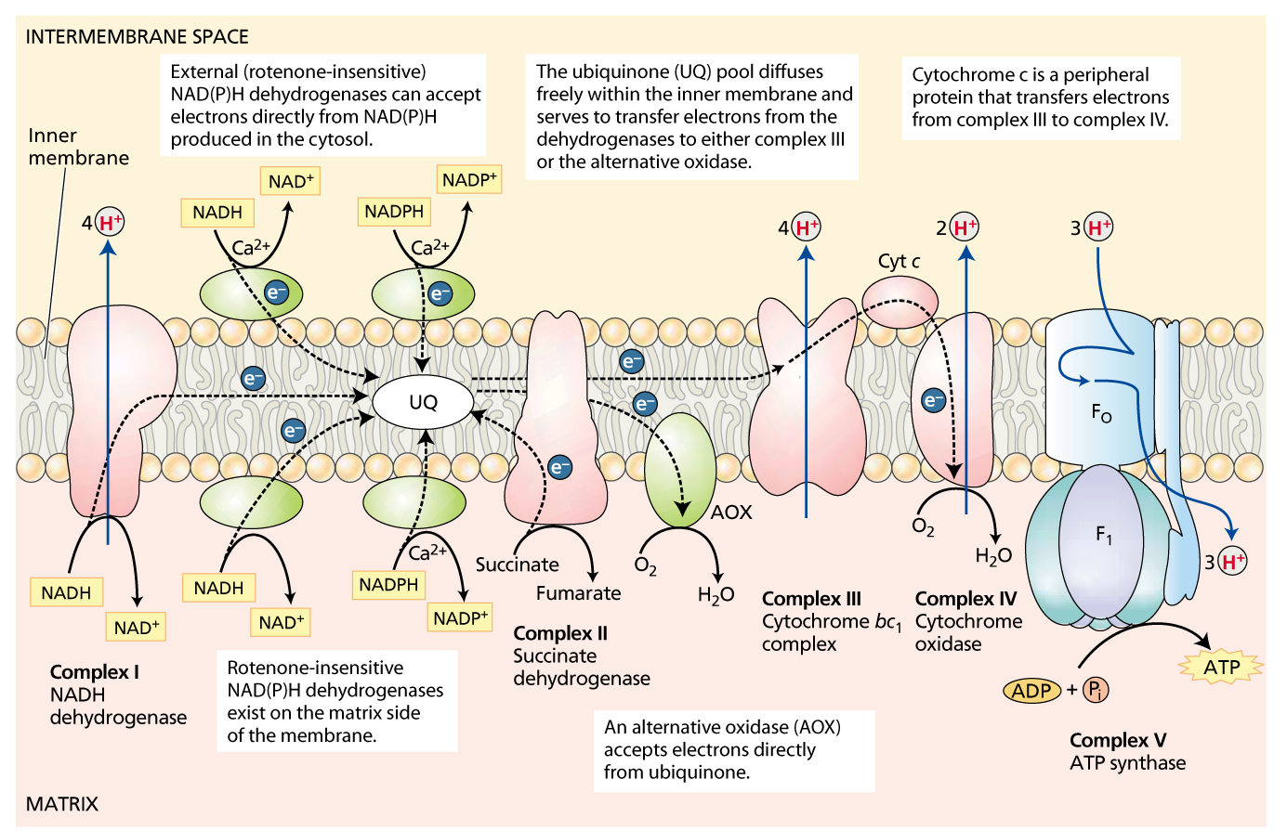
Oxidative phosphorylation
Electron transport chain and ATP synthesis in plant mitochondria
Four major complexes are involved in these reactions

Slide 37
Oxidative phosphorylation
The transfer of electrons to oxygen is coupled to the synthesis of ATP from ADP and Pi by the ATP synthase (complex V).
Some of the free energy released from oxidation of NADH and FADH₂ is used to generate an electrochemical proton gradient.
The electrochemical proton gradient plays a role in the movement of organic acids of citric acid cycle and products of ATP synthesis in and out of mitochondria,
for example, moving ADP in and ATP out of the mitochondria.

Slide 38
Aerobic Respiration - Summary
Aerobic respiration produces
60 ATP molecules per each sucrose molecule
The complete aerobic oxidation of a sucrose molecule into CO₂ is coupled to the synthesis of about 60 ATP molecules.

Slide 39
Lipid Metabolism
Lipids (fats and oils) are important storage forms of reduced carbon in many seeds (such as oilseeds, soybean, sunflower, peanut, cotton and canola).
The complete oxidation of 1 g of fat or oil (which contains about 9.3 kcal, of energy ) can produce considerably more ATP than the oxidation of 1 g of starch (about 3.8 kcal).
For this reason, seeds can be smaller because lipids store more energy per gram.

Slide 40
Lipid Metabolism
Other lipids are important for plant structure and function but are not used for energy storage, including ;
waxes, which make up the protective cuticle that reduces water loss from plant tissues.
terpenoids (also known as isoprenoids), which include carotenoids involved in photosynthesis and sterols present in many plant membranes.
Fats and oils exist mainly in the form of triacylglycerols (acyl refers to the fatty acid portion), or triglycerides.

Slide 41
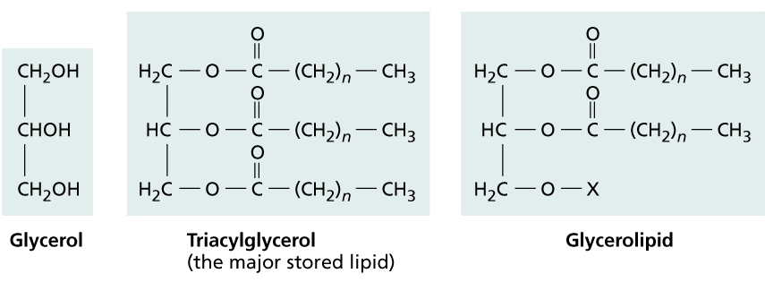
Lipid Metabolism
Structural features of triacylglycerols
and polar glycerolipids in higher plants
Fatty acid molecules are linked by ester bonds to the three hydroxyl groups of glycerol to compose triacylglycerols or glycerolipids

Slide 42
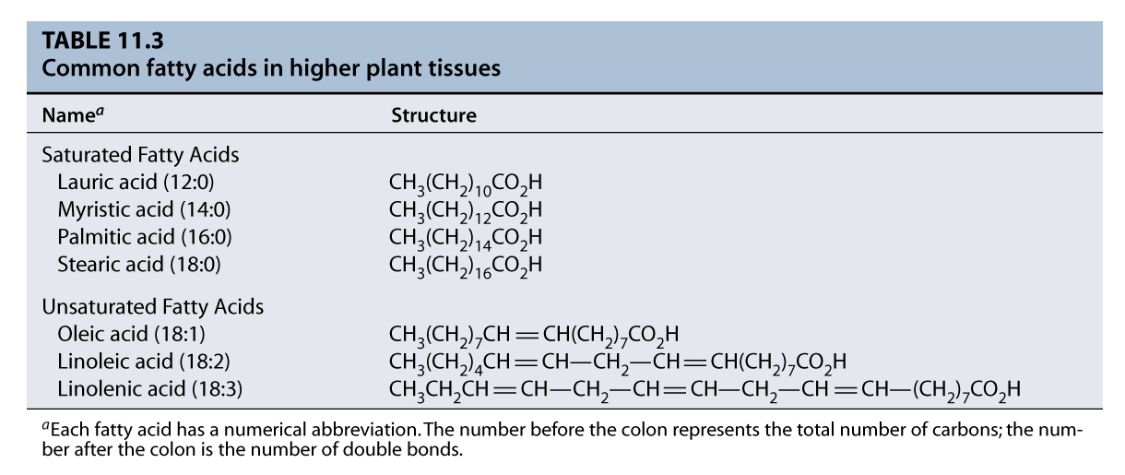
Lipid Metabolism
Common Fatty acids in higher plants

Slide 43
Lipid Metabolism
The Triacylglycerols in most seeds are stored in the cytoplasm of either cotyledon or endosperm cells in organelles known as oleosomes (also called spherosomes or oil bodies).
Triacylglycerol synthesis is completed by enzymes located in the membranes of the endoplasmic reticulum (ER), and the resulting fats accumulate between the two monolayers of the ER membrane bilayer.

Slide 44
Lipid Metabolism
The Polar Glycerolipids are the main structural Lipids in membranes ;
the hydrophobic portion of themembrane consists of two 16-carbon or 18-carbon fatty acid chains pound to positions 1 and 2 of a glycerol backbone.
the polar head group is attached to position 3 of glycerol.

Slide 45
Lipid Metabolism
Fatty acid biosynthesis consists of cycles of two-carbon addition, where the acetyl-CoA is the precursor.
In plants, fatty acids are synthesized in the plastids.
In animals, fatty acids are synthesized primarily in the cytosol.
The fatty acids synthesized in plant plastids are used to make the glycerolipids of membranes and oleosomes.
Fatty acids may is subjected to further modification in the endoplasmic reticulum after they are linked with glycerol to form glycerolipids.

Slide 46
Lipid Metabolism
Stored lipids are converted into carbohydrates
Plants are not able to transport fats from the endosperm to root and shoot of germinating seedling, so they must convert stored lipids to a more mobile form of carbon, sucrose.
Therefore, after germinating, oil-containing seeds metabolize stored lipids by converting them to sucrose.
This process involves several steps in different organelles, including oleosomes, glyoxysomes, mitochondria, and cytosol.

Slide 47
Lipid Metabolism
Lipids to Sucrose
(Mobilizing the energy in the stored oils)
The stored lipids are metabolized to carbohydrate in a series of reactions that involve a metabolic sequence known as the The glyoxylate cycle. This cycle takes place in glyoxysomes, and subsequent steps occur in the mitochondria.
The conversion of lipids to sucrose is driven by the germination and begins with the hydrolysis of triacylglycerols stored in oil bodies to free fatty acids by the enzyme lipase .

Slide 48
Lipid Metabolism
Lipids to Sucrose
The free fatty acids are then oxidized to produce acetyl-CoA.
Acetyl-CoA is metabolized in glyoxysome to produce succinate, which is transported from glyoxysome to mitochondria, where it is converted first to oxaloacetate and then to malate.
The process ends in the cytosol with the conversion of malate to glucose via gluconeogenesis, and then to sucrose.
Glycerol from triglyceride also enters the gluconeogenesis for sucrose synthesis, and NADH enters oxidative phosphorylation

Slide 49
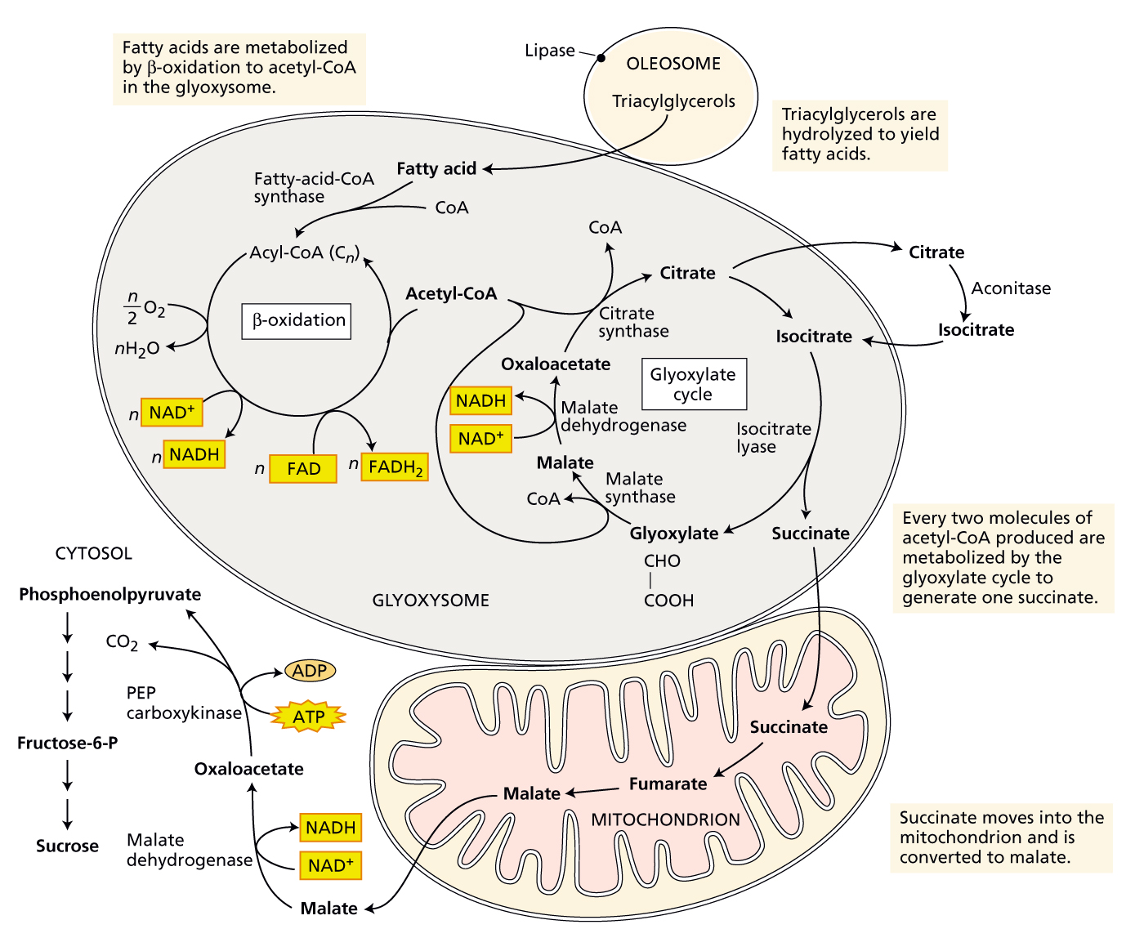
Lipid Metabolism
(Lipids to Sucrose)

Slide 50
Any
QUESTIONS ?

