Slide 1
Water Sources and Quality

Slide 2
Water Sources and Main Characteristics
Groundwater (deep/shallow wells)
Not exposed to pollution but once polluted, restoration is difficult, expensive, and long term.
Free of pathogens and turbidity (filtration action of soil).
May contain gases e.g. CO₂, H₂S (from bacterial decomposition of organic matter in soil or by-product of reduction of sulfur from mineral deposits).
May contain Ca⁺⁺, Mg⁺⁺ (hard water), fluoride, iron and manganese (Fe and Mn).
May contain large quantities of dissolved solids (TDS> 1000 mg/L, brackish water)
Can be normally used with little or no treatment.

Slide 3
Water Sources and Main Characteristics
Fresh surface water (rivers, lakes, wadis, ..)
Open to pollution of all kinds (e.g. runoff from urban and agricultural area, erosion of soil, industrial and municipal wastes discharges, air pollution)
Often requires extensive treatment particularly if it is polluted.

Slide 4
Water Sources and Main Characteristics
Seawater
TDS > 30000 mg/L.
Requires desalination to make it potable (desalination: removal of dissolved solids – an expensive process)
Reclaimed Wastewater
Reclaimed water is wastewater that has been treated sufficiently for use in industry and agriculture, and for some municipal applications (irrigation, toilet flushing, street washing)

Slide 5
Water Quality Standard
Quality is usually judged as the degree to which water conforms to physical, chemical and biological standards/criteria set by user.
Water quality standards/criteria are established in accordance with the intended use of water.
Significance of standards/criteria
Determine whether treatment of water is required.
Determine what processes are to be used to achieve the desired quality.

Slide 6
Water Quality Standard
Drinking Water Standards
Drinking water standards specify the maximum/optimum levels of contaminants in drinking water for the protection of human health.
Examples
Standards of Saudi Arabian Standards Organization (SASO)
Standards of US Environmental Protection Agency (EPA)
World health organization (WHO) guidelines.

Slide 7
Water Quality Standard
Quality Criteria for Wastewater Disposal and Reuse.
Authorities should specify quality criteria for treated water for each type of disposal and reuse options.
For example, in the USA, BOD or SS values in the effluent are set not to exceed an average of 30 mg/L; and the fecal coliform limit is 200/ 100 ml.
In Saudi Arabia, the ministry of water and electricity issued criteria for reuse of reclaimed water for agricultural irrigation.

Slide 8
Water Treatment

Slide 9
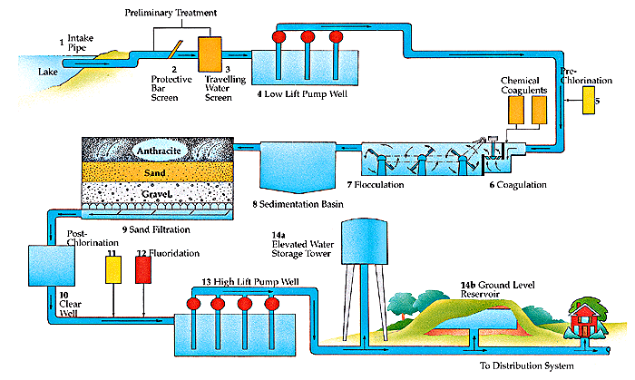
Water Treatment

Slide 10
Water Treatment
Chemical Adding: To add coagulant
Flash Mixing: To provide quick and uniform distribution of coagulant
Flocculation
To give enough time for chemical reaction to take place.
To provide enough time for flocs to grow in size
Sedimentation: To remove 96 to 99 % of S.S. and colloidal matter.
Filtration
To remove the remaining S.S.
To remove 90 % of bacteria
To remove iron and manganese
To remove color and taste.
Disinfection: To destroy pathogenic organisms

Slide 11
Water Treatment
Ground Storage:
To maintain adequate contact time for chlorination to take place.
To provide adequate volume of water for emergency cases.
To provide sufficient amount of water for fire protection.
To meet fluctuation in water consumption.
High lift pump: to raise water from the level of water ground tank to the desired head level in distribution system.

Slide 12
Water Treatment
Elevated Tank
To balance the fluctuation in water consumption through a day.
To improve water pressure in distribution networks.
To fix head on high lift pump.
To prevent water hammer.
To allow for future extension of city.
Distribution Network:

Slide 13
Water Treatment
Main Objectives of Water Treatment
Removal of particles (particulates)
Removal of dissolved solids
Removal of pathogens (disinfection)
Selection of water treatment processes depends on:
Type of water source
Desired water quality
Design capacity and period of water treatment plants:
Plants are designed for maximum daily demand (max. 24-hr demand)
Design period for processes and equipment: 15 – 20 years
Staging is usually considered for processes.

Slide 14
Removal of Particulate 1. Coagulation and Flocculation
It is a chemical-physical process used to increase size of colloidal particles (0.001 – 1 μm) that would never settle by plain settling, so that they can be removed by sedimentation (gravity settling)
The process involves two steps:
Coagulation
Addition of a chemical coagulant to destabilize colloidal particles so they can stick together and get larger when they are brought into contact by slow mixing (flocculation)
Colloids are negatively charged particles. The addition of a coagulant, which has positively charged particles, would neutralize the negative charge on the colloids.
It involves rapid mixing for few seconds to disperse the chemical.

Slide 15
Removal of Particulate 1. Coagulation and Flocculation
Flocculation
A slow and gentle mixing of the coagulated suspension to promote colloid-contact forming larger solids called (flocs) that can be removed by gravity settling.
The floc suspension is then transferred to settling tanks or directly to filters where flocs are removed.

Slide 16
Removal of Particulate 1. Coagulation and Flocculation
Types of Mixer
Mechanical Mixers (propellers or paddle-type mixers)
In-line Mixers
Pump Mixers
Types of Flocculation
Mechanical Flocculators (Paddle Flocculators)
Horizontal-Shaft Flocculator
Vertical-shaft Flocculator
Hydraulic Flocculators (Baffle Flocculators)
Over-and-under Baffle Flocculator
Maze-type Baffle Flocculator

Slide 17
Removal of Particulate 1. Coagulation and Flocculation
Important Parameters in Rapid and Slow Mixing
Mixing time (t)
t_{coagulation} = 30 seconds
t_{flocculation} = 20 – 40 minutes
Velocity gradient (G)
“G” reflects the degree of mixing
G = velocity gradient (second⁻¹ or s⁻¹ )
P = power input (W or N.m/s)
V = volume of mixing tank (m³)
μ = dynamic viscosity of water (N.s/m² ) = 1.0 x 10⁻³ N.s/m² at 20 ºC
G = 10 – 70 s⁻¹ , G.t = 10,000 – 100,000 for flocculation
Large G values produce small, dense flocs
Small G produce larger, lighter flocs

Slide 18
Removal of Particulate 1. Coagulation and Flocculation
Factors affecting Coagulation/Flocculation
Type of chemical coagulant
Aluminium sulphate (Alum): Al₂ (SO₄)₃ . 14H₂O (most widely used)
Sodium aluminate (ammonia alum): NaAlO₂
Ferrous sulfate: FeSO₄.7H₂O
Ferric chloride: FeCl₃. 6H₂O
Coagulant concentration (1% - 3%)
pH
Alum: 5.5 – 7.5 (optimum pH ≈ 7.0)
Ferric: 5.0 – 8.5 (optimum pH ≈ 7.5)

Slide 19
Removal of Particulate 1. Coagulation and Flocculation
Chemical composition of water (e.g. SO₄⁼ , CO₃⁼ , PO₄⁼)
Nature of turbidity
Particles of different size are easier to coagulate than uniform size particles.
Highly turbid waters may require a lesser amount of coagulant than waters with slightly turbidity.
Temperature
Cold water near 0 º C is difficult to coagulate.
Rapid Mixing (degree and time of mixing)
Coagulant/flocculant aids
Aid are used to improve settling and strength of flocs and to enhance turbidity and color removal
Examples of aids: activated silica, oxidants (chlorine, ozone, potassium permanganates to aid in color removal), and polymers.

Slide 20
Removal of Particulate 1. Coagulation and Flocculation
Theoretical Chemical Reactions
Aluminum Sulfate (Alum)
Alum reacts with natural alkalinity forming aluminum hydroxide flocs, Al(OH)₃.
Al₂(SO₄)₃.14.3H₂O + 3 Ca(HCO₃)₂ → 2Al(OH)₃ + 3CaSO₄ + 14. 3H₂O + 6CO₂
600 parts of alum use up 300 parts of alkalinity as CaCO₃
i.e. Each mg/L of alum decreases waster alkalinity by 0.5 mg/L as CaCO₃
Therefore the overall effect of alum addition will be a decrease in pH of water because CO₂ is formed from the reaction.
Note:
If water does not contain sufficient alkalinity to react with alum, lime Ca(OH)₂ or soda ash Na₂CO₃ is added to provide the necessary alkalinity:
Al₂(SO₄)₃.14.3H₂O + 3 Ca(OH)₂ → 2Al(OH)₃ + 3CaSO₄ + 14. 3H₂O
Al₂(SO₄)₃.14.3H₂O + 3 Na₂CO₃ + 3H₂O → 2Al(OH)₃ + 3 Na₂SO₄ + 3CO₂ + 14. 3H₂O

Slide 21
Removal of Particulate 1. Coagulation and Flocculation
Theoretical Chemical Reactions
Ferric Chloride
Ferric chloride reacts with natural alkalinity
2FeCl₃ + 3 Ca(HCO₃)₂ → 2Fe(OH)₃ + 2CaCl₂ + 6CO₂
MW: 162 300
EW: 27 50
1 mg/L of ferric chloride uses 1.85 mg/l of alkalinity as CaCO₃

Slide 22
Removal of Particulate 1. Coagulation and Flocculation
Example
A dose of 36 mg/L of alum is used in coagulating turbid water with turbidity = 10 NTU
How much alkalinity is consumed
What changes take place in the ionic character of the water?
How much mg/l of Al(OH)3 are produced?
What is the amount of sludge produced (mg/L or g/m3 of water)?
What is the volume of sludge produced (m3/m3 of water) if the solids concentration in sludge = 0.2% (i.e. 2000 mg/L)?

Slide 23
Removal of Particulate 1. Coagulation and Flocculation
Determination of Coagulation Effectiveness
Jar Test
Purpose: to determine the effectiveness of chemical coagulation and the optimum dosage of a coagulant under different environmental conditions (e.g. pH, flocculation time).
Procedure:
Fill the 6 jar with the water to be tested
Dose 5 jars with different amounts of the coagulant. The sixth jar is used as a control (i.e. no coagulation is added)
Mix rapidly for about 1.0 minute, and then mix slowly for 15 - 20 minutes.
Remove the stirrers, and allow the suspensions to settle for about 30 minutes.
During flocculation and settling, observe and record the characteristics of flocs in qualitative terms: poor, fair, good or excellent.
After settling, determine the turbidity of the supernatants and compare with initial turbidity.
The lowest dosage that provides good turbidity removal is considered the optimum dosage.
Using the optimum dosage, run the test again under different pH values by adding an acid or an alkaline to determine the optimum pH.
Using the optimum dosage and pH, repeat the test with different flocculation time, and determine the optimum mixing time.

Slide 24
Removal of Particulate 1. Coagulation and Flocculation
Example
Results of a jar-test demonstration on alum coagulation are tabulated below. The alum solution used had such strength that each mL of solution added to a jar of water produced a concentration of 10 mg/L of aluminum sulfate. Jars 1 through 5 contained a clay suspension in tap water, while jar 6 was a clay suspension in distilled water.
What is the most economical dosage of alum in mg/L
Why the clay suspension in Jar 6 did not destabilize.
Solution
The optimum dosage is 40 mg/L
(Jar 4)
Because distilled water has no
anions to form aluminum hydroxide
that can interact with colloids to
neutralize their charges.
Jar | Alum Added |  | Floc Formation | Supernatant Turbidity (NTU)
 | (mL) | (mg/L)
1 | 0 | 0 | None | 20
2 | 1 | 10 | Fair | 14
3 | 2 | 20 | Good | 12
4 | 4 | 40 | Heavy | 9
5 | 5 | 50 | Heavy | 9
6 | 4 | 40 | None | 20

Slide 25
Removal of Particulate 2. Sedimentation
Sedimentation is a process by which particles, flocs, or precipitates are removed (settled) by the gravity effect.
Sedimentation tank is also called settling tank or clarifier.
Common Criteria for sizing Settling Tanks:
Detention time (t) t (hr) = V (m³)/Q (m³/hr)
V = Volume of settling tank
Q = Water flow rate
Over flow rate (V_{o}) (surface loading)
V_{o} (m³/m².hr) = Q (m³/hr)/A (m²)
A = Surface area of the settling tank
All particles with settling velocity > V_{o} will be removed (settled)
Weir Loading
Weir Loading = Q (m³/hr)/L (m)
L = total length of effluent weir
Horizontal velocity, V_{h} (for rectangular tank)
V_{h} (m/s) = Q (m³/s)/ D x W (m²)
D = depth of the settling tank
W = width of the settling tank
L
D
W

Slide 26
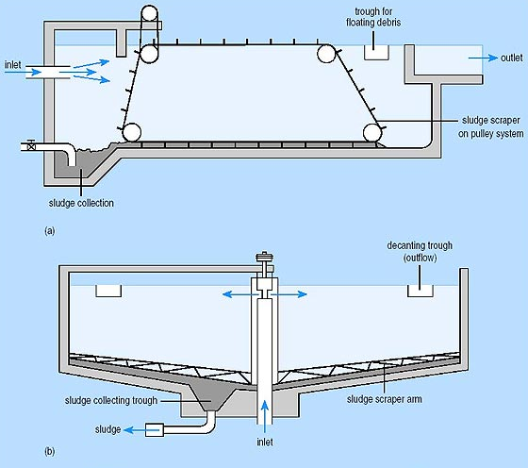
Removal of Particulate 2. Sedimentation
Types of Settling Tanks
Rectangular
Circular

Slide 27
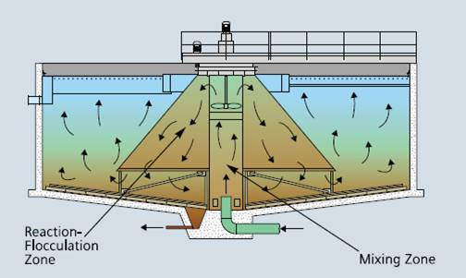
Removal of Particulate 2. Sedimentation
Flocculator-Clarifier (Solids Contact Unit)
A solids contact unit is one single tank combining the processes of
Mixing + Flocculation + Settling
Raw water and chemicals are mixed with settled solids to promote growth of larger that would settle rapidly.
m

Slide 28
Removal of Particulate 2. Sedimentation
Factors affecting efficiency of sedimentation
Retention period E α T
Velocity of flow (V_{h}) E α (1/ V_{h})
Surface loading rate (over flow rate) E α (1/S.L.R)
Size and shape of particles
Density of particles E α ρ
Density of fluid (water) E α 1/ρ_{water}
Turbulence
Increasing size of particles by using chemicals.
Inlet and outlet arrangement in order to avoid dead zone.
S
Dimensions of Tank (width, length, L/B, surface area)
Concentration of suspended solids
Sludge collection and removal
Inlet Weir
Outlet Weir
Dead zone

Slide 29
Removal of Particulate 2. Sedimentation
Design Parameters for settling tanks following chemical flocculation
Depth = 2.5 – 4 m
Diameter (circular tanks) = 12 – 70 m
Rectangular tanks: Length = 15 – 70 m, L/W = 3/1 – 5/1
t ≥ 4 hr
t ≥ 3 hr pre-sedimentation (settling before coagulation/flocculation for very turbid water)
Maximum horizontal velocity = 2.5 mm/s
Maximum weir loading = 250 m³/m².day
Over flow rate = 20 – 33 m³/m².day
Bottom slope = 8 % for circular tanks and = 1 % for rectangular tanks
Solids Contact time
Min. Flocculation and mixing time = 30 min
Min. Settling time = 2 hr for turbidity removal
= 1 hr for softening
Max. Overflow rate = 60 m3/m2.day for turbidity removal
= 100 m3/m2.day for softening
Max. Weir loading = 180 m3/m2.day for turbidity removal
= 360 m3/m2.day for softening

Slide 30
Removal of Particulate 2. Sedimentation
Example
What size of a rectangular settling tank not over 3.5 m deep, would be required to provide 4250 m³/day with at least 4 hours detention and an overflow rate less than 30 m³/m².day.
Using the flow rate of 30 m³/m².day:
Surface area, A = Q/V_{o} = (4250 m³/day) / (30 m³/m²/day) = 142 m²
Volume of tank, V = A x depth = 142 m² x 3.5 m = 497 m³
therefore, detention time, t = V/Q = 497 m³ / 4250 m³/d = 0.117 day = 2.8 hr
t = 2.8 hr < 4.0 hr (not OK)
Using the detention time of 4 hr
Volume of tank = Q . t = 4250 m³/d x (4/24) d = 708 m³
A = V/depth = 708 m³ / 3.5 m = 203 m²
Overflow rate, V_{o} = Q/A = 4250 m³/d / 203 m² = 21 m³/m².d < 30 (OK)
therefore, the detention time governs the design
L/W = 3/1 – 5/1, Use L/W = 5/1 therefore, L =5W
A = LW = 5W² , therefore, 203 = 5 W² → W = 6.4 m and L = 32 m
A = 32 x 6.4 = 204.8 m² and V = 204.8 x 3.5 = 716.8 m³
t = V/Q = (716.8 m³)/(4250 m³/d) = 0.169 d = 4.05 hr
Vo = Q/A = (4250 m³/d) / (204.8 m²) = 20.8 m³/m².d

