Slide 1
Chapter 20 Valuing Life and Other Nonmonetary Benefits

Slide 2
Establishing the appropriate degree of social regulation requires that a price is set for what the regulation produces
The Occupational Safety and Health Administration (OSHA) and the Environmental Protection Agency (EPA)
There are two approaches used to gain a better sense of the degree to which various forms of social regulation should be pursued
1) Estimate the implicit prices for social risk commodities that may be traded implicitly in markets
2) Ask people in interviews how much they value a particular health outcome

Slide 3
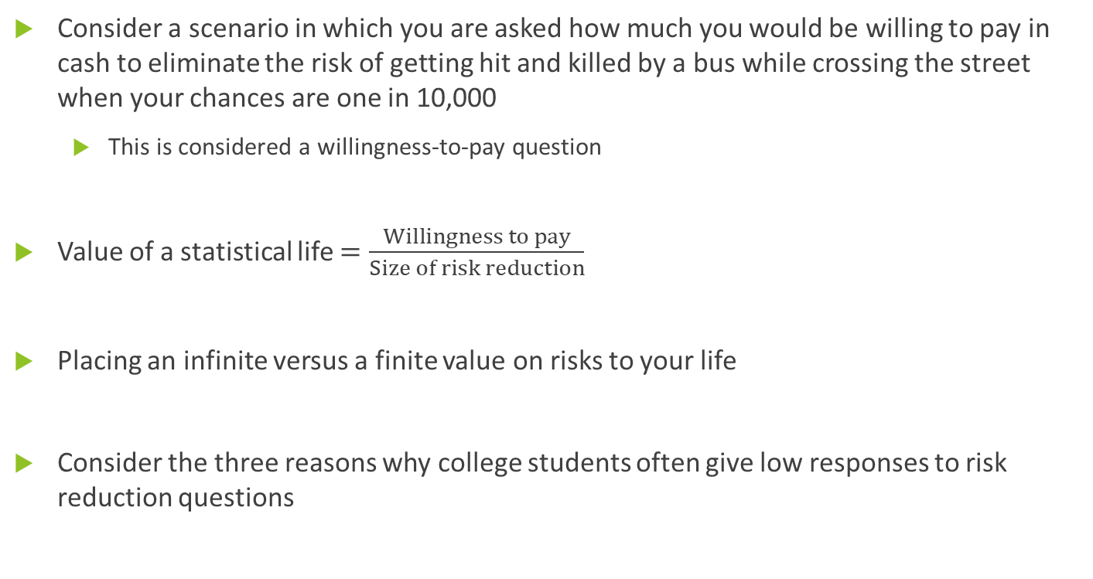
Policy Evaluation Principles
Consider a scenario in which you are asked how much you would be willing to pay in cash to eliminate the risk of getting hit and killed by a bus while crossing the street when your chances are one in 10,000
This is considered a willingness-to-pay question
Value of a statistical life $=\frac{Willingness to pay}{Size of risk reduction}$
Placing an infinite versus a finite value on risks to your life
Consider the three reasons why college students often give low responses to risk reduction questions

Slide 4
Willingness-to-Pay versus Other Approaches
Alternative approaches to valuing life have been suggested; these approaches mostly rely on various human capital measures related to one’s lifetime earnings
The first human capital measure one can consider is the present value of one’s lifetime earnings, but this has its drawbacks
A variant approach is to take the present value of lifetime earnings net of the consumption of the deceased (commonly used in court cases for compensating survivors in wrongful death cases)
A final approach is to look at the taxes that people might pay; much of the appeal of this method is that it lends itself to calculation

Slide 5
A major policy event that led to a shift in the approach taken was the OSHA hazard communication regulation that was the subject of intense debate in the early 1980s
The U.S. Office of Management and Budget (OMB)
Three decades ago, raising the issue of valuing risks to life appeared to be intrinsically immoral, but it has become less controversial over the years
The idea that it is not feasible to achieve an absolutely risk-free existence and that some tradeoffs must ultimately be made is becoming more widely understood

Slide 6
Variations in the Value of a Statistical Life
There is no right answer in terms of valuing risks to life; rather, the effort is simply one to establish an individual’s risk-dollar tradeoff
A major source of differences in preferences is likely to be individuals’ lifetime wealth
There is likely to be substantial heterogeneity in individual preferences, and this heterogeneity will be exhibited in the choices that people make
Consider the estimates by Joni Hersch and W. Kip Viscusi
Should we provide individuals with less stringent government regulations to protect them if they have revealed by other activities that they are willing to bear a variety of risks to their well-being?

Slide 7

The one instance in which the differences in the value of a statistical life should clearly be utilized is when assessing future impacts of regulatory programs
Present value of benefit = $\frac{b{\left(1+g\right)}^{n}}{{\left(1+r\right)}^{n}}≈b{\left(1+g−r\right)}^{n}$

Slide 8
Labor Market Model
Most empirical estimates of the value of a statistical life have been based on labor market data
Estimate the wage-risk tradeoff that workers implicitly make as part of their jobs and use the implications of this tradeoff as an estimate of the value of a statistical life
How one interprets differences in the estimated value of a statistical life depends on people’s opportunities, not just their preferences
Disadvantaged workers often do not have access to the same kinds of jobs as advantaged workers
A statistical approach generally involves the use of a large set of data on individual employment behavior

Slide 9
Equilibrium in the Market for Risky Jobs

Slide 10
Empirical Estimates of the Value of a Statistical Life
The general form of the estimation depends in part on the nature of the wage and risk information that is available, such as whether the data pertain to annual earnings or hourly wage rates
The most reliable estimates are those based on fatality rate estimates using data from the U.S. Bureau of Labor Statistics’ Census of Fatal Occupational Injuries
In general, the people who earn the highest incomes in our society also have fairly low-risk jobs
Economists cannot yet pinpoint the value of statistical life that is appropriate in every particular instance; however, the knowledge acquired thus far is considered sufficient

Slide 11
Value of Risks to Life for Regulatory Policies
For the most part, regulatory agencies have used estimates drawn from the labor market value of a statistical life literature to value the benefits of regulations that reduce risks to life
Examine the government policies that have actually been pursued in the social regulation area to see the extent to which they conform with an appropriate value of a statistical life
Because of agencies’ restrictive statutory guidance, the amounts that are actually spent to reduce risks to life are often quite different and may bear little relationship to the benefit values
Consider the columns of statistics that give the cost per expected life saved by each of the programs, the cost per normalized life saved, and the cost per expected life-year saved

Slide 12
All regulations from the U.S. Department of Transportation—the National Highway Traffic Safety Administration and the Federal Aviation Administration—pass a benefit-cost test
In contrast, during the regulatory era virtually every regulation by the EPA and OSHA fails a benefit-cost test because of the restrictive nature of their legislative mandates
In general, it is not necessary to pinpoint the exact value of a statistical life that is appropriate for any government policy
Widespread criticism of the checkered historical record with respect to the cost per expected life saved also may have prompted government agencies to structure policies without such imbalances between benefits and costs

Slide 13
Survey Approaches to Valuing Policy Effects
In many circumstances, there is not readily available market data that can be used to estimate either implicit or explicit prices
Because of this, surveys and survey data have become the dominant methodology for assessing environmental benefits
Contingent valuation: term used to describe studies that attempt to replicate the hedonic market estimate approach used to analyze quality-adjusted wage-risk tradeoffs and similar factors using survey data

Slide 14
Various approaches to stated preference studies
1) Ask individuals how much a particular benefit would be worth to them (one-step procedure)
2) The individual first answers the open-ended question and then is asked whether he or she would be willing to pay a small amount more than the initial response
3) Instead of asking open-ended questions, individuals are given a series of bids, and they would then have to determine how high or low they would go
The underlying issue is how the survey questions can be best framed to elicit the true underlying economic values that individuals have
A fundamental difficulty of survey studies is that some individuals often may not give thoughtful or meaningful responses to the question

Slide 15
Valuation of Air Quality
Two approaches used to value air quality
1) In the first, a hedonic rent-gradient equation for the Los Angeles area was estimated, analyzing the relationship of home sale prices to a variety of factors likely to influence house price
2) In the second, a survey approach was used to assess the amount that individuals would be willing to pay in terms of a higher utility bill to achieve cleaner air
The results suggest that at least in this case, overstatement of valuations in surveys may not be a problem, although this conclusion may not be true more generally

Slide 16
Supplementary Nature of the Survey Approach
Overall, survey approaches to establishing the benefits of social regulation represent an important complement to analyses using market data
The survey methodology should still be regarded as best used to substitute for market valuations when they are unavailable

Slide 17
Sensitivity Analysis and Cost Effectiveness
Typically, it will not be feasible to place dollar values on all outcomes of interest
One could undertake a cost-effectiveness analysis to analyze the cost per unit outcome achieved, and if there are multiple outcomes that one would wish to value but cannot, one can perform a sensitivity analysis assigning different relative weights to them to convert all of the health effects into a common cost-effectiveness index
Consider the calculations that formed the basis for resolving the debate over the OSHA hazard communication regulation

Slide 18
Risk-Risk Analysis
Two classes of costs can be identified under the general heading of risk-risk analysis
1) A direct risk-risk tradeoff arises from regulatory efforts
2) Risk regulations stimulate economic activity
The newest form of risk-risk analysis, regulatory expenditures, has drawn on the negative relationship between individual income and mortality
Although the theoretical relationships are not controversial, the exact value of the regulatory expenditure that will lead to a statistical death remains a matter of debate
Consider W. Kip Viscusi’s approach
The risk-risk tradeoff rate can also be used to assess the net health impact of policies

Slide 19
Summary
Because social regulation efforts deal in large part with outcomes that are not the result of explicit market transactions, there will always be a need to establish the value of these efforts
The general economic approach to formulating a benefit assessment is not particularly controversial, but some of the empirical methodologies for establishing such values are still in their development stage
The absence of a specific empirical estimate for the benefit value is not the most pressing policy problem: a more fundamental difficulty is that the importance of making tradeoffs at all has not even been recognized

