Slide 1
Chapter 12 Optimal Pricing

Slide 2
Subadditivity and Multiproduct Monopoly

Slide 3
Most firms supply multiple products or services
Vocabulary
Subadditivity
Economies of scope
Unsustainable
Natural monopoly prevails in the multiproduct setting when the industry cost function is subadditive, so that all relevant output combinations are produced at minimum cost by a single firm

Slide 4
Optimal Pricing Policies
Analyze the optimal design of pricing policies, first in a setting where the regulated firm supplies only a single service and then in a setting where the firm supplies multiple services

Slide 5
Optimal Pricing of a Single Service
One example of a firm that sells only one service could be an electricity distribution company

Slide 6
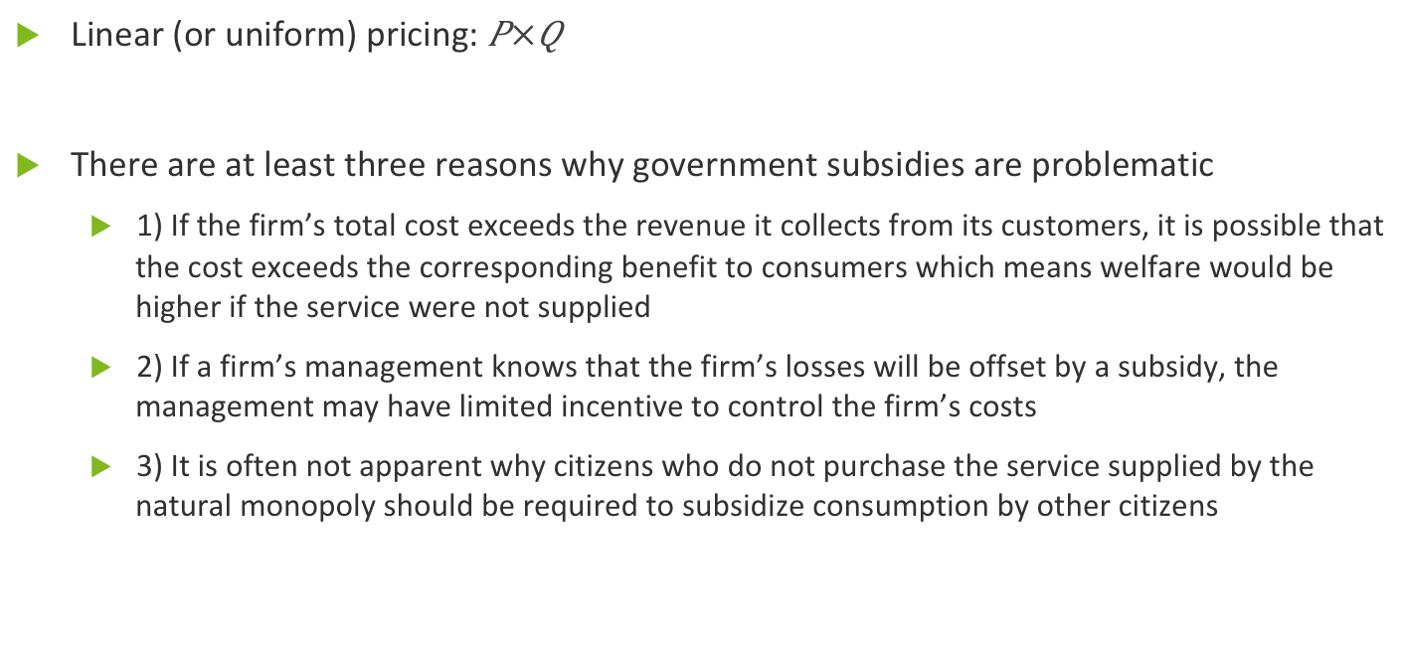
Linear Pricing
Linear (or uniform) pricing:
There are at least three reasons why government subsidies are problematic
1) If the firm’s total cost exceeds the revenue it collects from its customers, it is possible that the cost exceeds the corresponding benefit to consumers which means welfare would be higher if the service were not supplied
2) If a firm’s management knows that the firm’s losses will be offset by a subsidy, the management may have limited incentive to control the firm’s costs
3) It is often not apparent why citizens who do not purchase the service supplied by the natural monopoly should be required to subsidize consumption by other citizens

Slide 7
Nonlinear Pricing Two-part tariffs
Nonlinear pricing can help to reduce the welfare losses that arise under linear pricing
The parts of a two-part tariff are (1) a fixed fee, F and (2) a constant per-unit price, P
One potential drawback to a two-part tariff is that some consumers may be unable to afford a large fixed fee
Two-part tariffs generally can be designed to achieve a higher level of aggregate welfare than can linear pricing

Slide 8
Nonlinear Pricing Multipart tariffs
Electricity, water, and telephone utilities often implement multipart tariffs
Consider the pros and cons of the declining-block tariff example regarding a local telephone service

Slide 9
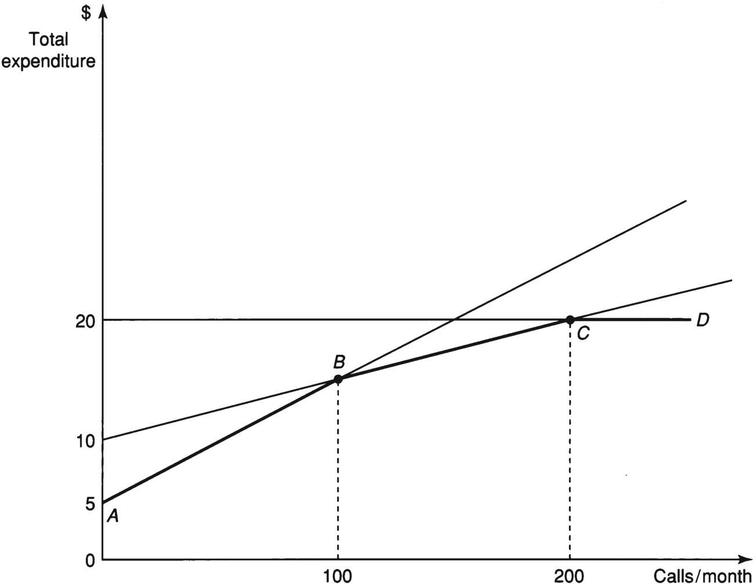
Multipart Tariff for Local Telephone Service

Slide 10
Optimal Pricing of Multiple Services Ramsey Pricing
Regulated enterprises often supply multiple services
Ramsey prices: the linear prices that minimize deadweight welfare losses while equating the monopolist’s total revenue and total cost
The mathematical Ramsey rule is
Value of service pricing

Slide 11
Non-Ramsey Pricing of Telephone Services
The Ramsey pricing rule is considered a sound principle, but regulators do not always follow the rule
Consider how AT&T operated before 1984
Network externalities: benefits that accrue to all network subscribers as more subscribers join the network
Prices other than Ramsey prices can be optimal when other goals (such a universal access) prevail or when particular emphasis is placed on the welfare of particular groups of consumers

Slide 12
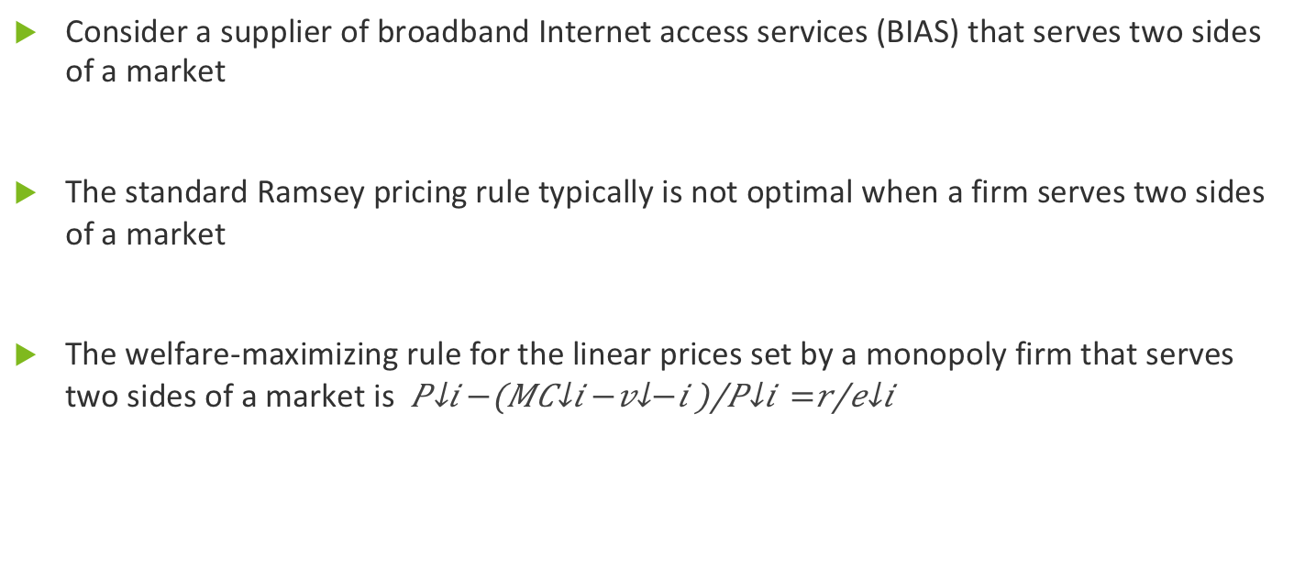
Optimal Pricing in Two-Sided Markets
Consider a supplier of broadband Internet access services (BIAS) that serves two sides of a market
The standard Ramsey pricing rule typically is not optimal when a firm serves two sides of a market
The welfare-maximizing rule for the linear prices set by a monopoly firm that serves two sides of a market is

Slide 13
Rate Structure
A common cost is a cost that is incurred in supplying multiple services and would not be avoided if just one of the services were no longer supplied
FDC pricing stands for fully distributed cost pricing

Slide 14
FDC Pricing
Two drawbacks to FDC pricing procedures are
1) They typically fail to produce prices that maximize welfare
2) They can engender serious disputes among customer classes

Slide 15
Avoiding Inefficient Entry
The stand-alone cost: when regulators can allocate common costs so as to produce a price for each service that exceeds the average cost of producing the service in isolation
It is not always possible to find prices that preclude inefficient entry

Slide 16
Time of Use Pricing Costs of Power Production
Time of use (TOU) pricing: when a firm might charge a different price for the same service at different times during the day
Types of generating units electricity suppliers employ to meet the time-varying demand for electricity
Baseload units
Peaker units

Slide 17
TOU Pricing Model
To explain the principles of TOU pricing most clearly, it is helpful to consider a simpler approximation of the setting

Slide 18
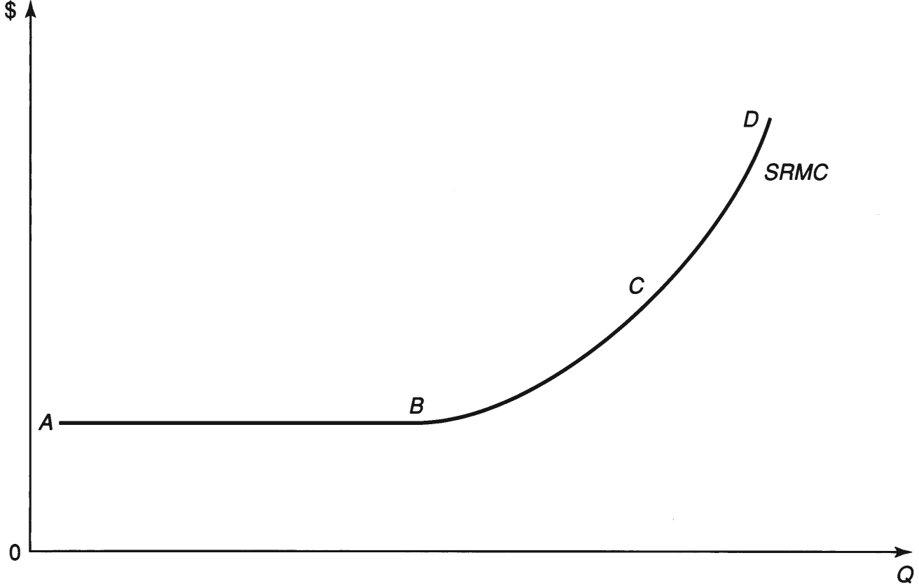
Short-Run Marginal Cost Curve for Electricity Supply

Slide 19
Summary
In this chapter we
Reviewed the key principles of optimal pricing in regulated industries
Noted that although marginal cost prices maximize aggregate welfare, they can impose financial losses on the regulated supplier in the presence of a natural monopoly
Characterized welfare-maximizing prices in two-sided markets and explored the value of time-of-use pricing in settings where marginal costs of production differ substantially at different times during the day

