Slide 1
Regulation, Free-Riding
Incentives, and
Investment in R&D
with Spillovers
By
John C. Strandholm , Ana Esp´ınola-Arredondo & Felix Munoz-Garcia
680 EconS
Dr. Aljulaifi

Slide 2
Agenda
Introduction
Research Question
The Model
Equilibrium Analysis
Comparison
Discussion

Slide 3
Introduction
Firms’ investment in clean (or environmentally friendly) research and development (R&D) has increased over time, from less than $30 billion in 2005 to $159 billion in 2012 worldwide.
Katsoulacos and Xepapadeas (1996); Montero (2002a); Comin (2004); Poyago-Theotoky (2007); While Espinola-Arredondo (2016).
The aforementioned literature assumes that all firms are subject to uniform environmental policies. However, when firms are asymmetric, they may invest different amounts in clean R&D, generating a distinct amount of pollution.
This asymmetry calls for a type-dependent environmental policy that takes into account the different marginal environmental damage each firm generates (first-best policy), whereas a uniform regulation, that sets the same emission fee to all firms, represents a second-best policy in this context.
Contribution:
Two regulatory regimes and focuses on settings where the regulator can accurately observe each firm’s pollution before choosing emission fees (point pollution) or, alternatively, contexts in which R&D is observable thus helping the regulator infer the reduction in pollution.
National Science Foundation’s Science and Engineer in Indicators(2014),Chapter 6 (https://www.nsf.gov/statistics/seind14/index.cfm/chapter-6).

Slide 4
2 Model
Consider a duopoly market similar to Poyago-Theotoky (2007) where: (3 stages)
1st stage, every firm i independently and simultaneously chooses its investment in R&D$, z_{i}.$
2nd stage, the regulator selects an emission fee t by maximizing social welfare.
3rd stage, every firm i competes `a la Cournot choosing its output level $q_{i}$.
For generality, firms can be symmetric in their R&D abilities,
if γ_{i} = γ_{j} , or asymmetric, if γ_{i} /= γ_{j} , where the latter can occur when one of the two firms has a previous history of innovation in the market.
Firms face linear demand
p(Q) = a − Q where p is price, a > 0, and Q ≡ q_{i} + q_{j} is the aggregate output level.
Both firms have the same marginal cost of production c, where a > c > 0.
Two forms of emission fees: uniform, where both firms are subject to the same fee t; and type dependent, whereby each firm is subject to a distinct fee t_{i}, which might affect firms’ incentives to invest in R&D
In order to sustain type-dependent fees, we consider that
environmental damage is $ED =\frac{1}{2} d(e_{i}^{2} + e_{j}^{2}), where d > 1$.

Slide 5
Equilibrium Analysis
Third Stage
Solving by backward induction, we first analyze optimal output under both policy regimes in the third stage of the game. Therefore, every firm solves:
max π_{i} = (a − q_{i} − q_{j} )q_{i} − cq_{i} − t(q_{i} − z_{i} − βz_{j} ),
where t = t_{i} when the fee is type-dependent, and β ∈ [0, 1] represents the knowledge spillover from firm j to i. Hence, when β = 0 spillover effects are absent, whereas when 0 < β ≤ 1 firm i benefits from every unit of investment in R&D by firm j (either fully, if β = 1, or partially, if 0 < β < 1).
Lemma 1. In the third stage, every firm i chooses output according to
q(t_{i}, t_{j} ) = ^{a−c−2ti+tj}
3
under a type-dependent fee, and q(t) = ^{a−c−t} under a uniform fee.
3
Hence, when the emission fee is uniform, a reduction in t benefits both firms. However, when the fee is type-dependent, a reduction on firm i’s tax is completely appropriated by this firm (which regulator sets emission fees, and immediately after firms compete in quantities. increases its output level) but harms its rival, decreasing its production.

Slide 6
3.2 Second Stage
The following lemma examines optimal fees under uniform regulation in the second stage of the game. In this case, the regulator solves:
max SW = CS + PS + T − ED (1)
t
where CS and PS represent consumer and producer surplus, respectively, and T denotes total tax revenue. A similar problem applies when regulation is type-dependent, and thus the regulator can set a pair of fees (t_{i}, t_{j} ).
Lemma 2. In the second stage, under a uniform regulation, the regulator sets an emission fee
of
2(a − c)(d − 1) − 3d(1 + β)(z + z )
t(z , z ) =
i j
,
i j
2(d + 2)
and in the case of type-dependent regulation, a fee of
t (z , z ) =
(a − c)(d − 1) − z_{i}[1 + 2d + β(d − 1)] − z_{j} [d − 1 + β(2d + 1)]
i i j
d + 2
for every firm i.
While an increase in either firm’s investment in R&D produces a symmetric reduction in the uniform emission fee t(z_{i}, z_{j} ), such effect is asymmetric when firms face type-dependent regulation, t_{i}(z_{i}, z_{j} ).
spillovers are absent, β = 0, firm i’s investment in R&D decreases its emission fee t_{i}(z_{i}, z_{j} ). Similarly, an increase in its rival’s investment in R&D, z_{j} , also decreases firm i’s emission fee t_{i}.
When spillovers are present, β > 0, similar effects arise, but an increase in firm j’s investment now facilitates firm i’s pollution abatement, producing a larger decrease in the optimal emission fee t_{i} than when spillover effects are absent.
Free-ride off each other’s investment in R&D as the spillover effect increases.

Slide 7
3.3 First Stage
We next analyze optimal investment in R&D in the first stage of the game under uniform regulation, and afterwards under type-dependent policy. In the case of uniform fees, every firm i solves
max π_{i} = [a − q_{i}(t(z_{i}, z_{j} ))−q_{j} (t(z_{i}, z_{j} ))]q_{i}(t(z_{i}, z_{j} ))
zi
− cq_{i}(t(z_{i}, z_{j} )) − t[q_{i}(t(z_{i}, z_{j} )) − z_{i} − βz_{j} ] − ½ γ_{i}z_{i} . (2)
which includes total revenue, production cost, tax payments which depend on net emissions, q_{i}(t(z_{i}, z_{j} )) − z_{i} − βz_{j} , and the cost of investing in R&D.
Proposition 1. In the first stage, every firm i chooses an R&D investment level of
where U denotes uniform fee, A ≡ (β + 1)d, B ≡ (β − 5)d − 12, and C_{i} ≡ 2γ_{i}(d + 2). In addition,
z^{U} decreases in γ_{i} but increases in γ_{j}.
Hence, firm i invests less in R&D as the cost of investing increases (larger γ_{i}), but invests more as the cost of its rival increases. This is because z_{i} and z_{j} are strategic substitutes, implying that an increase in γ_{j} shifts firm j’s best response function downwards, thus reducing z_{j} , which ultimately increases z_{i} since best response functions are negatively sloped. In addition, when firm i is the more efficient firm, γ_{i} < γ_{j} , the aggregate investment in R&D, z^{U} + z^{U} , increases in firm i’s efficiency (lower γ_{i}) but decreases on the competitor’s efficiency level.
i j

Slide 8
Proposition 2. In the first stage, every firm i chooses an R&D investment level of
We next analyze aggregate investment in R&D, and how it is affected by the asymmetry in investment efficiency.
Corollary 1. Consider that γ_{i} < γ_{j}. A symmetric marginal improvement in efficiency produces
If firm i is the most efficient (γ_{i} < γ_{j} ), a symmetric improvement in efficiency produces a larger increase in investment in R&D from firm i than from j.

Slide 9
4 Comparison
We next compare equilibrium investment levels under uniform and type-dependent regulation.
Corollary 2. Every firm i’s best response function in the investment stage under a type- dependent fee lies above the best response function under a uniform fee for all z_{j} and all parameter values. In addition, equilibrium investment in R&D satisfies $z_{i}T D > z_{j}U$for all parameter values.
Intuitively, when firm i invests an additional unit in R&D under type-dependent regulation, it reduces its future emission fee more significantly than when facing uniform regulation. As a consequence, firms have more incentives to invest in R&D.

Slide 10
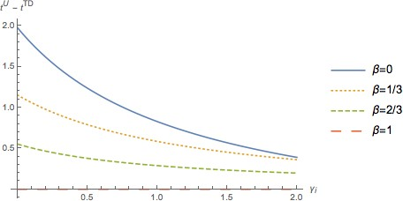
Emission Fees. Figure 1 depicts the difference between the emission fee under the uniform regime and the type-dependent regime, t^{U} − t^{T D}.
Figure 1: Difference between the uniform and type-dependent fees as a function of firm i’s efficiency.

Slide 11
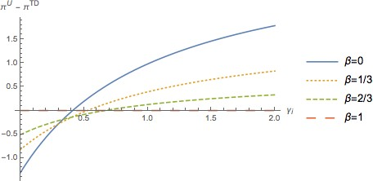
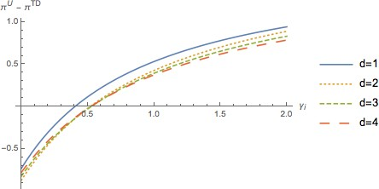
Profits Figures 2 and 3 show the profit difference across regimes, π^{U} − π^{T D}, for every firm i, as a function of its own efficiency, γ_{i}, when the efficiency of its rival is held constant at γ_{j} = 2/3.
Figure 2: The difference in profits between the uniform and type-dependent fees as a function of firm i’s efficiency.
Figure 3: The difference in profits between the uniform and type-dependent fees as a function of firm i’s efficiency.

Slide 12
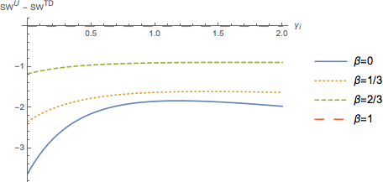
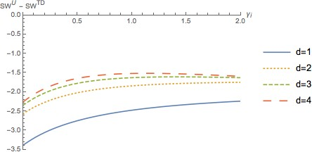
Social Welfare.
Figure 5: Social welfare difference between the two regulation types for different spillovers.
Figure 6: Social welfare difference between the two regulation types for different environmental damages.

Slide 13
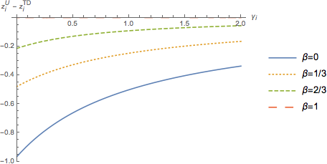
Environmental Research Cartel (ERC).
In order to evaluate the free-riding effect of in vestment in R&D, we need to evaluate the investment decision if the firms were to collude in the first stage. This will give us the joint profit maximizing amount of investment in R&D. This case, known as an environmental research cartel (ERC) in Poyago-Theotoky (2007), uses the second and third stage decisions from lemmas 1 and 2, but firms maximize joint profits by solving:
max π_{i} + π_{j}.
The objective function of this joint maximization problem is the same under both policy regimes. This means that, under each regime, when firms are engaged in an ERC, each firm faces the same emission fee.
Proposition 3. The equilibrium level of investment in R&D for every firm i when firms engage in an environmental research cartel is
Figure 4: The difference in investment between the uniform and type-dependent fees as a function of firm i’s efficiency.

Slide 14
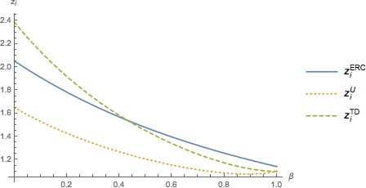
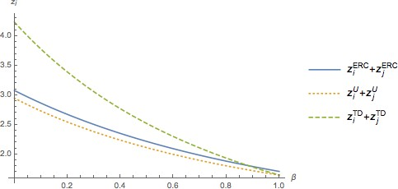
Figure 7: Investment in R&D as a function of the spillover under the two regimes and the ERC.
Figure 8: The total level of investment in R&D as a function of the spillover under the two regimes and the ERC.

Slide 15
5 Discussion
When is type-dependent regulation critical.
Our results show that when spillovers are small, such as when firms are located far apart or operate in different industries, regulators should pay close attention to the difference in each firm’s pollution when designing environmental policy. Doing so induces firms to increase their investment in R&D, reducing pollution, and thus helping regulators more easily reach their environmental targets. In contrast, when spillover effects are significant, such as in industry clusters, the use of either policy regime does not entail substantial differences in investment levels. Since the uniform regime is easier to implement, our findings imply that the regulator can rely on this policy tool to achieve similar welfare levels.
Efficiency and type-dependent policies.
We find that firms exhibiting efficiency in R&D investment would gain from a change in policy regime. In particular, a move from uniform to type-dependent fees increases the efficient firm’s profits, appropriating a larger proportion of their investment, while it reduces the profits of inefficient firms who would favor uniform policies. Hence, regulators should expect efficient firms aggressively lobbying for fine-tuned regulation that takes into account each firm’s characteristics, whereas inefficient firms would favor uniform standards across the industry.
Preference alignment.
When firms are efficient at investing in R&D, they would favor type- dependent policies, as described above. Similarly, regulators would like to introduce this policy as it yields a large reduction in pollution, and thus an increase in welfare, relative to uniform fees. Therefore, both regulator and firm would favor a similar policy regime, thus facilitating the introduction of more fine-tuned policies. However, when firms are inefficient, they prefer a uniform policy, while regulators still find welfare gains from introducing type-dependent fees. In this case, the preferences of firms and regulator become misaligned over policy.
Further Research.
Our model can be extended along different dimensions. First, we consider that R&D investment is deterministic, but a different setting could assume that firm i’s investment z_{i} is succesful with a positive probability, affecting the difference in emission fees across policy regimes. Second, we consider that every firm benefits from its own R&D investment, and a share of its rival’s (spillover effect). However, abatement patents could follow an R&D tournament structure, as in Lazear and Rosen (1981) and Nalebluff and Stiglitz (1983). In this setting, every firm would only benefit from either its own R&D investment (if it wins the tournament) or from a share of its rival’s (if it loses), rather than from both. In these two extensions, R&D expenditure can differ from R&D outcomes, implying that taxing outcomes can induce firms to invest suboptimal amounts in R&D. In this context, it would be interesting to analyze whether this inefficiency is, as in our model, larger when the regulator uses uniform rather than type-dependent policies.

Slide 16
Thank You!

