Slide 1
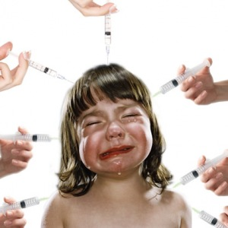
INJECTABLES
Nora A. Alkhudair

Slide 2
Injections
Percutaneous introduction of a medicinal substance, fluid or nutrient into the body. (e. g. intradermal, subcutaneous, intramuscular, intravenous)

Slide 3
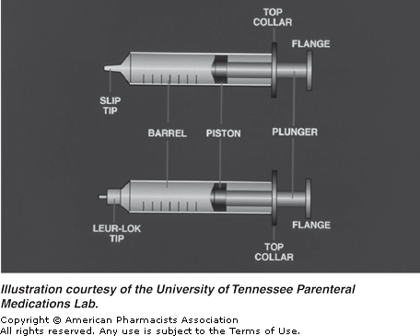
Syringe
Notes:
A syringe is a calibrated glass or plastic cylinder with a plunger at one end and an opening that attaches to a needle in the second.

Slide 4
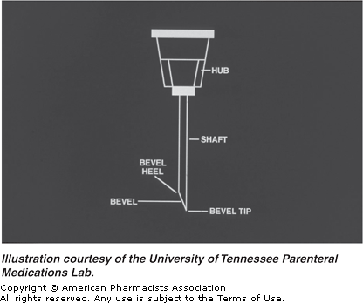
Needle
Notes:
The needle is a hollow metal tube with a pointed tip.

Slide 5
Unsafe Use of Injections
caused by re-use of syringes and needles without sterilization.
21 million hepatitis B infections
Sub-Saharan Africa, Asia and former Eastern bloc countries
2 million hepatitis C infections
260 000 HIV/AIDS

Slide 6
Safe Injection Practices
A safe injection is one that does not harm the recipient, does not expose the provider to any avoidable risks and does not result in waste that is dangerous for the community.
Unsafe injection practices can lead to transmission of bloodborne pathogens, with their associated burden of disease.

Slide 7
PRESCRIBING OF INJECTABLE MEDICINES
Pt. name
number
date of birth
the allergy status
written legibly
Signed
dated by the prescriber
full approved name of the injectable medication
appropriate dose
frequency and route of administration
duration of treatment
Verbal orders for injections must not be accepted unless there are exceptional circumstances.

Slide 8
PREPARATION OF INJECTABLE MEDICINES
not always available from the manufacturer in a ready-to use
need to be prepared before they can be administered.
preparation may be straightforward, e.g. a simple dilution
complex involving several manipulations and/or complicated calculations.
risks of error in calculations
risks of microbial and particulate contamination
trained and competent staff

Slide 9
ADMINISTRATION OF INJECTABLES
General safety practices:
hand hygiene
gloves where appropriate
other single-use personal protective equipment
skin preparation and disinfection

Slide 10
ADMINISTRATION OF INJECTABLES
Preparing the skin
Since the skin is the body’s first defense against infection, it must be cleansed thoroughly before a needle is inserted.
Cleanse the skin with a back­and­forth motion using an alcohol swab. This motion moves bacteria away from the injection site.
Allow the alcohol to dry completely by air.

Slide 11
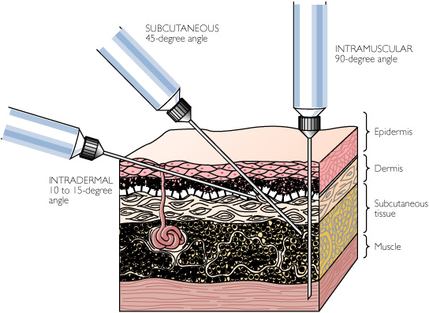
ADMINISTRATION ROUTS OF INJECTABLES
Intradermal injection: A shallow injection given between the layers of the skin, creating a “weal” on the skin.
Intramuscular injection: An injection given into the body of a muscle.
Intravascular: Within a blood vessel.
Intravenous injection: An injection given into a vein.

Slide 12
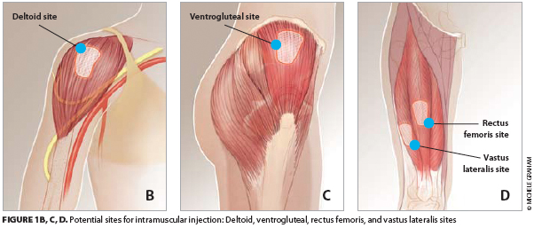
IM Injection Sites
The dorsogluteal site (upper outer quadrant of the buttock)
The vastus lateralis site (anterolateral thigh)
The deltoid site
Not more than 2-3ml should be given per injection site.
a second injection site must be used
OR a higher strength of the injectable preparation of the drug used instead.
Notes:
should be given into the dorsogluteal site (upper outer quadrant of the buttock) or into the vastus lateralis site (anterolateral thigh)
The Z-track method of IM injection prevents leakage [tracking] into the subcutaneous tissue and is the technique of choice for giving IM injections.

Slide 13
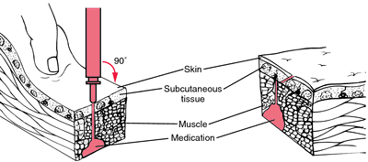
The Z tracking technique
Prevents backflow or leaking of the medication into the needle track.
The medication is locked in and discomfort, pain, tissue irritation and abscess/nodule formation caused by leakage of medication into subcutaneous tissue is minimised.

Slide 14
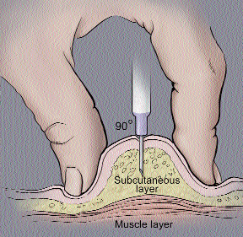
ROUTES OF ADMINISTRATION OF INJECTABLE MEDICINES
Subcutaneous (SC) injection: go into the fatty tissue just below the skin and allow for slower and more sustained absorption of medication.
Many drugs are injected subcutaneously, including vaccines, opioids, insulin's and heparins.

Slide 15
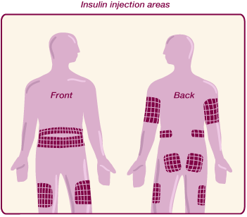
Subcutaneous (SC) injection
Common sites for subcutaneous injections are the abdomen, lateral and anterior aspects of upper arm or thigh or upper ventrodorsalgluteal area.

Slide 16
Intravenous (IV) injection
An intravenous (IV) medication is administered directly into the vein.
A bolus is an injection of solution into the vein over a short period of time.
An infusion refers to the introduction of larger volumes of solution given over a longer period of time.
Intradermal injections (I.D)
An intradermal injection is injected into the top layer of the skin.
The volume of solution that can be administered intradermally is limited to 0.1 mL.

Slide 17
Safe needle disposal
Place the syringe or needle in a hard plastic or metal container with a tightly secured lid.
Do not re­cap needles after use.
Keep the container out of the reach of children or pets.
When the container is three­quarters full, take it to a health care facility (hospital or doctor’s office) for proper disposal

Slide 18
https://www.youtube.com/watch?v=AX_RHZ7c0Qs

