Slide 1
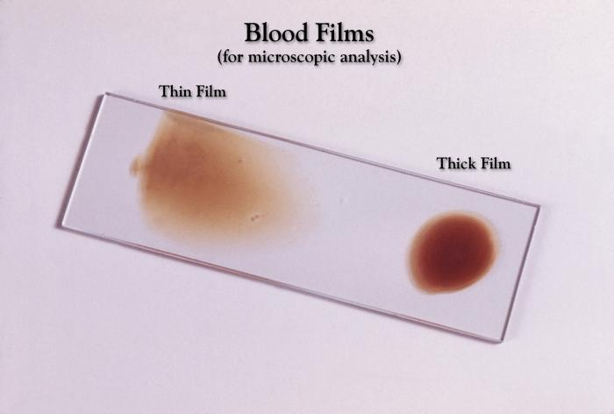
Preparation of thick & thin blood film for detection of blood parasites
Amal almuanna
ZOO 515
1433-1434

Slide 2
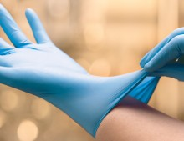
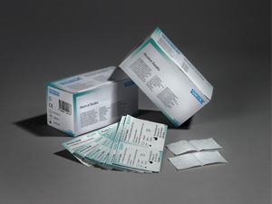
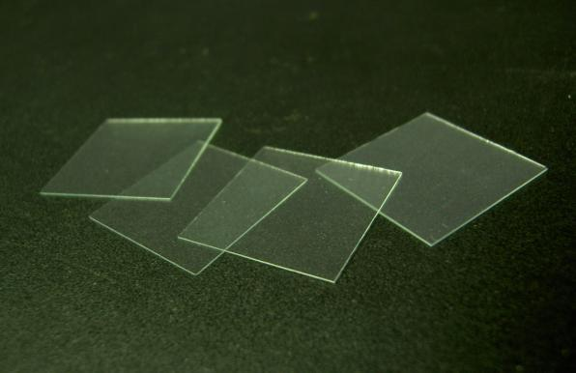
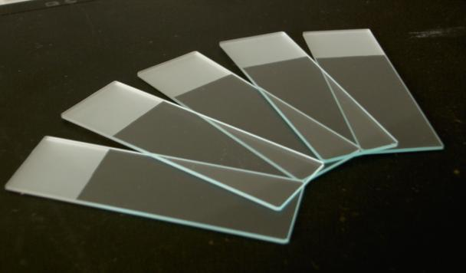
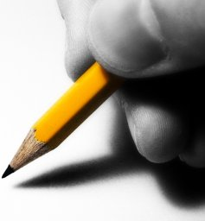
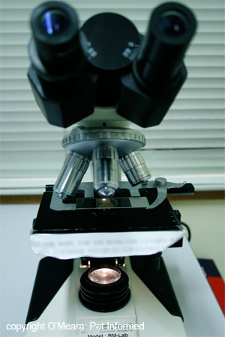
Materials
Glass slide
Coverslips
alcohol swabs
Gloves
Microscope
pencil

Slide 3
Capillary blood obtained by fingerstick:
1. Label pre-cleaned slides (preferably frosted-end) with patient’s name (or other identifier), date and time of
collection.
2. Wear gloves.
3. Clean slides with 70 to 90% alcohol and allow to dry. Do not touch the surface of the slide where the
blood smear will be made.

Slide 4
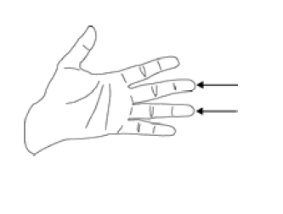
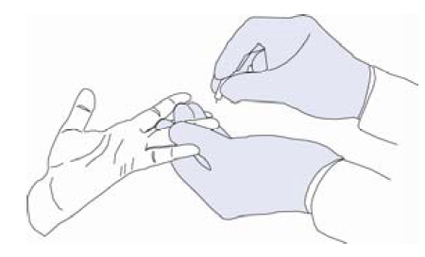
4. Select the finger to puncture, usually the middle or ring finger. In infants, puncture
the heel.
5. Clean the area to be punctured with 70% alcohol; allow to dry.
6. Puncture the ball of the finger, or in infants puncture the heel.

Slide 5
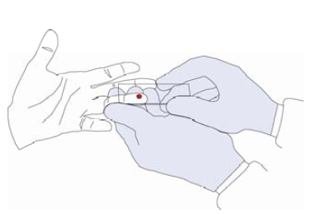
7. Wipe away the first drop of blood with clean gauze. 8. Touch the next drop of blood with a clean slide. Repeat with several slides (at least two thick and two thin smears should be made). If blood does not well up, gently squeeze the finger.

Slide 6
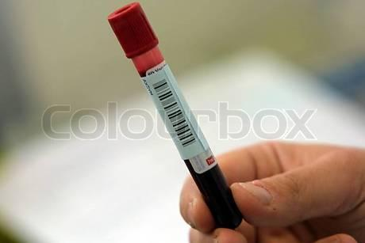
For venous blood obtained by venipuncture:
1. Label collection tubes and pre-cleaned slides (preferably frosted-end) with the patient’s name (or other identifier), date and time of collection.
2. Clean the site for blood collection well using 70% alcohol; allow to dry.
3. Collect the venous blood in a vacuum tube containing anticoagulant (preferably EDTA); alterna-tively, collect the blood in a syringe and transfer it to a tube with anticoagulant; mix well.
4. Prepare at least two thick smears and two thin smears as soon as possible after collection.

Slide 7
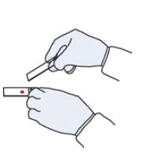
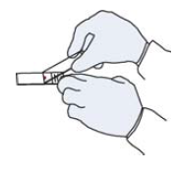
8. Whenever possible, use separate slides for thick and thin smears.
9. Thin film (a): Bring a clean spreader slide, held at a 45° angle, toward the drop of blood on the specimen slide.
10. Thin film (b): Wait until the blood spreads along the entire width of the spreader slide.

Slide 8
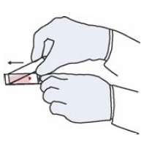
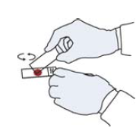
11. Thin film (c): While holding the spreader slide at the same angle, push it forward rapidlyand smoothly.
12. Thick film: Using the corner of a clean slide, spread the drop of blood in a circle the size of a dime (diameter 1-2 cm). Do not make the smear too thick or it will fall off the slide. (You should be able to read newsprint through it.)

Slide 9
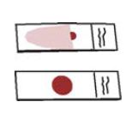
13. Wait until the thin and thick films are completely dry before staining. Fix the thin film with methanol (100% or absolute) and let it dry completely before staining. The thick film should not be fixed.
14. If both thin and thick films need to be made on the same slide, fix only the thin film with methanol. The thick film should not be fixed.

Slide 10
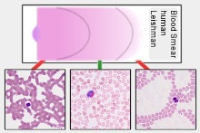

Slide 11
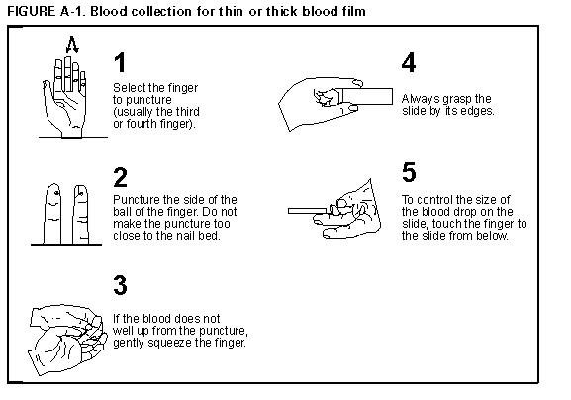

Slide 12
