Slide 1
Posttranscriptional Modification of RNA

Slide 2
A primary transcript is the initial, linear, RNA copy of a transcription unit—the segment of DNA between specific initiation and termination sequences.
The primary transcripts of both prokaryotic and eukaryotic tRNA and rRNA are posttranscriptionally modified by cleavage of the original transcripts by ribonucleases.
tRNAs are then further modified to help give each species its unique identity.
In contrast, prokaryotic mRNA is generally identical to its primary transcript, whereas eukaryotic mRNA is extensively modified both co- and posttranscriptionally.

Slide 3
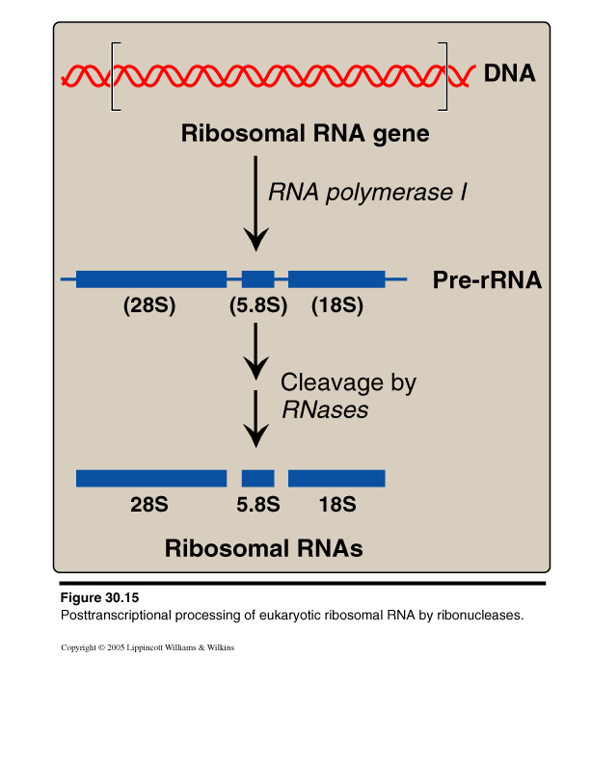
A. Ribosomal RNA
rRNAs of both prokaryotic and eukaryotic cells are generated from long precursor molecules called pre-rRNAs.
The 23S, 16S, and 5S rRNA of prokaryotes are produced from a single pre-rRNA molecule, as are the 28S, 18S, and 5.8S rRNA of eukaryotes.
The pre-rRNAs are cleaved by ribonucleases to yield intermediate-sized pieces of rRNA, which are further processed (trimmed by exonucleases and modified at some bases and riboses) to produce the required RNA species.
Posttranscriptional processing of eukaryotic ribosomal RNA by ribonucleases (RNases).

Slide 4
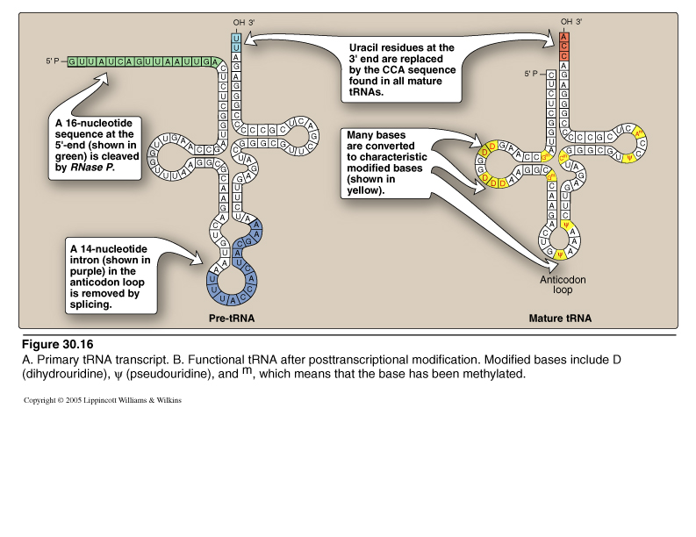
B. Transfer RNA
A. Primary tRNA transcript. B. Functional tRNA after posttranscriptional modification. Modified bases include D (dihydrouracil), ψ (pseudouracil), and m, which means that the base has been methylated.

Slide 5
Both eukaryotic and prokaryotic tRNA are also made from longer precursor molecules that must be modified.
Sequences at both ends of the molecule are removed and, if present, an intron is removed from the anticodon loop by nucleases.

Slide 6
C. Eukaryotic mRNA
The collection of all the primary transcripts synthesized in the nucleus by RNA polymerase II is known as heterogeneous nuclear RNA (hnRNA).
The pre-mRNA components of hnRNA undergo extensive co- and posttranscriptional modification in the nucleus.
These modifications usually include:
1. 5’- Capping: 7-Methyl-guanosine
2. 3’- Poly-A tail addition
3. Removal of introns
4. Alternative splicing of mRNA molecules

Slide 7
1. 5’- Capping: 7-Methyl-guanosine
The cap is a 7-methylguanosine attached “backward” to the 5'-terminal end of the mRNA, forming an unusual 5'→5' triphosphate linkage.
Creation of the cap requires removal of the γ phosphate from the 5’-triphosphate of the premRNA, followed by addition of GMP (from GTP) by the nuclear enzyme guanylyltransferase.
Methylation of this terminal guanine occurs in the cytosol, and is catalyzed by guanine-7-methyltransferase. S-adenosylmethionine is the source of the methyl group Additional methylation steps may occur.
The addition of this 7-methylguanosine “cap” helps stabilize the mRNA, and permits initiation of translation.
Eukaryotic mRNAs lacking the cap are not efficiently translated.

Slide 8
2. 3’- Poly-A tail addition
Most eukaryotic mRNA have a chain of 40–200 adenine nucleotides attached to the 3'-end.
This poly-A tail is not transcribed from the DNA, but rather is added after transcription by the nuclear enzyme, polyadenylate polymerase, using ATP as the substrate.
The mRNA is cleaved downstream of a consensus sequence, called the polyadenylation signal sequence (AAUAAA), found near the 3'-end of the RNA, and the poly-A tail is added to the new 3'-end.
These tails help stabilize the mRNA, facilitate its exit from the nucleus, and aid in translation. After the mRNA enters the cytosol, the poly-A tail is gradually shortened.

Slide 9
3. Removal of introns
Maturation of eukaryotic mRNA usually involves the removal of RNA sequences (introns, or intervening sequences), which do not code for protein from the primary transcript.
The remaining coding sequences, the exons, are joined together to form the mature mRNA.
The process of removing introns and joining exons is called splicing.
The molecular complex that accomplishes these tasks is known as the spliceosome. A few eukaryotic primary transcripts contain no introns, for example,
those from histone genes.
Others contain a few introns, whereas some, such as the primary transcripts for the α chains of collagen, contain more than 50 intervening sequences that must be removed before mature mRNA is ready for translation.

Slide 10
Splicing. snRNP = small nuclear ribonucleoprotein particle.

Slide 11
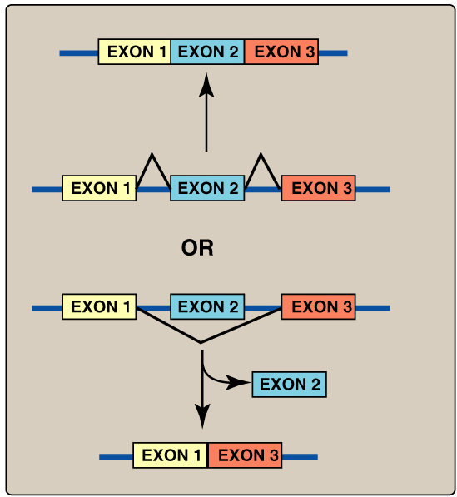
4. Alternative splicing of mRNA molecules
The pre-mRNA molecules from some genes can be spliced in alternative ways in different tissues.
This produces multiple variations of the mRNA and, therefore, of its protein product.
This appears to be a mechanism for producing a diverse set of proteins from a limited set of genes.
Alternative splicing: A diverse set of proteins from a small set of genes

Slide 12
Posttranscriptionally modified by cleavage of the original transcripts by ribonucleases.
rRNA of both prokaryotic and eukaryotic cells are synthesized from long precursor molecules called preribosomal RNA.
These precursors are cleaved and trimmed by ribonucleases, producing the three largest rRNA, and bases and sugars are modified.
Eukaryotic 5S rRNA is synthesized by RNA polymerase III , and is modified separately.
Prokaryotic mRNA is generally identical to its primary transcript, whereas eukaryotic mRNA is extensively modified co- and posttranscriptionally.
Most eukaryotic mRNAs also contain intervening sequences (introns) that must be removed to make the mRNA functional.
Their removal, as well as the joining of expressed sequences (exons), requires a spliceosome composed of small, nuclear ribonucleoprotein particles that mediate the process of splicing.
Eukaryotic mRNA is monocistronic, containing information from just one gene. Prokaryotic and eukaryotic tRNA are also made from longer precursor molecules.
If present, an intron is removed by nucleases, and both ends of the molecule are trimmed by ribonucleases. A 3'-CCA sequence is added, and bases at specific positions are modified, producing “unusual” bases.

