Slide 1
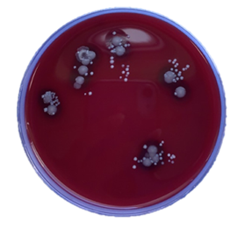
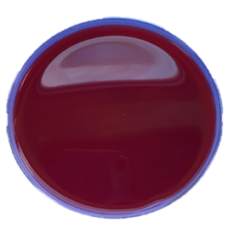
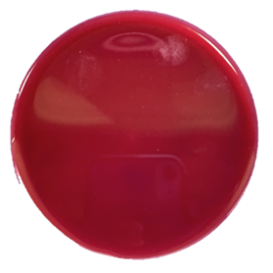
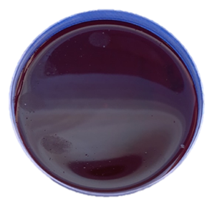
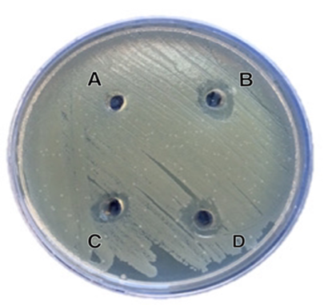
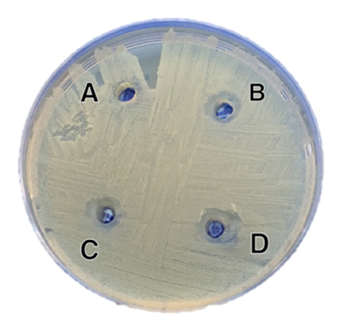
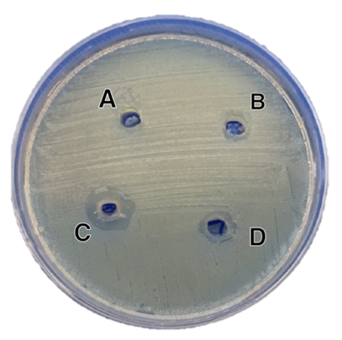
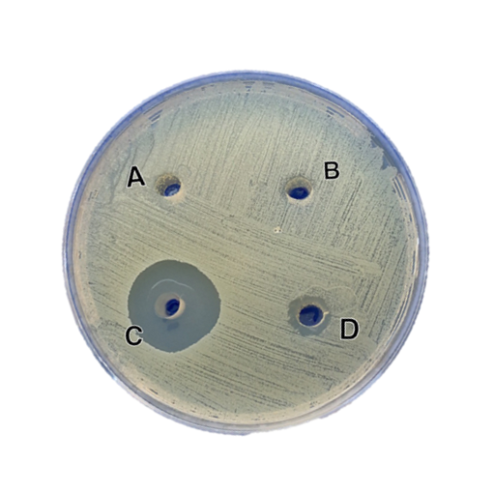
Hand sanitizer vs Hand washing: For best
practice to prevent spread of infection
Prepared By Reuof Mohammed Al-Hajeri Reuofhaj@gmail.com
Supervised By: Fatimah Al-Khataf
Introduction
After washing hands thoroughly.
Questionnaire
Hand hygiene is a critical and cost-effective method for preventing health-care-associated infections (HCAIs), as well as a critical patient safety measure. Poor aseptic technique or insufficient hand hygiene can increase the risk of transmitting potentially pathogenic microorganisms to the patient or the patient's immediate surroundings (Megeus et al., 2015). Hand washing is the best procedure to reduce these pathogenic microbes and prevent infection, as well as to avoid dirt from food residues and dust after using the toilet. Hand sanitizers are most effective in hospitals when hands are in contact with germs, but not dusty or greasy. Hand sanitizers as a disinfectant have become more widely used today due to their ease of use when water is not available, the lack of time and their proven effectiveness in reducing the microbial load, and they are available in different types depending on the presence or absence of alcohol (Singh et al., 2020).
Types of hand sanitizers:
Alcoholic hand sanitizers are the most prevalent of non-alcoholic sanitizers, and claim to kill 99.99% of microorganisms, including the most resistant form. They contain either ethanol, isopropanol or n-propanol. The antimicrobial effect is attributed to alcohols being able to dissolve fatty membranes and change the nature of proteins, then cell lysis (Kampf and Ostermeyer, 2005).
Non-alcoholic hand sanitizers: Because of the defects and the harsh nature that alcohols cause on the hands of dryness and irritation of the skin, also the rapid evaporation of alcohol before rubbing it on the whole hands loses the effectiveness of the sanitizer (Kampf et al., 2010). wherefore non-alcoholic alternatives have been resorted to consisting of povidone Iodine, Triclosan and Benzalkonium chloride (BAC), which is the main active ingredient Anti-bacterial.
After applying alcohol sterilizers.
Table 1 A survey was conducted on 50 people to determine their awareness of hand hygiene.
 | Question | Yes | No | Sometimes
1 | In this time of epidemics, has the awareness of the hygiene of your hands increased? | 94% | 2% | 4%
2 | Do you wash your hands before and after every meal? | 54% | 8% | 38%
3 | Is it possible to replace hand washing with hand sanitizer? | 16% | 50% | 34%
4 | Do you suffer from dehydration after using sterilizers? | 66% | 4% | 30%
5 | Do you know that there are two types of sanitizers, alcoholic and non-alcoholic? | 38% | 62% | 0%
6 | Do you think that the efficiency of non-alcoholic sanitizers is similar to the efficiency of the alcohol sanitizers we use? | 10% | 54% | 36%
After applying non-alcoholic sterilizers
After incubation We prepare isolates for examination under a microscope by gram Stain.
Examine the slide under a microscope and identify the type and shape of bacteria.
2- Disc diffusion:
The six different marketed products of hand gel sanitizers were separately determined in plates containing 15 ml of Muller–Hinton agar medium. Each plate was inoculated with either Staphylococcus aureus or Escherichia coli. 0.1ml of each gel sanitizer was poured in pores (5mm in diameter) in Muller–Hinton agar. The negative control was placed as a pore filled with sterile distilled water. The cultures were incubated at 37°C for 24 h. After incubation antibacterial effectiveness were determined by measuring the diameter of the inhibition zone (including the diameter of the disc) for each sanitizer with a ruler or a caliper and recorded in mm (A. W. Bauer, 1966).
Graph 1 A comparison on 50 people to determine their awareness of hand hygiene.
Discussion
In Fingerprint method The correct way to wash hands has proven to be 100% effective and no microorganism has appeared on the plate. In alcohol-based hand sanitizers, proved effective and no microorganisms appeared in the plate. In the non-alcoholic hand sanitizer, which was found that 62% were not aware of its presence, there are no growth of gram-negative or even gram-positive bacteria appeared.
In Disk Diffusion method, the efficacy of the sanitizer varies both in its composition and its effect on the test organism. In this study the two bacteria used (Staphylococcus aureus and Escherichia coli) were found to be sensitive to sanitizers. According to (Figure 2,3), it was found that all the inhibition zones are close to each other, but slightly higher for Staphylococcus aureus. In Figure 5, among the hand sanitizers used, the most effective with the highest inhibition zone was the hand sanitizer C (22mm) on Staphylococcus, similarly on Escherichia coli (14mm). The effect of all the sanitizers were compared with the negative control in which the sterilized distilled water was used having no effect on test organism. Thus, through the results, it was found that hand sanitizers of all kinds are slightly more effective on Staphylococcus aureus, while Escherichia coli was more resistant. In a previous study, it was shown that E. coli, being Gram-negative bacteria, is surrounded by an outer membrane, which is necessary for cell survival and acts as a permeability barrier that prevents the entry of toxic compounds into the cell (Ebbensgaard et al., 2018).
Results
Fingerprint
Control
Objectives
Hand wash
The aim of this study was to show the importance of hand hygiene through hand washing and the use of sanitizers, and how these measures are able to reduce the transmission of microbes and the spread of infection, as well as to raise awareness of the presence of non-alcoholic alternatives that reduce dryness and irritation of the skin.
Alcoholic hand
sanitizer
Conclusion
Non-Alcoholic hand sanitizer
In this study, the role and importance of hand hygiene was clarified, and it was found that hand sanitizers regardless of alcohol / non-alcoholic are effective in controlling bacteria, but we recommend those who suffer from skin irritation or dryness to use non-alcoholic hand sanitizers instead of alcoholic hand sanitizers, and we also recommend proper hand washing which is universally recommended by the World Health Organization (WHO).
Materials and Methods
Materials:
Bacterial samples: Staphylococcus aureus, Escherichia coli.
Six different marketed products of hand sanitizers (Alcoholic and Nonalcoholic).
Blood agar.
Muller–Hinton agar.
Crystal violet.
Iodine.
Alcohol.
Safranin.
Methods:
1- Fingerprint:
Disc diffusion
Acknowledgment
I would like to thank my supervisor, Dr. Fatimah Al-Khataf, for her constant guidance and advice whenever needed during this experiment, and a special thanks to my teacher, Noura Al-Saqabi, for welcoming me into her lab and helping me with all that is practically difficult for me. Finally, I would like to thank my family and friends for always supporting me in all my needs.
Figure 2: Different alcohol sterilizers
against Escherichia coli.
Figure 3: Different alcohol sterilizers
against Staphylococcus aureus.
References
1- Kampf, G. and Ostermeyer, C. (2005) “Efficacy of two distinct ethanol-based hand rubs for surgical hand disinfection - A controlled trial according to prEN 12791,” BMC Infectious Diseases, 5. doi:10.1186/1471-2334-5-17.
2- Megeus, V. et al. (2015) “Hand Contamination, Cross-Transmission, and Risk-Associated Behaviors: An Observational Study of Team Members in ORs,” AORN Journal, 102(6), pp. 645.e1-645.e12. doi:10.1016/j.aorn.2015.06.018
3- Singh, P. et al. (2020) “Hand Sanitizer an Alternative to Hand Washing—A Review of Literature,” Journal of Advanced Oral Research, 11(2), pp. 137–142. doi:10.1177/2320206820939403.
Take fingerprints from random students in the College of Science on blood agar, then incubate it at 37 C° for 24 hours:
Before washing hands as a control.
Figure 4: Different Non-alcohol
sterilizers against Escherichia coli.
Figure 5: Different Non-alcohol
sterilizers against Staphylococcus aureus.

