Slide 1
PERSONAL HEALTH PRACTICES

Slide 2
the increased mortality risk associated with low levels of income and education is due to an increased prevalence of risky health practices, such as smoking, alcohol intake and physical inactivity.
such practices develop from a complex interplay of factors, including income, education, gender, age, social support, cultural background and physical environment,

Slide 3
The health practices includes:
eating practices,
exercise,
Weight control
Sleeping
smoking,
alcohol consumption,
and use of complementary and alternative therapies.

Slide 4
sleep
Animal studies suggest that sleep is as vital as food for survival.
Rats, for example, normally live 2–3 years, but they live only 5 weeks if they are deprived of REM sleep
and only 2–3 weeks if they are deprived of all sleep stages—a timeframe similar to death due to starvation.

Slide 5
What Is Sleep?
it is now known that sleep has distinct stages that cycle throughout the night in predictable patterns. How well rested you are and how well you function depend not just on your total sleep time but on how much of the various stages of sleep you get each night.
Your brain stays active throughout sleep, and each stage of sleep is linked to a distinctive pattern of electrical activity known as brain waves.

Slide 6
Sleep is divided into two basic types
rapid eye movement (REM) sleep
non-REM sleep (with 4different stages).
Typically, sleep begins with non-REM sleep. In stage 1 non-REM sleep, you sleep lightly and can be awakened easily by noises or other disturbances

Slide 7
your eyes move slowly, and your muscle activity slows.
You then enter stage 2 non-REM sleep, when your eye movements stop. Your brain shows a distinctive pattern of slower brain waves with occasional bursts of rapid waves.

Slide 8
stage 3 non-REM sleep, your brain waves become even slower.
By stage 4 non-REM sleep, the brain produces extremely slow waves almost exclusively.
Stages 3 and 4 are considered deep sleep, during which it is very difficult to be awakened

Slide 9
Children who wet the bed or sleep walk tend to do so during stages 3 or 4 of non-REM sleep.
Deep sleep is considered the “restorative” part of sleep that is necessary for feeling well rested and energetic during the day.

Slide 10
During REM sleep, your eyes move rapidly in various directions, even though your eyelids remain closed.
Your breathing also becomes more rapid, irregular, and shallow, and your heart rate and blood pressure increase. Dreaming typically occurs during REM sleep.

Slide 11
usually occurs about an hour to an hour and a half after falling asleep.
After that, the sleep stages repeat themselves continuously while you sleep.
As the night progresses, REM sleep time becomes longer, while time spent in non-REM sleep stages 3 and 4 becomes shorter.

Slide 12
infants spend half or more of their total sleep time in REM sleep.
As people get older, the pattern of sleep also changes—especially the amount of time spent in the deep sleep stages.

Slide 13
Children spend more time than adults in these sleep stages. This explains why children can sleep through loud noises and why they might not wake up when they are moved from the car to their beds.

Slide 14
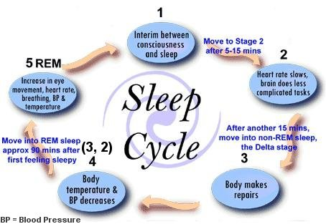

Slide 15
What Does Sleep Do for You?
Learning, Memory, and Mood:
Recent studies reveal that people can learn a task better if they are well rested. They also can remember better what they learned if they get a good night’s sleep after learning the task than if they are sleep deprived.
Many well-known scientists claim to have had creative insights while they slept.

Slide 16
lack of sleep causes:
thinking processes to slow down.
makes it harder to focus and pay attention.
Make you more easily confused.
faulty decision-making
Slows down your reaction time (just as poorly as people who are drunk), which is particularly significant to driving and other tasks that require quick response.
Mode changes e.g. irritability and depression

Slide 17
Video

Slide 18
heart and vascular system
Sleep gives your heart and vascular system a much-needed rest.
During non-REM sleep, your heart rate and blood pressure progressively slow as you enter deeper sleep.
During REM sleep, your heart rate and blood pressure have boosted spikes of activity. Overall, however, sleep reduces your heart rate and blood pressure by about 10 %.

Slide 19
A lack of sleep also puts your body under stress and may trigger the release of more adrenaline, cortisone, and other stress hormones during the day.
These hormones contribute to your blood pressure not dipping during sleep, thereby increasing the risk for heart disease.

Slide 20
lack of sleep causes: (cont.)
Increased risks of strokes, chest pain known as angina, an irregular heartbeat, and congestive heart failure, a condition in which fluid builds up in the body because the heart is not pumping sufficiently.
.

Slide 21
Hormones
Deep sleep triggers more release of growth hormone, which fuels growth in children and boosts muscle mass and the repair of cells and tissues in children and adults.
Sleep’s effect on the release of sex hormones also encourages puberty and fertility, Consequently, women who work at night and tend to lack sleep are, therefore, more likely to have trouble conceiving or to miscarry.

Slide 22
During sleep, your body creates more cytokines—cellular hormones that help the immune system fight various infections. Lack of sleep can reduce the ability to fight off common infections.
During sleep, the body’s production of the appetite suppressor leptin increases, and the appetite stimulant grehlin decreases.

Slide 23
Studies find that the less people sleep, the more likely they are to be overweight or obese
People who report an average total sleep time of 5 hours a night, for example, are much more likely to become obese compared to people who sleep 7–8 hours a night.

Slide 24
Another study found that women who slept less than 7 hours a night were more likely to develop diabetes over time than those who slept between 7 and 8 hours a night.

Slide 25
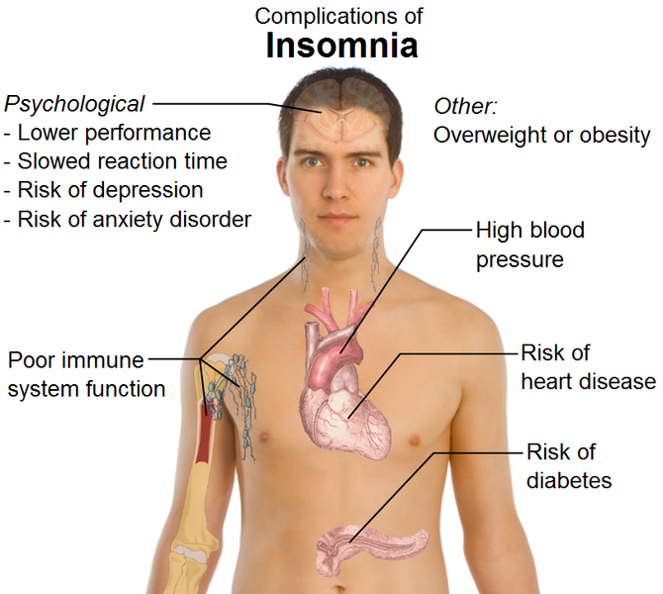

Slide 26
How Much Sleep Is Enough?
Newborns sleep between 16 and 18 hours a day,
children in preschool sleep between 10 and 12 hours a day.
Schoolaged children and adolescents need at least 9 hours of sleep a night.
7–8 hours for adults

Slide 27
Sleep Myths
Myth : Children who don’t get enough sleep at night will show signs of sleepiness during the day.
Unlike adults, children who don’t get enough sleep at night typically become more active than normal during the day. They also show difficulty paying attention and behaving properly. Consequently, they may be misdiagnosed as having attentiondeficit hyperactivity.

Slide 28
Tips for Getting a Good Night’s Sleep
Stick to a sleep schedule.
Exercise is great but not too late in the day.
Avoid caffeine and nicotine. Coffee, colas, certain teas, and chocolate contain the stimulant caffeine, and its effects can take as long as 8 hours to wear off fully. Nicotine is also a stimulant, often causing smokers to sleep only very lightly. In addition, smokers often wake up too early in the morning because of nicotine withdrawal.

Slide 29
Avoid large meals late at night. A light snack is okay, but a large meal can cause indigestion that interferes with sleep.
Take a hot bath before bed. The drop in body temperature after getting out of the bath may help you feel sleepy, and the bath can help you relax and slow down so you’re more ready to sleep.

Slide 30
Have a good sleeping environment. Get rid of anything that might distract you from sleep, such as noises, bright lights, an uncomfortable bed
Don’t lie in bed awake. If you find yourself still awake after staying in bed for more than 20 minutes, get up and do some relaxing activity until you feel sleepy.

