Slide 1
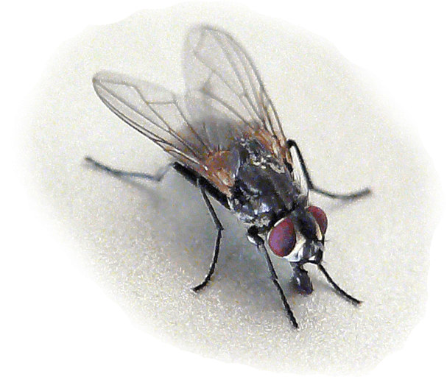
Musca (house fly)
Amal almuhanna ZOO 511

Slide 2
Musca (house fly)
Scientific classification
Kingdom: | Animalia
Phylum: | Arthropoda
Class: | Insecta
Order: | Diptera
Section: | Schizophora
Family: | Muscidae
Genus: | Musca
Species: | M. domestica

Slide 3
MOUTH PARTS OF HOUSEFLY

Slide 4
MOUTH PARTS OF HOUSEFLY
Housefly mouth parts arc of sponging and sucking type.
• In Housefly, labium is modified into proboscis.The proboscis consists of 3 parts.
• Proximal - rostrum
• Middle - Haustcllum
• Distal - Labellum
• The rostrum distally articulated with haustellum by hinge joint.

Slide 5
MOUTH PARTS OF HOUSEFLY

Slide 6
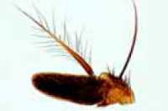
Aristate Antenna

Slide 7
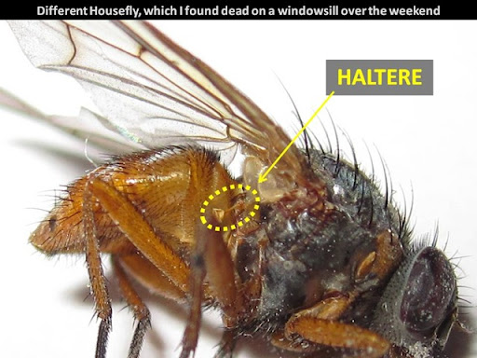
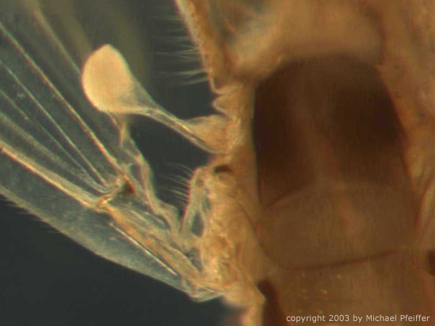
In the Diptera (housefly ), there are only one pair of functional wings, with the posterior pair of wings are reduced to halteres, which help the fly to sense its orientation and movement, as well as to improve balance.
membranous wings
halteres

Slide 8
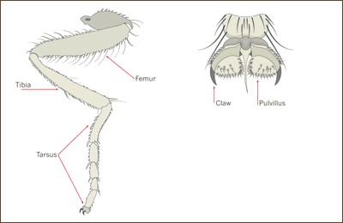
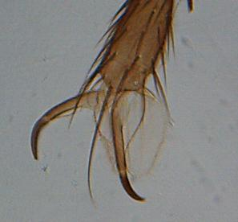
Legs
Also attached to the thorax are the three pairs of legs, each made up of five segments.
Leg of a house fly showing femur, tibia and five segmented tarsis with an enlargement of the tip of the tarsus showing claws and sticky pads (pulvilli).
At the tip of the tarsus is a pair of claws with a fleshy pad (pulvillus) by each. The pulvilli are bladder-like with tiny glandular hairs causing a sticky surface which enables the fly to cling to surfaces, even upside down.

Slide 9
The abdomen of Musca (House fly )

Slide 10
The ovipositor of House fly
House fly have a different version of the ovipositor.
The last few abdominal segment telescope into the larger anterior abdominal segments except when the fly is laying eggs. Then these segment are extended as shown here.

Slide 11
The ovipositor of House fly

