Slide 1
CEN352 Digital Signal Processing
By
Dr. Anwar M. Mirza
Office No. 2185
Phone: 4697362
anwar.m.mirza@gmail.com or ammirza@ksu.edu.sa
الدكتور / انور مجيد ميرزا
Lecture No. 12 to 14
Department of Computer Engineering,
College of Computer and Information Sciences,
King Saud University, Riyadh, Kingdom of Saudi Arabia
October, 2012

Slide 2
It is a very efficient algorithm for computing the DFT coefficients.
Fast Fourier Transform

Slide 3
z=x+y
x
x
z=x − y
z=wx
x
y
w
y
−1
Definitions of the graphical operations
Method of Decimation-in-Frequency
a(0)
X(0)
x(0)
(N/2)-point DFT
a(1)
X(2)
x(1)
a(2)
X(4)
x(2)
a3)
X(6)
x(3)
b(0)
W_{N}⁰
X(1)
x(4)
(N/2)-point DFT
−1
b(1)
W_{N}¹
X(3)
x(5)
−1
b(2)
W_{N}²
X(5)
x(6)
−1
b(3)
W_{N}³
X(7)
x(7)
−1
The first iteration of the 8-point FFT

Slide 4
Method of Decimation-in-Frequency
x(0)
X(0)
(N/4)-point DFT
x(1)
X(2)
x(2)
X(4)
−1
W_{N}⁰
(N/4)-point DFT
x(3)
X(6)
−1
W_{N}²
X(1)
x(4)
W_{N}⁰
(N/4)-point DFT
−1
X(3)
x(5)
W_{N}¹
−1
X(5)
x(6)
W_{N}²
−1
W_{N}⁰
(N/4)-point DFT
−1
X(7)
x(7)
W_{N}³
−1
W_{N}²
−1
The second iteration of the 8-point FFT

Slide 5
Method of Decimation-in-Frequency
x(0)
X(0)
x(1)
−1
W_{N}⁰
X(2)
x(2)
X(4)
−1
x(3)
−1
X(6)
−1
W_{N}⁰
x(4)
W_{N}⁰
X(1)
−1
x(5)
W_{N}¹
−1
W_{N}⁰
X(3)
−1
x(6)
W_{N}²
−1
W_{N}⁰
X(5)
−1
x(7)
W_{N}³
−1
W_{N}²
−1
X(7)
−1
W_{N}⁰
Block diagram for the 8-point FFT
(total twelve multiplications)

Slide 6
Example 4.12
Solution
First Iteration
Second Iteration
Bit Reversal
Bit Index
4
10
10
= X(0)
00
00
x(0)=1
6
-2
-2
= X(2)
10
01
x(1)=2
-2+2j
W₄⁰ = 1
-2
-2
-2+2j
= X(1)
01
10
x(2)=3
-2
W₄⁰ = 1
2j
-2-2j
-2-2j
= X(3)
11
11
x(3)=4
W₄¹ = -j
W₄⁰ = 1

Slide 7
Example 4.13
Solution
First Iteration
Second Iteration
Bit Reversal
Bit Index
8
10
4
= x(0)
00
00
X(0)=10
-4
-2
12
= x(2)
10
01
X(1)=-2+j2
12
12
-2+2j
8
= x(1)
01
10
X(2)=-2
j4
-4
-2-2j
16
= x(3)
11
11
X(3)=-2-j2

Slide 8
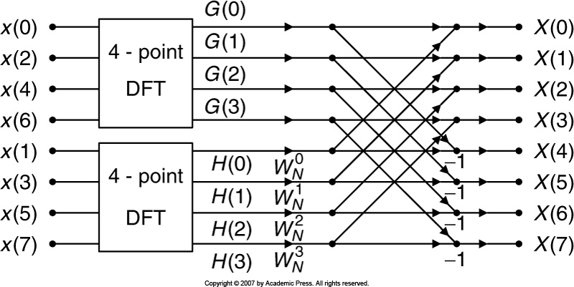
Method of Decimation-in-Time
The first iteration of the 8-point FFT using Decimation-in-Time

Slide 9
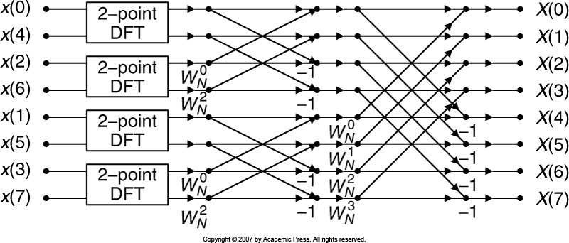
Method of Decimation-in-Time
The second iteration of the 8-point FFT using Decimation-in-Time

Slide 10
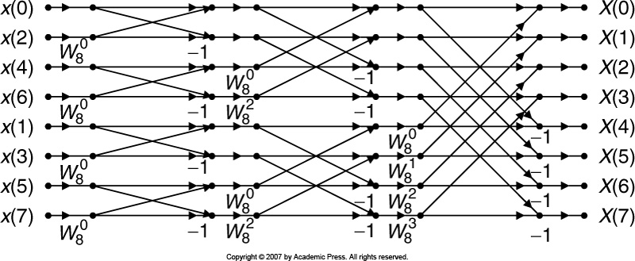
Method of Decimation-in-Time
The 8-point FFT using Decimation-in-Time (12 complex multiplications)

Slide 11
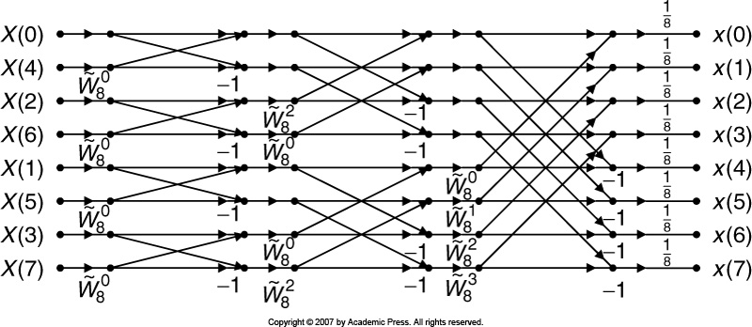
Method of Decimation-in-Time
The 8-point IFFT using Decimation-in-Time

Slide 12
The 4-point FFT using Decimation-in-Time

Slide 13
The 4-point FFT using Decimation-in-Time

Slide 14
That’s it for today !!

Slide 15
Example 4.12
Solution
First Iteration
Second Iteration
Bit Reversal
Bit Index
8
12
12
= X(0)
00
00
x(0)=6
4
4
4
= X(2)
10
01
x(1)=4
4-4j
W₄⁰ = 1
4
4
4-4j
= X(1)
01
10
x(2)=2
4
W₄⁰ = 1
-4j
4+4j
4+4j
= X(3)
11
11
x(3)=0
W₄¹ = -j
W₄⁰ = 1

Slide 16
Example 4.12
Solution
First Iteration
Second Iteration
Bit Reversal
Bit Index
4
10
10
= X(0)
00
00
x(0)=1
6
-2
-2
= X(2)
10
01
x(1)=2
-2+2j
W₄⁰ = 1
-2
-2
-2+2j
= X(1)
01
10
x(2)=3
-2
W₄⁰ = 1
2j
-2-2j
-2-2j
= X(3)
11
11
x(3)=4
W₄¹ = -j
W₄⁰ = 1

