Slide 1
CEN352 Digital Signal Processing
By
Dr. anwar M. Mirza
Office No. 2185
Phone: 4697362
anwar.m.mirza@gmail.com or ammirza@ksu.edu.sa
الدكتور / انور مجيد ميرزا
Lecture No. 6
Department of Computer Engineering,
College of Computer and Information Sciences,
King Saud University, Riyadh, Kingdom of Saudi Arabia
September 24th, 2012

Slide 2
Quantization
A digital signal is a sequence of numbers (samples) in which each number is represented by a finite number of digits (finite precision i.e. finite number of digits).
The process of converting a discrete-time continuous-amplitude signal into a digital signal by expressing each sample value as a finite (instead of an infinite) number of digits is called quantization.
The error introduced in representing the continuous-valued signal by a finite set of discrete value levels is called quantization error or quantization noise.

Slide 3
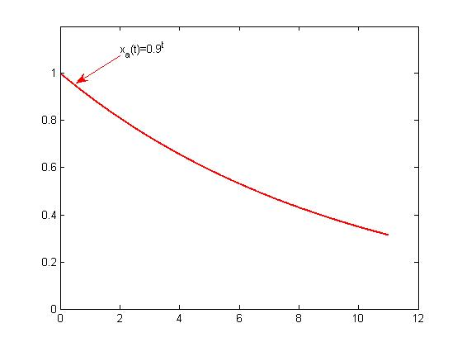
Quantization: Example
Analog signal

Slide 4
Quantization: Example
Analog signal
Discrete-time signal
Table: Numerical Illustration of Quantization with One Significant Digit using Truncation or Rounding
 | Discrete-time signal | (Truncation) | (Rounding) | (Rounding)
0 | 1
1 | 0.9
2 | 0.81
3 | 0.729
4 | 0.6561
5 | 0.59049
6 | 0.531441
7 | 0.4782969
8 | 0.43046721
9 | 0.387420489

Slide 5
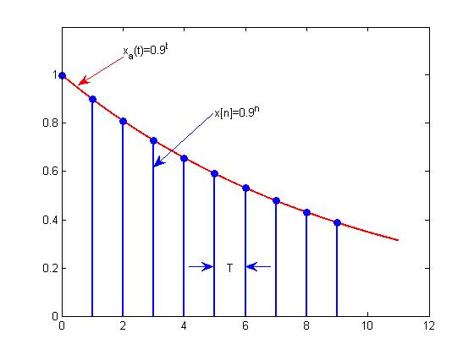
Quantization: Example
Analog signal
Discrete-time signal

Slide 6
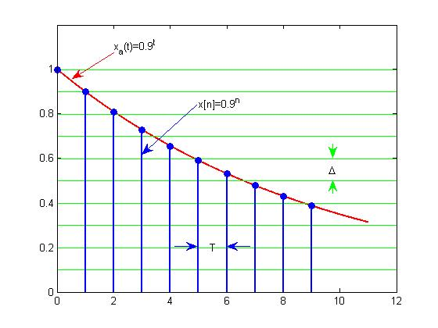
Quantization: Example
Analog signal
Discrete-time signal

Slide 7
Quantization: Example
Analog signal
Discrete-time signal
Table: Numerical Illustration of Quantization with One Significant Digit using Truncation or Rounding
 | Discrete-time signal | (Truncation) | (Rounding) | (Rounding)
0 | 1 | 1.0 | 1.0
1 | 0.9 | 0.9 | 0.9
2 | 0.81 | 0.8 | 0.8
3 | 0.729 | 0.7 | 0.7
4 | 0.6561 | 0.6 | 0.7
5 | 0.59049 | 0.5 | 0.6
6 | 0.531441 | 0.5 | 0.5
7 | 0.4782969 | 0.4 | 0.5
8 | 0.43046721 | 0.4 | 0.4
9 | 0.387420489 | 0.3 | 0.4

Slide 8
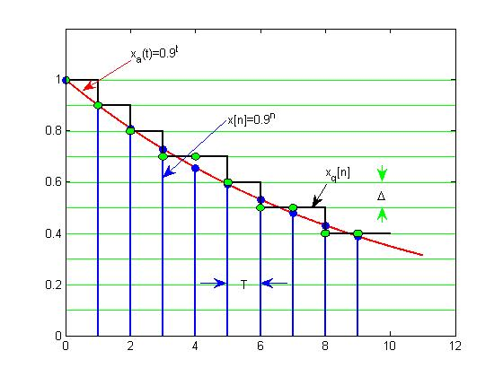
Quantization: Example
Analog signal
Discrete-time signal

Slide 9
Quantization: Example
Analog signal
Discrete-time signal
Table: Numerical Illustration of Quantization with One Significant Digit using Truncation or Rounding
 | Discrete-time signal | (Truncation) | (Rounding) | (Rounding)
0 | 1 | 1.0 | 1.0 | 0.0
1 | 0.9 | 0.9 | 0.9 | 0.0
2 | 0.81 | 0.8 | 0.8 | -0.01
3 | 0.729 | 0.7 | 0.7 | -0.029
4 | 0.6561 | 0.6 | 0.7 | 0.0439
5 | 0.59049 | 0.5 | 0.6 | 0.00951
6 | 0.531441 | 0.5 | 0.5 | -0.031441
7 | 0.4782969 | 0.4 | 0.5 | 0.0217031
8 | 0.43046721 | 0.4 | 0.4 | -0.03046721
9 | 0.387420489 | 0.3 | 0.4 | 0.012579511

Slide 10
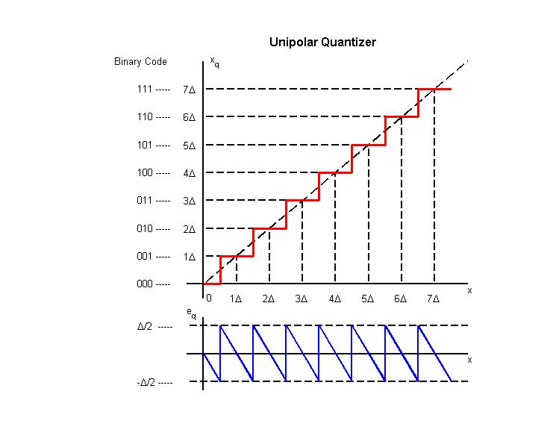
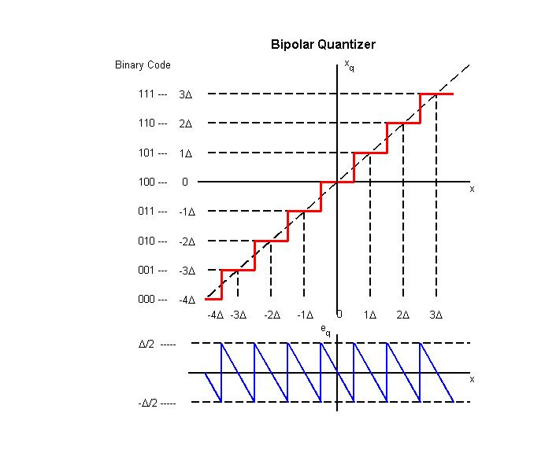
Quantization: How it done?
Given an analog signal x(t) and the number of bits m in an ADC
Find out the number of quantization levels: L=2^{m}
Find out the step size of the quantizer: Δ = (x_{max} ‒ x_{min})/L
The index corresponding to the binary code is: i = round(x ‒ x_{min})/Δ
Values of the quantization levels: x_{q} = x_{min} + i Δ, where i=0,1,2,…,L

Slide 11
Quantization: Example 2.9
Assuming that a 3-bit ADC channel accepts analog input ranging from 0 to 5 volts, determine the following:
Number of quantization levels
Step size of the quantizer or resolution
Quantization level when the analog voltage is 3.2 volts
Binary code produced by the ADC
Solution
In this case
x_{min} = 0 volts, x_{max} = 5 volts and m = 3 bits.
Part(a): The number of quantization levels are given by
L=2^{m} = 2³ = 8.
Part (b): Step size is given by
Δ = (x_{max} – x_{min} )/L = (5 – 0)/8 = 0.625 volts
Part(c): The index to the quantization level is given by
i = round((x – x_{min})/ Δ) = round((3.2 – 0)/0.625)
= round(5.12) = 5
Therefore, the quantization level for analog voltage 3.2 volts is
x_{q} = x_{min} + i* Δ = 0 + 5 * 0.625 = 3.125
Part (d): The 3-bit binary code corresponding to level 5 is 101.

Slide 12
Signal to Quantization Noise
Quantization
The error introduced by the quantization process is given by
The signal to quantization noise ratio (SQNR or simply SNR) is given by
The signal to quantization noise ratio (SQNR or simply SNR) in decibels (dB) is given by

