Slide 1
CEN352
Digital Signal Processing
By
Dr. anwar M. Mirza
Office No. 2185
Phone: 4697362
anwar.m.mirza@gmail.com or ammirza@ksu.edu.sa
الدكتور / انور مجيد ميرزا
Lecture No. 1
Department of Computer Engineering,
College of Computer and Information Sciences,
King Saud University, Riyadh, Kingdom of Saudi Arabia
September 3rd, 2012

Slide 2
Class Particulars
Credit Hours: 3
Course Structure:
  Three Lectures a week (Each of duration about 50 minutes).
  One tutorial session of 50 min duration
Class Venue:
  Lecture Hall B093
Class Timings:
  Section 1: Saturday, Monday, Wednesday 1:00pm to 1:50pm
  Section 2: Saturday, Monday, Wednesday 2:00pm to 2:50pm
  Tutorials: Sunday5:00pm to 5:50pm, Wednesday 6:00pm to 6:50pm

Slide 3
Pre-requisites
The course requires as pre-requisites:
  CEN 340 Signals and Systems
Topics
  Concept of analog signals

Slide 4
Major Topics Covered and
Schedule in Weeks
Topic | Weeks (Approx.)
Sampling theory, and periodicity | 2
Fourier Transform (DFT, FFT) | 3
z-transform | 3
Digital Filters | 3
Applications: Audio and image | 3
Review and evaluation | 2

Slide 5
Recommended Texts
Primary:
  L. Tan, Digital Signal Processing: Fundamentals and Applications, Elsevier, 2008.
Supplementary:
  Openheim A., Willsky A. and S. Nawab, Signals and Systems, 2nd Ed., 1997, Prentice Hall.
  John G. Proakis and Dimitris G. Manolakis, Digital Signal Processing: Principles, algorithms and applications, 4th Ed., 2007, Prentice Hall.
  Lecture notes given on the course website.

Slide 6
Evaluation and Grading
Activity | Marks
Quizzes | 05
Assignments | 15
Mid-term Test 1 | 20
Mid-Term Test 2 | 20
Final Exam | 40
Total | 100

Slide 7
Quizzes and Assignments Policies
Quizzes
  Frequent quizzes of duration 5-10 minutes will be taken.
  Students are required to attend the classes regularly and come prepared in each class.
Assignments
  No assignments will be accepted after due date.
  Programming assignments should be well documented.
  There are “no groups” for assignments. Each student is expected to do and submit the assignment individually.
  Students are “not” allowed to “copy” each other’s work.
  Cheating or plagiarism in any form will not be tolerated. A grade of zero will be registered for any infraction.
  All exams are closed book.

Slide 8
http://king-saud.academia.edu/AnwarMirza/Teaching

Slide 9
Digital Signal
Analog Signal
Discrete-time Signal
Continuous amplitude
Continuous amplitude
Continuous time
Discrete time
Discrete amplitude
Digital Signal
Discrete time

Slide 10
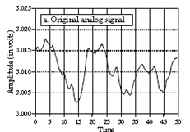
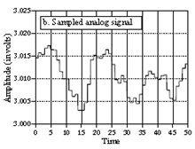
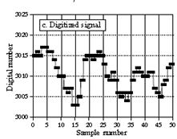
Digital Signal – contd.
Discrete-time Signal
Analog Signal
Digital Signal

Slide 11
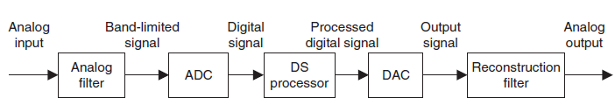
DSP (Digital Signal Processing)
A digital signal processing scheme
Analog to Digital Converter
Digital to Analog Converter
To avoid aliasing for sampling
To avoid aliasing for sampling
Computer / microprocessor / micro controller/ etc.

Slide 12

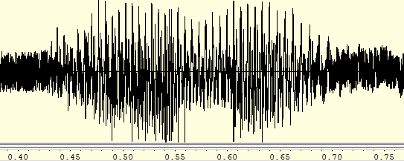
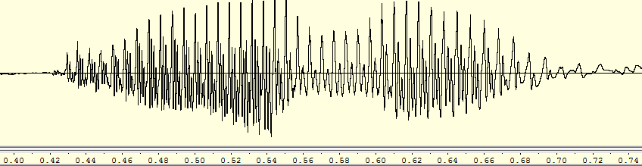
Some Applications of DSP
Noise removal from speech.
Noisy Speech
Clean Speech

Slide 13
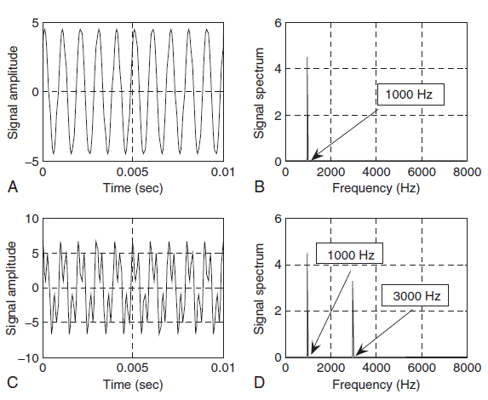
Some Applications of DSP
Signal spectral analysis.
Time domain
Frequency domain
Single tone: 1000 Hz
Double tone: 1000 Hz and 3000 Hz

Slide 14
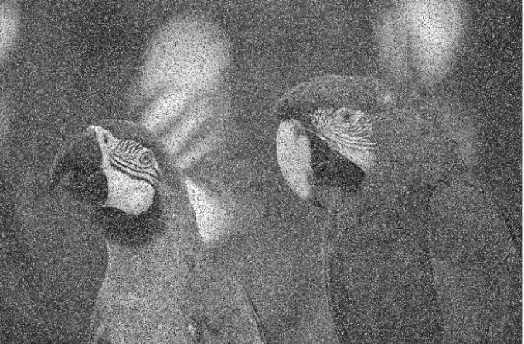

Some Applications of DSP
Noise removal from image.

Slide 15
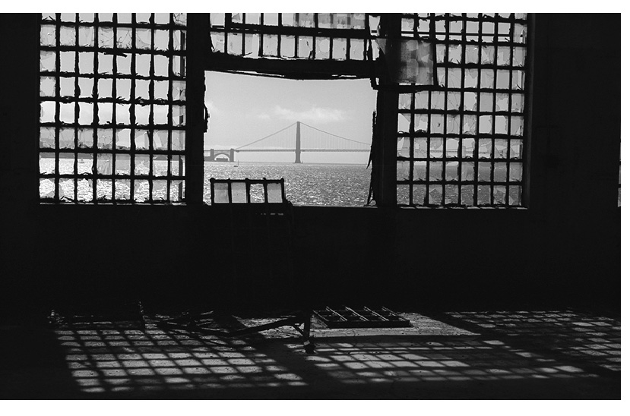
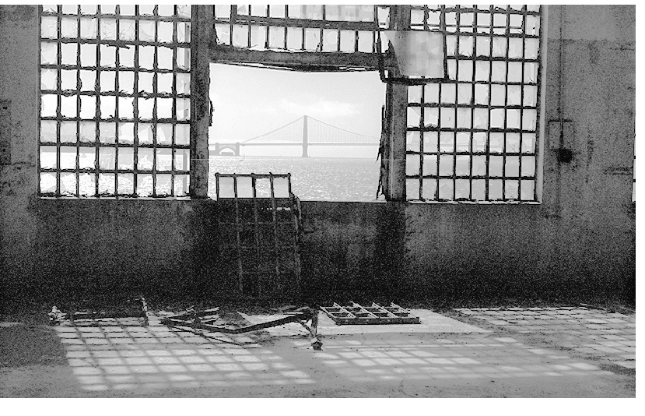
Some Applications of DSP
Image enhancement.

Slide 16
Summary Applications of DSP
Speech recognition
Speaker recognition
Speech synthesis
Speech enhancement
Speech coding
Digital speech and audio:
Image enhancement
Image recognition
Medical imaging
Image forensics
Image coding
Digital Image Processing:
Internet audio, video, phones
Image / video compression
Text-to-voice & voice-to-text
Movie indexing
Multimedia:
……..

Slide 17
Applications
Voice and data compression
Echo cancellation
Signal multiplexing
Filtering
Space photograph enhancement
Data compression
Intelligent sensory analysis by remote space probes
Telephone
Space
Diagnostic imaging (CT, MRI, ultrasound and others)
Electrocardiogram analysis
Medical image storage / retrieval
Medical
DSP
Military
Radar
Sonar
Ordnance guidance
Secure communication
Scientific
Earthquake recording / analysis
Data acquisition
Spectral analysis
Simulation and modeling
Industrialial
Oil and mineral prospecting
Process monitoring & control
Nondestructive testing
CAD and design tools

