Slide 1
ARCH 435 PROJECT MANAGEMENT
Lecture 6: Time-Cost Trade-Offs

Slide 2
Time-Cost Trade-off
The results of planning and scheduling stages of the critical path method provide a network plan for the activities making up the project and a set of earliest and latest start and finish times for each activity.
In particular, the earliest occurrence time for the network terminal event is the estimated “normal” project duration time, based on “normal” activity time estimates.

Slide 3
Why Project Time Reduction
To meet the customer contractually required time.
To recover time of delays, that occur in the early stages of the project, to avoid paying liquated damages, or avoid damaging the company relationship with the customer.
To complete a project earlier than schedule in order to free resources used and move on to another project.
To avoid adverse weather.
To receive an early-completion bonus.
To meet a client’s desire for expediting the project.

Slide 4
How to Shorten Project Time
Free Time
Reviewing the job logic (critical activities in parallel).
Reviewing duration of critical activities.
Use overlap.

Slide 5
How to Shorten Project Time
Buy Time
Have the existing crew work overtime.
Bring in additional workers (resources) up to practical limit.
Work on multiple shifts.
Achieve more output by offering incentive payments.
Use better/more advanced equipment(s).
Use more quickly installed materials.
Use subcontractors.
Change construction method.

Slide 6
Purpose of Time Reduction Technique
The main purpose of this topic is to demonstrate a procedure to determine activity schedules to reduce the project duration time with a minimum increase in the project direct costs, by buying time along the critical path (s) where it can be obtained at least cost.
Assumption: It is assumed in all of the procedures that are presented in this topic that unlimited resources are available.

Slide 7
Definitions
Activity time-cost trade-off input for the CPM procedure

Slide 8
Definitions
Activity Direct Cost: It includes the cost of the material, equipment, and direct labor required to perform the activity in question. If the activity is entirely performed by a subcontractor, then the activity direct cost is equal to the price of the subcontract, plus any added fees.
Project indirect cost: It includes, supervision and other overhead costs, interest charges on project investment, penalty costs due to poor quality or delayed projects.

Slide 9
Definitions
Normal Activity Time: It is the normal time that is used in the basic critical path planning and scheduling based on the normal level of resource.
Normal Activity Cost: The normal activity cost is equal to the minimum of direct costs required to perform the activity, and the corresponding activity duration is called the normal time.
The normal time is actually the shortest time required to perform the activity under the minimum direct cost constraint.

Slide 10
Definitions
Crash Activity Time: Minimum activity duration time that is technically possible.
Crash Cost: is assumed to be the minimum direct cost required to achieve the crash performance time.

Slide 11
Activity Direct Cost / Time Relationship
The relationship between the activity direct cost and activity time may be straight line, continuous curve, or point.
The direct cost tends to increase if less time is available for activity.
Time reduction approach assumed here will be based on simple linear time-cost trade-off for each activity.
Activity time-cost trade-off input for the CPM procedure

Slide 12
Indirect Cost / Time Relationship
The indirect cost tends to increase if more time is consumed for the project.
The indirect cost is generally vary approximately linearly with the time.

Slide 13
Optimum Contract Duration
Optimum contract duration = project schedule for minimum total cost
Determining project schedule for minimum total cost

Slide 14
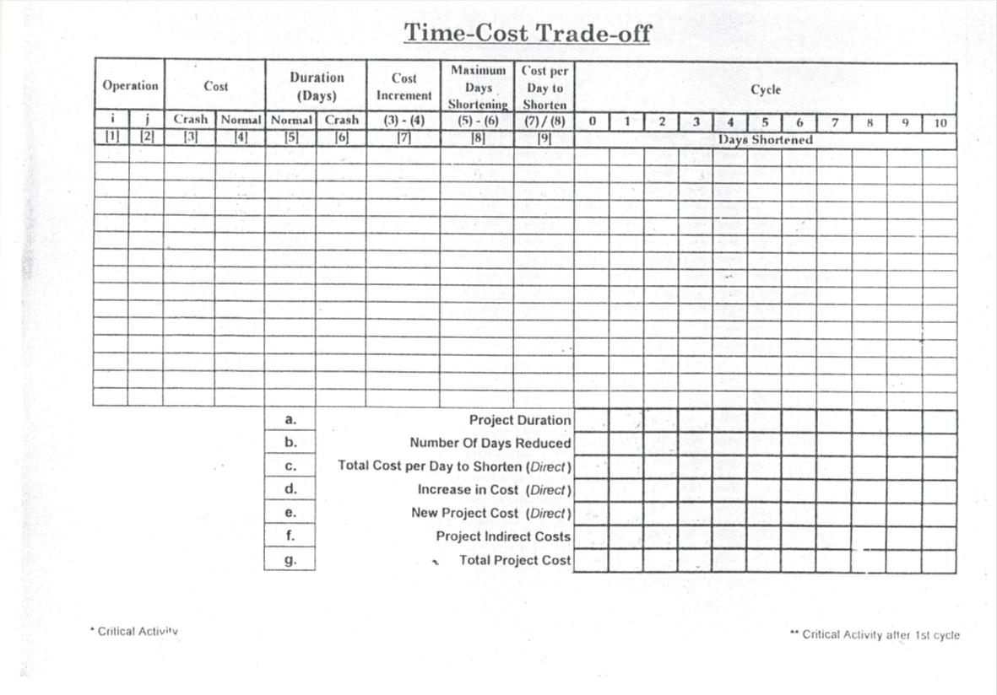
10*
20*
30
15
9
6
15
3
5
3/0
10**
30**
78
42
18
12
36
6
6
3/3
20*
30*
54
42
12
9
12
3
4
3/0
20**
40**
51
33
21
15
18
6
3
6/0
30*
40*
72
30
12
6
42
6
7
6/0
33
30
24
21
3
6
3
4
10
11
12
60
33
162
174
234
267
99
90
72
63
261
264
306
330

