Slide 1
BCH 462- Biotechnology & Genetic Engineering [Practical]
Lab (8) Quantitative Reverse Transcription PCR (RT-qPCR) “ Real-time PCR”
Notes:
https://www.youtube.com/watch?v=DH7o9Df5_50

Slide 2
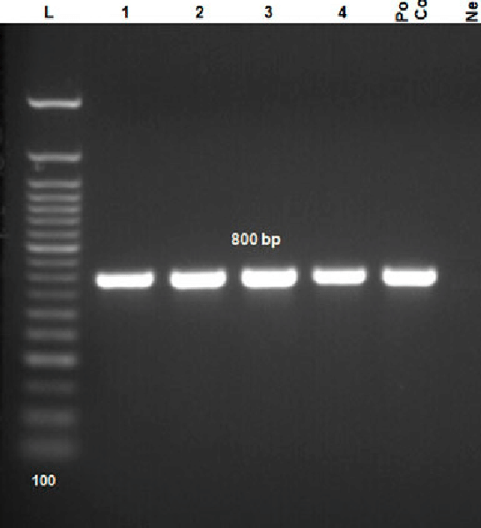
Polymerase chain reaction (PCR)
One of the most powerful technologies in molecular biology.
PCR is used in molecular biology to make many copies of (amplify) small sections of DNA or a gene
In such traditional PCR (endpoint), detection of the amplicon is performed at the end of the reaction after the last PCR cycle, using gel electrophoresis. Why RT-PCR ?
Notes:
Quantitative PCR (qPCR) is used to detect, characterize and quantify nucleic acids for numerous applications. Commonly, in RT-qPCR, RNA transcripts are quantified by reverse transcribing them into cDNA first, as described above and then qPCR is subseq.

Slide 3
RT-PCR is identical to standard PCR except that the progress of the reaction is monitored during each PCR cycle.
Real-time quantitative (RT-qPCR)
In real-time quantitative PCR fluorescent reporter dyes allow a PCR reaction to be visualized “in real time” as the reaction progresses by combine the amplification and detection steps in the PCR reaction.
The assay relies on measuring the increase in fluorescent signal.
Is proportional to the amount of DNA produced during each PCR cycle.
Gives a quantitative information on the starting quantity of the amplified target.
Applications:
1. Gene expression (most common application).
2. Microbial load testing (type and # of microorganism)
PCR
RT-PCR
(PCR + Spectrofluorometry)

Slide 4
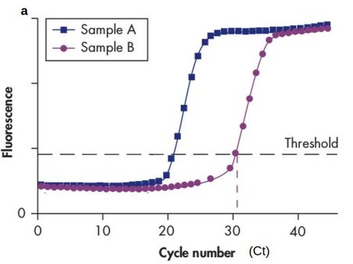
RT-qPCR quantification methods
Absolute quantification: the exact concentration of sample can be determined, in which samples (typically a plasmid, oligonucleotide, or purified PCR product) of known quantity are serially diluted and then amplified to generate a standard curve.
Unknown samples are then quantified by comparison with this curve.
Relative quantification (Comparative): analyze changes in gene expression in a given sample relative to the same gene in another reference sample (disease vs normal control sample). The results are expressed as fold change (increase or decrease).
A normalizer gene (such as β-actin) is used as a control for experimental variability in this type of quantification.
Notes:
The fold change is the expression ratio: if the fold change is positive it means that the gene is upregulated; if the fold change is negative it means it is downregulated

Slide 5
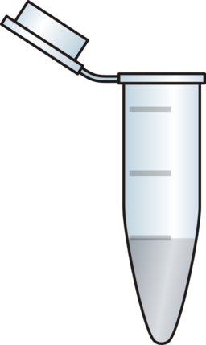
RT-qPCR chemistries (detection systems)
SYBR
SYBR-green based assay:
Principle:
The double-strands DNA-intercalation agent (DNA-binding dyes) such as SYBR Green.
The SYBR Green 1 is only fluorescing when intercalated into dsDNA.
The intensity of the fluorescence signal is therefore dependent on the quantity of dsDNA present in the reaction.
The main disadvantage of this method is that it is not specific since the dye binds to all dsDNAs formed during the PCR reaction (i.e., nonspecific PCR products and primer-dimers).
DNA sample
dNTPs
Taq Polymerase
Primers
Detector
Notes:
Binds to minor grooves
Advantages and disadvantages

Slide 6
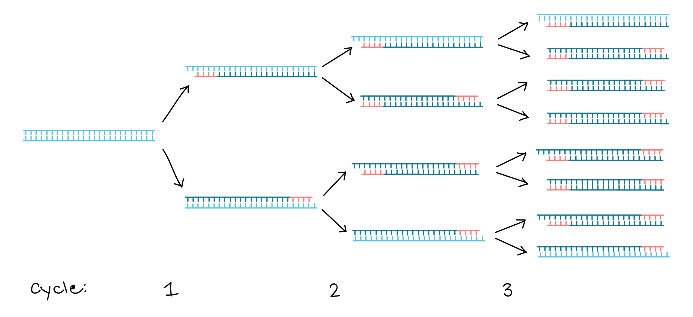
More dsDNA ➜ More binding ➜ More fluorescence
↑ Quantity of dsDNA
↑ Fluorescence signal
SYBR
SYBR
SYBR
SYBR
SYBR
SYBR
SYBR
SYBR
SYBR
SYBR
SYBR
SYBR
SYBR
SYBR

Slide 7
fluorescence
RT-qPCR chemistries (detection systems)
Fluorophore
Quencher
F
Q
II. Fluorogenic 5' nuclease assay (TaqMan® probe assay):
Principle:
A probe is used in the real-time quantitative TaqMan assay.
The probe is a specific sequence which has a fluorescent reporter dye linked to its 5 ́end and a non-fluorescent quencher at its 3 ́end.
Whilst the probe is intact, the quencher absorbs the fluorescence emitted by the reporter dye.
The TaqMan probe anneals downstream the target sequence from one of the primer sites and is cleaved by the 5 ́ nuclease activity of the Taq polymerase during the PCR extension phase.
Cleavage of the probe by Taq polymerase during PCR will cause the separation of the reporter and quencher dyes, thereby allowing the reporter’s fluorescent signal to be liberated.
With each cycle additional reporter dye molecules are cleaved from their respective probes, leading to an increase in fluorescence intensity proportional to the amount of amplicon produced.
5'
3'

Slide 8
DNA polymerase
dsDNA
5'
3'
3'
Denaturation
Q
F
ssDNA
DNA polymerase
5'
3'
3'
Annealing
Q
5'
3'
5'
3'
Primer
3'
Hybridization
Q
5'
3'
5'
F
Q
3'
Primer
Extension
DNA polymerase
5'
3'
3'
5'
3'
5'
F
Q
Primer

Slide 9
More dsDNA ➜ More probe displacement and cleavage➜ More fluorescence
↑ Quantity of dsDNA
↑ Fluorescence signal
F
F
F
F
F
F
F
F
F
F
F
F
F
F
Notes:
Specificity.
Applications.
Optimization.

Slide 10
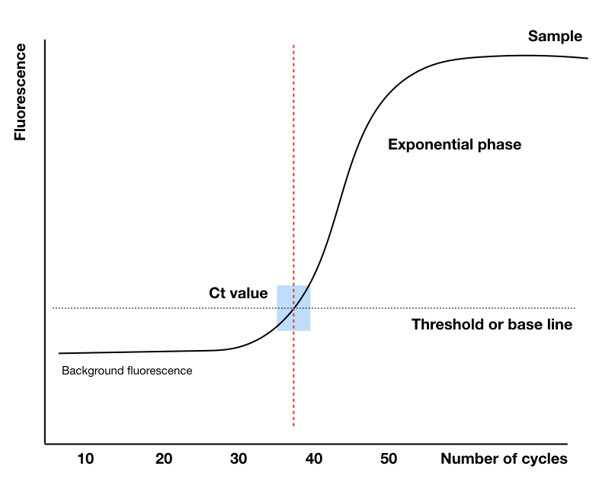
RT-qPCR amplification curve
Amplification plot is the plot of fluorescence signal versus cycle number.
Baseline: The baseline of the real-time PCR reaction refers to the little change in fluorescent signal during the initial cycles of PCR (background or the “noise” of the reaction).
Threshold: is the level of detection or the point at which a reaction reaches a fluorescent intensity above background (baseline) levels.
C_{t} (threshold cycle): The threshold cycle (Ct) is the PCR cycle number at which your sample’s reaction curve intersects the threshold line.
Threshold
Baseline
Notes:
* Low Ct value << high expression (high starting quantity of the amplified target )
The reaction is characterized/identified by the PCR cycle at which fluorescence first rises above a defined or threshold background fluorescence, a parameter known as the threshold cycle (Ct).

Slide 11
Practical Part 🧬

Slide 12
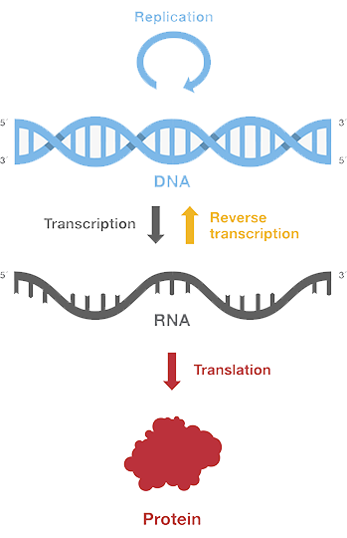
RT-qPCR for gene expression analysis
Gene expression is the process by which the heritable information in a gene is made into a functional gene product, such as protein or RNA.
Notes:
Gene expression is the process by which the heritable information in a gene, the sequence of DNA base pairs, is made into a functional gene product, such as protein or RNA. The basic idea is that DNA is transcribed into RNA, which is then translated into proteins

Slide 13
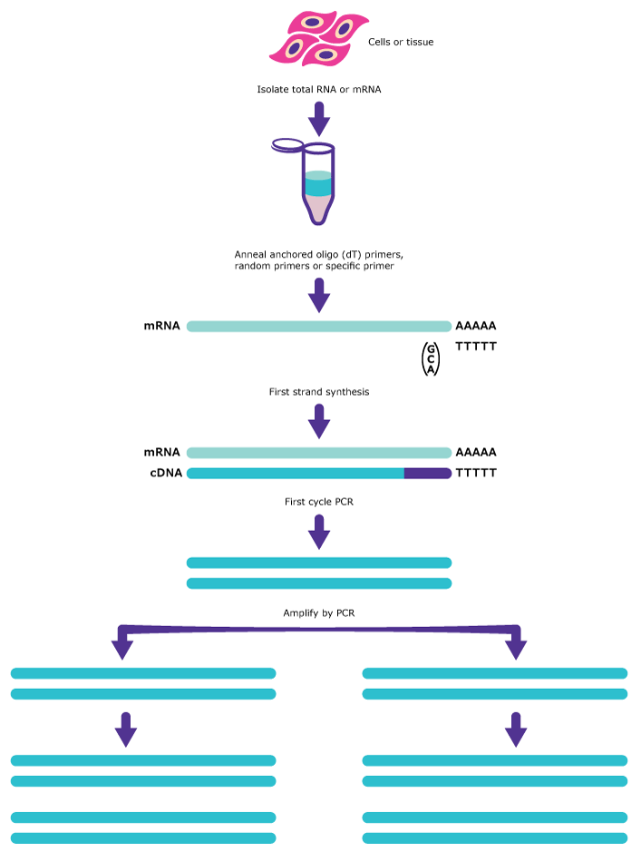
Steps of evaluation gene expression by RT-qPCR
Step 1: RNA Extraction from Tissue/ Cell line or blood
Step 2: Reverse transcription to convert RNA to cDNA
Step 3: Determination of cDNA using real time PCR
Step 4: Data analysis
💡 Pause and Think why do we use cDNA instead of gDNA or RNA?
Notes:
gDNA or RNA

Slide 14
RT-qPCR types
The RT-qPCR assay can be performed either as a one-tube single RT and PCR enzyme method or a separate RT and PCR enzyme technique using one or a two tubes.
One-step RT-qPCR, combines reverse transcription and PCR in a single tube and buffer, using a
reverse transcriptase along with a DNA polymerase, simplifying reaction setup and reducing the possibility of contamination.
Two-step RT-qPCR, the reverse transcription and PCR steps are performed in separate tubes, with different optimized buffers, reaction conditions, and priming strategies.
Notes:
Primers.
Advantages and disadvantages.
Single closed-tube reaction, reducing contamination
Greater variation and risk of contamination due to extra open-tube step and pipetting

Slide 15
Reaction Components
RT-qPCR for gene expression analysis
SYBR® Green PCR Master Mix
Component | Volume per 12.5µl reaction
2X Green Master mix | 6.25
Forward primer | 0.25
Reverse primer | 0.25
Nuclease free water | 3.75
cDNA Template | 2
Total: | 12.5 µl
Hot-start iTaq DNA polymerase
dNTPs
MgCl₂
SYBR® Green I dye
Notes:
SYBR® Green PCR Master Mix:
Hot-start iTaq DNA polymerase
dNTPs
MgCl₂
SYBR® Green I dye
The inhibitor can be an antibody that binds the polymerase and denatures at the initial denaturation temperature.

Slide 16
Quantitative real-time PCR workflow

Slide 17
Let’s assume we want to study p53 expression in colorectal cancer patient using Relative RT-PCR.
Patient 1
Normal
Cancer
Target gene
(p53)
Reference gene
(GAPDH)
Target gene
(p53)
Reference gene
(GAPDH)
Each As triplicate
Notes:
Normalizer, reference or endogenous control :
➔An endogenous control gene is a gene whose expression level should not differ between samples, such as a housekeeping. (ex: GAPDH)

Slide 18
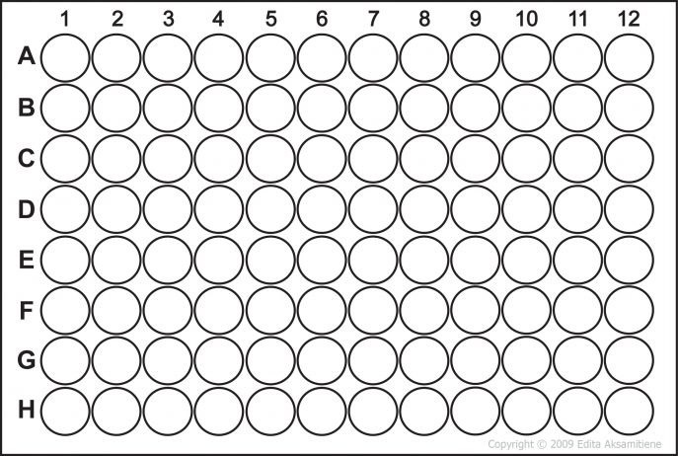
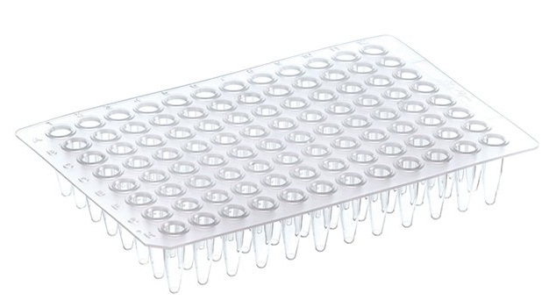
Each As triplicate
Target gene
Cancer cell
Target gene
Normal cell
Reference gene
Normal cell
Reference gene
Cancer cell
Each row represents one patient
-ve control for each master mix
(no template control)
Notes:
negative controls or no template control (NTC) omits any DNA or RNA template from a reaction, and serves as a general control for extraneous nucleic acid contamination. When using SYBR Green chemistry, this also serves as an important control for primer dimer formation.

Slide 19
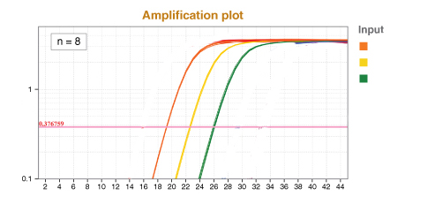
Ct levels are inversely proportional to the amount of target nucleic acid expression in the sample (i.e. the lower the Ct level the greater the amount of target nucleic acid in the sample).
Samples | Ct value
 | GAPDH | p53
Normal 1 | 19.90 | 23.00
Normal 2 | 19.80 | 22.74
Normal 3 | 19.85 | 22.80
Tumor 1 | 20.00 | 26.00
Tumor 2 | 19.75 | 26.20
Tumor 3 | 19.72 | 26.12
GAPDH
p53 in normal cell
p53 in cancer cell
Fluorescence
Threshold
Cycles
1- Did GAPDH expression change in normal and cancer cell? why?
2- What happened to p53 expression in cancer? Up/down?
Notes:
Down regulated * because it is a tumor suppressor gene

Slide 20
GAPDH
p53 in normal cell
p53 in cancer cell
Fluorescence
Original P53 expression
Cycles
Cycle-1
Cycle-2
Detectable
Normal
Cancer
Cycle-1
Cycle-2
Threshold

Slide 21
Detectable
Cycle Threshold
Cancer (p53)
(low expression=low RNA levels)
Normal (p53)
(High expression= high RNA levels)

Slide 22
A.
B.
Normal
Cancer
Normal
Cancer
Based on western blot and RT-PCR results we can conclude that p53 is …………………. in CRC.
And that could be explained through its function as …………………….......gene.
Notes:
Downregulated/underexpressed
tumor suppressor gene

Slide 23
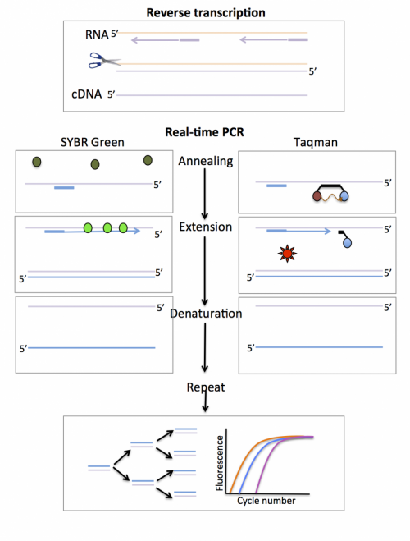
Comparison between Conventional PCR and RT-PCR
Conventional PCR | Real-time PCR
Qualitative / semi-quantitative | Quantitative
Endpoint | Real time
Gel-based PCR | Fluorescence-based PCR
Overview of RT-PCR technique

Slide 24
Resources:
Gene Regulation Virtual Lab (both RT-PCR and Western blot are included)
https://www.labster.com/simulations/gene-regulation/

Slide 25
تم بحمد الله ... 💜

