Slide 1
Enzyme-linked Immunosorbent Assay (ELISA)

Slide 2
Enzyme-linked immunosorbent assay (ELISA)
Sensitive immunochemical technique which used to detect
and quantify** a specific protein (antigen or antibody) in a given sample.
Other names, such as Enzyme Immunoassay (EIA), are also used to describe the same technology.
The reaction is measurable in both qualitative and quantitative terms.

Slide 3
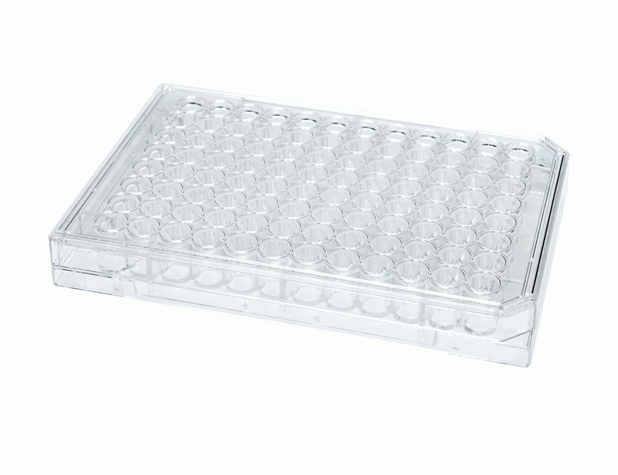
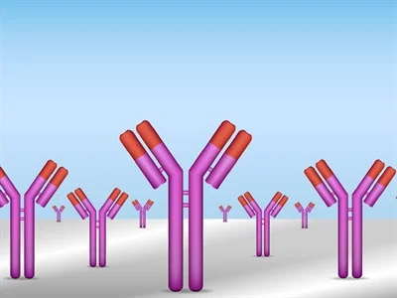
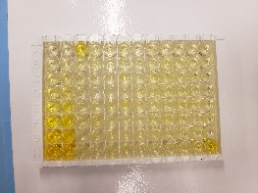
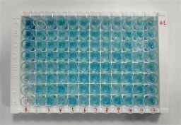
1-wells, pre-coated with capture antibody)
Principle
3-Detection Ab
2-Sample (Serum/BALF)/contains Ag
Y
Ag
Ag
Y
Y
Y
Y
Incubate
then wash (using wish buffer)
Y
Incubate
then wash (using wish buffer)
4-Enzime (E)
4-Substrate solution S ( to develop a color)
E
E
Y
Y
S
Ag
S
S
Ag
E
E
E
Y
E
Y
Y
E
Y
E
Y
Y
Stop solution
Notes:
Coated plate (Ab)

Slide 4
enzyme converts colorless substrate to a colored product (indicating the presence of Ag : Ab binding). The darker the color the higher the Ag concentration

Slide 5
ELISA Types:
There are five types* of ELISA methods which include:
Direct ELISA
Indirect ELISA
Sandwich ELISA
Competitive ELISA
Multiplex ELISA
The indirect (to detect antibodies) and the sandwich (to detect antigens) ELISA methods are the two most common types used.

Slide 6
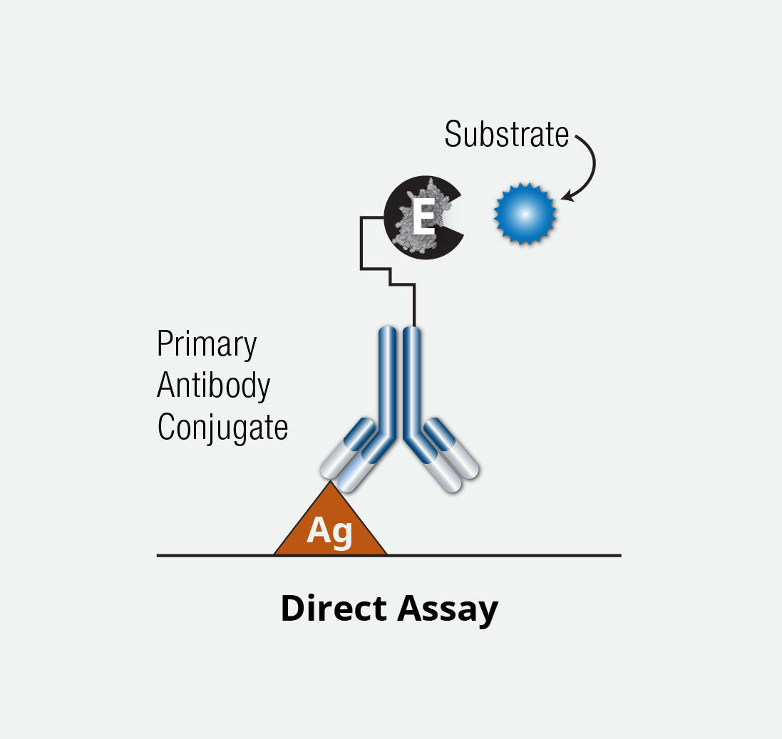
Direct ELISA
Ag directly captured by specific Ab
the Ab is conjugated to an Enzyme
The enzyme converts colorless substrate to a colored product (indicating the presence of Ag : Ab binding).

Slide 7
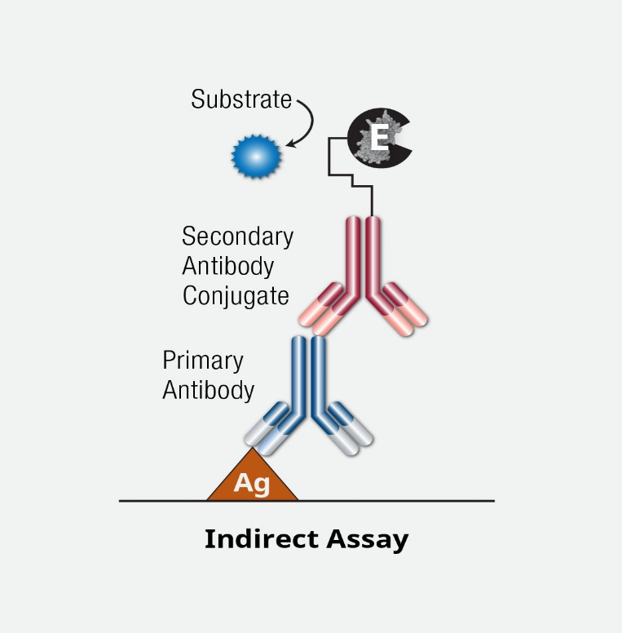
Indirect ELISA
To detect Ab, (example: HIV, HCV)
To the antigen (fixed to Elisa plate), an antibody is added.
Then a secondary Ab is added, which is enzyme-linked (WHY?)
**An antigen of the disease-causing agent may not be present, but a corresponding antibody is available in the patient sample

Slide 8
Sandwich ELISA
To detect Ag, (example: Tumor Markers, Hormones )
This is also an indirect type of Elisa.
just like a sandwich, in between two antibodies, an antigen is present

Slide 9
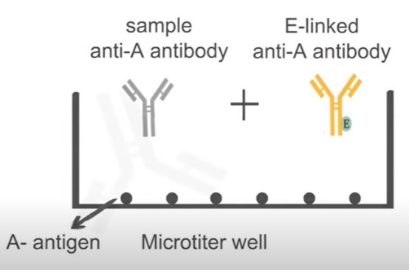
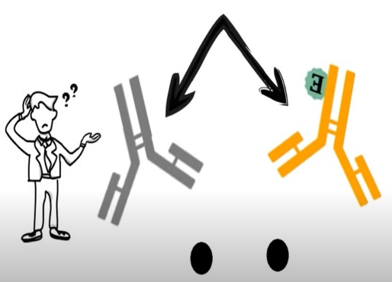
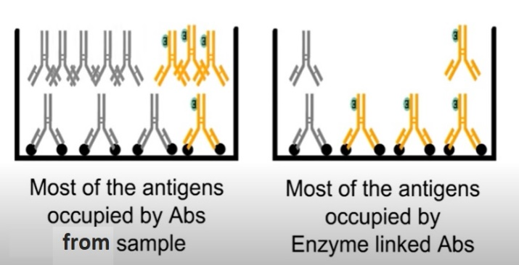
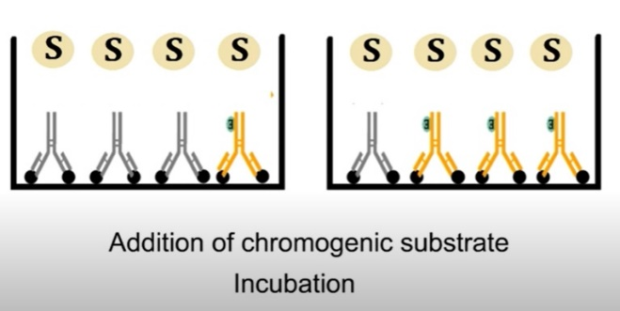
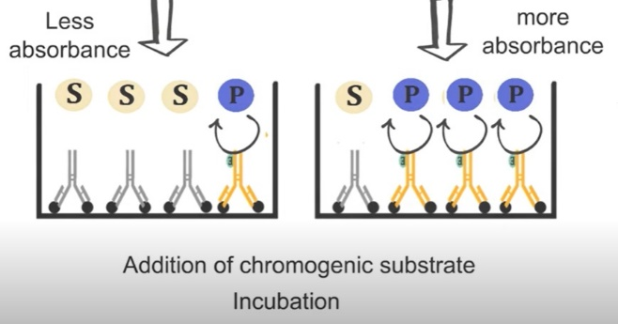
Competitive ELISA (Inhibition Or Blocking ELISA)
2
1
2 possibilities
Which one will win the competition?
Wash to remove unbound Abs
3
4
5
Notes:
Competitive ELISA

Slide 10
Fig. 3. ELISA Reader Spectrophotometer, A microplate reader with a 96-well plate in the sample drawer

