Slide 1
Lab 6 :
Simple Staining

Slide 2
Simple stain
Purpose
To recognize the shape and the arrangements of bacterial cells.
1-Coccus
2-Bacillus

Slide 3
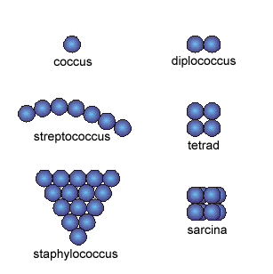
1-Coccus
having one of the following arrangements :
1-Diplococcus: a pair of cocci
2-Streptococcus: a chain of cocci
3-Tetrad: a square of 4 cocci
4-Sarcina: a cube of 8 cocci
5-Staphylococcus: grape-like clusters

Slide 4
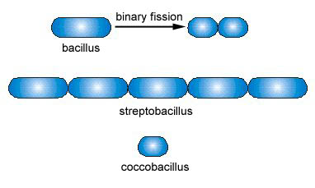
Bacillus 2-
Bacillus: a single bacillus
Streptobacillus: bacilli in chains

Slide 5
Simple stain :
The simple stain is a very simple staining procedure involving only one stain.
You may choose from methylene blue, safranin, and crystal violet.

Slide 6
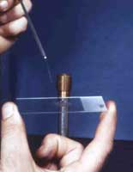
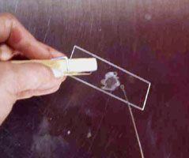
Simple stain :
Prepare the smear.
- place a small drop of water on a clean slide. Drag the sterile inoculating needle tip through the edge of colony.
- Gently spread the mixture into a circle to spread out.
2. Let the smear air dry completely.

Slide 7
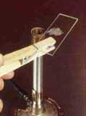
Simple stain :
3. Heat-Fix the smear.
Smears are heat-fixed by quickly passing the slide through a flame two or three times.
This causes the microbes to stick to the slide and not get washed off during the staining process.

Slide 8
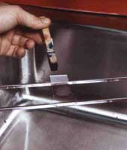
Simple stain :
4. Stain the smear.
Place the slide on a rack over the sink. Flood the smear with stain and let it for 60-90 seconds. Rinse gently and blot dry using filter paper.

Slide 9
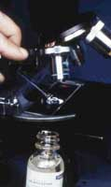
Simple stain :
5. Then, place a drop of oil directly on the stained smear .Turn the oil lens into position and fine focus to observe the cells.

Slide 10
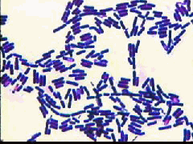
Result

