Slide 1
How to isolate PBMC
Peripheral blood mononuclear cells (PBMC)
Dr. Saeedah Almutairi

Slide 2
Why do we need to isolate PBMC?
The human immune response is a complex and dynamic system involving several different cell types and hundreds of signaling molecules and pathways. Immunological research can give insights into the mechanisms underlying responses to allergies, bacterial, fungal, or viral infections, as well as autoimmune diseases, such as rheumatoid arthritis.
To investigate the immune response to certain stimuli, we can look at peripheral blood mononuclear cells (PBMC).

Slide 3
Peripheral blood mononuclear cells (PBMC)
They must be isolated from freshly drawn blood
They can then be cryopreserved at ultra-low temperatures in liquid nitrogen and remain viable for decades with no significant changes to viability or functionality.
After a careful thawing procedure, cryopreserved (c-) PBMCs can be stimulated or treated with various immunomodulatory agents or drugs in vitro.

Slide 4
Isolation
The method for mononuclear cell isolation was first developed by Boyum in 1986.
PBMCs are isolated by density gradient centrifugation*, as different components of the blood have different densities and can be separated accordingly.
The density gradient medium most commonly used: (Ficoll or Ficoll-Paque) contains sodium diatrizoate, polysaccharides, and water, and has a density of 1.08 g/mL.
This medium is denser than lymphocytes, monocytes, and platelets (meaning these will remain above it), but less dense than granulocytes and erythrocytes, which will drop below it.
Notes:
density gradient centrifugation

Slide 5
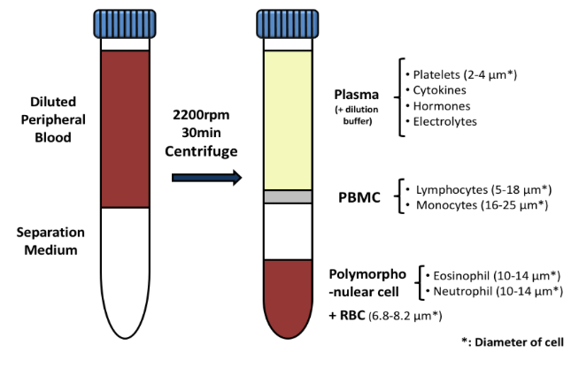
Isolation
To isolate PBMCs, whole blood, diluted with PBS, is gently layered over an equal volume of Ficoll in a Falcon tube and centrifuged for 30-40 minutes at 400-500 g without brake.
Four layers will form, each containing different cell types:
The uppermost layer will contain plasma, which can be removed by pipetting.
The second layer will contain PBMCs and is a characteristically white and cloudy “blanket.”
These cells can be gently removed using a Pasteur pipette and added to warm medium or PBS to wash off any remaining platelets.
The pelleted cells can then be counted, and the percentage viability estimated using Trypan blue staining.
Cells can be used immediately or frozen for long-term storage.
(diluted with PBS)
white and cloudy “blanket
(equal volume of Ficoll)
(41) How to Isolate PBMCs from Whole Blood Using Density Gradient Centrifugation (Ficoll™ or Lymphoprep™) - YouTube

Slide 6
Count PBMC
Hemocytometer:
A device that is used for counting cells.
It’s a modified microscope slide, containing two identical wells or chambers into which a small volume of a cell suspension is pipetted.
https://youtu.be/pP0xERLUhyc
https://www.ncbionetwork.org/educational-resources/elearning/hemocytometer
**Concentration (viable cells/mL) =Average number of cells/ square X dilution factor X 10⁴

Slide 7
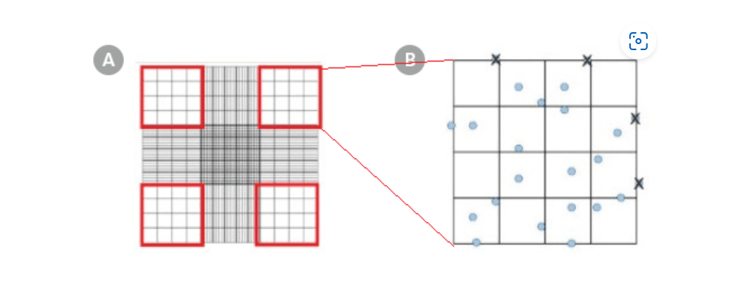
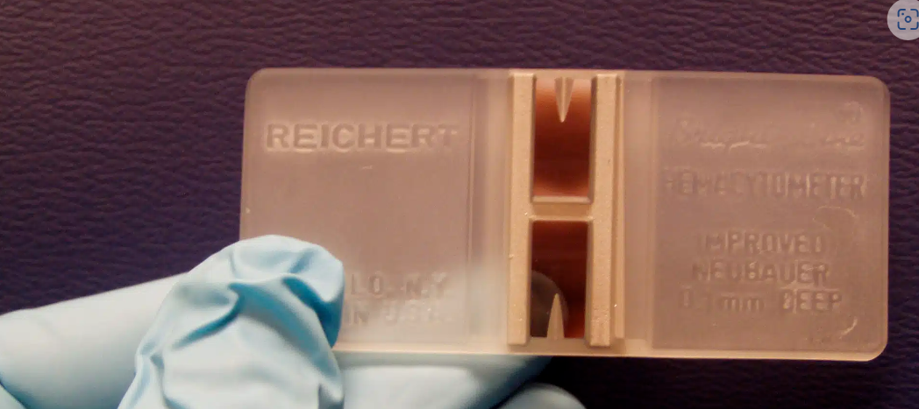
1- 10 ul sample (cell suspension)+10 ul trypan blue (=> total vol=20)
DF= total vol/sample vol= 20/10=2
1
2
3
4
2- if the cell counts for each of the four outer squares were 20, 12, 22, and 18 ➔the average cell count would be (20 + 12 + 22 + 18) ÷ 4 = 18
3-Total number of cells/mL = average cell count x dilution factor x 10⁴
=18 X 2 X 10⁴
=360000 cells /ml
(37) Counting Cells with a Hemocytometer - YouTube
Using a Hemocytometer for Cell Counting | Protocol (stemcell.com)
Notes:
1

Slide 8
Cryopreservation
To preserve PBMCs at ultra-low temperatures in liquid nitrogen:
Dimethyl sulfoxide (DMSO) is used as a cryo protectant to reduce the formation of ice crystals and prevent cell damage.
**Note:
DMSO is toxic to cells at higher temperature and must be washed off immediately once cells are thawed.
To freeze, freshly isolated PBMCs are resuspended to 5-10 x 10⁶ cells/mL in freezing medium containing 10-20% DMSO and 40% fetal bovine serum (FBS) or human serum albumin (BSA) in RPMI-1640 medium.
Cells are placed inside a freezing container (i.e. Mr. Frosty) at -80°C overnight to allow gradual and even cooling.
The following day, samples can be moved to a liquid nitrogen tank for long-term storage.

Slide 9
Thawing and resting of PBMCs
PBMCs must be thawed carefully to avoid loss of cell viability and functionality.
Samples are removed from liquid nitrogen and placed on ice, after which they are thawed in a 37°C water bath.
Once there is a small crystal of ice left in the bottom on the tubes, 500 µL warm medium supplemented with 10% FBS, 1% penicillin/streptomycin, and L-glutamine is added drop-wise.
The cells are then transferred to Falcon tubes containing 10 mL warm medium and centrifuged for 5 minutes at 500 g to wash off the toxic DMSO.

Slide 10
Thawing and resting of PBMCs
The wash step is repeated, and the cell pellet is then resuspended in medium to count as before.
Once thawed, PBMCs must be rested overnight to remove any apoptotic cells—this increases viability and improves functionality and involves incubating the freshly thawed PBMCs in supplemented medium for approximately 18 hours.
After this resting period, cells must be washed, and are then ready to be used in culture or any other assay.

Slide 11
PBMC culture
PBMCs can be cultured for 5-7 days in 24- or 96-well plates, using supplemented RPMI-1640 medium, and incubated at 37°C in a humidified, 5% CO₂ atmosphere.
PBMCs do not readily proliferate without stimulus and should be plated at a density of 0.5-1 x 10⁶ cells/mL in a total volume of 0.5-1 mL in a 24-well plate, and 200 µL in a 96-well plate.
Because PBMCs comprise both lymphocytes and monocytes, some cells will adhere to the plate (monocytes/macrophages) while others may be in suspension (lymphocytes).
This must be considered when culturing—for example, round- or V-bottom plates may be more appropriate if cells need to be pelleted by centrifugation.

Slide 12
PBMC culture
To induce proliferation, phytohemagglutinin (PHA) or lipopolysaccharide (LPS) can be added to the culture medium at a concentration of 1-5 µg/mL.
While PBMCs may seem tricky to work with at first, their analysis can shed light on mechanisms underlying immune diseases and can be of huge benefit to the scientific and medical research worlds.

Slide 13
Applications
PBMC can be evaluated via several techniques such as (ELISA), which allows for the accurate detection and quantification of cytokines, chemokines, and other signaling molecules.
PBMC culture can also be useful to the field of proteomics, and more specifically mass spectrometry-based proteomics.
Some researches involves the re-stimulation and treatment of patient-derived PBMCs, which are then processed for analysis via mass spectrometry.
Samples can be split into cell culture supernatants (containing secreted proteins) and cell lysates (containing intracellular proteins) and analyzed separately.
PBMCs can be analyzed via flow cytometry, and each sub-population of cell can be isolated via fluorescence-activated cell sorting (FACS). Other parameters, such as cell surface markers, viability, and proliferation, can also be assessed via flow cytometry.

Slide 14
References
https://blog.quartzy.com/2017/05/30/peripheral-blood-mononuclear-cells-pbmc-isolation-preservation-culture

